Slide 1
3D:
A Discussion on Youth Mental Health
State Epidemiological Outcomes Workgroup
University of Delaware Center for Drug and Health Studies

Slide 2
State Epidemiological Outcomes Workgroup
Funding for this project has been provided by the Delaware Department for Health and Social Services, Division of Substance Abuse and Mental Health through the Substance Abuse and Mental Health Services Administration (SAMHSA).
https://www.cdhs.udel.edu/seow/what-is-seow

Slide 3
The 4 Goals of the SEOW
Identify, Analyze, and Share Data
Create Data Products
Train Communities in Understanding and Using Data
Build State and Local Level Monitoring Systems

Slide 4
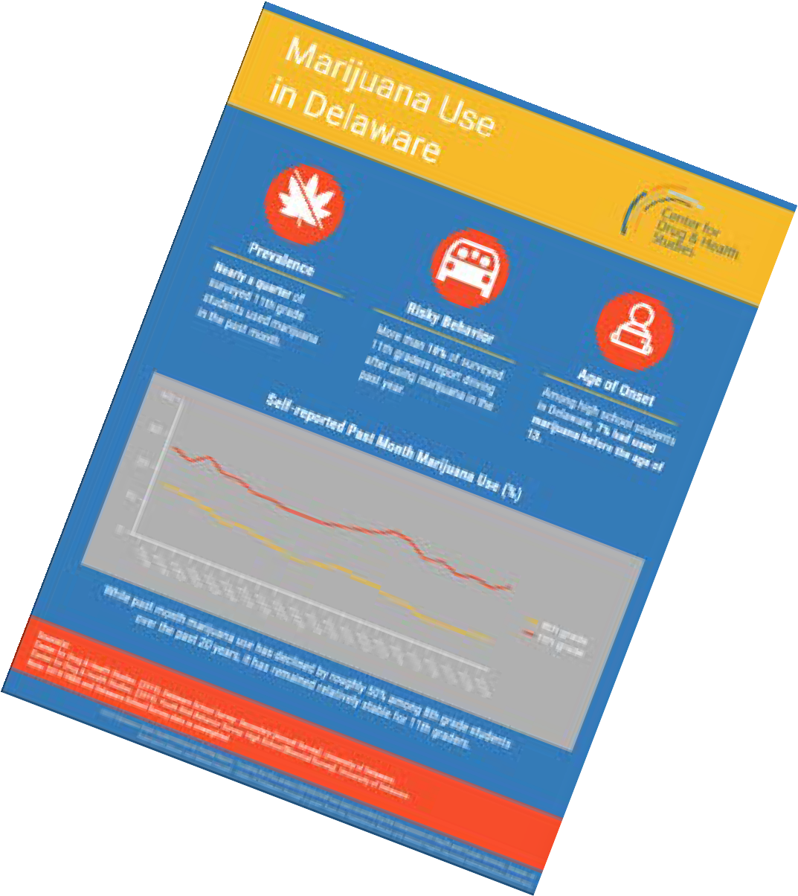
SEOW Data Products
Annual Delaware epidemiological profile – 2021 Coming Soon!
Gap reports
Infographics
NEW! Infographic-Violence: Delaware Youth Data
NEW! Infographic-LGBTQ+ Affirming Spaces
Presentations and recordings

Slide 5
Introductions
4

Slide 6
Objectives
Learn how Delaware youth rate their own emotional health
Discuss who youth consider sources of support
Examine any disparities in perceived mental health

Slide 7
Change in administration: In response to the COVID-19 pandemic and the remote learning policies adopted by Delaware schools, the Delaware School Survey was converted to an online format in lieu of the traditional paper and pencil format.
2021
Delaware School Survey
Districts and Schools could choose to participate using either the online format or paper and pencil format. The majority of the 2021 Delaware School Survey data was collected via an online survey platform Qualtrics. Both formats have the same questions and do not collect personal identifying information.
•Change in 2021 response rate: As a result of the COVID-19 pandemic, school closures, and changes in the approach to the Delaware School Survey administration, users of the 2021 Delaware School Survey data should note that response rates are lower than average. As a result, some changes observed in trend data among the 2020 and 2021 data may be partially influenced by these external events and the change in response rate.

Slide 8
Emotional Health
“In general, how would you rate your emotional health?” (%)
23%
23%
25%
23%
25%
18%
20%
15%
16%
13%
Excellent
Very Good
Good 8th Grade
Fair
Poor
11th Grade
Source: 2021 Delaware School Survey Secondary

Slide 9
Q: Does this reflect what you see among the youth you serve?

Slide 10
Emotional Health: LGB 11th Grade Students
“In general, how would you rate your emotional health?” (%)
37%
35%
27%
24%
22%
19%
19%
9%
6%
3%
Excellent
Very Good
Good Heterosexual LGB
Fair
Poor
Source: 2021 Delaware School Survey Secondary

Slide 11
Q: What is one way that you are promoting equity and inclusion among the youth you serve?

Slide 12
Mind & Body
On an average school night…
37% of 8th Graders &
52% of 11th Graders
…reported getting less than 7
hours of sleep.
In the week before the survey…
56% of 8th Graders &
53% of 11th Graders
…reported being physically active for at least an hour on 3 days or less.
Source: 2021 Delaware School Survey Secondary

Slide 13
Q: How we can promote whole child wellness?

Slide 14
Helping Adults
“If you had a problem and wanted to discuss it with an adult who would you talk to?”
(Mark All That Apply)
School Resource Officer Principal/Asst. Princ
Coach Guidance Counselor
Teacher
0.0% | 10.0% | 20.0% | 30.0% | 40.0% | 50.0% | 60.0%
 |  | 11th Grade | 8th Grade
Source: 2021 Delaware School Survey Secondary

Slide 15
Q: What can adults do to provide youth safe spaces to work through challenges they are experiencing?

Slide 16
Thank You

Slide 17
Contact Information
M. J. Scales, MPH, CPS mjscales@udel.edu
Dana Holz, PhD danaholz@udel.edu

