Slide 1
Adverse Childhood Experiences in Delaware, 2019
DELAWARE DEPARTMENT OF HEALTH AND SOCIAL SERVICES (DHSS),
DIVISION OF PUBLIC HEALTH, FAMILY HEALTH SERVICES SECTION
Division of Reproductive Health (DRH), Field Support Services Branch (FSB)

Slide 2
Disclaimer/Disclosure
The findings and conclusions in this presentation are those of the author(s) and do not necessarily represent the official position of the Centers for Disease Control and Prevention (CDC).
The views expressed in this presentation are those of the author and are not an official position of the Delaware Health and Social Services, Division of Public Health, Family Health Systems.
The author/presenter has nothing to disclose.

Slide 3
Outline
What are Adverse Childhood Experiences (ACEs) and why are they important?
    Life Course Framework and ACEs
    How ACEs impact overall well-being?
A brief recap– Delaware ACEs in Children (0-17 years) from National Survey of Children’s Health (NSCH), 2016-2019
Overview of 2019 Behavior Risk Factor Surveillance System (BRFSS) in Delaware
What do we know about ACEs in Delaware?
    A snapshot in time – Delaware ACEs in Adults (18 and older) from BRFSS
Summary
Opportunities and challenges

Slide 4
What are Adverse Childhood Experiences (ACEs) AND HOW THEY were originally MEASURED?
Three categories of childhood abuse:
    psychological abuse (2 questions),
    physical abuse (2 questions); or
    contact sexual abuse (4 questions).
Four categories of exposure to household dysfunction during childhood:
    exposure to substance abuse (defined by 2 questions);
    mental illness (2 questions);
    violent treatment of mother or stepmother (4 questions); and
    criminal behavior (1 question) in the household.
Notes:
1. Felitti VJ, Anda RF, Nordenberg D, et al. Relationship of childhood abuse and household dysfunction to many of the leading causes of death in adults. The Adverse Childhood Experiences (ACE) Study. Am J Prev Med. 1998;14(4):245-258. doi:10.1016/s0749-3797(98)00017-8

Slide 5
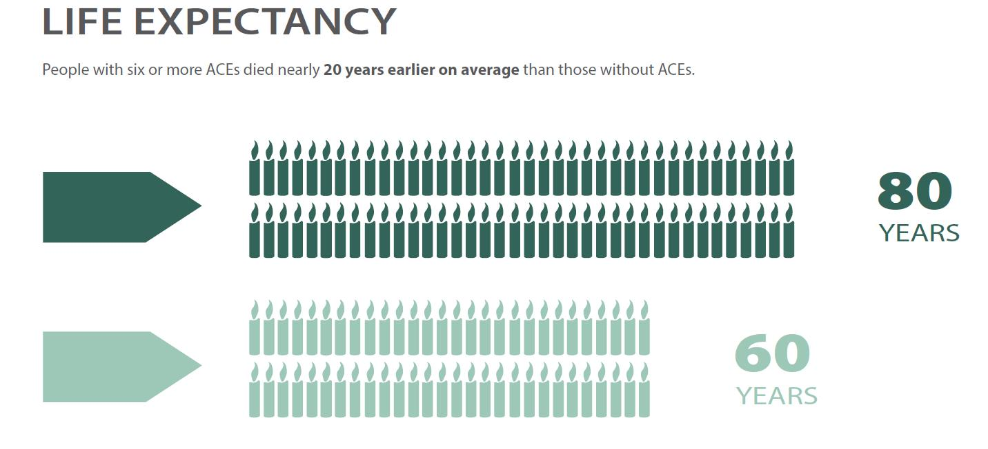
Evidence…
Compelling evidence…
Epigenetics
Cost (Estimated life-time cost associated with childhood maltreatment is $124 billion)
Life-course and the importance of identifying opportunities for prevention early on!

Slide 6
life course framework
A theoretical framework to understand social pathways, development trajectories, and social change – essentially “guides research on human lives within context”¹
Popularized as “womb to tomb” in epidemiology and “cradle to grave” in sociology, the approach is continuous in scope
Two approaches in life course epidemiology²
    Developmental – “socially patterned exposures to risk factors during sensitive life stages shift health trajectories” – emphasizes biological and behavioral aspects
    Structural – “how social identity and position within socially patterned environments disproportionately allocate risk factors and resources, resulting in altered health trajectories” – emphasizes repeated or chronic stressors that are cumulative
Notes:
1. Elder et al. 2003 in Mortimer, J., & Shanahan, M. (2016). Handbook of the life course. Volume 2. Springer.
2. Jones, N. L., Gilman, S. E., Cheng, T. L., Drury, S. S., Hill, C. V., & Geronimus, A. T. (2019). Life Course Approaches to the Causes of Health Disparities. American journal of public health, 109(S1), S48–S55. https://doi.org/10.2105/AJPH.2018.304738

Slide 7
Source: Halfon, N., Larson, K., Lu, M., Tullis, E., & Russ, S. (2014). Lifecourse health development: past, present and future. Maternal and child health journal, 18(2), 344–365. https://doi.org/10.1007/s10995-013-1346-2
This Photo by Unknown Author is licensed under CC BY-NC

Slide 8
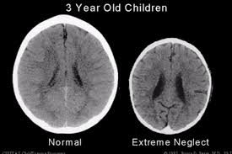
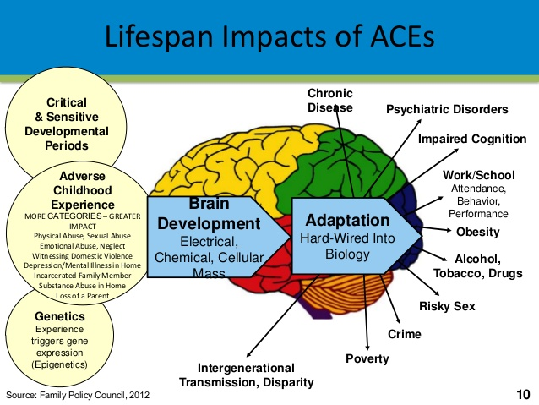
Why are ACes important?
Source: The Telegraph ihttp://www.telegraph.co.uk/news/health/children/9637682/Whats-the-difference-between-these-two-brains.html

Slide 9
A brief recap- ACEs in children (0-17 yrs) National Survey of Children’s Health (NSCH)
As a reminder, NSCH ACEs are based on 9 questions that capture most domains except for sexual abuse as the questions are reported by caregiver/parents.
  ACE 1 Hard to Cover Basics Like Food or Housing ACE 2 Child Experienced - Parent or Guardian Divorced ACE 3 Child Experienced - Parent or Guardian Died ACE 4 Child Experienced - Parent or Guardian Time in Jail ACE 5 Child Experienced - Adults Slap, Hit, Kick, Punch Others; ACE 6 Child Experienced - Victim of Violence ACE 7 Child Experienced - Lived with Mentally Ill ACE 8 Child Experienced - Lived with Person with Alcohol/Drug Problem ACE 9 Child Experienced - Treated Unfairly Because of Race
For details of ACE measurement development in NSCH see Bethell CD, Carle A, Hudziak J, et al. Methods to Assess Adverse Childhood Experiences of Children and Families: Toward Approaches to Promote Child Well-being in Policy and Practice. Acad Pediatr. 2017;17(7S):S51-S69. doi:10.1016/j.acap.2017.04.161

Slide 10
Source: Delaware Department of Health and Social Services, Division of Public Health, National Survey of Children’s Health, 2016-2019. *Weighted percent with 95% confidence intervals
Notes:
ACE 1 Hard to Cover Basics Like Food or Housing ACE 2 Child Experienced - Parent or Guardian Divorced ACE 3 Child Experienced - Parent or Guardian Died ACE 4 Child Experienced - Parent or Guardian Time in Jail ACE 5 Child Experienced - Adults Slap, Hit, Kick, Punch Others
ACE 6 Child Experienced - Victim of Violence ACE 7 Child Experienced - Lived with Mentally Ill ACE 8 Child Experienced - Lived with Person with Alcohol/Drug Problem ACE 9 Child Experienced - Treated Unfairly Because of Race

Slide 11
Notes:
ACE 1 Hard to Cover Basics Like Food or Housing ACE 2 Child Experienced - Parent or Guardian Divorced ACE 3 Child Experienced - Parent or Guardian Died ACE 4 Child Experienced - Parent or Guardian Time in Jail ACE 5 Child Experienced - Adults Slap, Hit, Kick, Punch Others
ACE 6 Child Experienced - Victim of Violence ACE 7 Child Experienced - Lived with Mentally Ill ACE 8 Child Experienced - Lived with Person with Alcohol/Drug Problem ACE 9 Child Experienced - Treated Unfairly Because of Race

Slide 12
Source: Delaware Department of Health and Social Services, Division of Public Health, National Survey of Children’s Health, 2016-2019. *Weighted percent with 95% confidence intervals

Slide 13
Source: Delaware Department of Health and Social Services, Division of Public Health, National Survey of Children’s Health, 2016-2019. *Weighted percent with 95% confidence intervals
Notes:
*As per NSCH, Underweight (< than 5th percentile BMI), Normal weight (5th to 84th percentile BMI), Overweight (85th to 94th percentile BMI), and Obese (>=95th percentile BMI)
Overweight or obese (>=85th percentile BMI).
Weak to modest effect - Hughes, K., Bellis, M. A., Hardcastle, K. A., Sethi, D., Butchart, A., Mikton, C., Jones, L., & Dunne, M. P. (2017). The effect of multiple adverse childhood experiences on health: a systematic review and meta-analysis. The Lancet. Public health, 2(8), e356–e366. https://doi.org/10.1016/S2468-2667(17)30118-4

Slide 14
Overview of Behavioral Risk Factor Surveillance System (BRFSS)
The BRFSS is a collaborative project between the Centers for Disease Control and Prevention (CDC) and the states. It was established in 1984 with 15 states, and now collects data in all 50 states as well as the District of Columbia and three U.S. territories.
BRFSS collects state data about U.S. residents (18 and older) regarding their health-related risk behaviors, chronic health conditions, and use of preventive services.
BRFSS completes more than 400,000 adult interviews each year, making it the largest continuously conducted health survey system in the world.
Delaware has been collecting BRFSS data continuously since 1990 with approximately 4,000 responses annually.

Slide 15
Delaware 2019 brfss
Demographic characteristics | Sample size (n)† | Percent (95% CI)‡
Sex
Male | 1,741 | 47.8 (45.6-50)
Female | 2,156 | 52.2 (50-54.4)
Age (in years)
18-24 | 247 | 11.3 (9.5-13.1)
25-34 | 436 | 16.5 (14.5-18.4)
35-44 | 485 | 14.9 (13.2-16.5)
45-64 | 1,407 | 32.9 (30.9-34.9)
65+ | 1,322 | 24.4 (22.8-26.0)
Educational attainment¶
Less than high school | 408 | 11.0 (9.5-12.4)
High school graduate/GED | 1,052 | 31.9 (29.8-34.1)
Attended college or technical school | 953 | 28.6 (26.5-30.7)
College | 1,458 | 28.5 (26.7-30.4)
Income¶
<$20,000 | 505 | 13 (11.5-14.5)
$20,000-$49,999 | 976 | 30.6 (28.3-33.0)
$50,000+ | 1,596 | 56.4 (53.9-58.9)
Race and Ethnicity¶
White (non-Hispanic) | 2,636 | 64.3 (62-66.6)
Black (non-Hispanic) | 493 | 21.1 (19-23.2)
Hispanic | 446 | 8.3 (7.2-9.5)
Other races | 225 | 6.3 (5.0-7.5)
County
Kent | 1,218 | 18.1 (17.0-19.2)
New Castle | 1,381 | 57.1 (55.7-58.6)
Sussex | 1,298 | 24.8 (23.6-25.9)
Notes: Delaware Department of Health Services, Division of Public Health, BRFSS, 2019 †Unweighted sample size ‡Weighted percentage with 95% confidence intervals (CI) ¶Excludes unknown/refused/missing data and total do not add up to 3,897
Delaware completed 1,035 landline and 3,005 cell phone interviews with a response rate 38.2%
Average number of attempts (M = 3.4; SD = 2.4; Min = 1 and Max = 13)
The 2019 DE BRFSS effective sample size was 3,897 (Females = 2,156; Males = 1,741)
It represents 774,343 adults 18 and older.
Notes:
See: https://www.cdc.gov/brfss/annual_data/2019/pdf/2019-response-rates-table-508.pdf

Slide 16
A snapshot in time – Delaware ACEs in Adults (18 and older) from BRFSS
Prologue: I'd like to ask you some questions about events that happened during your childhood. This information will allow us to better understand problems that may occur early in life, and may help others in the future. This is a sensitive topic and some people may feel uncomfortable with these questions. At the end of this section, I will give you a phone number for an organization that can provide information and referral for these issues. Please keep in mind that you can ask me to skip any question you do not want to answer. All questions refer to the time period before you were 18 years of age. Now, looking back before you were 18 years of age---.

Slide 17
ACEs questions in brfss
1) Did you live with anyone who was depressed, mentally ill, or suicidal? ACE1
2) Did you live with anyone who was a problem drinker or alcoholic? ACE2
3) Did you live with anyone who used illegal street drugs or who abused prescription medications? ACE3
4) Did you live with anyone who served time or was sentenced to serve time in a prison, jail, or other correctional facility? ACE4
5) Were your parents separated or divorced? ACE5
6) How often did your parents or adults in your home ever slap, hit, kick, punch or beat each other up? ACE6
7) Before age 18, how often did a parent or adult in your home ever hit, beat, kick, or physically hurt you in any way? Do not include spanking. Would you say— ACE7
8) How often did a parent or adult in your home ever swear at you, insult you, or put you down? ACE8
9) How often did anyone at least 5 years older than you or an adult, ever touch you sexually? ACE9
10) How often did anyone at least 5 years older than you or an adult, try to make you touch sexually? ACE10
11) How often did anyone at least 5 years older than you or an adult, force you to have sex? ACE11
Notes:
Q1-Q4 Responses: Yes/No/DK/NS/Refused; Q5 Response: Yes/No/DK/NS/Parents not married/Refused; Q6-Q11 Responses: Never/Once/More than once/DK/NS/Refused coded once or more than once as “Yes”
ACEs 1-6 Household dysfunction; ACE7 – Physical Abuse; ACE8 – Emotional Abuse; ACEs 9-11 Sexual abuse

Slide 18
ACEs – Responses
Adverse Child Experiences (ACEs) | Sample size (n)† | Percent (95% CI)‡
Household Dysfunction¶
Live with anyone depressed, mentally ill, or suicidal? | 484 | 17.3 (15.3-19.4)
Live with a problem drinker/alcoholic? | 705 | 23.5 (21.3-25.7)
Live with anyone who used illegal drugs or abused prescriptions? | 315 | 12.5 (10.6-14.3)
Live with anyone who served time in prison or jail? | 215 | 8.9 (7.2-10.6)
Were your parents divorced/seperated? | 804 | 28.5 (26.1-30.9)
How often did your parents beat each other up? | 533 | 18.0 (16.0-20.0)
Physical Abuse¶
How often did a parent physically hurt you in any way? | 408 | 11.0 (9.5-12.4)
Emotional Abuse¶
How often did a parent swear at you? | 505 | 13.0 (11.5-14.5)
Sexual Abuse¶
How often did anyone ever touch you sexually? | 349 | 10.1 (8.6-11.5)
How often did anyone make you touch them sexually? | 275 | 8.2 (6.8-9.6)
How often did anyone ever force you to have sex? | 173 | 4.8 (3.8-5.8)
Notes: Delaware Department of Health Services, Division of Public Health, BRFSS, 2019 †Unweighted sample size ‡Weighted percentage with 95% confidence intervals (CI) ¶Number/Percent responding "Yes" and excludes DK/NS/Refused
43.4% (95% CI: 40.8-45.9) were exposed to two or more ACEs
23.3% (95% CI: 21.2-25.4) were exposed to one ACE
33.3% (95% CI: 31.0-35.6) were not exposed to any ACEs.

Slide 19
aceS STRATIFIED BY SEX AND AGE, 2019
Source: Delaware Department of Health and Social Services, Division of Public Health, BRFSS, 2019. *Weighted percent with 95% confidence intervals

Slide 20
Aces stratified by education and income, 2019
Source: Delaware Department of Health and Social Services, Division of Public Health, BRFSS, 2019. *Weighted percent with 95% confidence intervals

Slide 21
Aces stratified by race and place, 2019
Source: Delaware Department of Health and Social Services, Division of Public Health, BRFSS, 2019. *Weighted percent with 95% confidence intervals

Slide 22
Aces and poor health and behaviors, 2019
Source: Delaware Department of Health and Social Services, Division of Public Health, BRFSS, 2019. *Weighted percent with 95% confidence intervals

Slide 23
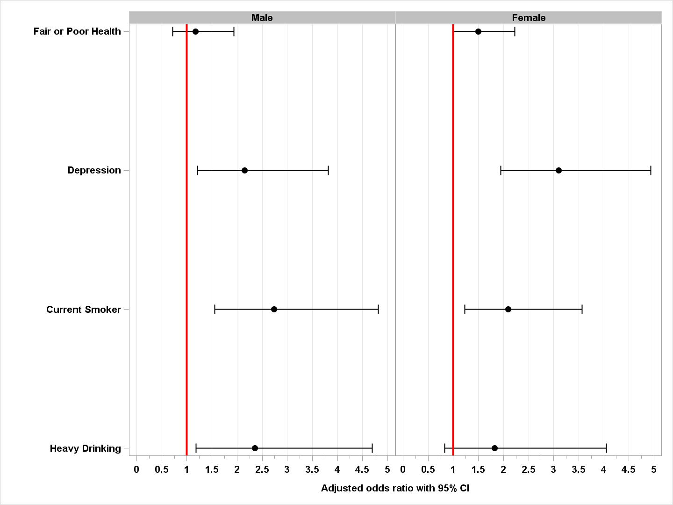
Adjusted prevalence odds ratios
One or more ACEs associated with fair or poor health for females but not males.
One or more ACEs associated with current depression and current smoking for both males and females.
One or more ACEs associated with current heavy drinking for males but not for females.
Notes:
Adjusted for age, education, income, race and ethnicity.

Slide 24
summary
Early adverse childhood experiences are known to play a critical role during the life course and may affect health trajectories and outcomes
Accordingly, addressing ACEs require “…a life-course approach [that is] holistic, long-term, policy and investment strategies that promote[s] better health outcomes for individuals and greater health equity in the population – the two are interlinked”¹
It is important to have multisectoral collaboration/partnership (i.e., public-private) with local community involvement to develop a multi-generational trauma-informed approach to care.
Notes:
Bulletin of the World Health Organization 2018;96:42-50. doi: http://dx.doi.org/10.2471/BLT.17.198358. See Source: World Health Organization https://www.who.int/bulletin/volumes/96/1/17-198358/en/

Slide 25
Opportunities and challenges
What opportunities do we see to reduce ACEs early in life?
What are the challenges?

Slide 26
Thank you
Khaleel.Hussaini@Delaware.gov
Acknowledgements: Delaware Division of Public Health authors would like to acknowledge/thank Dr. Khaleel S. Hussaini and the Maternal and Child Health Epidemiology Program, Field Support Branch, Division of Reproductive Health, National Center for Chronic Disease Prevention and Public Health Promotion, Centers for Disease Control and Prevention, for preparation of this presentation.
DELAWARE DEPARTMENT OF HEALTH AND SOCIAL SERVICES (DHSS),
DIVISION OF PUBLIC HEALTH, FAMILY HEALTH SERVICES SECTION
Division of Reproductive Health (DRH), Field Support Services Branch (FSB)

