Slide 1

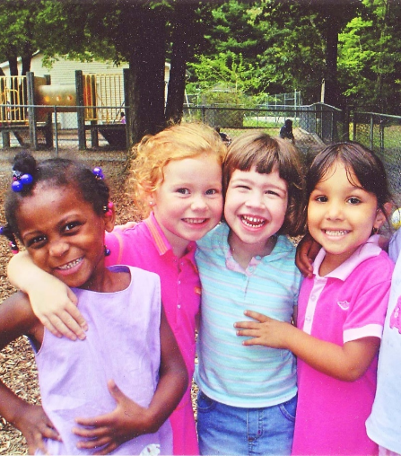
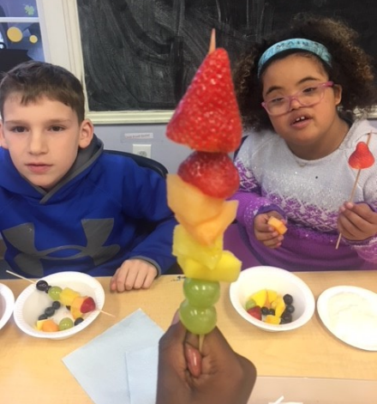
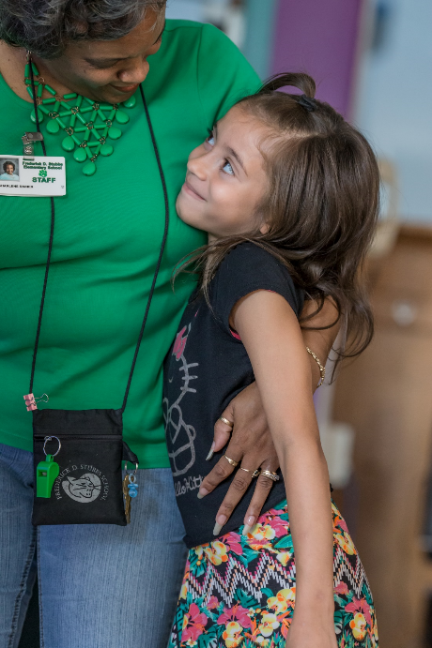
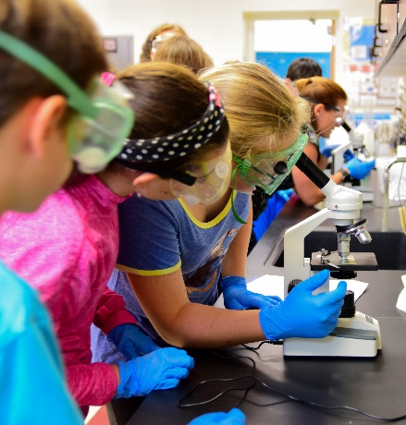

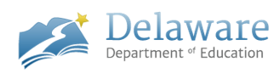
Creating a Statewide Culture of Care
Bridging Hope and Opportunity with Positive Childhood Experiences
July 2020

Slide 2


Slide 3

“If 20 million people were infected by a virus that caused anxiety, impulsivity, aggression, sleep problems, depression, respiratory and heart problems, vulnerability to substance abuse, antisocial and criminal behavior, retardation and school failure, we would consider it an urgent public health crisis. Yet, in the United States alone, there are more than 20 million abused, neglected and traumatized children vulnerable to these problems. Our society has yet to recognize this epidemic, let alone develop an immunization strategy.”
Dr. Bruce Perry, 2016, childtrauma.org

Slide 4

2 Things That Can Go Wrong in Childhood and Negatively Affect School Success
When things don’t happen that should happen - absence of non-stressed, safe, stable, nurturing relationships & environments
When things happen that shouldn’t happen - abuse, neglect, trauma

Slide 5

Recommendations from the CDCs
(Centers for Disease Control and The Harvard Center on the Developing Child)
Safe
Nurturing
Stable
Relationships & Environments

Slide 6

Safe, Stable, Nurturing Relationships & Environments are a Fundamental Requirement for Healthy Development and School Success
We are social creatures with a social brain; however, we live in a relationally impoverished world.
Caregivers and educators who are stressed are not as present and emotionally attuned to the needs of children, which can impact:
  Healthy physical development
  Social, emotional, and behavioral health
  School Success
Benzies, Harrison, & Magill-Evans, 2004; Essex et al., 2013; Gao et al., 2014; Gilbert, Bauer, Carroll, & Downs, 2013; Kinner, Mooney, Crowley, & Miller, 2008; Mate, 2017; Wright et al., 2004; Wurmser et al., 2006)

Slide 7
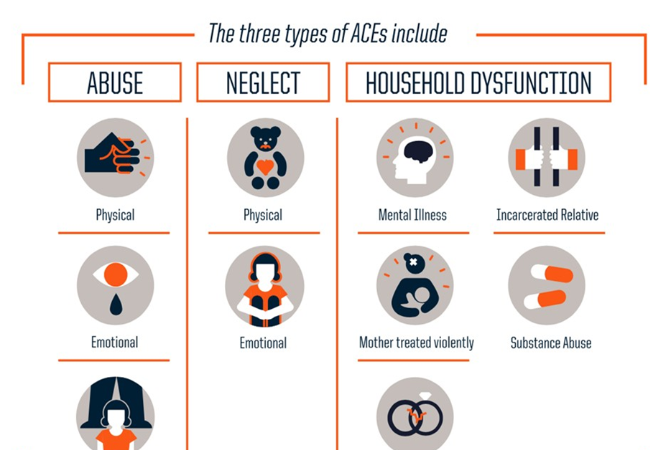
ADVERSE CHILDHOOD EXPERIENCES (ACES)
(Felitti, Anda, Nordenberg, Williamson , Spitz, Edwards, et al., 1998)

Slide 8
….MORE CHILDHOOD ADVERSITY
Extreme poverty
Homelessness
Community violence
Drug culture
Unstable or chaotic home life
Refugee experiences
Human Trafficking
Discrimination/ Racism
Bullying
Illness of a loved one or
friend
Pest infestations
Inconsistent presence of 1 or more parent
Frequent changes in placements/ schools
Gentrification
Gang culture
Child Adultification/Exposure to violence/horror movies/pornography
Natural Disasters
Intrusive medical treatments
Serious accidents

Slide 9
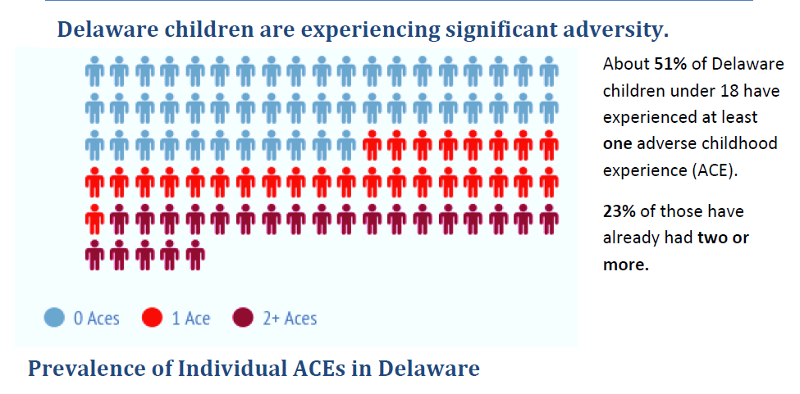
Notes:
Think about your students – let’s say for the sake of argument that you have 24 students in a typical class. Chances are that 12 of them have already experienced one traumatic experience – and 6 of them have already experienced 2 or more!
Plus we know that trauma and poverty go hand in hand:
Families living in poverty often encounter multiple traumas over many years.
Families living in poverty less likely to have access to the resources to help negotiate traumatic experiences.
Low income students are now a majority of the school children attending the nation’s public schools.

Slide 10
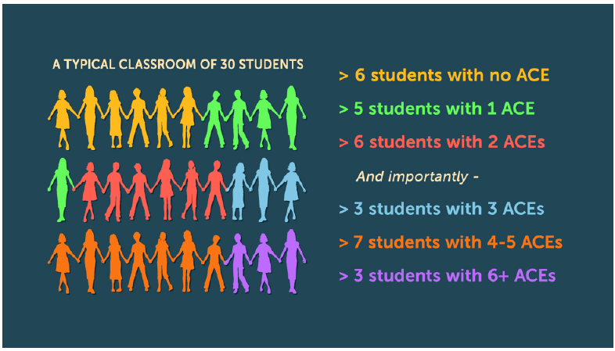

Slide 11








The Crisis: Pandemic (CDC) & Racial Injustice
Health-related fear
Worsening of chronic health problems
Sleep problems
Increased use of alcohol, tobacco, and other drugs
Eating problems
Isolation
  50% of 20K responders reported feeling lonely (Cigna Survey)
Concentration problems
©2020 Pure Edge, Inc.

Slide 12
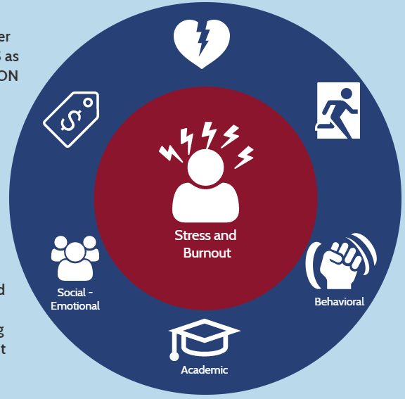
Why Focus on School Stress?
In highly stressed school environments, teachers and learners pay the price.
40-50%
of new teachers leave within first 5 years.
Teacher turnover:
$2 BILLION
each year
High DAILY levels of stress:
46% of teachers
“Stress and disappointments”:
49% of teachers
say it isn’t worth it.
New principals NOT retained beyond third year:
50%
When teachers are highly stressed, students show lower levels
of both social adjustment and academic performance.
Sources (clockwise from 40-50%): Ingersoll, Merrill & Stuckey (2014); Greenberg, Brown, Abenavoli (2016); School Leaders Network (2014); Rentner, Kober, Frizzell, (2016); Alliance for Excellent Education (2014).
Notes:
Go over statistics. Highlight that stress is an issue across the field of education. Stress has impact on both educators and learners.

Slide 13
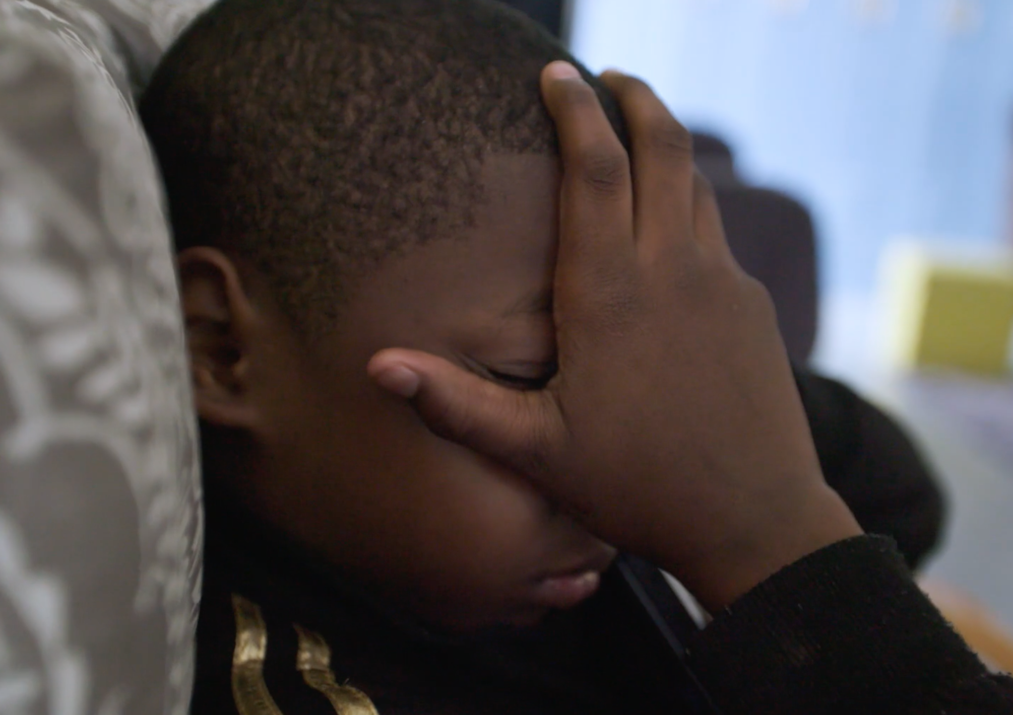
Stress Is Contagious
Higher cortisol levels were found in students whose teachers reported high levels of stress and burnout.
Researcher Kimberly Schonert-Reichl (University of British Columbia) urges educators to be aware of their own mindsets and to practice mental wellness exercises to reduce their stress levels.
www.tricitynews.com/news/stress-is-contagious-education-leaders-told-1.24030014

Slide 14
Community Resilience Model
Shared Understanding
Toxic Stress and Adversity
State of Readiness
Educator Capacity
Cross-Sector Partners
How to Connect
Engaged Community
Organizational Linkages
Strategies to Build Resilience
Narratives of School and Community
Partner Supports
System Capacity
Policy Supports
Resource Distribution
School, Community and Political Partnerships
Collaboration and System Integration
Teacher and Community CHAMPIONIS
Social Supports and Prioritized Wellbeing

Slide 15
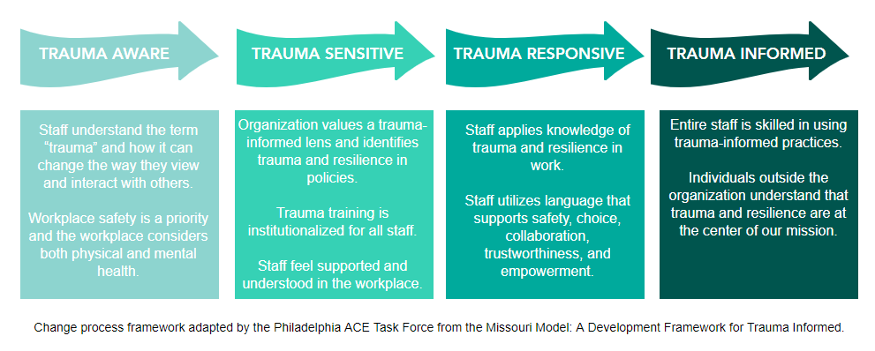
Delaware Developmental Framework

Slide 16

Strategic Initiatives
Inward Facing
Integration of Equity Lens to Whole Child Integration
Outward Facing
Support to Charter and District SEL Coordinators
System Integration
State Agency Partner Management and Support
CASEL and CSI
Development and Monitoring of the Strategic Plan
Strategic Communications Collaborative
SEL-CTE Integration
Monitoring Goals for OGov, FSCC
Integration of DDOE TIP
Communication and Support to Charters and Districts
Progress Monitoring on the Developmental Framework
TIP-SEL and SDIP Professional Learning
DE SEL Core Team
FSTRDP Project Director
TIP, SEL, and Mindfulness Communities of Practice
Monitor TCD Readiness and Implementation
– Wellness Committee
- Onboarding New Staff
- Reflection Stations
- Book Studies
- Quarterly Challenges
- District Trainers
- Quarterly Community Training for Trainers

Slide 17
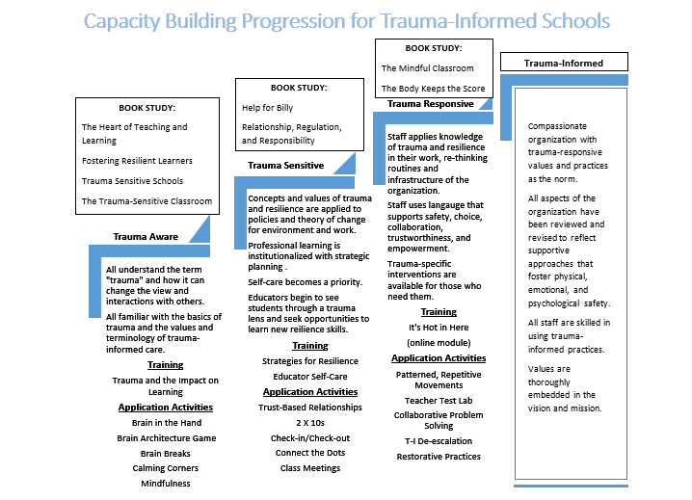
Educator Preparation

Slide 18
Trauma Responsive Educational Practices

Slide 19
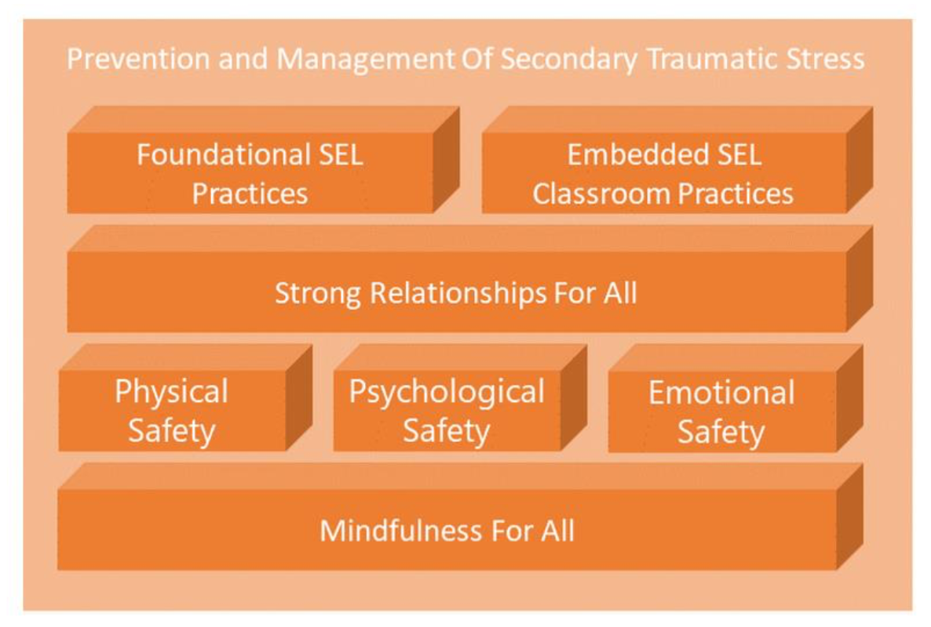
Prioritize Adult SELf-Care
Notes:
Tier 1: School-wide policies and practices that promote a safe and socioemotionally informed learning environment in all classrooms
Prevention and Management of Secondary Traumatic Stress
It is important to ensure adult well-being in the building before moving on to the classroom interventions
Mindfulness for All
Mindfulness helps self-regulation skills and reduce emotional reactivity in adults and students
Multilevel Safety
Students need to feel physically, psychologically and emotionally safe in order to lower emotional reactivity and engage in academic tasks
Strong Relationships for All
Strong relationships help drive the development of positive behaviors and act as a buffer against future traumatization

Slide 20

First State Trauma Recovery Demonstration Grant
DIRECT SUPPORTS
85%
Trauma-Specific Recovery Services
INDIRECT SUPPORTS
INDIRECT SUPPORTS
Training Institute
Systems Integration
Advisory Group
Program Evaluation
Awareness Campaign
Billing Specialist

Slide 21
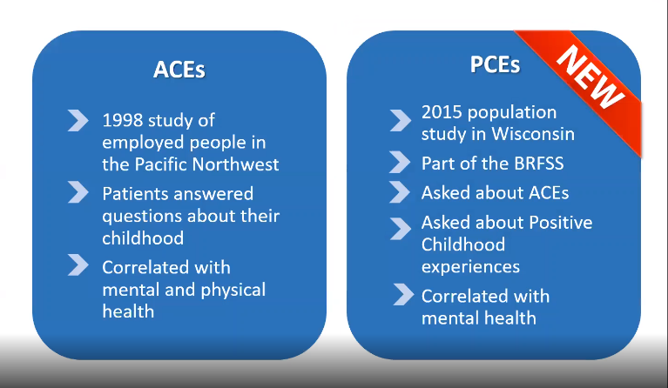
Tip the Scales with Positive Childhood Experiences

Slide 22
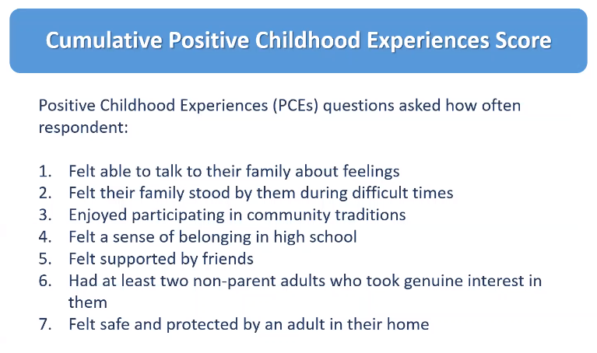

Slide 23
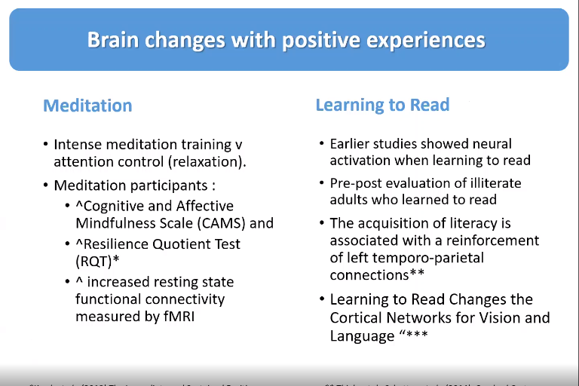

Slide 24
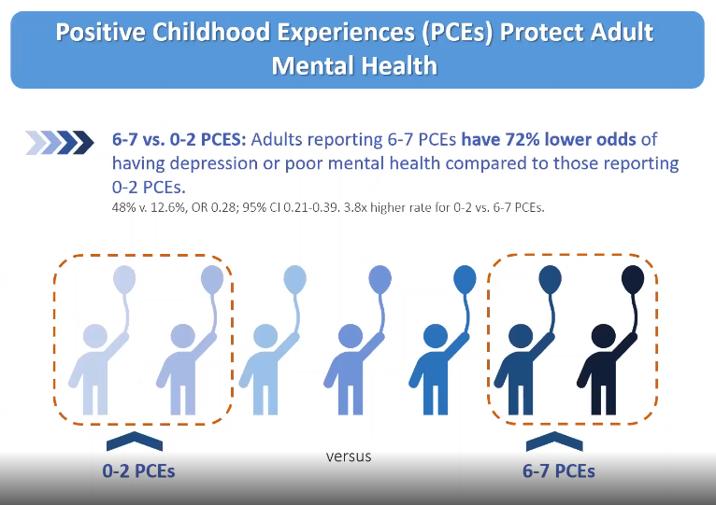

Slide 25
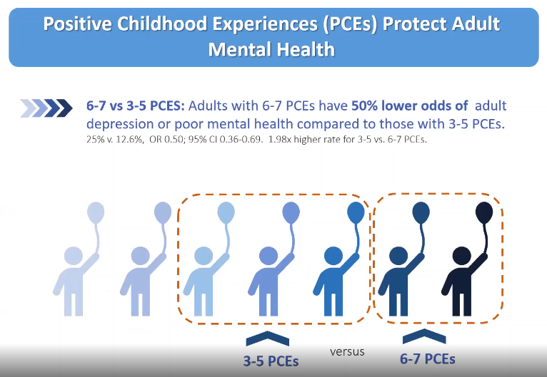

Slide 26
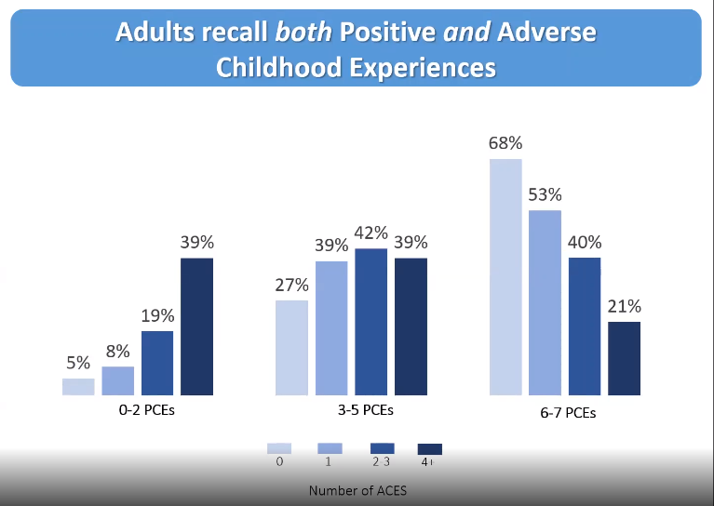

Slide 27
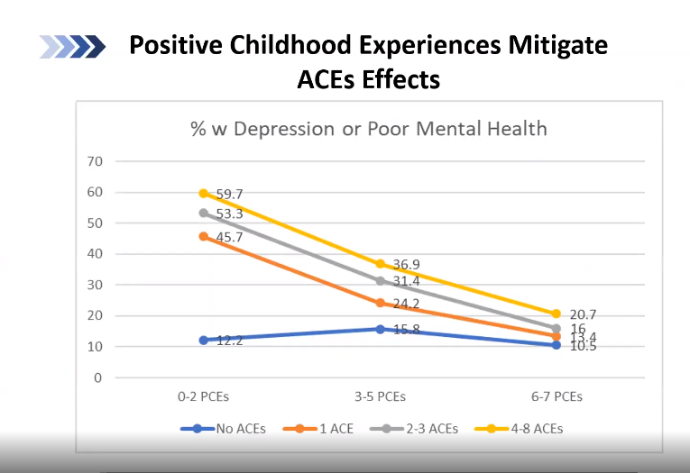

Slide 28
Use a Hope-Informed Lens
TRADITIONAL VIEW | HEALING-CENTERED ENGAGEMENT
Student has anger management problems | Student may be using maladaptive responses to get needs met, but what’s working for them?
Student has ADHD; is destructive and uncontrollable | Student has difficulty self-regulating; student was triggered,
Student is choosing to act out | Student can build from lagging skills.
Student is non-responsive | Who does student trust that can help build a bridge?
Student needs consequences or medication | Student needs support and it begins with trust-based relationships and a sense of belonging.
Notes:
A trauma responsive lens begins by shifting from asking “what’s wrong with this student” to “what may have happened to this student”
Trauma informed schools provide supports to help students feel safe physically, socially, emotionally and academically
Trauma informed schools intentionally build student resilience and self-regulation as protective factors to buffer against trauma exposure
The approach is often embedded within positive behavioral support and includes both school-wide and individual strategies as well as a focus on staff self-care

Slide 29
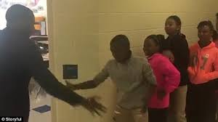
Build Meaningful Connections
Notes:
https://www.youtube.com/watch?v=BUQIARSN3ag

Slide 30
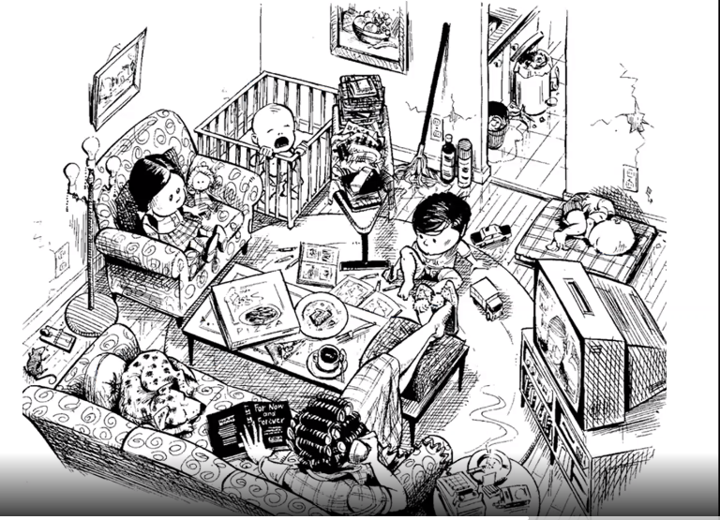
Reframe to Focus on Assets

Slide 31
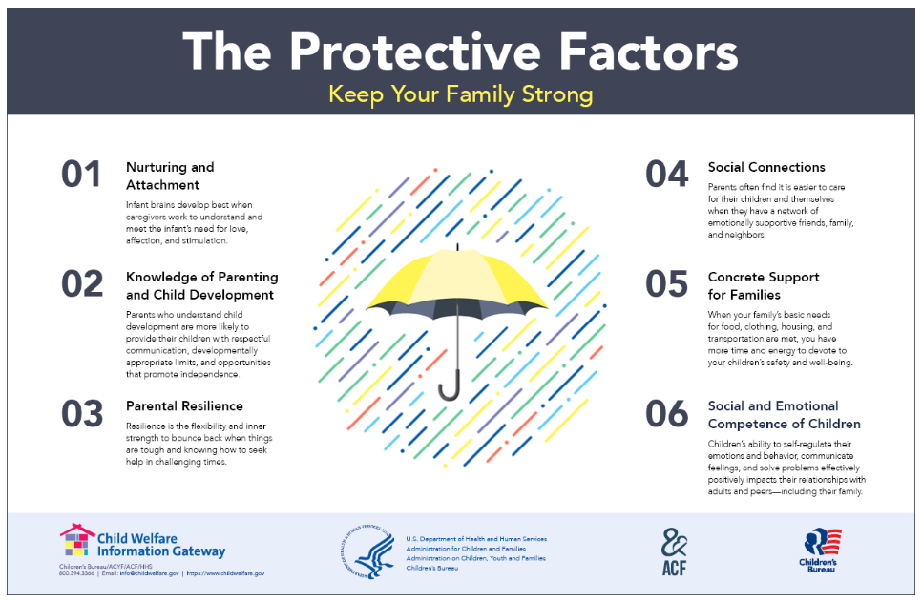

Slide 32
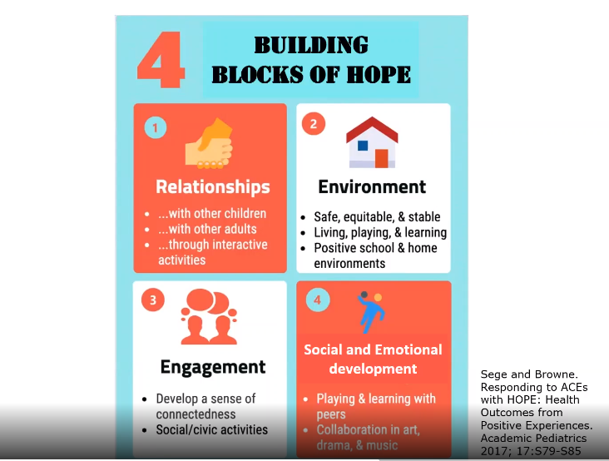

Slide 33
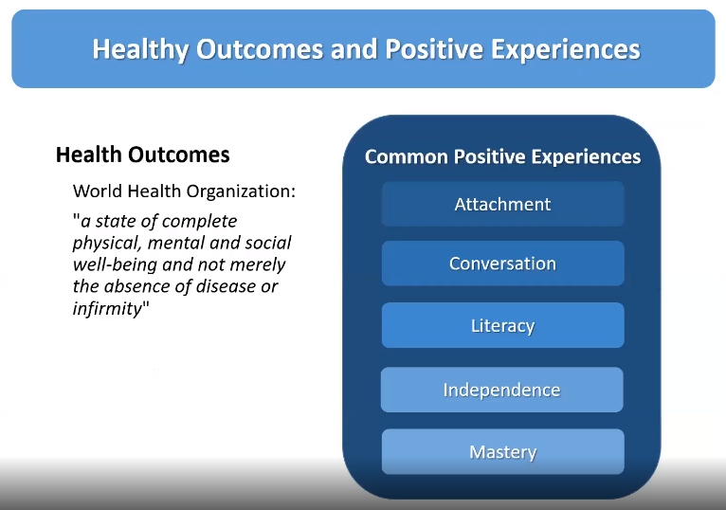

Slide 34
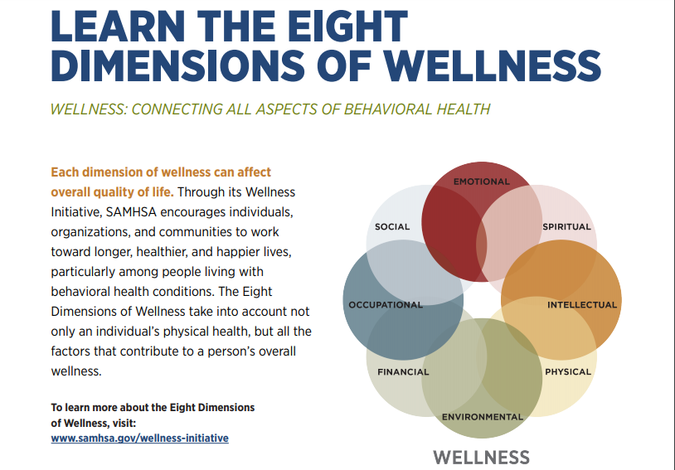

Slide 35
“…in order to develop normally, a child requires progressively more complex joint activity with one or more adults who have an irrational emotional relationship with the child. Somebody’s got to be crazy about that kid. That’s number one. First, last, and always.”
(Bronfenbrenner, National Scientific Council on the Developing Child)

Slide 36

WHERE OUR WORK MUST BEGIN AND END
“The flower that blooms in adversity is the rarest and most beautiful of all.” - Mulan, 1998
Humans have an astounding capacity to use challenging life experiences to create richer and more meaningful ways of living. We must foster resilience and empowerment.

Slide 37

Stay Connected
Teri Lawler, MA, LPCMH
Education Associate
Trauma-Informed Practices and Social and Emotional Learning
Office of Equity and Innovation
Delaware Department of Education
teri.lawler@doe.k12.de.us
@TeriLawler
#DEWholeChild

