Slide 1
An Examination of Wilmington Shooting Data
Darryl L. Chambers, MA
January 26, 2022

Slide 2
A Record Year for Wilmington, DE
“Wilmington’s 41 homicides in 2021 left it with a rate that surpassed larger cities that got more publicity. There were 5.8 homicides for every 10,000 people in Wilmington. Philadelphia saw 3.5 homicides for every 10,000 people and Chicago saw 2.9 homicides for every 10,000 people.”
Delaware News Journal January 24, 2022 [N]o confidence in police chief, now what?

Slide 3
Wilmington Gun Violence – Historical View
YEAR | INCIDENTS | VICTIMS | KILLED
2011 | 88 | 95 | 22
2012 | 96 | 118 | 25
2013 | 127 | 154 | 18
2014 | 114 | 124 | 23
2015 | 131 | 151 | 26
2016 | 127 | 145 | 21
2017 | 166 | 197 | 32
2018 | 71 | 78 | 19
2019 | 90 | 114 | 25
2020 | 135 | 169 | 29
2021 | 120 | 152 | 39

Slide 4
Shooting Incidents by Age
January 1, 2011 – December 31, 2021
January 1, 2021 – December 31, 2021

Slide 5
Shooting Incidents by Locations in Wilmington
 | January 2011 -December 2021 | January 2021 – December 2021
Hilltop | 16% (n=246) | 17% (n=25)
West Center City | 16% (n=244) | 19% (n=29)
Eastside | 13% (n=197) | 19% (n=28)
Northside | 33% (n=497) | 28% (n=42)
Other | 21% (n=310) | 18% (n=27)

Slide 6
LOOKING AT THE ZONES

Slide 7
ZONE ONE HOT SPOTS

Slide 8
ZONE TWO HOT SPOTS

Slide 9
ZONE THREE HOT SPOTS

Slide 10
ZONE FOUR HOT SPOTS

Slide 11
JAN 2011 TO JUNE 2020 SHOOTINGS IN WILMINGTON

Slide 12
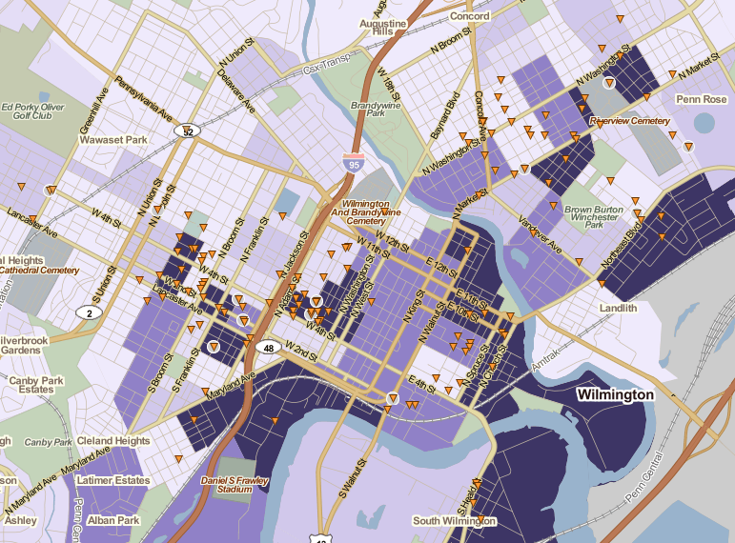
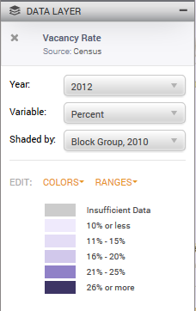
Wilmington DE Police Calls for Service for Shooting incidents which were founded. January Through June 2014, by Percent of Dwellings Vacant.
Notes:
Quality of life issue

Slide 13
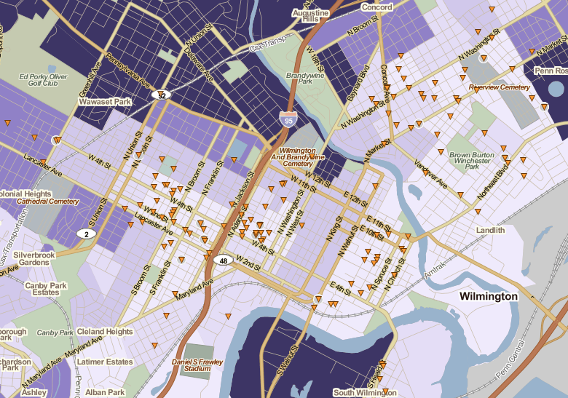
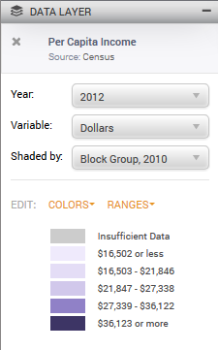
Wilmington DE Police Calls for Service for Shooting incidents which were founded. January Through June 2014, by Per Capita Income.

Slide 14
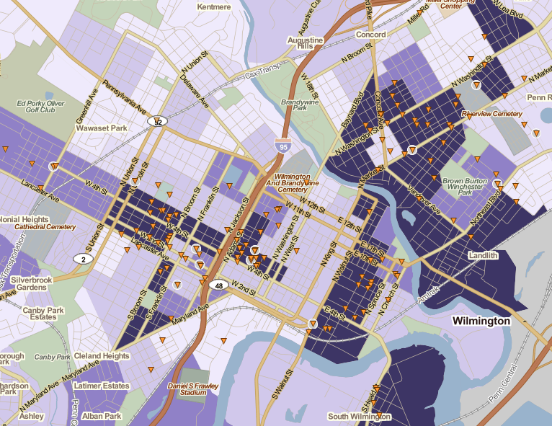
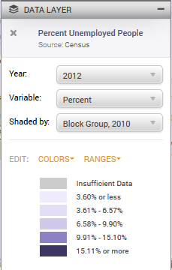
Wilmington DE Police Calls for Service for Shooting incidents which were founded. January Through June 2014, by Percent Unemployed
Notes:
Reference the People’s report

Slide 15
Data Notes
All reported data are current as of January 21, 2022.
Shooting incidents include events where one or more persons are wounded or killed by a firearm.
These data are available from Delaware Online/The News Journal.
Rounding to the nearest whole number may generate totals that equal slightly less or more than 100%.

Slide 16
Thank you. dchamber@udel.edu

