Slide 1
Mapping naloxone distribution in Delaware
nUNO MARTINS BHA I, Research and Evaluation
KRIS FRASER bha ii, Research and Evaluation
Michael C. Williams, MA III, Research and evaluation
John gudzelak, ma iii, research and evaluation
Division of Substance Abuse and Mental Health
Department of Health and Social Services

Slide 2
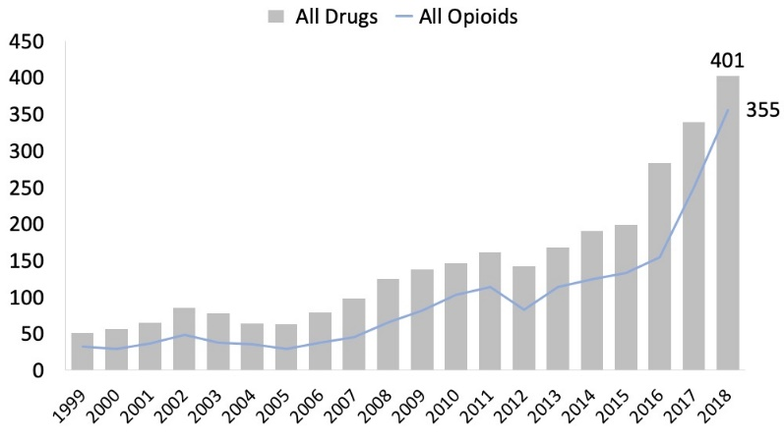
Opioid Crisis in delaware
Drug overdose death rates have been increasing in Delaware. In 2011, the drug overdose death rate was 17.4 per 100K people while in 2017 the overdose death rate was up to 38 per 100K people.
About 88% of the overdose deaths reported in Delaware in 2018 involved the use of opioids.
Expanding access to naloxone is one of the various strategies implemented by the State to fight the Opioid Crisis.
Figure 1. Number of overdose deaths in Delaware. Source: CDC Wonder, 2020.

Slide 3
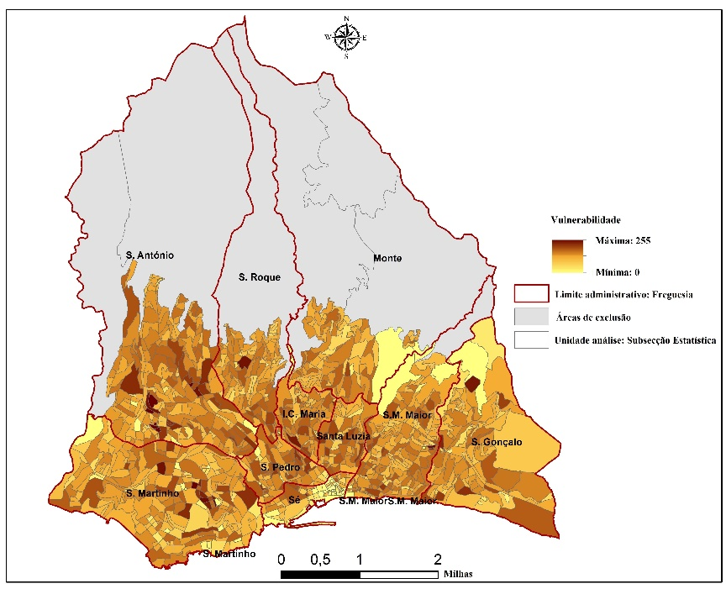
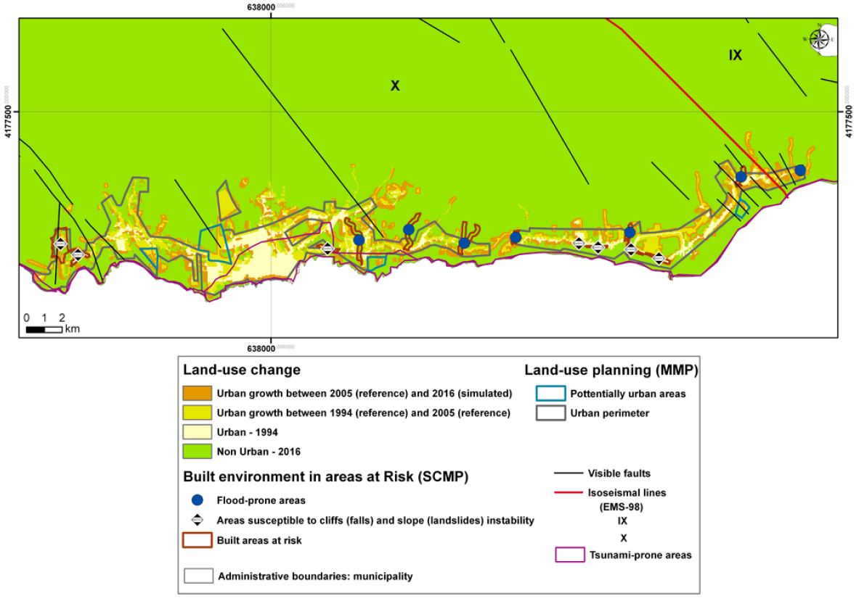
USING GIS IN EMERGENCY PLANNING
Figure 2. Social vulnerability of the city of Funchal, Madeira Island, Portugal. Source: Martins, 2020.
Figure 3. Land-use change in Vila Franca do Campo, Azores, considering land-use plans and natural hazardouness. Source: Martins et al., 2012.

Slide 4
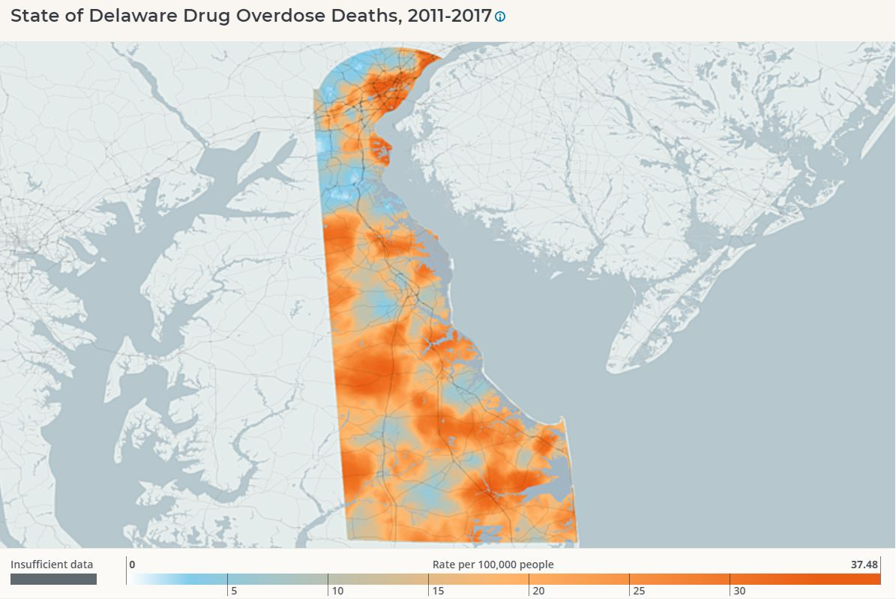
Using gis to tackle the opioid crisis
Collect, store, and visualize data (drug overdoses; naloxone deployment; drop-off locations).
Support policy-making and decision-making.
Risk communication and public education.
Figure 4. Drug Overdose Deaths Rate in DE, 2011-2017. Source: Myhealthycommunity.dhss.delaware.gov

Slide 5
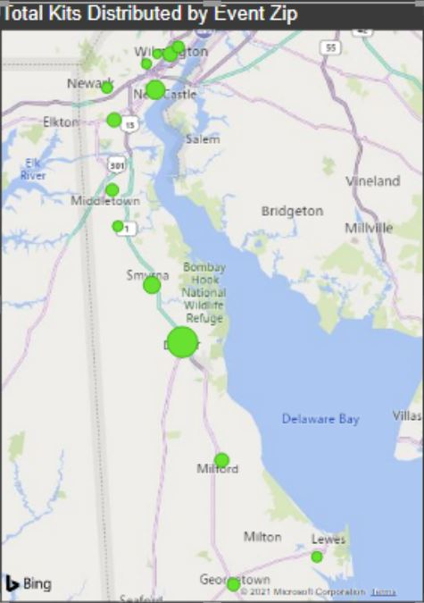
PROJECT objectives
Identify hot spots and cold spots of drug overdoses in Delaware.
Map the location and volume of naloxone distribution.
Identify gaps and disparities in access to naloxone by analyzing the spatial relationship between drug overdoses and naloxone distribution.
Map high-risk populations for opioid use.
Figure 5. DSAMH Naloxone distribution events. Source: DSAMH, 2021.

Slide 6
primary Data Sources
DSAMH Naloxone Distribution Data: dataset that includes information about the naloxone distribution events organized by DSAMH (e.g., event locations; number of events & kits distributed)
Death Investigation Alert (DIA): collects data on suspected overdose death in Delaware.
Consumer Reporting Form (CRF): client-level data on DSAMH-associated treatment for substance abuse and mental health. Collects data from all phases of treatment of DSAMH clients, from admission to discharge.
American Community Survey (ACS): main source of information for demographic, housing, and economic data of American communities.

Slide 7
GIS ANALYSIS
DIA data and naloxone distribution data will be aggregated by zip code.
Hot spot analysis: identify hot spots/cold spots of drug overdose deaths.
Overlay analysis: identify geospatial relationships between drug overdose deaths and naloxone distribution.
Demographic maps: identify high-risk populations based on demographic (age; gender; race and ethnicity) and socioeconomic (income; employment) indicators.

Slide 8
EXPECTED OUTCOMES
Optimize naloxone distribution and accessibility.
Decrease overdose deaths by improving access to naloxone.
Improve risk assessment (identify areas and populations at risk and in need of access to naloxone).

Slide 9
THANK YOU

