Slide 1

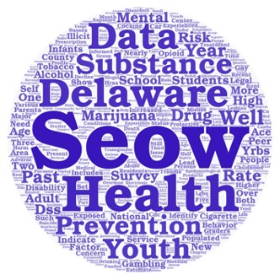
Behavioral Health Data Highlights from the
2020 Delaware Epidemiological Profile
3D: Delaware Data Discourse
Hosted by the State Epidemiological Outcomes Workgroup (SEOW)
Center for Drug and Health Studies of the University of Delaware
December 17, 2020

Slide 2

Funding for the State Epidemiological Outcomes Workgroup (SEOW) has been provided by the
Delaware Department for Health and Social Services,
Division of Substance Abuse and Mental Health (DSAMH)
through the Substance Abuse and Mental Health Services Administration (SAMHSA).
The SEOW is facilitated by the
Center for Drug and Health Studies at the University of Delaware.
Visit:
https://www.cdhs.udel.edu/seow/what-is-seow

Slide 3
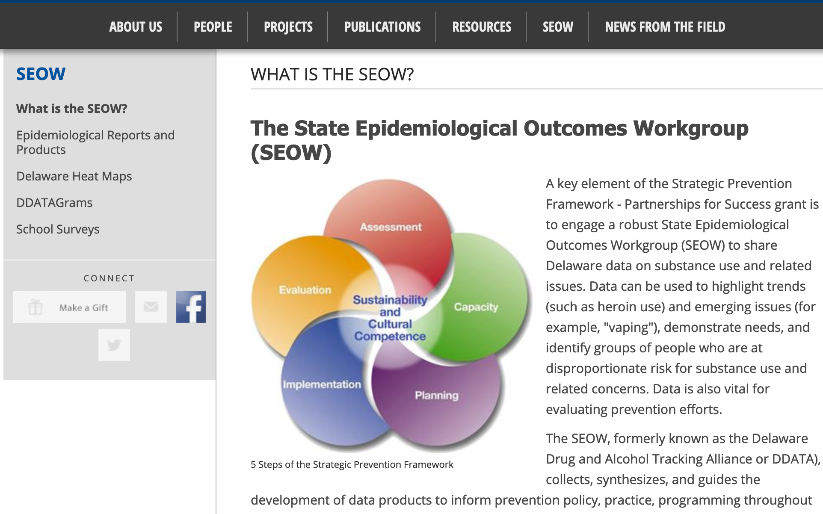
The 4 Goals of the SEOW
Identify, Analyze, and Share Data
Create Data Products
Train Communities in Understanding and Using Data
Build State and Local Level Monitoring Systems

Slide 4
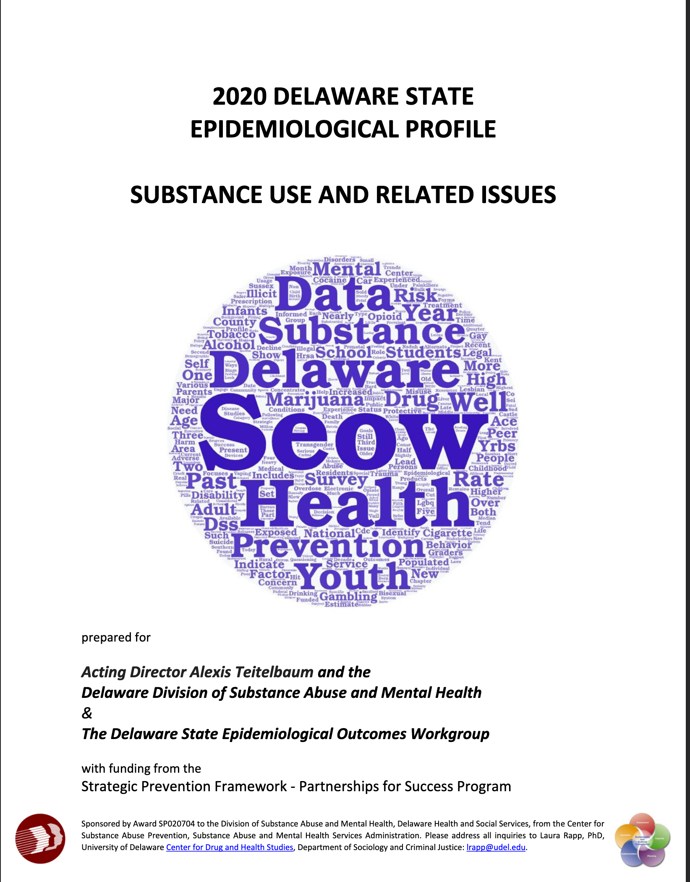
“The Epi”
The Delaware Epidemiological Profile is an annual report of data highlighting the trends and patterns in substance use, mental health indicators, risk and protective factors, and special topics.
The report is a resource for:
Needs assessment
Grant applications
Evaluation planning
Presentations, public awareness, and media outreach

Slide 5
Data Sources
Data Instrument | Administered/Compiled by | Year
Delaware Annual Traffic Statistical Report | Delaware State Police/Delaware Statistical and Analysis Center | 2019
Delaware Behavioral Risk Factor Surveillance System (BRFSS) | DE Division of Public Health (sponsored by the CDC) | 2018
Delaware Prescription Monitoring Program (PMP) | DE Department of State, Division of Professional Regulation | 2018
Delaware School Survey (DSS) – 5th, 8th, and 11th grades | Center for Drug and Health Studies, UD | 2019
Delaware Youth Risk Behavior Survey (YRBS) – High School | Center for Drug and Health Studies, UD (sponsored by DE Division of Public Health and the CDC) | 2019
Delaware Youth Risk Behavior Survey (YRBS) – Middle School | Center for Drug and Health Studies, UD (sponsored by Nemours) | 2019
Delaware Youth Tobacco Survey – 6th – 12th grades | Center for Drug and Health Studies, UD (sponsored by DE Division of Public Health) | 2018
Monitoring the Future – 8th, 10th, and 12th grades | University of Michigan (sponsored by the National Institute on Drug Abuse) | 2019
National High School Youth Risk Behavior Survey | US Centers for Disease Control | 2019
Performance Measures, Delaware | National Highway Safety Administration | 2018
National Survey on Children’s Health (NSCH) | US Health Resources & Services Administration | 2018
National Survey on Drug Use and Health (NSDUH) | US Substance Abuse and Mental Health Services Administration | 2016 - 2018
Substance-Exposed Infant Program | Office of the Child Advocate | 2019
Treatment Admissions Data | US Substance Abuse and Mental Health Services Administration, collected by Delaware Division of Substance Abuse and Mental Health | 2019
Additional Data Sources
America’s Health Rankings
Bureau of Labor Statistics
Centers for Disease Control and Prevention
Delaware Department of Education
Delaware Department of Safety and Homeland Security,
  Division of Forensic Science
Delaware Health Tracker
Delaware Household Health Survey
Drug Enforcement Administration
Health Resources and Services Administration
KIDS COUNT in Delaware
National Center for Health Statistics
National Conference of State Legislatures
National Institute on Drug Abuse
National Institute on Mental Health
RTI International
State of Delaware Economic Development Office
The Trevor Project
U.S. Census Bureau

Slide 6
Infographics

Slide 7
2020 Delaware State Epidemiological Report
An Overview of Key Findings

Slide 8
2020 Delaware State Epidemiological Report Chapter Outline
Specific Focus by Type of Substance Use
Specific Focus by Special Topics and Subgroups
State Demographic Background
Tobacco and Electronic Cigarettes
Alcohol
Marijuana
Opioid Use
Other Illegal Drugs
Substance-Exposed Infants
Gambling
Mental Health and Wellness
Persons with Disabilities
Adverse Childhood Experiences (ACEs)
Gender and Sexuality
Protective Factors

Slide 9
Reported Use of Selected Substances in the Past Year among Delaware Students (%)
2019 Delaware School Survey
State Demographic Overview: A Snapshot of Substance Use
Medication used not as prescribed includes steroids, over-the-counter medication, prescription uppers (diet pills, Ritalin, Concerta, Adderall), downers (Xanax and other benzodiazepines), and painkillers.
Other illegal drugs include ecstasy, hallucinogens, street uppers, inhalants, cocaine, crack, heroin, and synthetic marijuana used to get high.
Center for Drug & Health Studies. (2019). Delaware School Survey: 5th Grade [Annual Survey]. University of Delaware.
Notes:
Three most common substances used by students in the past year are alcohol, marijuana, and vaping/e-cigarettes. We’ll see in the next slide that vaping has very quickly become popular over the last few years.

Slide 10
Trends in Vaping among 11th Grade Students (%)
Delaware School Survey, 2014-2019
Tobacco and Electronic Cigarettes (Vaping)
Vaping includes use of e-cigarettes, Juul, or any other vaping device.
Center for Drug & Health Studies. (2019). Delaware School Survey: Secondary [Annual Survey]. University of Delaware.
Notes:
The percentage of students reporting that they used a vaping device in the past year more than quadrupled in the 6 years since we started tracking this information on our surveys. Also important to note that the questions we ask about vaping have changed several times in this period.

Slide 11
Trends in High School Students’ Past Month Use of Alcohol (%)
Youth Risk Behavior Survey, National and Delaware
Alcohol
Year | National | Delaware
1999 | 50 | 47
2001 | 47 | 46
2003 | 45 | 45
2005 | 43 | 43
2007 | 45 | 45
2009 | 42 | 44
2011 | 39 | 41
2013 | 35 | 36
2015 | 33 | 33
2017 | 30 | 29
2019* | 29 | 25
Center for Drug & Health Studies. (2019). Youth Risk Behavior Survey: High School [Biennial Survey]. University of Delaware.
Notes:
Past month alcohol use among high school students has declined overall in the past 20 years, both in Delaware and at the national level.

Slide 12
Trends in Delaware Students’ Past Month Marijuana Use by Grade (%)
Delaware School Survey, 1999-2019
Marijuana
Center for Drug & Health Studies. (2019). Delaware School Survey: Secondary [Annual Survey]. University of Delaware.
Notes:
While alcohol has declined and vaping has increased, marijuana has remained relatively stable. 8th grade use has decreased but 11th grade has been varying by a few percentage points for years.

Slide 13
Opioids and Prescription Misuse
Prevalence and Perception of Risk (%)
2019 Delaware School Survey and
2017-2018 National Survey on Drug Use and Health
Approximately 3% of eighth and eleventh grade students surveyed by the Delaware School Survey reported misusing prescription painkillers in the past year.
According to the National Survey on Drug Use and Health, the 18-25 year-old age group has the highest prevalence of prescription painkiller misuse. In Delaware, 6.85% of 18-25 year-olds reported misusing prescription painkillers in the past year.
*Prescription misuse is defined as use without a doctor’s prescription or in ways other than prescribed, such as use in greater amounts, more often, or for longer than told.
Center for Drug & Health Studies. (2019). Delaware School Survey: Secondary [Annual Survey]. University of Delaware.
“National Survey on Drug Use and Health: Comparison of 2016-2017 and 2017-2018 Population Percentages.” Center for Behavioral Health Statistics and Quality, Substance Abuse and Mental Health Services Administration
Notes:
Opportunity to talk about limitations of data?

Slide 14
Substance-Exposed Infants
Risk Factor | 2017 | 2018 | 2019
DFS History/Trauma as Child | 40% | 43% | 40%
Mental Health Condition | 34% | 46% | 56%
Among mothers who give birth to an infant that has been exposed to substances, there is a high prevalence of both a childhood involvement with the Division of Family Services and mental health conditions.
Source: Delaware Infants with Prenatal Substance Exposure 2019 Year in Review, Division of Family Services, State of Delaware, Office of the Child Advocate.
Notes:
Among cases involving SEI births, 40% of mothers were involved with DFS themselves or had some other trauma as children. This points to the cycle of intergenerational trauma and gives us a lens for thinking about the mothers in these cases. We are concerned about and it’s important to take care of the infants, but these mothers have often experienced trauma themselves. There is a real lack of resources/care for a lot of these women that contributes to scenarios leading to substance-exposed births.

Slide 15
Gambling and Substance Use among High School Students (%)
2019 Delaware Youth Risk Behavior Survey
Gambling
**Gambling refers to at least one of the following: played the lottery or scratch-off tickets; bet on fantasy sports; bet on individual sports teams; played Bingo for money; bet on dice games such as craps; bet money on a challenge (dare, fight, street race, etc.); played online gambling games for money; bet on video games; bet on games of personal skill such as pool, darts, or basketball.
Center for Drug & Health Studies. (2019). Youth Risk Behavior Survey: High School [Biennial Survey]. University of Delaware.
Notes:
There is a positive correlation between gambling and past month substance use.

Slide 16
Trends in Feelings of Sadness or Hopelessness among High School Students (%)
Delaware Youth Risk Behavior Survey, 1999-2019
Mental Health and Wellness
*Students are asked if, in the past year, they have ever felt sad or hopeless nearly every day for a two-week period or longer.
Center for Drug & Health Studies. (2019). Youth Risk Behavior Survey: High School [Biennial Survey]. University of Delaware.

Slide 17
Mental Health among High School Students with Disabilities (%)
2019 Delaware Youth Risk Behavior Survey
Persons with Disabilities
ªDisability is defined in the YRBS as serious difficulty hearing or seeing, difficulty walking or climbing stairs, or difficulty concentrating, remembering, making decisions, or doing things due to a physical, emotional, or learning disability identified by the student or a doctor/healthcare professional.
Center for Drug & Health Studies. (2019). Youth Risk Behavior Survey: High School [Biennial Survey]. University of Delaware.
Notes:
**Add note about disability indicators.

Slide 18
Prevalence of ACEs and Association with Greater Substance Use among High School Students (%)
2019 Delaware Youth Risk Behavior Survey
Adverse Childhood Experiences
Note: Students who confirmed experiencing any of the following events: homelessness, incarcerated parent, fighting, being threatened, being bullied, or teen dating violence or sexual violence, were placed in either “1 ACE” or “2 or More ACEs” category depending on the number of different experiences they reported.
Center for Drug & Health Studies. (2019). Youth Risk Behavior Survey: High School [Biennial Survey]. University of Delaware.
Notes:
*Past month substance use.

Slide 19
Bullying and School Safety Among LGBTQ High School Students (%)
2019 Delaware Youth Risk Behavior Survey
Gender and Sexuality
Center for Drug & Health Studies. (2019). Youth Risk Behavior Survey: High School [Biennial Survey]. University of Delaware.

Slide 20
Sources of Support and Encouragement among High School Students (%)
2019 Delaware Youth Risk Behavior Survey
Protective Factors
Center for Drug & Health Studies. (2019). Youth Risk Behavior Survey: High School [Biennial Survey]. University of Delaware.
Notes:
Add slide from NSCH on family resilience.

Slide 21
Protective Factors
2017-2018 National Survey of Children’s Health
Family Resilience Composite Measure (%)
Indicator 6.12 Family Resilience: “Does this child live in a home where the family demonstrates qualities of resilience during difficult times.” The composite measure includes four items: “Talk together about what to do; Work together to solve the problem; Know we have strengths to draw upon; Stay hopeful even in difficult times.”
National Survey of Children’s Health, Health Resources and Services Administration, Maternal and Child Health Bureau. https://mchb.hrsa.gov/data/national-surveys.

Slide 22
A note about the COVID-19 Pandemic
Delaware, along with the rest of the country, is undergoing enormous health and economic challenges related to the ongoing crisis of the COVID-19 pandemic. Nationally, evidence is emerging to suggest that rates of mental health issues and substance use are on the rise as people face uncertainty over health and financial security and experience isolation due to social distancing measures (Czeisler et al., 2020). Much of the data reported in the 2020 Delaware Epidemiological Profile does not fully reflect these trends, but this context will be important to consider when reviewing data in upcoming reports. Although it will be more important than ever to capture this data, due to the impact of the pandemic, data collection will be extremely challenging.
Czeisler, M., Lane, R.I., Petrosky, E., Wiley, J.F., Christensen, A., Njai, R., Weaver, M.D., Robbins, R., Facer-Childs, E.R., Barger, L.K., Czeisler, C.A., Howard, M.E., Rajaratnam, S. M. W., Mental Health, substance use, and suicidal ideation during the COVID-19 pandemic – United States, June 24-30, 2020. MMWR Morbidity and Mortality Weekly Report, 69(32), 1049-1057. Retrieved on August 28, 2020 from
DOI: http://dx.doi.org/10.15585/mmwr.mm6932a1external icon .
Notes:
Suggestions for this one? Before or after data? Can verbally contextualize important by talking about mental health during the pandemic rather than having more text on the slides…
Do we have any updates on survey plans for spring 2021?

Slide 23

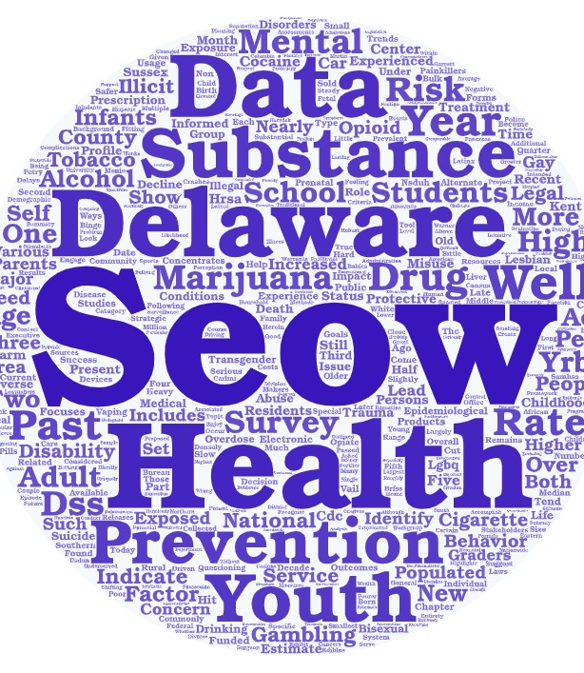
Questions?

Slide 24


For More Information…
Sharon Merriman-Nai smnai@udel.edu
Rachel Ryding rryding@udel.edu
Center for Drug and Health Studies
at the University of Delaware
www.cdhs.udel.edu

Slide 25

Thank You!
Please take a moment for a quick poll in Zoom.

