Slide 1


Timeline Tuesday
Data Snapshot:
Adverse Childhood Experiences (ACEs)
Sharon Merriman-Nai
Annie Slease
LaWanda Burgoyne
Kier Berkel

Slide 2




Slide 3
Data Overview
Sharon Merriman-Nai
Community Perspective Panelists
Annie Slease
LaWanda Burgoyne
Kier Berkel

Slide 4

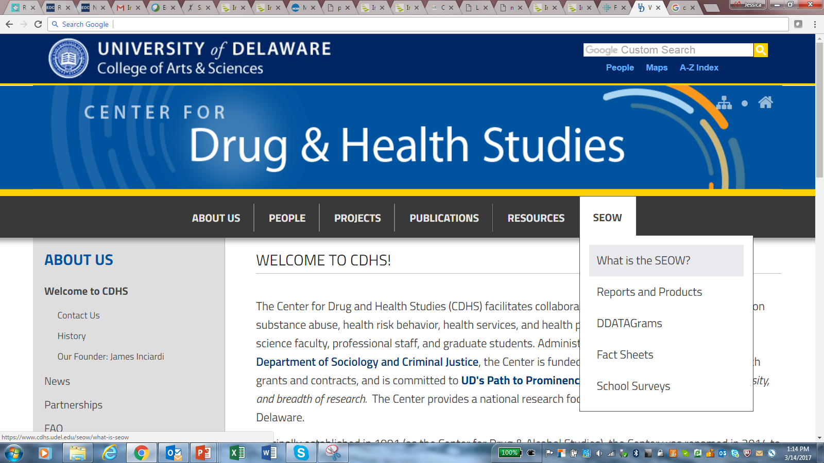
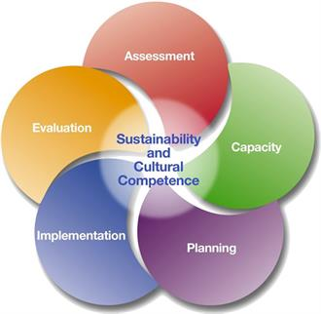
The State Epidemiological Outcomes Workgroup (SEOW)
4 Goals of the SEOW
Identify, Analyze, and Share Data
Create Data Products
Train Communities in Understanding and Using Data
Build State and Local Level Monitoring Systems

Slide 5
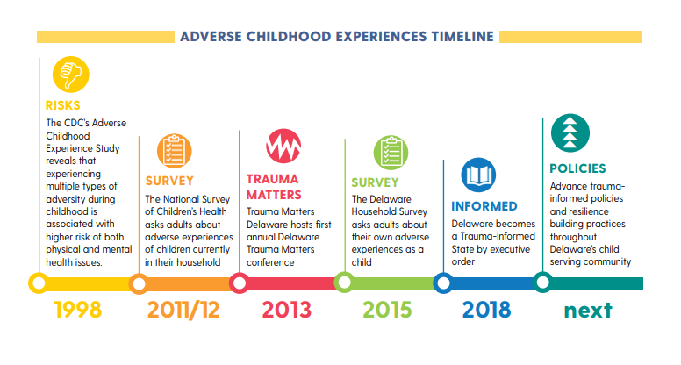

Slide 6
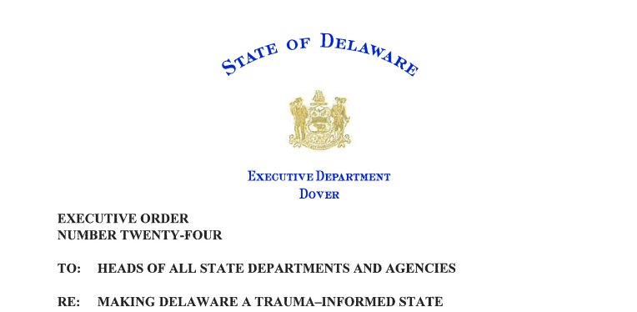
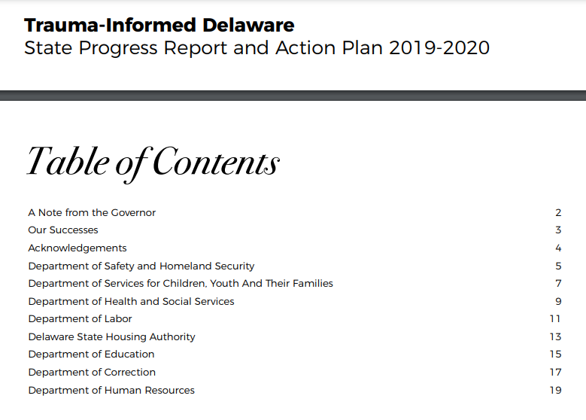

Executive Order 24, Progress Report and Action Plan
https://governor.delaware.gov/wp-content/uploads/sites/24/2018/10/Executive-Order-Number-24-Trauma-Informed-State.pdf
https://governor.delaware.gov/wp-content/uploads/sites/24/2019/11/DE-TIC-Progress-Report-and-Action-Plan.pdf

Slide 7
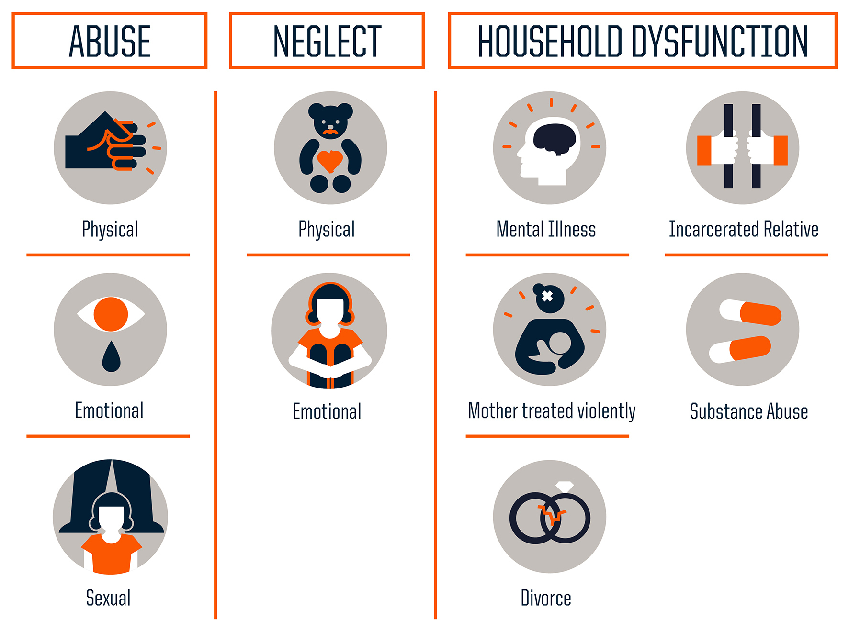
What are ACEs?
Original Kaiser study included 10 adverse childhood experiences including abuse, neglect, and household/family dysfunction.
Broader issues such as poverty, racism, and exposure to community violence are now considered ACEs.
ACEs create toxic stress which can lead to changes in brain structure and function, and poorer health and social outcomes throughout the lifespan – the more ACEs experienced, the greater the impact.

Slide 8
How Prevalent are ACEs?
Findings from 25 states asking ACE questions in the CDC Behavioral Risk Factor Surveillance System (BRFSS, 2015-2017):
Almost 2 in 3 adults report at least 1 ACE
Nearly 16% of adults report 4 or more ACEs
Higher rates of being overweight and obese, heavy drinking, COPD, and depression are associated with higher numbers of reported ACEs
Among these respondents, greater ACE scores are also associated with greater socio-economic challenges
                (Merrick et al., 2019)

Slide 9
How Prevalent are ACEs in Delaware?
Source: Delaware Household Health Survey, 2015

Slide 10
National Survey of Children’s Health
Source: Hussaini, K. DE Dept. of Health and Social Services, Div. of Public Health, Preliminary Analysis, National Survey of Children’s Health, 2016-2018.

Slide 11
NSCH 2016-2018 – ACEs and Poverty

Slide 12
NSCH 2016-2018 – ACEs and Race

Slide 13
NSCH 2016-2018 ACEs and Parent Place of Birth
Source: Hussaini, K. DE Dept. of Health and Social Services, Div. of Public Health, Preliminary Analysis, National Survey of Children’s Health, 2016-2018.

Slide 14
NSCH 2016-2018 - ACEs in Special Health Needs
Source: Hussaini, K. DE Dept. of Health and Social Services, Div. of Public Health, Preliminary Analysis, National Survey of Children’s Health, 2016-2018.

Slide 15
2019 Delaware High School Youth Risk Behavior Survey (YRBS) – ACE Indicators (%)
Source: Center for Drug & Health Studies. (2019). Youth Risk Behavior Survey: High School [Biennial Survey].

Slide 16
2019 Delaware High School YRBS
Prevalence of ACEs (%)
Source: Center for Drug & Health Studies. (2019). Youth Risk Behavior Survey: High School [Biennial Survey].

Slide 17
2019 Delaware High School YRBS
ACEs and Gender* (%)
Source: Center for Drug & Health Studies. (2019). Youth Risk Behavior Survey: High School [Biennial Survey].

Slide 18
2019 Delaware High School YRBS
ACEs and Race and Ethnicity (%)
Source: Center for Drug & Health Studies. (2019). Youth Risk Behavior Survey: High School [Biennial Survey].

Slide 19
2019 Delaware High School YRBS
ACEs and Substance Use (past month, %)
Source: Center for Drug & Health Studies. (2019). Youth Risk Behavior Survey: High School [Biennial Survey].

Slide 20
2019 Delaware High School YRBS
ACEs and Mental Health (past year, %)
Source: Center for Drug & Health Studies. (2019). Youth Risk Behavior Survey: High School [Biennial Survey].

Slide 21
Protective factors at the family, school, community, and societal levels can help to prevent ACEs and reduce their impact.

Slide 22
References
Data highlights are from the 2020 Delaware State Epidemiological Profile, a product of the State Epidemiological Outcomes Workgroup (SEOW) which is supported by the Delaware Department of Health and Social Services, Division of Substance Abuse and Mental Health. To access the report and infographics on this and related prevention topics, visit: https://www.cdhs.udel.edu/seow/reports-and-products.
The SEOW is grateful for Dr. Khaleel Hussaini for the preliminary analysis of the National Survey of Children’s Health data.
For more on the Delaware Youth Risk Behavior Survey, please visit the UD Center of Drug and Health Studies at: https://www.cdhs.udel.edu/seow/school-surveys.
Centers for Disease Control and Prevention. (n.d.). Adverse childhood experiences (ACEs), https://www.cdc.gov/violenceprevention/acestudy/ .
Fink, A. (2016, Dec. 16). Adverse childhood experiences and behavioral health. [Presentation to the State Epidemiological Outcomes Workgroup, New Castle, Delaware]. https://bit.ly/3l4XTZx
Hussaini, K. S. (2020). [Presentation]. Preliminary Analysis of the National Survey of Children’s Health, adverse childhood experience in the U.S. and in Delaware, 2016-2018. Delaware Department of Health and Social Services, Division of Public Health.
Merrick, M., et al. (2019). Vital Signs: Estimated proportion of adult health problems attributable to adverse childhood experiences and implications for prevention – United States, 2015-2017. Morbidity and Mortality Weekly Report, 68(44), 999-1005, www.cdc.gov/mmwr/volumes/68/wr/mm6844e1.htm .

Slide 23

  Sharon Merriman-Nai smnai@udel.edu
  Center for Drug and Health Studies at the University of Delaware
  www.dekidscount.org

