Slide 1
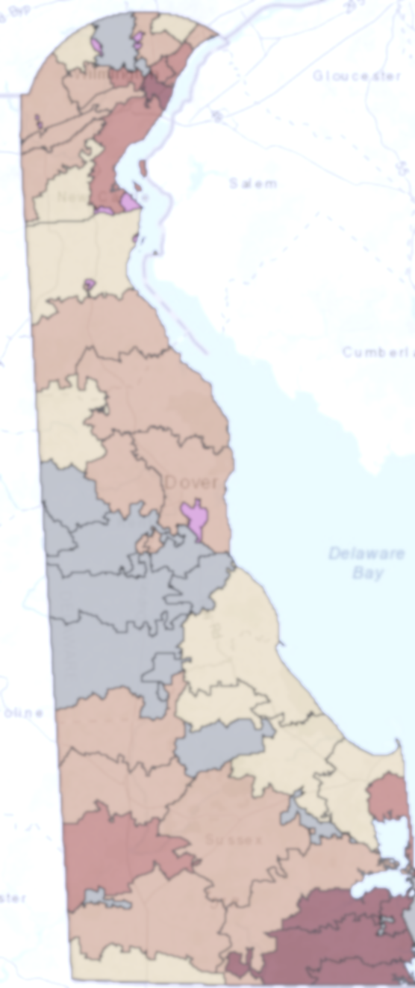
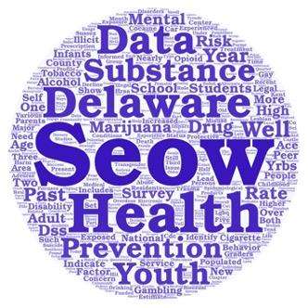
3D: Delaware Data Discourse
Welcome! Please feel free to introduce yourself in the chat box and let us know if you’re familiar with the Delaware Epidemiological Profile.
This meeting will be recorded.

Slide 2
Behavioral Health Data Highlights from the 2021 Delaware Epidemiological Profile
3D: Delaware Data Discourse
Hosted by the State Epidemiological Outcomes Workgroup (SEOW)
Center for Drug and Health Studies of the University of Delaware
April 26th, 2022

Slide 3
The State Epidemiological Outcomes Workgroup (SEOW)
Funding for the State Epidemiological Outcomes Workgroup has been provided by the
Delaware Department for Health and Social Services, Division of Substance Abuse and Mental Health (DSAMH) through the Substance Abuse and Mental Health Services Administration (SAMHSA).
The SEOW is facilitated by the Center for Drug and Health Studies at the University of Delaware. Visit the SEOW online at:
https://www.cdhs.udel.edu/seow/what-is-seow

Slide 4
The 4 Goals of the SEOW
Identify, Analyze, and Share Data
Create Data Products
Train Communities in Understanding and Using Data
Build State and Local Level Monitoring Systems

Slide 5
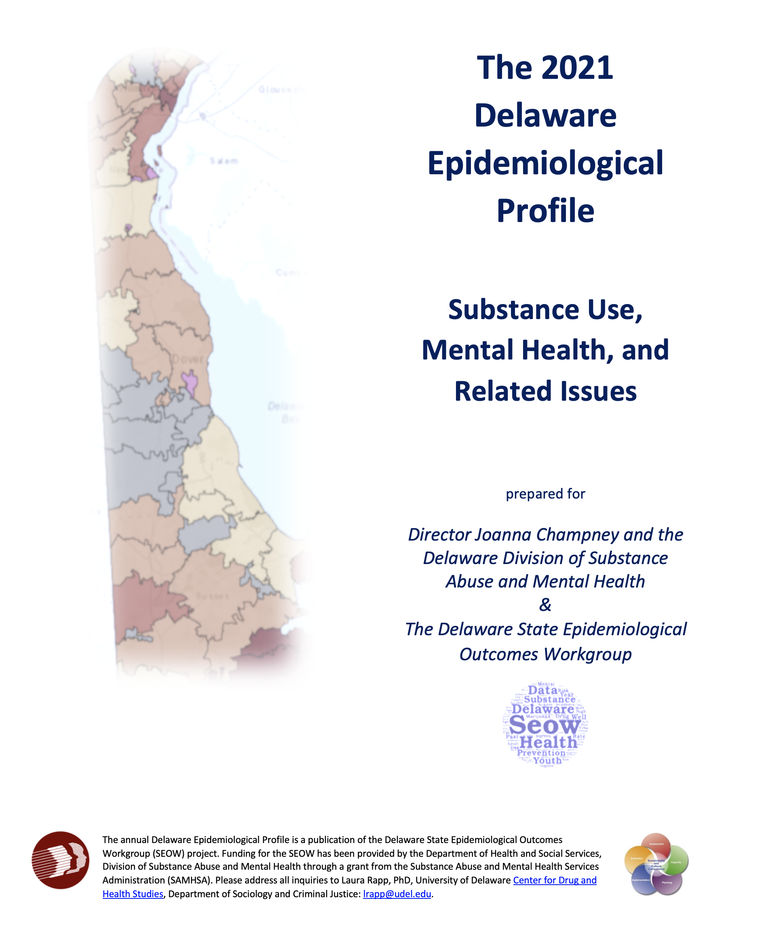
“The Epi”
The Delaware Epidemiological Profile is an annual report of data highlighting the trends and patterns in substance use, mental health indicators, risk and protective factors, and special topics.
The report is a resource for:
Needs assessment
Grant applications
Evaluation planning
Presentations, public awareness, and media outreach

Slide 6
Data Sources
Additional Data References
America’s Health Rankings
American Psychological Association
Bureau of Labor Statistics
Center for Drug and Health Studies, University of Delaware
Crisis Text Line
Delaware Department of Education
Delaware Department of Health and Social Services, Division of Public Health, My Healthy Community
Delaware Department of Safety and Homeland Security, Division of Forensic Science
Delaware Household Health Survey
Drug Enforcement Administration
KIDS COUNT in Delaware
KFF
National Academies of Sciences, Engineering, and Medicine
National Center for Health Statistics
National Conference of State Legislatures
National Institute on Alcohol Abuse and Alcoholism
National Institute on Drug Abuse
National Institutes of Health
National Institute on Mental Health
Rapid Assessment of Pandemic Impact on Development – Early Childhood
RTI International
State of Delaware Economic Development Office
The Trevor Project
U.S. Census Bureau
U.S. Centers for Disease Control and Prevention
U.S. Health Resources and Services Administration
Data Instrument | Most Recent Data | Trend Range
Delaware Annual Traffic Statistical Report | 2020 | -
Delaware Behavioral Risk Factor Surveillance System (BRFSS) | 2019 | -
Delaware Prescription Monitoring Program (PMP) | 2020 | 2012- 2020
Delaware School Survey (DSS) – 5th, 8th, and 11th grades | *2019 2020 | *1999 - 2019 1999 - 2020
Delaware Youth Risk Behavior Survey (YRBS) – High School | 2017 | 1999 - 2017
Delaware Youth Risk Behavior Survey (YRBS) – Middle School | 2019 | 1999 - 2019
Delaware Youth Tobacco Survey – 6th – 12th grades | 2020 | -
Infants with Prenatal Substance Exposure Program | 2020 | 2015-2020
Monitoring the Future – 8th, 10th, and 12th grades | 2020 | 1999 - 2020
National High School Youth Risk Behavior Survey | 2019 | 1999 - 2019
Performance Measures, Delaware | 2018 | 2014-2019
National Survey on Children’s Health (NSCH) | 2019 | 2016 - 2019
National Survey on Drug Use and Health (NSDUH) | 2018-2019 | 2002 - 2019
Treatment Admissions Data | 2019 | -

Slide 7
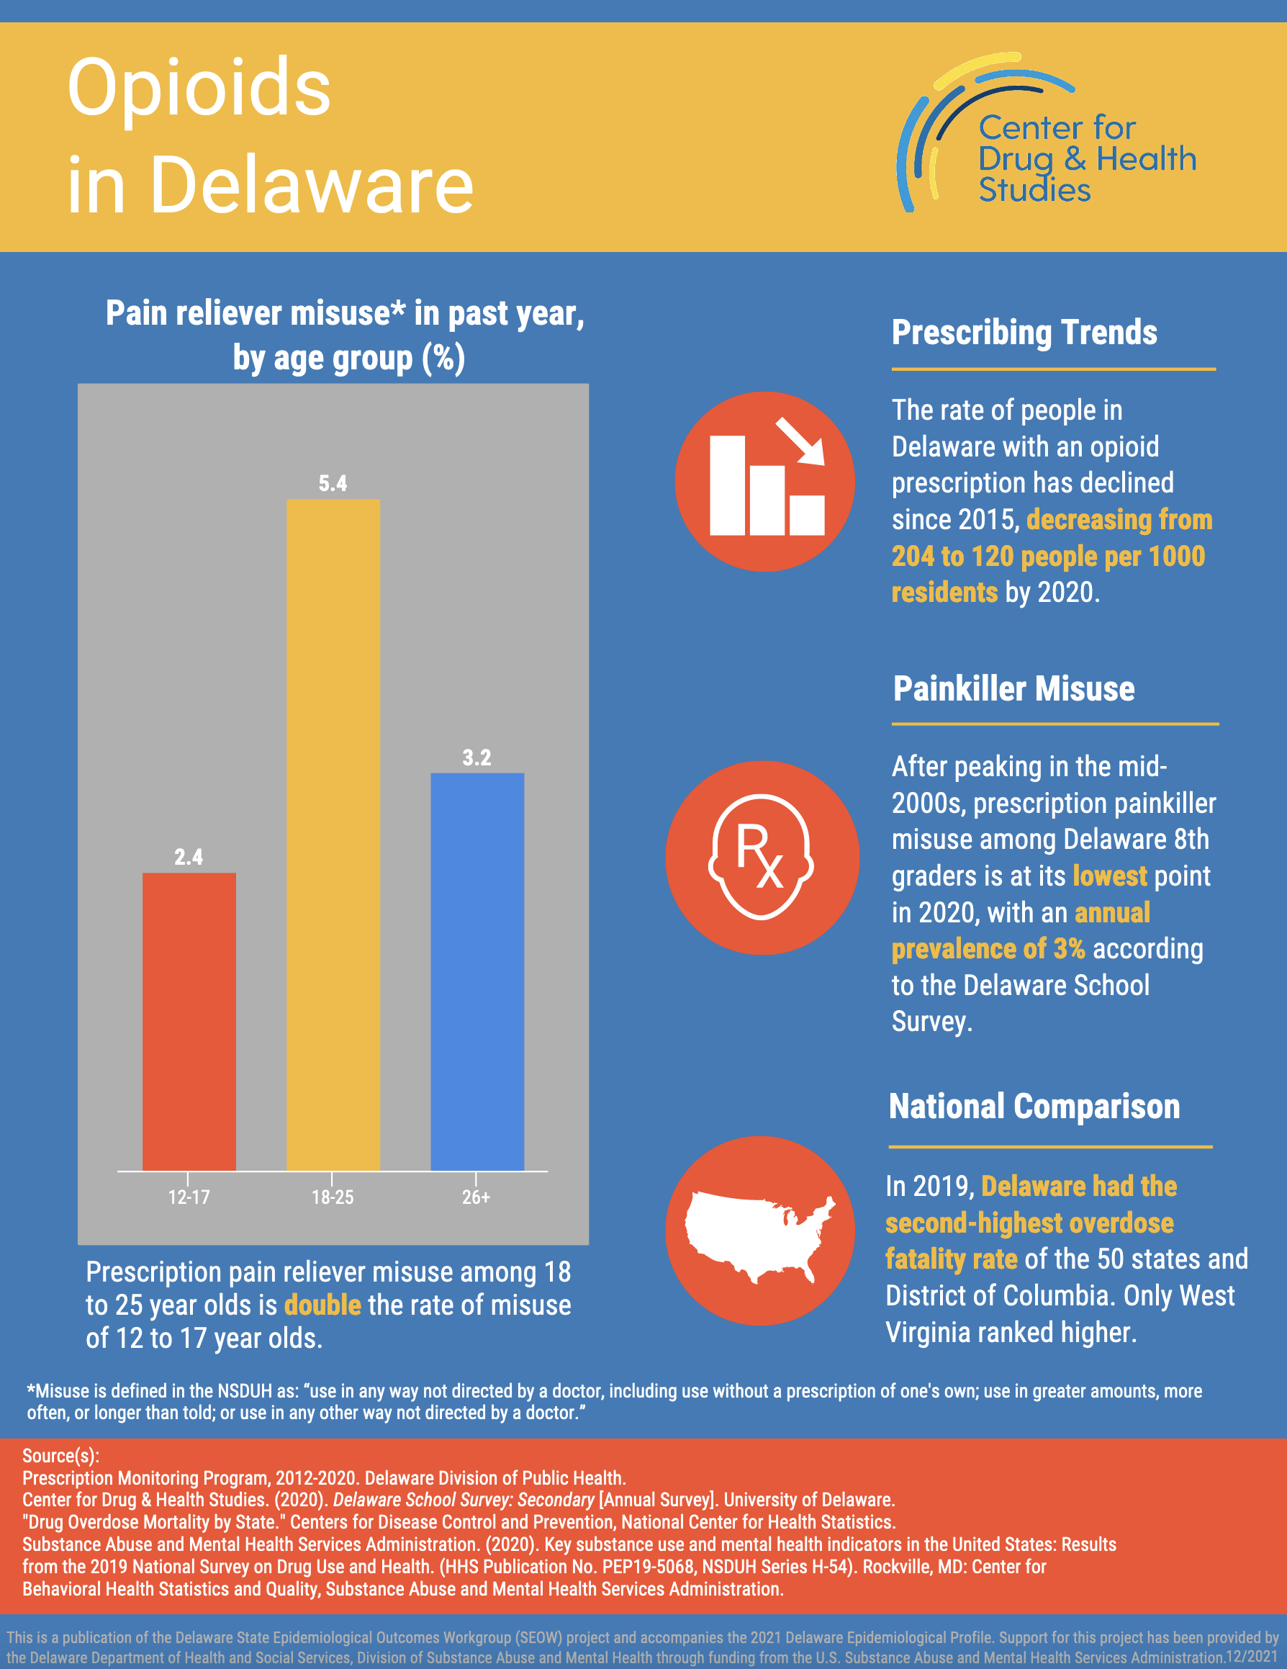
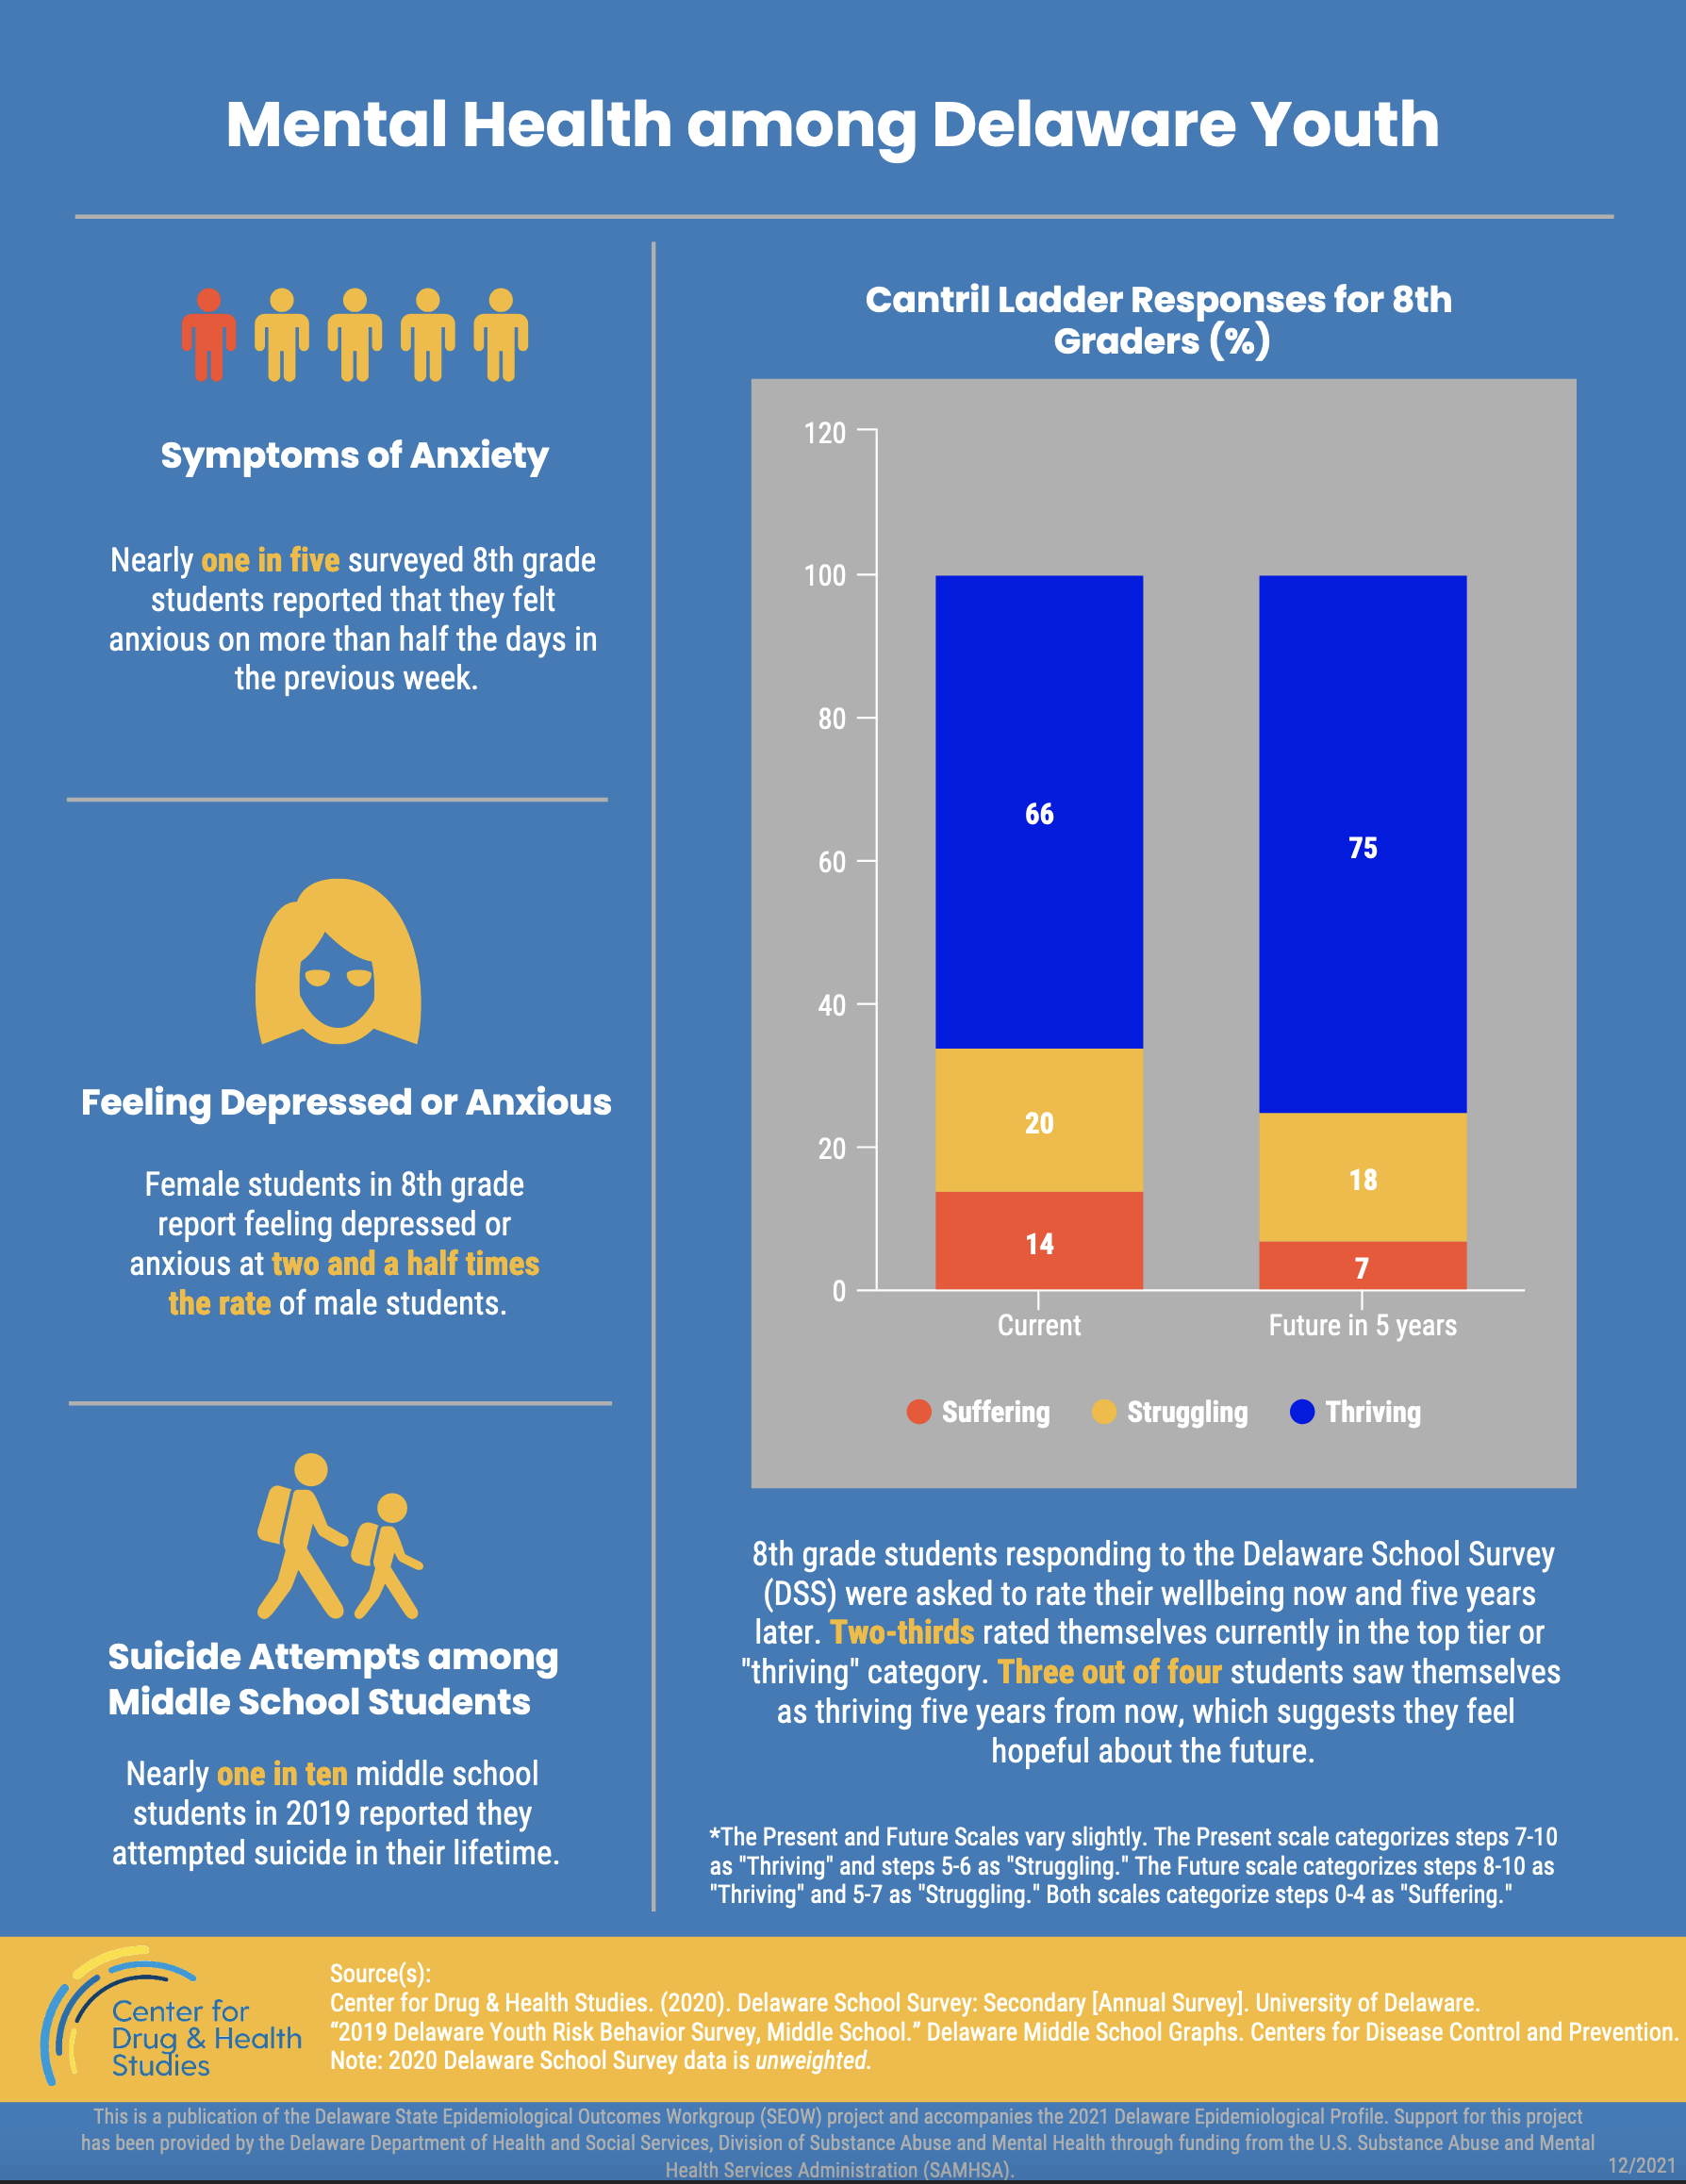
2021 Epi Infographic Series

Slide 8
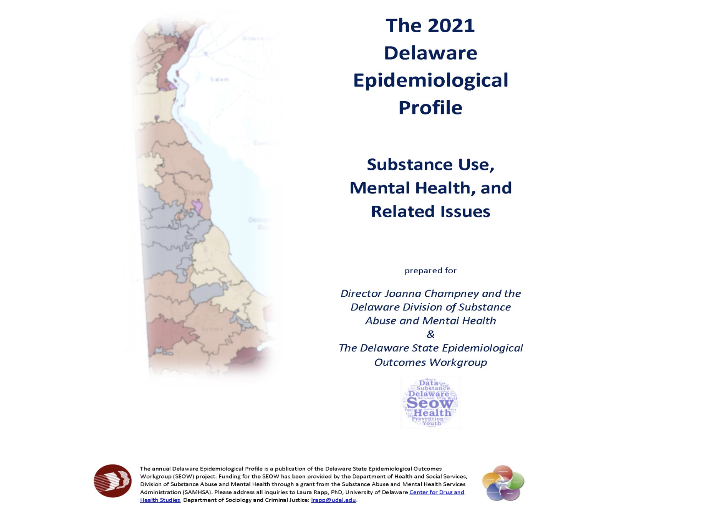
2021 Epi Slides

Slide 9
What’s New in the 2021 Profile?
Data in Action segments that consider behavioral health during the COVID-19 pandemic
“Highlight” boxes at the beginning of each chapter narrative that feature key takeaways
Adult ACEs data from the 2019 Behavioral Risk Factor Surveillance System (BRFSS)

Slide 10
Notes Regarding School Survey Data Reported in the 2021 Profile
In previous years, Delaware met the CDC’s required participation rate to obtain weighted data for the Youth Risk Behavior Middle and High School Surveys. However, during the 2019 administration, participation rates for the Delaware high school survey did not meet the required threshold for weighting the data. Therefore, this report only includes 2019 middle school findings from the YRBS based on 1,153 respondents. Whenever available, trend data from the CDC Youth Online Data Portal is also reported. Additional high school YRBS data from previous years may be requested by following the Delaware Division of Public Data Information & Request Process.
In 2020, the advent of the COVID-19 pandemic and subsequent school closures and shifts to remote learning greatly impacted the ability to collect school survey data. As a result, in 2020, we are unable to report data from the Youth Tobacco Survey (YTS) for middle or high school, or from the Delaware School Survey (DSS) for 5th and 11th graders. However, the 2021 report includes findings from the 8th grade Delaware School Survey, based on responses from 3,799 respondents.

Slide 11
2021 Delaware State Epidemiological Report
Data Reporting and Interpretation

Slide 12
Notes on Data Reporting and Interpretation
In order to protect the anonymity of respondents and to ensure that the data reported meet certain statistical standards, the Center for Drug and Health Studies (CDHS) at the University of Delaware recently updated its guidelines for reporting and interpreting data from surveys that it administers to students across the state of Delaware. As a result, in the 2021 Delaware State Epidemiological Profile, data in some tables and figures have been aggregated or otherwise reported differently than in years prior.
The following notes summarize the guidelines for
interpreting data presented in this report:
Reporting Small Numbers
Rounding
Missing Observations
Statistical Significance
Discrepancies in Reporting
Weighted Data

Slide 13
Reporting Small Numbers and Rounding
Reporting small numbers: For any estimate where the raw number of responses is less than 30, no statistical estimates are reported. Statistics computed from such a small proportion of the total number of students may be unreliable, inflating the significance of existing relationships in the data, and among some special populations, may put individuals at risk of being identified. In some data products such as our heat maps, multiple years of data have been combined in order to increase the sample sizes to a reportable figure.
Rounding: All figures from Delaware school survey data (DSS) are rounded to the nearest whole percent. As such, in some cases the cells in a table may add up to slightly more or less than 100%.

Slide 14
Missing Observations
In the analysis of Delaware school survey data, any missing observations (responses) are not calculated into the total percentages. Because different questions have varying numbers of missing responses, the total sample size and percent missing may fluctuate slightly from question to question. This is due to a few factors:
Students may not answer all questions on a survey, particularly those towards the end if they run out of time or they get tired of answering questions.
Students may also skip or decide not to respond to certain questions for various reasons (e.g., if they fear their responses will not be kept confidential; if they consider the question too personal or sensitive; if they do not understand the question; etc.)

Slide 15
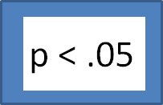
Statistical Significance
Unless otherwise indicated, all reported correlations between variables are statistically significant at the p<.05 level. Null hypothesis testing, used to estimate statistical significance, provides an estimate of the likelihood that the relationship between two indicators is not due to random chance. If the p-value for a given crosstab is less than .05, this suggests that in 95% of cases, the correlation between the relevant variables is because there is a relationship between them.

Slide 16
Discrepancies in Reporting
In some instances, there may be slight differences in estimates reported by the Center for Drug and Health Studies compared to those reported by other state or federal entities for the same data source. In most cases this is due to differing practices in rounding or handling missing observations in the data and does not substantially impact the overall prevalence estimates, trends, and relationships among these data points.
This Photo by Unknown Author is licensed under CC BY-SA
This Photo by Unknown Author is licensed under CC BY-SA

Slide 17
Weighted Data
Weighting data is a correction technique that compensates for nonresponses, helps correct for unequal probabilities of being selected within the sample, and helps ensure that the sample drawn is representative of the Delaware student population. If data is weighted, there will be a notation indicating the data is weighted for the specific fact, figure, or table.

Slide 18
2021 Delaware State Epidemiological Report
An Overview of Key Findings

Slide 19
2021 Delaware State Epidemiological Report Chapter Outline
Specific Focus by Type of Substance Use
Specific Focus by Special Topics and Subgroups
State Demographic Background
Tobacco and Electronic Cigarettes
Alcohol
Marijuana
Opioid Use
Other Illegal Drugs
Infants with Prenatal Substance Exposure
Gambling
Mental Health and Wellness
Persons with Disabilities
Adverse Childhood Experiences (ACEs)
Gender and Sexuality
Protective Factors

Slide 20
Reported Use of Selected Substances in the Past Year among Delaware Students (%) 2020 Delaware School Survey, 8th Grade
State Demographic Overview: A Snapshot of Substance Use
Medication used not as prescribed includes steroids, over-the-counter medication, prescription uppers (diet pills, Ritalin, Concerta, Adderall), downers (Xanax and other benzodiazepines), and painkillers.
Other illegal drugs include ecstasy, hallucinogens, street uppers, inhalants, cocaine, crack, heroin, and synthetic marijuana used to get high.
Center for Drug & Health Studies. (2020). Delaware School Survey: Secondary [Annual Survey]. University of Delaware.
Notes:
Three most common substances used by students in the past year are alcohol, marijuana, and vaping/e-cigarettes. We’ll see in the next slide that vaping has very quickly become popular over the last few years.

Slide 21
Perception of “Great Risk” of Cigarettes vs. Vaping (%) 2020 Delaware School Survey, 8th Grade
Tobacco and Electronic Cigarettes (Vaping)
Center for Drug & Health Studies. (2020). Delaware School Survey: Secondary [Annual Survey]. University of Delaware.
Notes:
The percentage of students reporting that they used a vaping device in the past year more than quadrupled in the 6 years since we started tracking this information on our surveys. Also important to note that the questions we ask about vaping have changed several times in this period.

Slide 22
Trends in Delaware Students’ Self-Reported Past Month Alcohol Use (%) Delaware School Survey, 1999-2020
Alcohol
Center for Drug & Health Studies. (2020). Delaware School Survey: Secondary [Annual Survey]. University of Delaware.
Notes:
Past month alcohol use among high school students has generally declined.

Slide 23
Trends in Delaware Students’ Perception of “Great Risk” in Using Marijuana Regularly (%) Delaware School Survey, 1999-2020
Marijuana
Center for Drug & Health Studies. (2020). Delaware School Survey: Secondary [Annual Survey]. University of Delaware.
Notes:
While we’ve seen decreased in alcohol use, marijuana use has remained relatively stable over time. While that prevalence rate hasn’t changed substantially, the perception of risk among students has consistently gotten lower overtime, decreasing by close to 50%.

Slide 24
Opioids and Prescription Misuse
Trends in People Filling Opioid Prescription in Delaware,
By Prescription Category (rate per 1,000 people)
In 2020, fentanyl was identified in 372 of 447 overdose deaths and 94 involved heroin (Delaware Division of Forensic Science, 2021).
Data collected by the Delaware Prescription Monitoring Program (PMP) and reported on the Delaware Department of Health and Social Services My Healthy Community Data Dashboard.
Delaware Department of Safety and Homeland Security, Division of Forensic Science. (2021). Division of Forensic Science 2020 annual report.
Notes:
Opportunity to talk about limitations of data?
(Delaware Division of Forensic Science, 2021).

Slide 25
Infants with Prenatal Substance Exposure (IPSE)
2020 IPSE Notifications
Plans of Safe Care Prepared (n=653)
In 2020, there were 702 cases of infants with prenatal substance exposure reported in Delaware. POSCs were established for 653 cases with the father identified as a plan participant in 371 of them.
Source: Delaware Infants with Prenatal Substance Exposure 2020 Year in Review, Division of Family Services, State of Delaware, Office of the Child Advocate.
Notes:
Add context about Aiden’s Law and plans of safe care??

Slide 26
Gambling and Substance Use among Delaware Students, Past Year (%) 2020 Delaware School Survey, 8th Grade
Gambling
Approximately half (51%) of Delaware 8th graders report that they gambled at least once in the past year.
**Gambling refers to at least one of the following: played the lottery or scratch-off tickets; bet on fantasy sports; bet on individual sports teams; played Bingo for money; bet on dice games such as craps; bet money on a challenge (dare, fight, street race, etc.); played online gambling games for money; bet on video games; bet on games of personal skill such as pool, darts, or basketball.
Center for Drug & Health Studies. (2020). Delaware School Survey: Secondary [Annual Survey]. University of Delaware.
Notes:
There is a positive correlation between gambling and past month substance use.

Slide 27
Feelings of Anxiety* and Depression** by Gender (%) 2020 Delaware School Survey, 8th Grade
Mental Health and Wellness
*Students are asked if they have felt very nervous or anxious on more than half the days in the past two weeks
**Students are asked if they have been bothered by feeling down, depressed or hopeless on more than half the days in the past two weeks.
Center for Drug & Health Studies. (2020). Delaware School Survey: Secondary [Annual Survey]. University of Delaware.

Slide 28
Behavioral Health among Delaware Adults with Disabilities (%) 2019 Delaware Behavioral Risk Factor Surveillance System (BRFSS)
Persons with Disabilities
 | Adults with Disability | Adults without Disability
Current Smoker | 27.6 | 13.2
Former Smoker | 23.9 | 24.1
Never Smoker | 48.5 | 62.7
Binge drinking in past 30 days | 23.0 | 18.1
Mentally Unhealthy for 14+ days in the past 30 | 36.2 | 8.0
Ever had depression | 41.0 | 13.5
ª Disability is defined in the BRFSS as at least one of the following: serious difficulty hearing; serious difficulty seeing; serious difficulty concentrating, remembering or making decisions due to a physical, mental or emotional condition; serious difficulty walking or climbing stairs; difficulty dressing or bathing; or having difficulty doing errands alone because of a physical, mental, or emotional condition.
Source: 2019 Delaware Behavior Risk Factor Surveillance System. Disability and Health Data System (DHDS), Centers for Disease Control and Prevention.
Notes:
**Add note about disability indicators.

Slide 29
Prevalence of ACEs, aggregated and individual (%) 2020 Delaware School Survey, 8th Grade
Adverse Childhood Experiences
ªStudents who confirmed experiencing any of the following events: homelessness (past 30 days), incarcerated parent (past year), ever seeing/hearing violence between adults at home, ever being hit by an adult who intends to hurt you, being ever hit by another teen who intends to hurt you; ever being bullied at school or in their neighborhood, or have ever lived with a household member who was depressed, mentally ill, or attempted suicide, or lived with someone who had a problem with drinking or drugs, were placed in either the “1 ACE” or “2 ACES” or “3 or More ACEs” category depending on the number of different experiences they reported.
Center for Drug & Health Studies. (2020). Delaware School Survey: Secondary [Annual Survey]. University of Delaware.
Notes:
*Past month substance use.

Slide 30
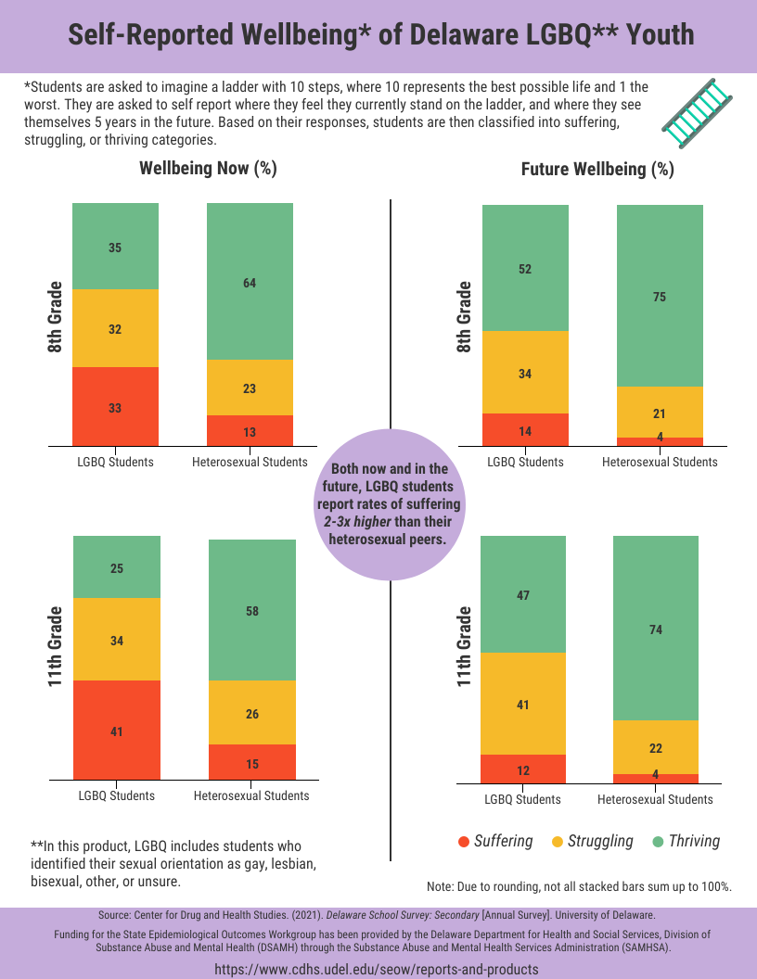
Gender and Sexuality
A peek at new analysis from the 2021 Delaware School Survey not included in this report.

Slide 31
Sources of Support and Encouragement among Students (%) 2020 Delaware School Survey, 8th Grade
Protective Factors
Center for Drug & Health Studies. (2020). Delaware School Survey: Secondary [Annual Survey]. University of Delaware.
Notes:
Add slide from NSCH on family resilience.

Slide 32
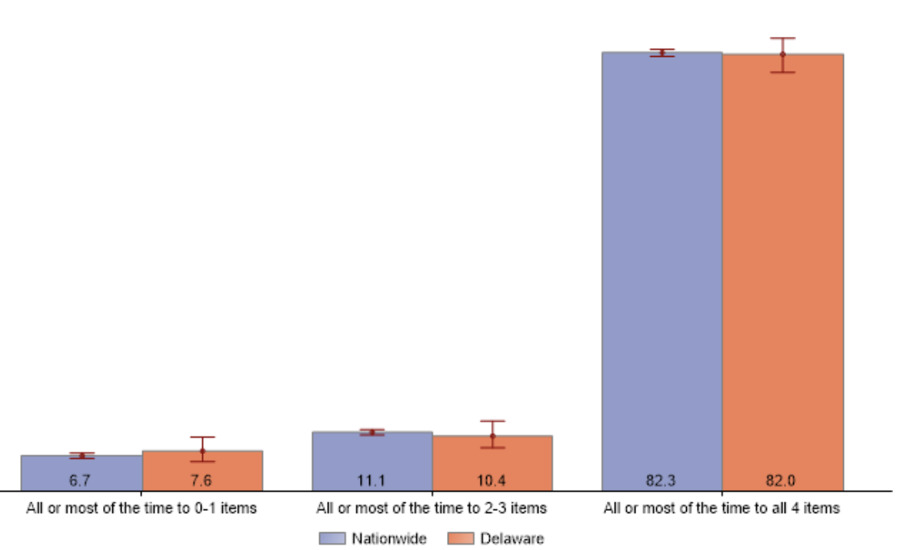
Protective Factors
2018-2019 National Survey of Children’s Health
Family Resilience Composite Measure (%)
Indicator 6.12 Family Resilience: “Does this child live in a home where the family demonstrates qualities of resilience during difficult times.” The composite measure includes four items: “Talk together about what to do; Work together to solve the problem; Know we have strengths to draw upon; Stay hopeful even in difficult times.”
National Survey of Children’s Health, Health Resources and Services Administration, Maternal and Child Health Bureau. https://mchb.hrsa.gov/data/national-surveys.

Slide 33
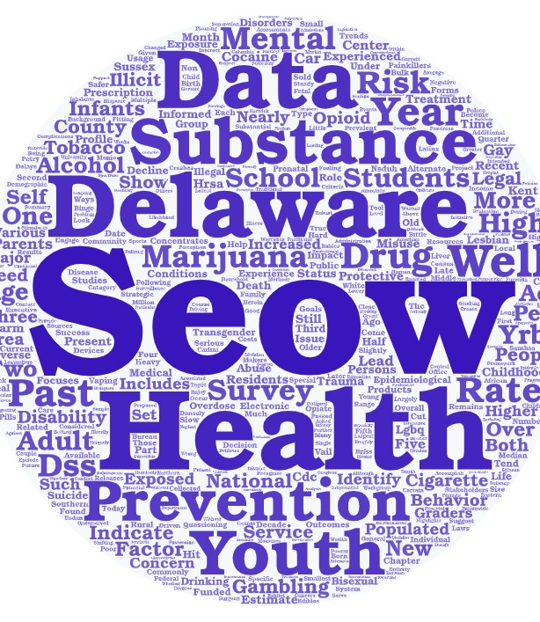
Questions?

Slide 34
For More Information…
Sharon Merriman-Nai smnai@udel.edu
Rachel Ryding rryding@udel.edu
Center for Drug and Health Studies
at the University of Delaware
www.cdhs.udel.edu

Slide 35
Thank You!

