Slide 1
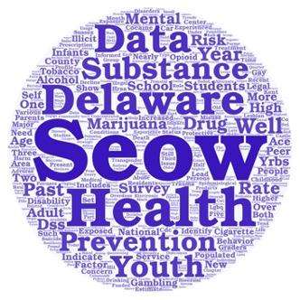
SEOW What? Finding and Using Data to Support Behavioral Health Programs in Delaware
3D: Delaware Data Discourse
Hosted by the State Epidemiological Outcomes Workgroup (SEOW)
Center for Drug and Health Studies of the University of Delaware
June 29th, 2021

Slide 2
Funding for the State Epidemiological Outcomes Workgroup (SEOW) has been provided by the
Delaware Department for Health and Social Services,
Division of Substance Abuse and Mental Health (DSAMH)
through the Substance Abuse and Mental Health Services Administration (SAMHSA).
This webinar is being recorded and will be available for future viewing. Please contact the webinar facilitator if you have any concerns of questions.
The SEOW is facilitated by the
Center for Drug and Health Studies at the University of Delaware.
Visit:
https://www.cdhs.udel.edu/seow/what-is-seow

Slide 3
Today’s Presenters
Dana Holz, PhD Sharon Merriman-Nai, MC Rachel Ryding, PhD

Slide 4
Objectives
Highlight the data resources and technical assistance available through the Delaware State Epidemiological Outcomes Workgroup (SEOW) to support behavioral health initiatives in Delaware
Identify available national and Delaware-specific data sources that can be used to strengthen local program planning, implementation, and evaluation

Slide 5
Delaware State Epidemiological Outcomes Workgroup

Slide 6
The 4 Goals of the SEOW
Identify, Analyze, and Share Data
Create Data Products
Train Communities in Understanding and Using Data
Build State and Local Level Monitoring Systems

Slide 7
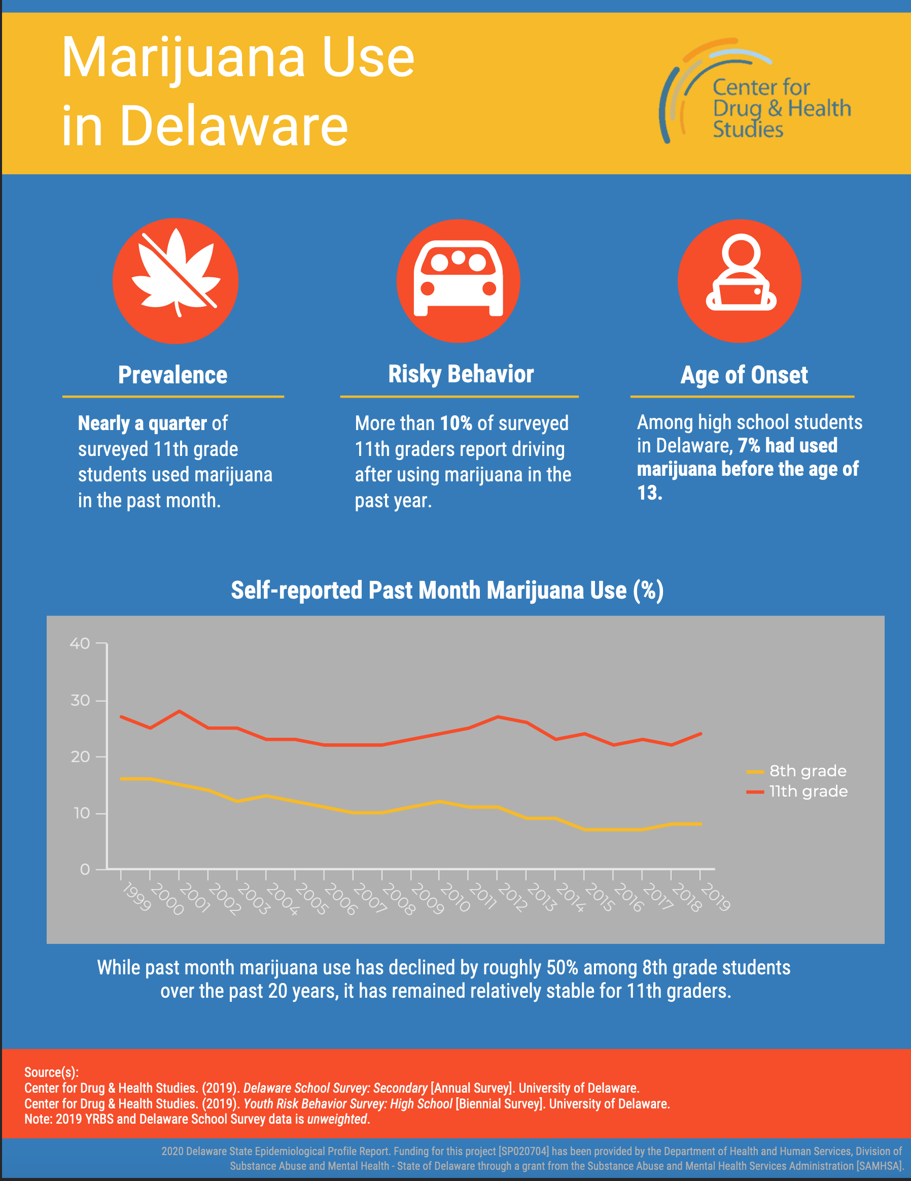
SEOW Data Products
Annual Delaware epidemiological profile
Gap reports
Infographics
Venn Diagrams of shared risk and protective factors
Presentations and recordings

Slide 8
Support the SEOW can provide
Data presentations
Data points for media or public awareness campaigns
Technical assistance on finding and utilizing data for prevention planning and evaluation
Center for Drug and Health Studies data analysis assistance as requested

Slide 9
Participant Question: Which of these houses represents your comfort level with data?

Slide 10
How do you use data in your work?
Needs assessment
Grant applications
Program planning
Documenting success
Evaluation
Other?

Slide 11
Navigating the SEOW Website at CDHS
https://www.cdhs.udel.edu/seow/what-is-seow

Slide 12
News in the areas of health,
substance use, violence,
criminal justice
Resources for data,
treatment, communities,
agencies, and coalitions

Slide 13
Data Sources Used in the Annual Delaware Epidemiological Profile (“The Epi”)
Data Instrument | Administered/Compiled by
Delaware Annual Traffic Statistical Report | Delaware State Police/Delaware Statistical and Analysis Center
Delaware Behavioral Risk Factor Surveillance System (BRFSS) | DE Division of Public Health (sponsored by the CDC)
Delaware Prescription Monitoring Program (PMP) | DE Department of State, Division of Professional Regulation
Delaware School Survey (DSS) – 5th, 8th, and 11th grades | Center for Drug and Health Studies, UD
Delaware Youth Risk Behavior Survey (YRBS) – Middle School | Center for Drug and Health Studies, UD (sponsored by Nemours)
Delaware Youth Tobacco Survey – 6th – 12th grades | Center for Drug and Health Studies, UD (sponsored by DE Division of Public Health)
Monitoring the Future – 8th, 10th, and 12th grades | University of Michigan (sponsored by the National Institute on Drug Abuse)
National High School Youth Risk Behavior Survey | US Centers for Disease Control
Performance Measures, Delaware | National Highway Safety Administration
National Survey on Children’s Health (NSCH) | US Health Resources & Services Administration
National Survey on Drug Use and Health (NSDUH) | US Substance Abuse and Mental Health Services Administration
Substance-Exposed Infant Program | Office of the Child Advocate
Treatment Admissions Data | US Substance Abuse and Mental Health Services Administration, collected by Delaware Division of Substance Abuse and Mental Health
Additional Data Sources
America’s Health Rankings
Bureau of Labor Statistics
Centers for Disease Control and Prevention
Delaware Department of Education
Delaware Department of Safety and Homeland Security,
Division of Forensic Science
Delaware Health Tracker
Delaware Household Health Survey
Drug Enforcement Administration
Health Resources and Services Administration
KIDS COUNT in Delaware
National Center for Health Statistics
National Conference of State Legislatures
National Institute on Drug Abuse
National Institute on Mental Health
RTI International
State of Delaware Economic Development Office
The Trevor Project
U.S. Census Bureau

Slide 14
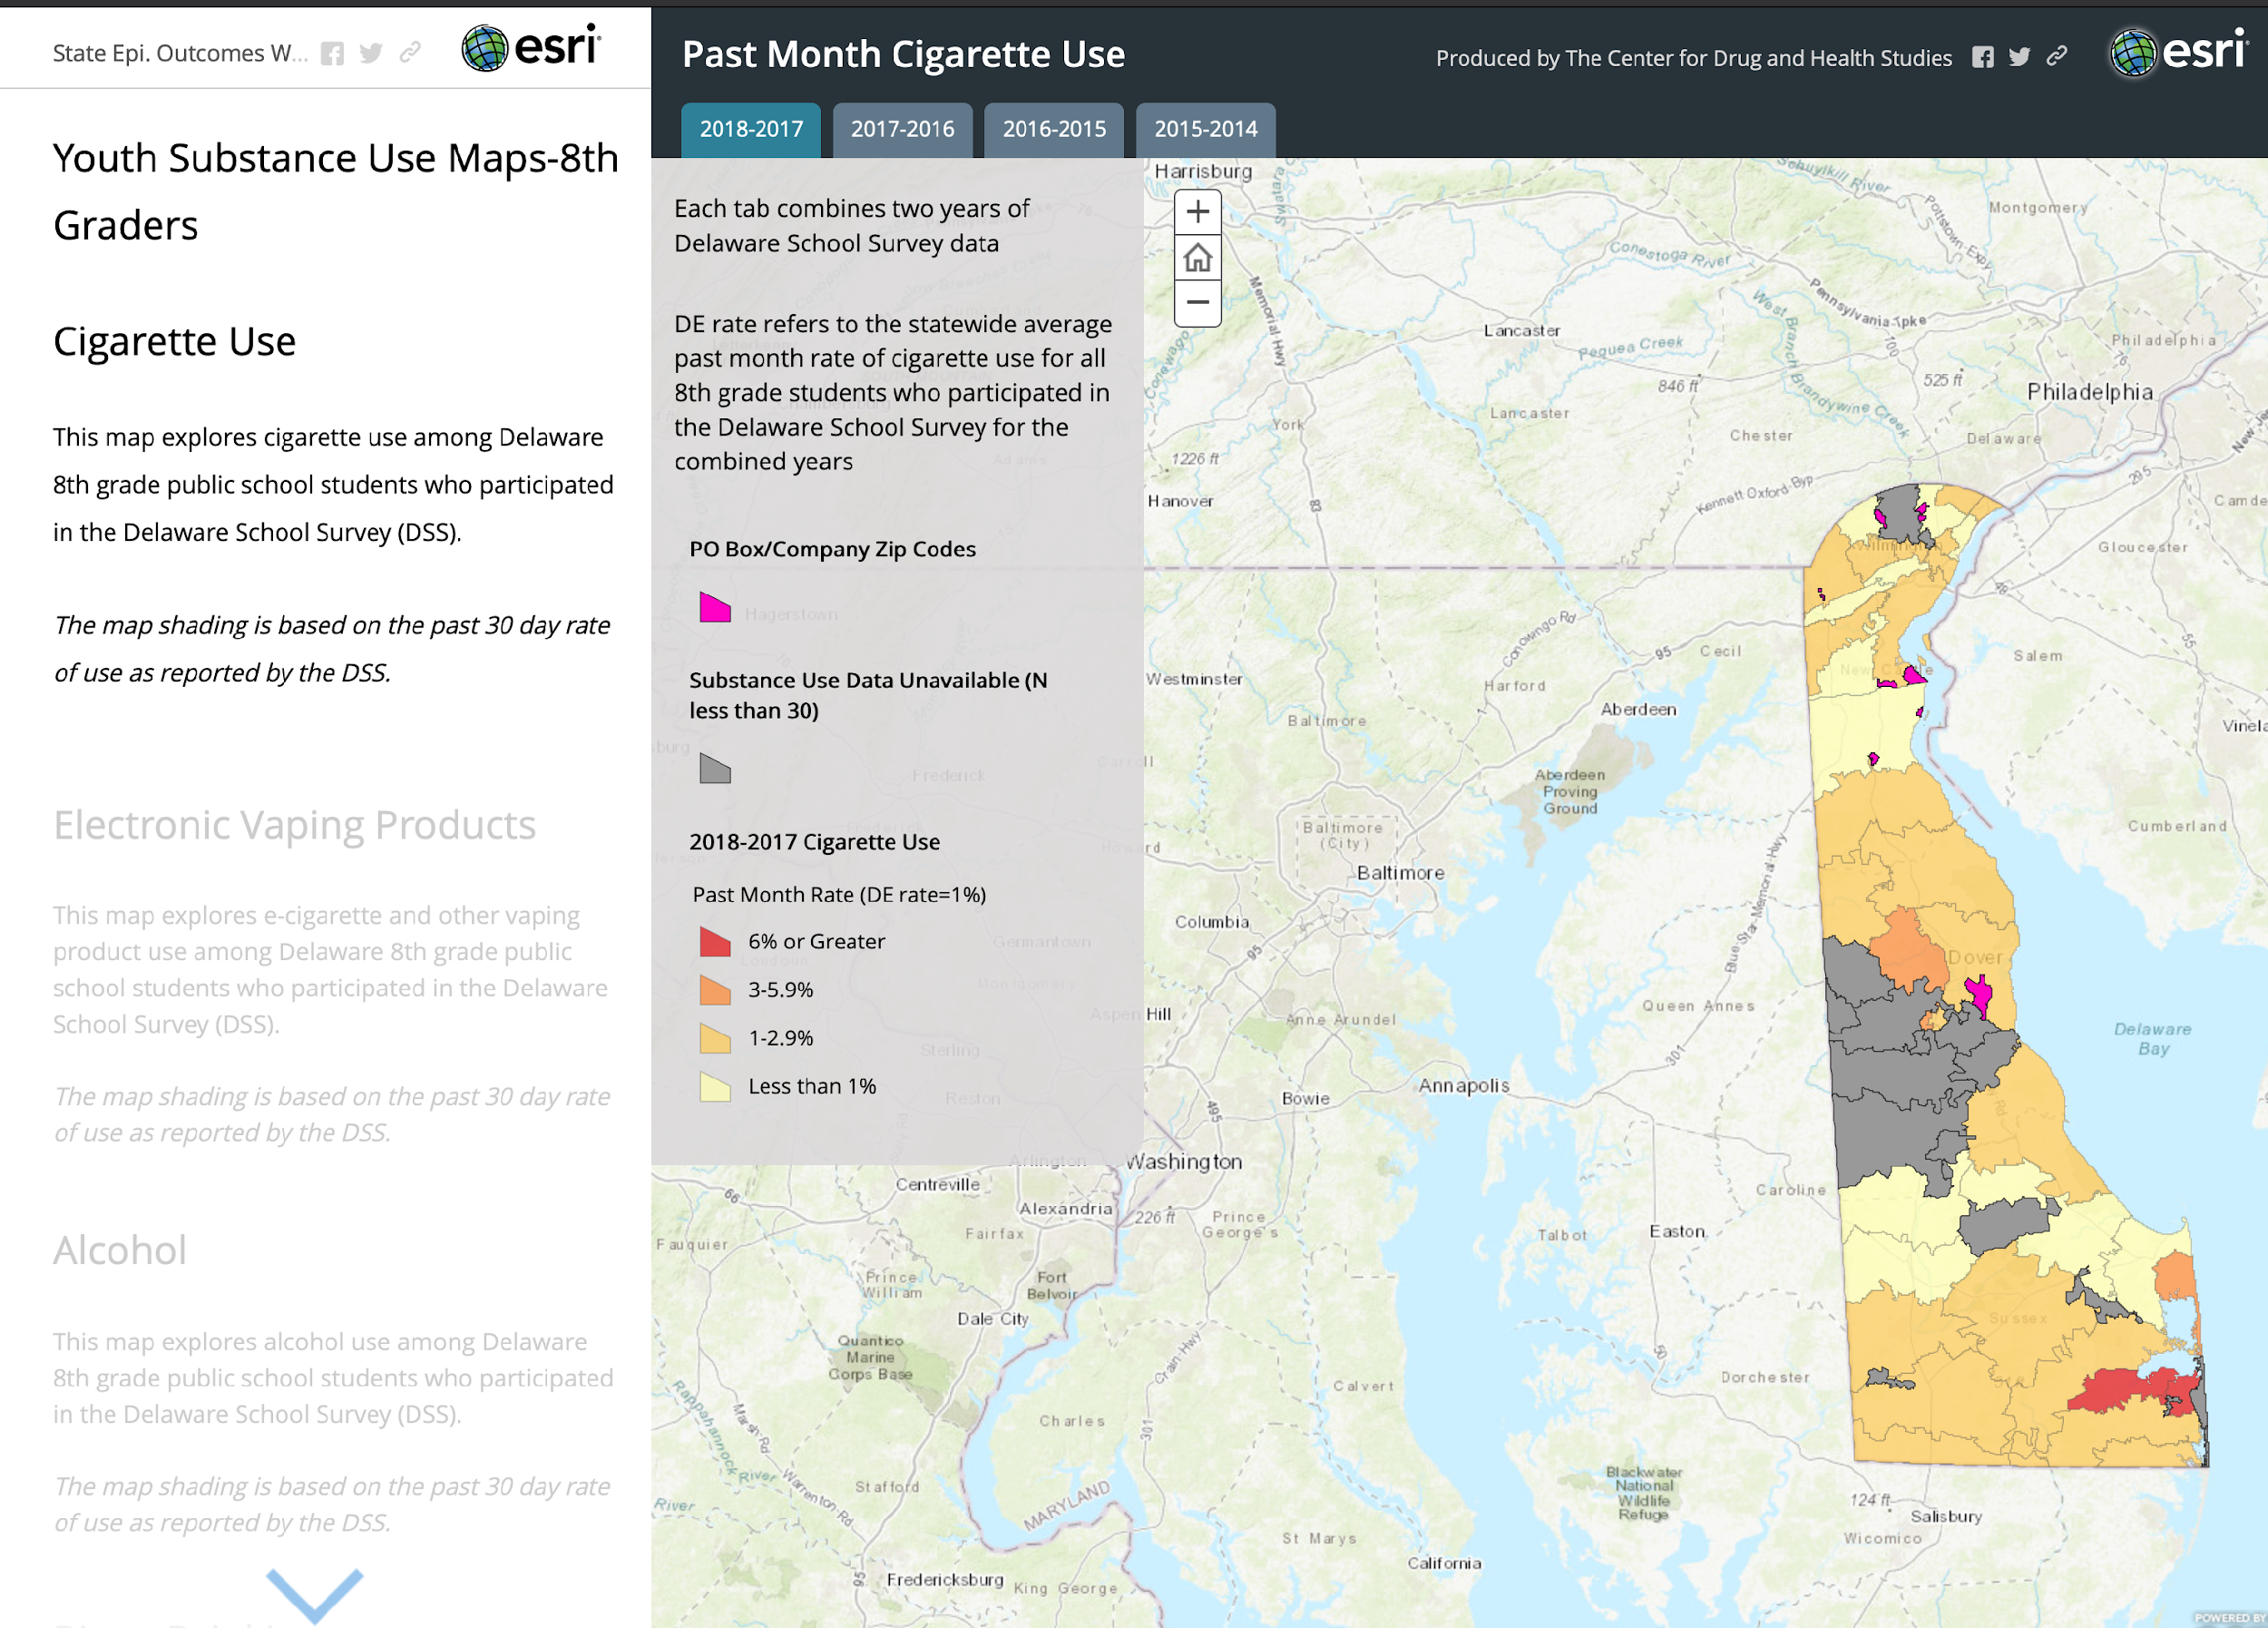
Interactive Heat Maps

Slide 15
Select National Data Sources
America’s Health Rankings
Behavioral Risk Factor Surveillance System (BRFSS)
Monitoring the Future
National Survey on Drug Use and Health (NSDUH)
National Survey of Children’s Health
National Youth Risk Behavior Survey (YRBS)
Policy Map
Substance Abuse and Mental Health Data Archive (SAMHDA)
U.S. Census

Slide 16
Featured Delaware Data Sources
Delaware School Survey
Delaware Behavioral Risk Fact Surveillance System (BRFSS)
Delaware Division of Public Health
KIDS COUNT in Delaware (Data Center)
My Healthy Community Data Portal

Slide 17
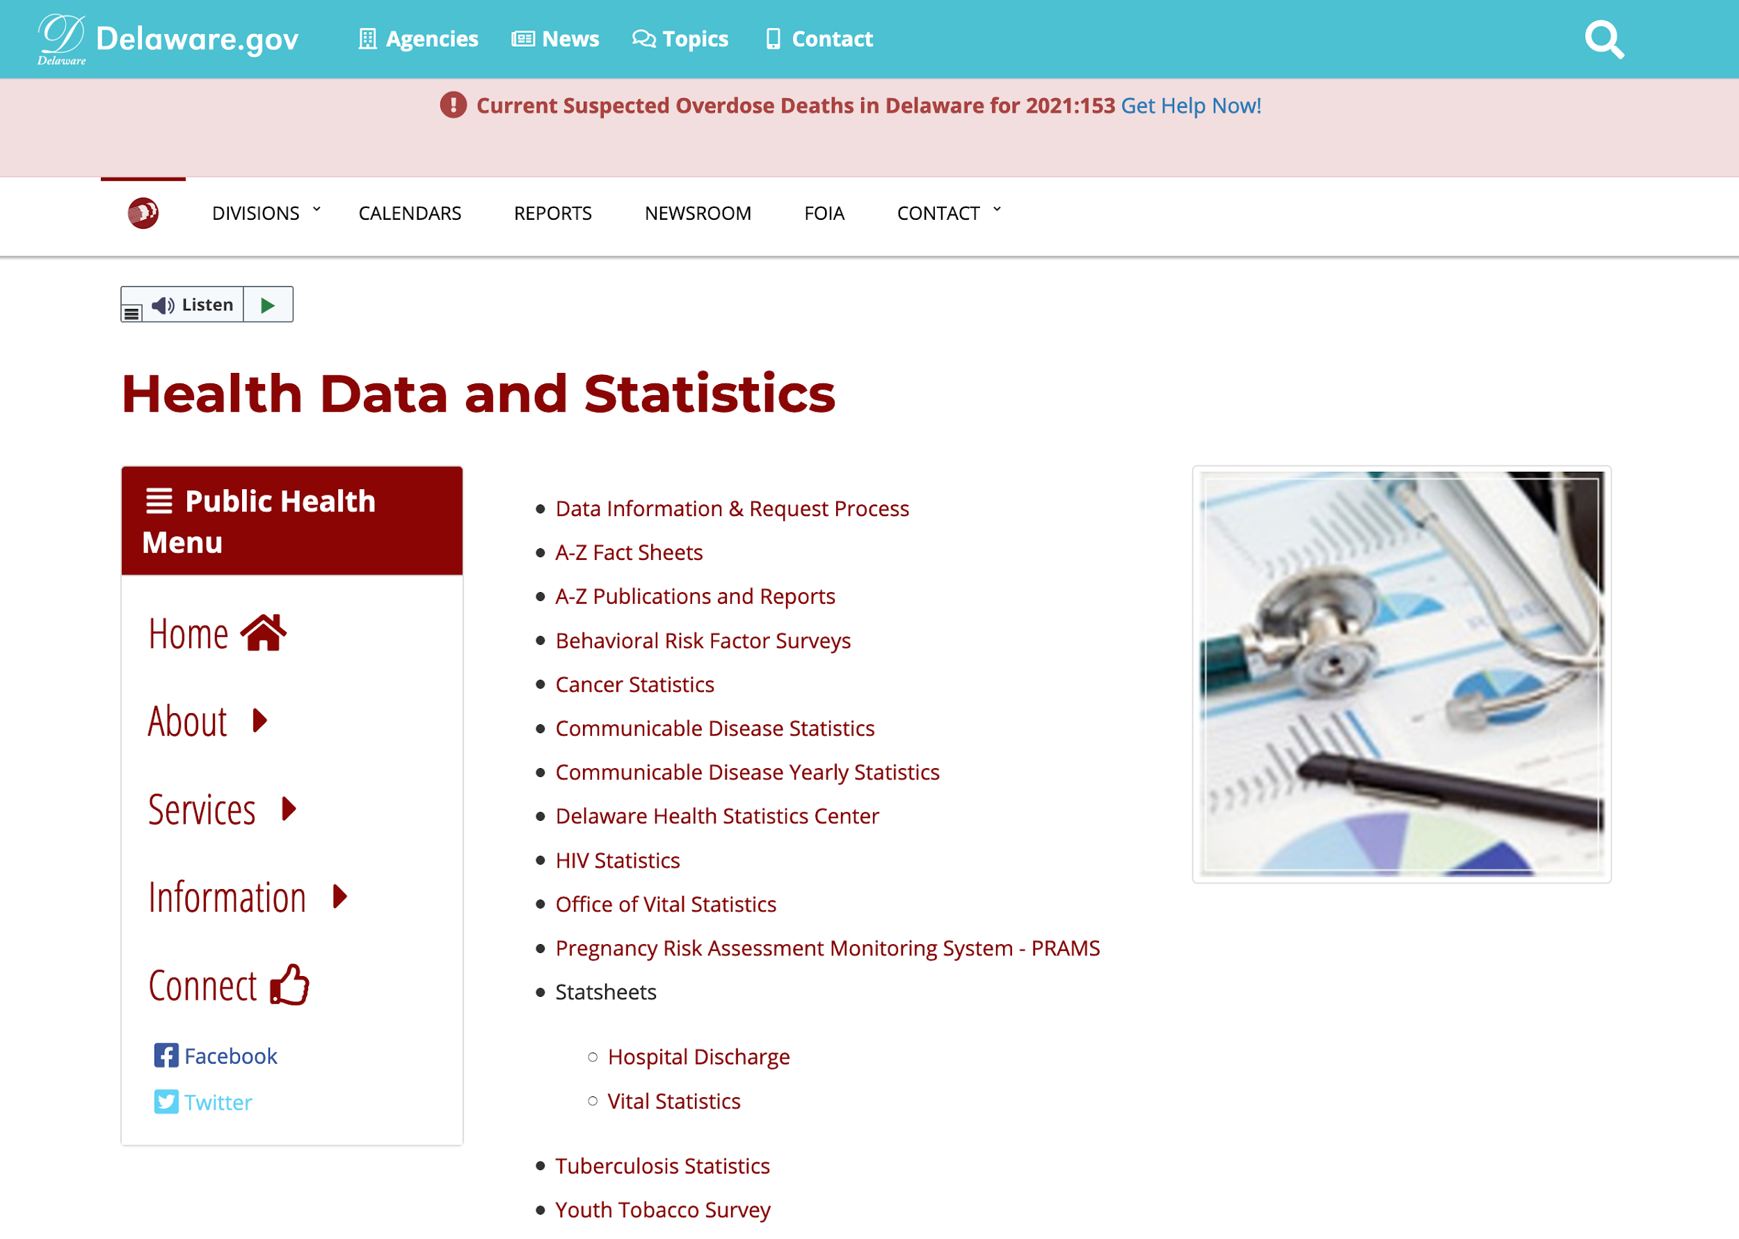
Data from the Division of Public Health

Slide 18
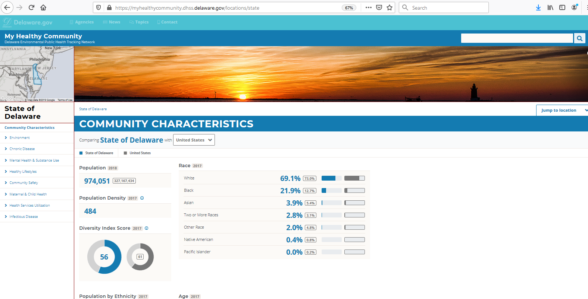
Notes:
It will start by bringing up some very basic statistics around the population and demographics of the state overall. This is just the top of the report that you’ll see, scrolling down will show you other indicators related to life expectancy, income, education etc. And throughout the site, it will try to shown you a comparison to some other area. The default at the state level is comparing Delaware to the United States as a whole, but you can also select areas to compare within Delaware.

Slide 19
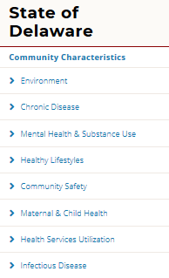
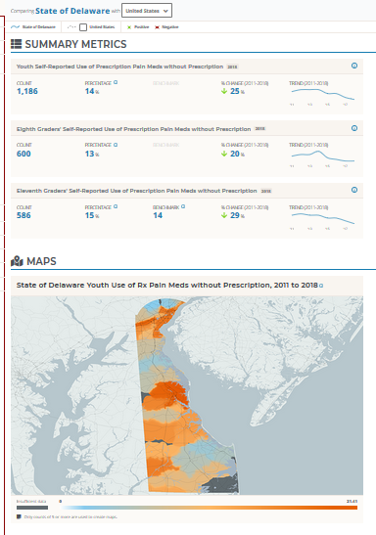
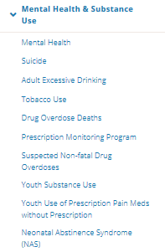
Notes:
In order to look at data on a particular topic, such as mental health & substance use, the menu on the leftmost side of the screen is your starting point. You can simply click through the options, to get more granular data on what you’re interested in. Here, for example, if we click through to view Youth use of prescription pain meds without a prescription, you’ll be taken to a report that not only shows you statewide statistics and also a map of how data differs throughout the state. You can see that this data is fairly up to date, including data up through 2018.

Slide 20
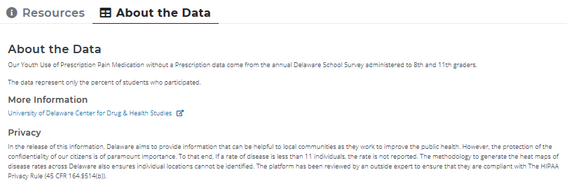
Additional Resources & Data Sources
Notes:
If you scroll down to the bottom of the page, you’ll see an option to access additional resources and learn about the source of the data which is always a good thing to know. Each topic on the site should have information about the root source of the data.

Slide 21
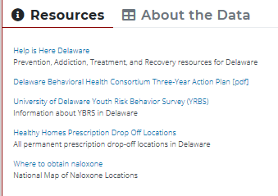
Additional Resources & Data Sources
Notes:
And under Resources, you can see links to various pieces of information that you could utilize or share for people with concerns on the topic of interest. So logically in this case, with regard to youth use of prescription pain medication without a prescription, sites like “Help is Here” or more information about the school survey or safe disposal of prescription medications could be useful.

Slide 22
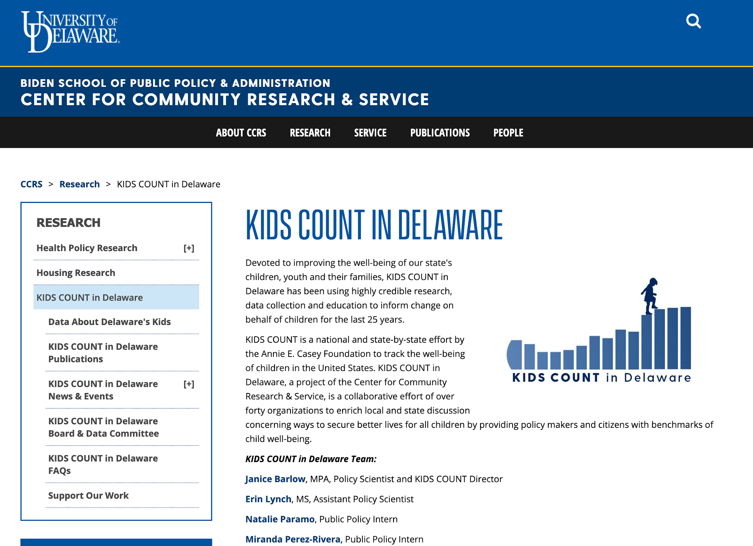

Slide 23
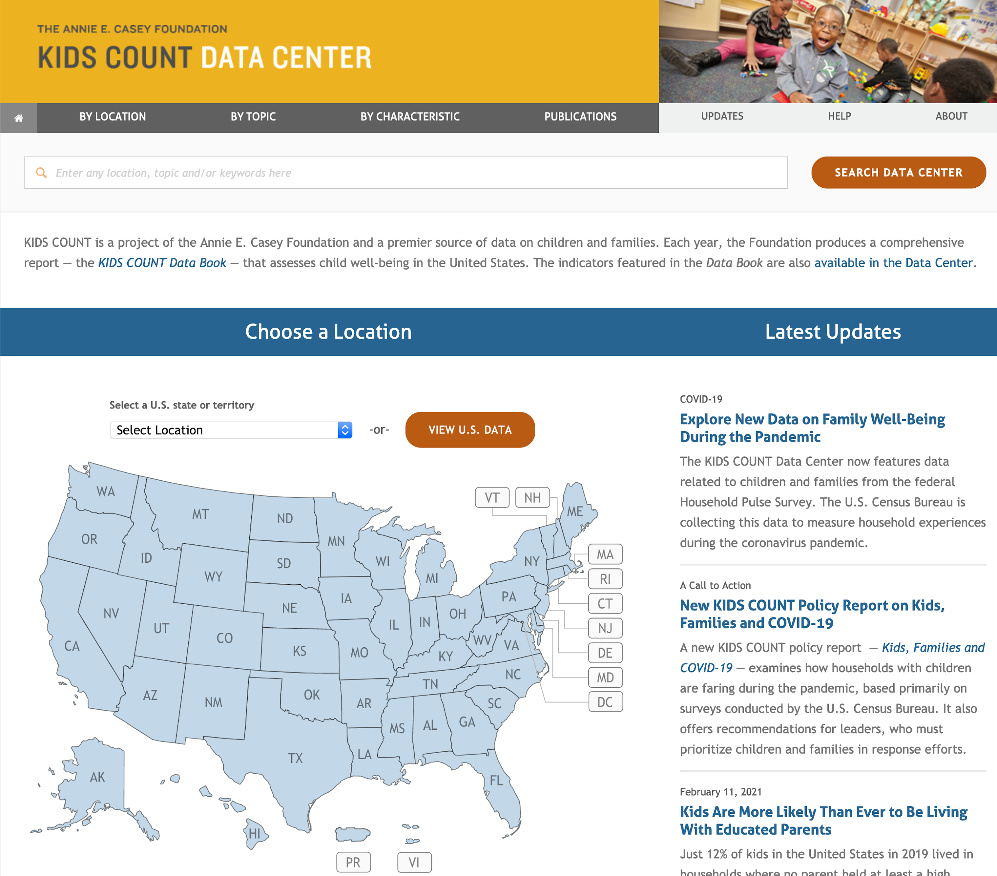

Slide 24
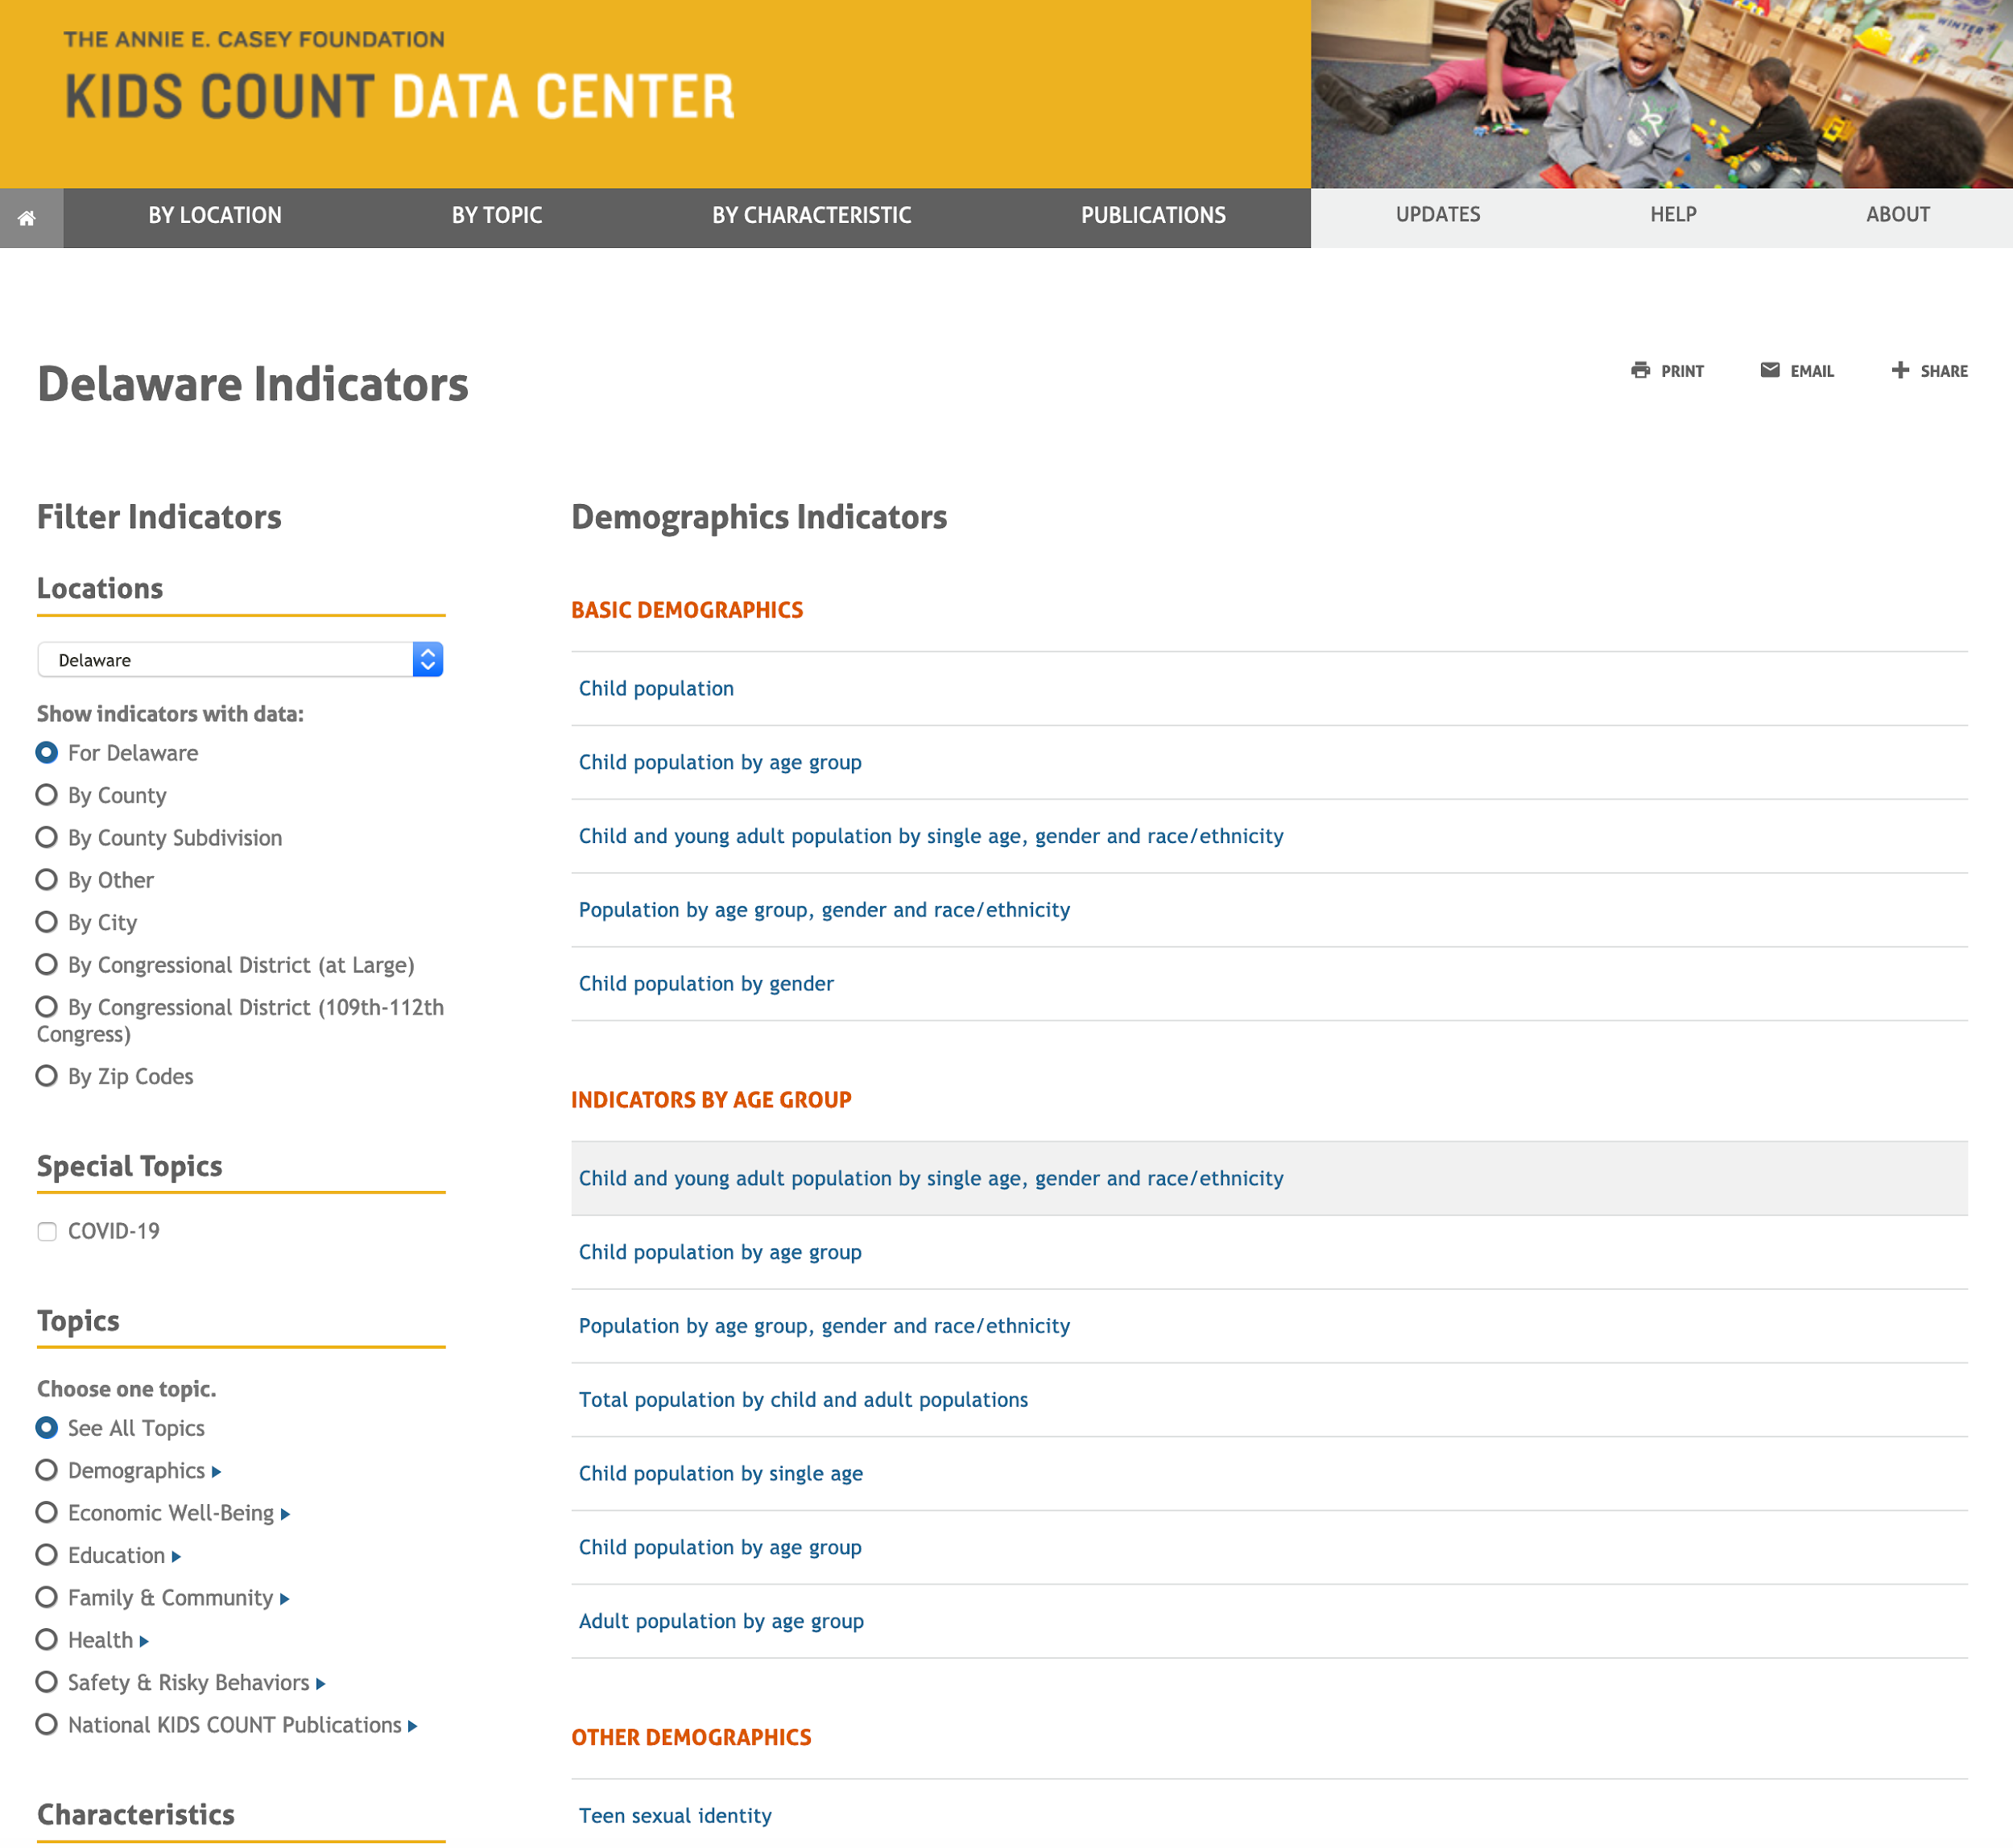

Slide 25
Your Turn:
Breakout Room Activity: Data Scavenger Hunt
Find the data!! Each group has a data problem to solve. Your team will work to identify relevant data sources to answer the question.

Slide 26
Questions?

Slide 27
Wrapping up:
Data is critical to document behavioral health needs, plan and implement programs, and evaluate their impact.
The SEOW provides tools and services to support these efforts.
For more information, visit the SEOW website!

Slide 28
Final question…
Please share in the chat one way you think you will use something you learned today in your work in the next three months.

Slide 29
Data Resource Weblinks
State Epidemiological Outcomes Workgroup | https://www.cdhs.udel.edu/seow/what-is-seow
America’s Health Rankings | https://www.americashealthrankings.org/
Behavioral Health Risk Factor Surveillance System (national) | https://www.cdc.gov/brfss/brfssprevalence/index.html
Delaware Behavioral Risk Factor Surveillance System (BRFSS) | https://www.dhss.delaware.gov/dhss/dph/dpc/brfsurveys.html
Delaware School Survey (DSS) | https://www.cdhs.udel.edu/seow/school-surveys/delaware-school-survey-(dss)
Delaware Division of Public Health | https://www.dhss.delaware.gov/dhss/dph/healthdatastats.html
KIDS COUNT in Delaware | https://www.bidenschool.udel.edu/ccrs/research/kids-count-in-delaware
KIDS COUNT National Data Center | https://datacenter.kidscount.org/
Monitoring the Future (Survey) | https://www.drugabuse.gov/drug-topics/trends-statistics/monitoring-future
National Survey of Children’s Health (NSCH) | https://www.childhealthdata.org/
National Survey of Drug Use and Health (NSDUH) | https://nsduhweb.rti.org/respweb/homepage.cfm
National Youth Risk Behavior Survey (YRBS) | https://www.cdc.gov/healthyyouth/data/yrbs/index.htm
Policy Map | https://www.policymap.com/
Substance Abuse and Mental Health Data Archive (SAMHDA) | https://pdas.samhsa.gov/#/
U.S. Census | https://www.census.gov/data.html

Slide 30
For More Information…
Dana Holz danaholz@udel.edu
Sharon Merriman-Nai smnai@udel.edu
Rachel Ryding rryding@udel.edu
Center for Drug and Health Studies
at the University of Delaware
www.cdhs.udel.edu

Slide 31
Thank You!
Please take a moment to share your feedback on this presentation:
SEOW Evaluation Form
Notes:
Also enter into the chat: https://delaware.ca1.qualtrics.com/jfe/form/SV_2nHrqtuX8wZVPnw

