Slide 1


Slide 2
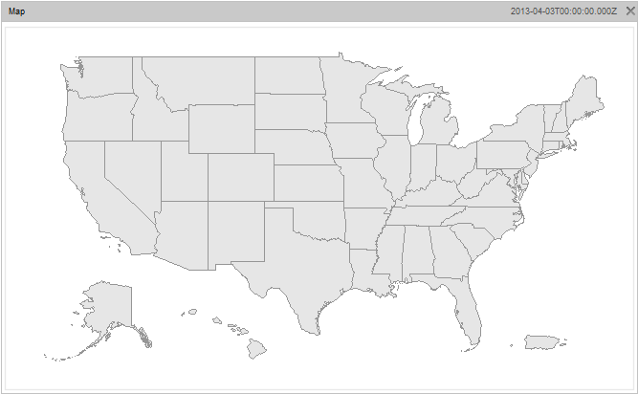





















































STATE KIDS COUNT NETWORK

Slide 3
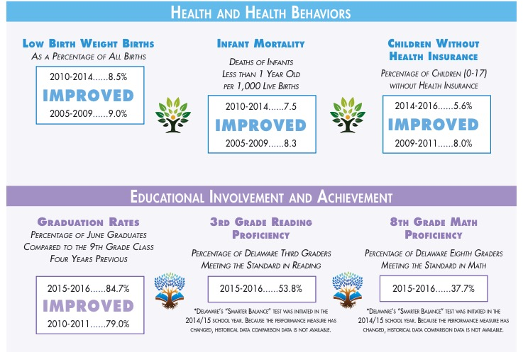

Slide 4
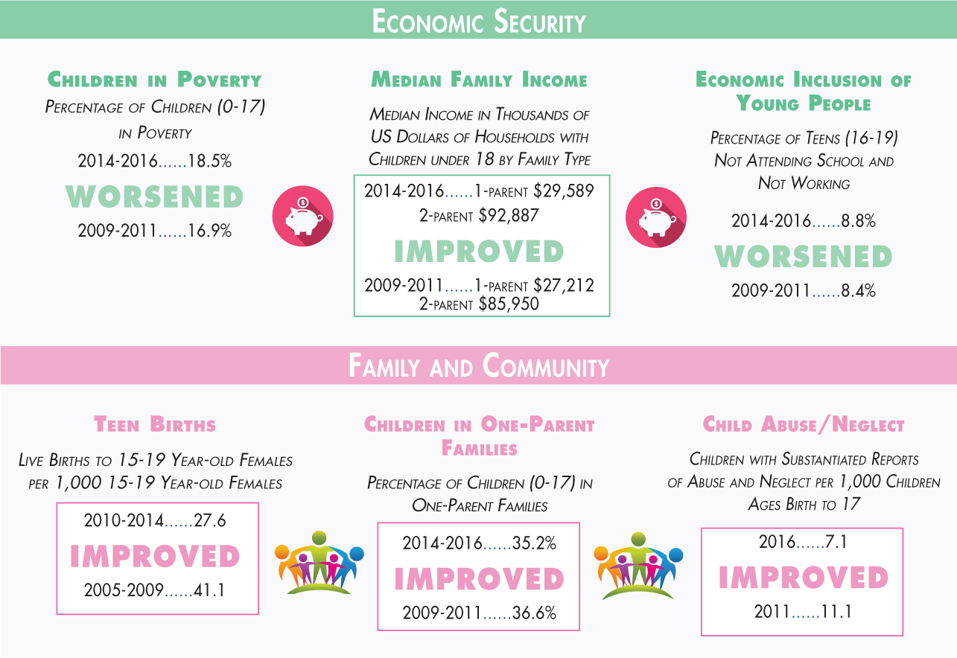

Slide 9


Slide 11


Slide 13


Slide 14


Slide 17

2010
$19,337
Nineteen thousand three hundred thirty seven and 00/100
Family of 3 (1 parent, 2 children)

