Slide 1
Lesbian, Gay, Bisexual, and Questioning (LGBQ) Youth in Delaware:
Data from the
2017 Youth Risk Behavior Survey
a presentation to the
Nemours Pride Associate Resource Group
January 15, 2019
Prepared by the: University of Delaware
Center for Drug and Health Studies on behalf of the
Strategic Prevention Framework – Partnerships for Success Project

Slide 2
The State Epidemiological Outcomes Workgroup

Slide 3
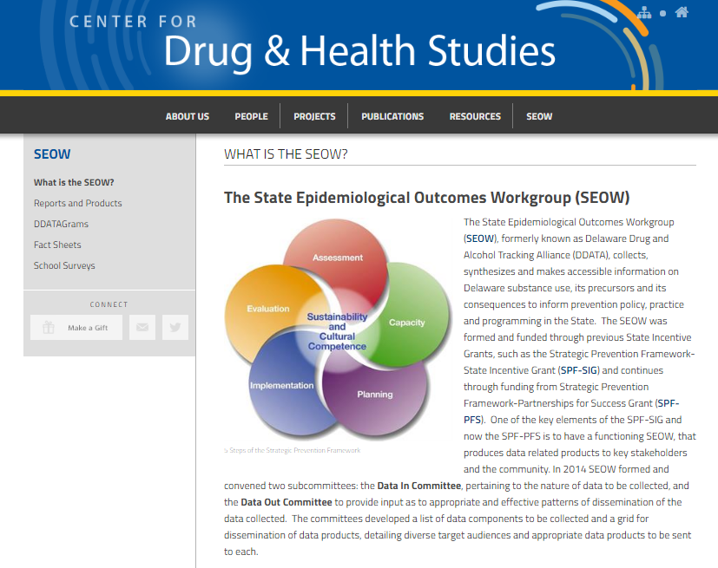
The Delaware SEOW
The SEOW collects, synthesizes, and promotes the use of information on Delaware substance use, its precursors and its consequences to inform prevention policy, practice and programming in the state.
The SEOW is convened by the Center for Drug and Health Studies at the University of Delaware on behalf of DSAMH and the Strategic Prevention Framework – Partnerships for Success. Many data products are available online.
www.cdhs.udel.edu/seow
Notes:
Goals: disseminate data, getting data into the community, long-term surveillance
Identify populations vulnerable to behavioral health disparities within identified high-need communities, and the specific disparities experienced by these populations. Housed within/facilitated by CDHS.
The Center for Drug and Health Studies – holds the data, houses the SEOW (evaluation and epidemiology come out of CDHS) Two functions: Surveys & SEOW. Affiliated with the Department of Sociology and Criminal Justice at UD.
The Center for Drug and Health Studies (CDHS) facilitates collaborative and engaging primary research on substance abuse, health risk behavior, health services, and health policy among social and behavioral science faculty, professional staff, and graduate students. Administratively housed in the University’s Department of Sociology and Criminal Justice.
Delaware School Survey: 2015 Delaware School Survey which provides State and County level data on substance abuse, perceptions of risk, and school environment indicators for 5th, 8th, and 11th grade public school students. This includes data for the 2015 survey as well as trends data through 2015.
Delaware State Evaluation Team as a resource!
For a broader range of indicators that may signal communities that experience health disparities, check out two publications, both of which the Evaluation Team helped provide the data for:
An Overview of Poverty in Delaware http://www.ccrs.udel.edu/sites/ccrs.udel.edu/files/Overview%20of%20Poverty%20in%20Delaware%20Brief%20Updated%2010-2015%20%283%29.pdf
(provides some local level data on child and elder poverty in the state, along with statewide data and comparisons to regional and national data)
Kids Count in Delaware Families Count in Delaware
Fact Book 2015 http://www.ccrs.udel.edu/sites/ccrs.udel.edu/files/KCDE2015-reduced_1.pdf
This annual publication provides a comprehensive profile of the status of children and families in Delaware along sixteen indicators. As you review Kids Count DE 2015, you may find the following of particular interest (please note these refer to PDF page numbers and not publication page numbers)
National School Lunch and School Breakfast Programs in DE: p73 shows Community Eligibility Provision (CEP) for school breakfast and lunch programs: if a school has a designated student percentage of at least 40, the school is eligible for
Children in Poverty (pp104-108) GIS map; data tables on page 218 (table 98), 221 (table 99)
Children in one-parent households (pp112-113)
Adult HS drop outs by census tracts in NCC (p86: GIS map)
Adult HS drop outs by census tracts in Kent and Sussex Counties (p87: GIS map)
SEOW - Helping people conduct data collection, analyze and interpret data, disseminate data to community partners
SEOW can offer training and Technical Assistance on data collection, literacy, dissemination

Slide 4
Measuring Youth Behavior and Experiences
Survey | Schedule | Who Participates
Delaware School Survey | Annually - Spring semester | Census of 5th, 8th, 11th grade students
Youth Risk Behavior Survey | Every other odd-numbered year – Spring semester | Random sample of classrooms within census of public middle* and high schools
Youth Tobacco Survey | Every other eve-numbered year – Spring semester | Random sample of classrooms within census of public middle and high schools
School Health Profiles | Every other even-numbered year – Spring | Principals and lead health educators
College Risk Behavior Survey | Annually – Spring Semester | Random sample of college students

Slide 5
Are LGBQ Youth at
Greater Risk than Other Students?

Slide 6
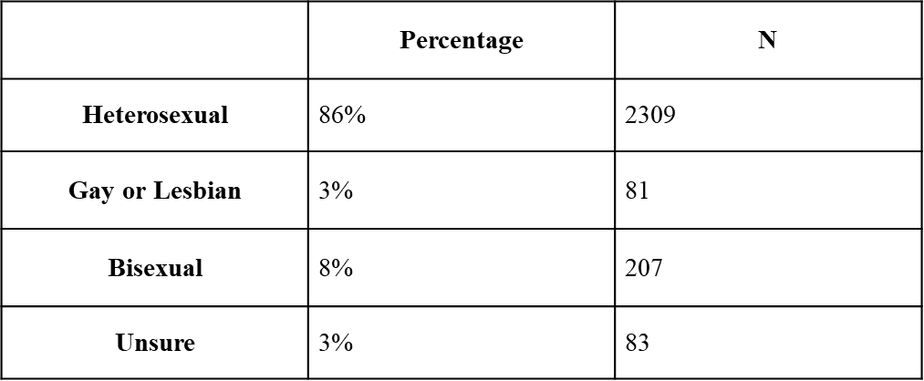
Lesbian, Gay, Bisexual, and Questioning Youth Reported sexual orientation of Delaware High School Youth
Source: “2017 Delaware Youth Risk Behavior Survey (YRBS).” Centers for Disease Control and Prevention (Administered by the Center for Drug and Health Studies, University of Delaware).
Notes:
Table copied as image (cannot be altered)

Slide 7
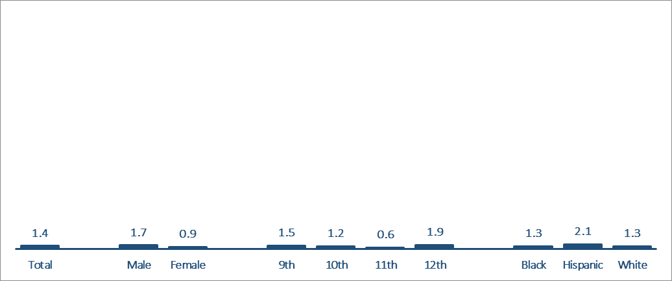
Transgender Youth Percentage of high school students who report they are transgender
Note: Weighted data
Source: “2017 Delaware Youth Risk Behavior Survey (YRBS).” Centers for Disease Control and Prevention (Administered by the Center for Drug and Health Studies, University of Delaware).
Notes:
Table copied as image (cannot be altered)

Slide 8
Substance Use

Slide 9
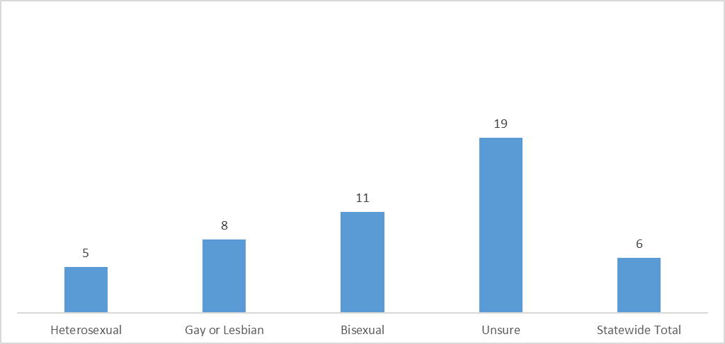
LGBQ Youth – Cigarettes Percentage of high school students who reported smoking cigarettes on one or more of the past 30 days (in percentages)
Source: “2017 Delaware Youth Risk Behavior Survey (YRBS).” Centers for Disease Control and Prevention (Administered by the Center for Drug and Health Studies, University of Delaware).
Notes:
Table copied as image (cannot be altered)

Slide 10
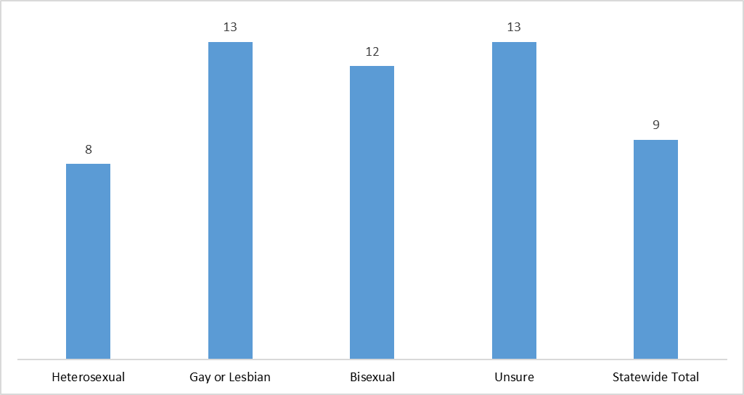
LGBQ Youth – Cigarettes Percentages of high school students who smoked a whole cigarette for the first time before age 13
Source: “2017 Delaware Youth Risk Behavior Survey (YRBS).” Centers for Disease Control and Prevention (Administered by the Center for Drug and Health Studies, University of Delaware).
Notes:
Table copied as image (cannot be altered)

Slide 11
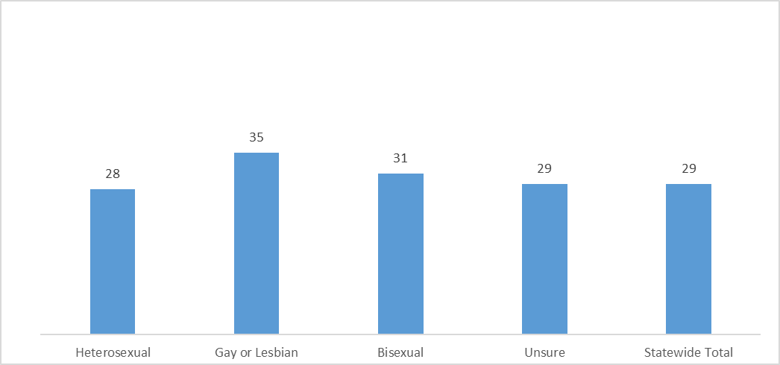
LGBQ Youth – Drinking Percentage of high school students who reported having at least one drink of alcohol on one or more of the past 30 days (in percentages)
Source: “2017 Delaware Youth Risk Behavior Survey (YRBS).” Centers for Disease Control and Prevention (Administered by the Center for Drug and Health Studies, University of Delaware).
Notes:
Table copied as image (cannot be altered)

Slide 12
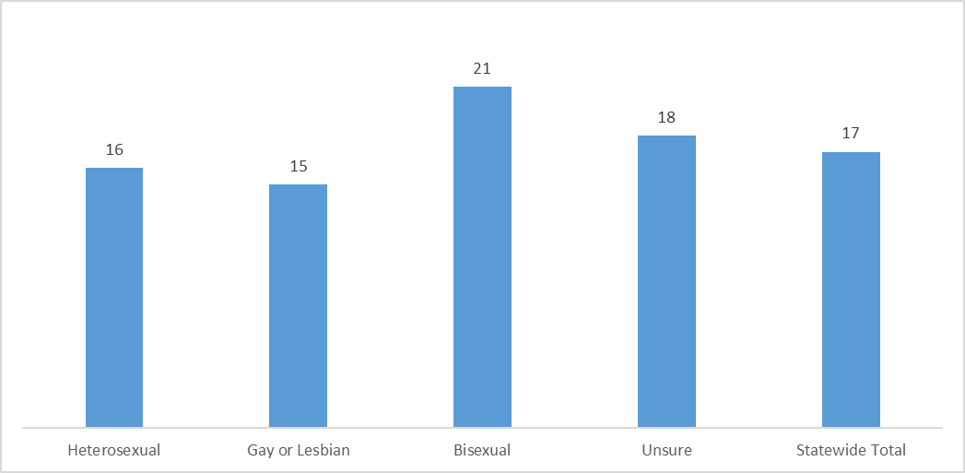
LGBQ Youth – Drinking Percentage of Students who had alcohol before age 13
Source: “2017 Delaware Youth Risk Behavior Survey (YRBS).” Centers for Disease Control and Prevention (Administered by the Center for Drug and Health Studies, University of Delaware).
Notes:
Table copied as image (cannot be altered)

Slide 13
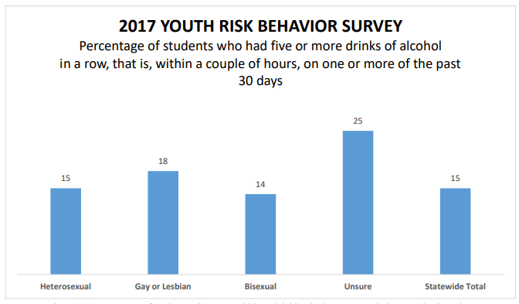
Note: Unweighted
Data Source: “2017 Delaware Youth Risk Behavior Survey (YRBS).” Centers for Disease Control and Prevention (Administered by the Center for Drug and Health Studies, University of Delaware).

Slide 14
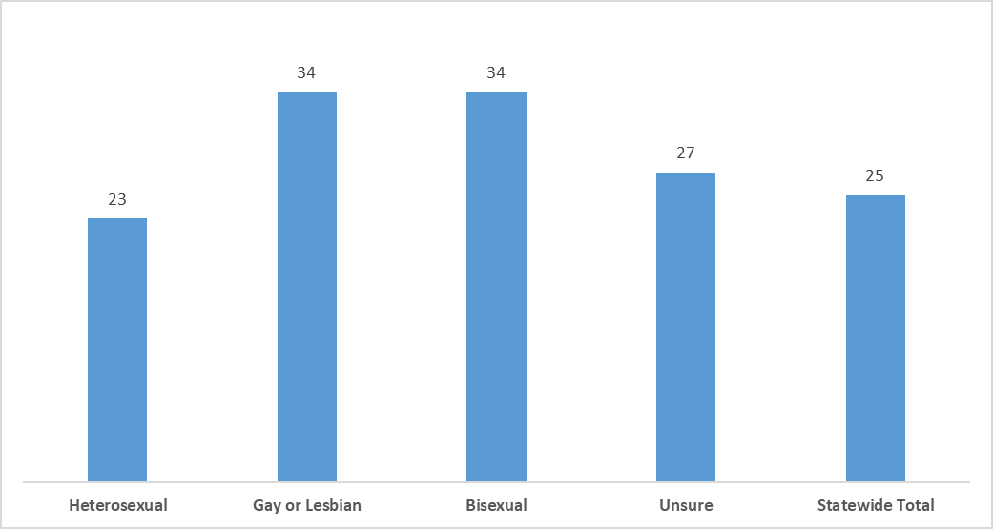
LGBQ Youth – Marijuana Percentage of high school students who reported using marijuana one or more times during the past 30 days
Source: “2017 Delaware Youth Risk Behavior Survey (YRBS).” Centers for Disease Control and Prevention (Administered by the Center for Drug and Health Studies, University of Delaware).
Notes:
Table copied as image (cannot be altered)

Slide 15
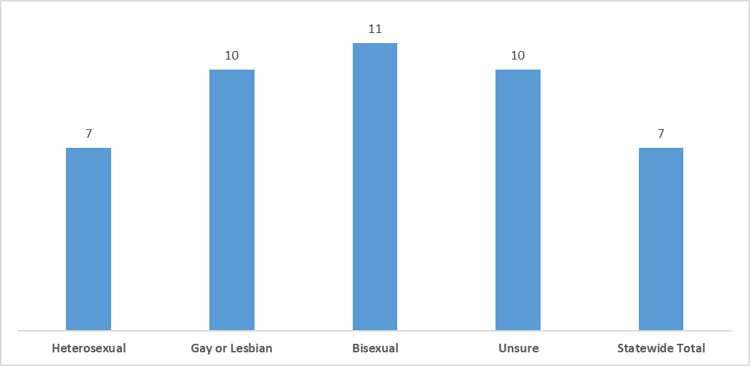
LGBQ Youth – Marijuana Percentage of high school students who reported smoking marijuana before age 13
Source: “2017 Delaware Youth Risk Behavior Survey (YRBS).” Centers for Disease Control and Prevention (Administered by the Center for Drug and Health Studies, University of Delaware).
Notes:
Table copied as image (cannot be altered)

Slide 16
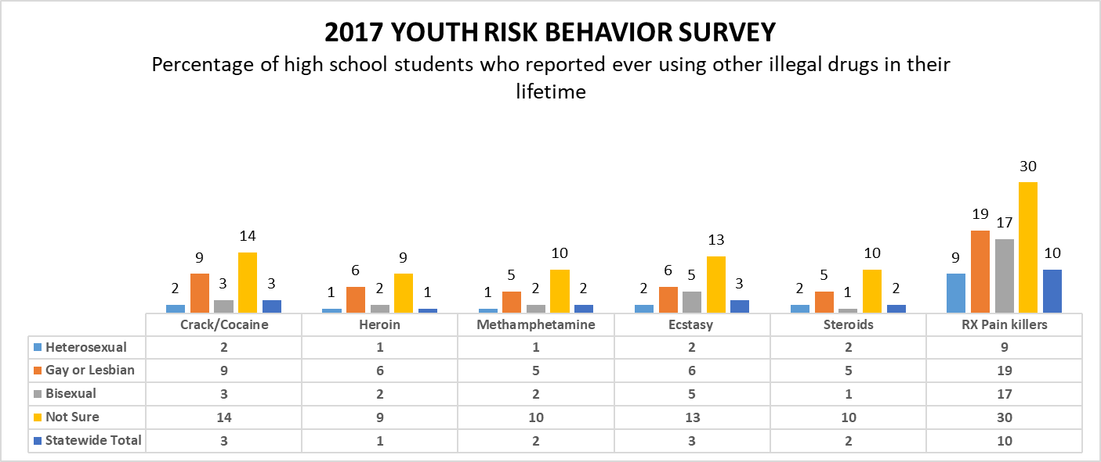
LGBQ Youth – Other Illegal Drugs Percentage of high school students who reported ever using other illegal drugs in their lifetime
Source: “2017 Delaware Youth Risk Behavior Survey (YRBS).” Centers for Disease Control and Prevention (Administered by the Center for Drug and Health Studies, University of Delaware).
Notes:
Table copied as image (cannot be altered)

Slide 17
Sexual Behavior

Slide 18
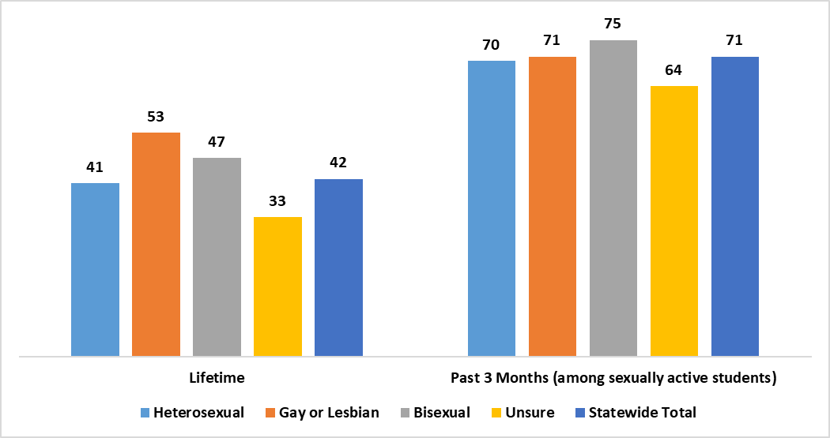
LGBQ Youth – Sexual Activity Percentage of high school students reporting sexual intercourse
Source: “2017 Delaware Youth Risk Behavior Survey (YRBS).” Centers for Disease Control and Prevention (Administered by the Center for Drug and Health Studies, University of Delaware).
Notes:
Table copied as image (cannot be altered)

Slide 19
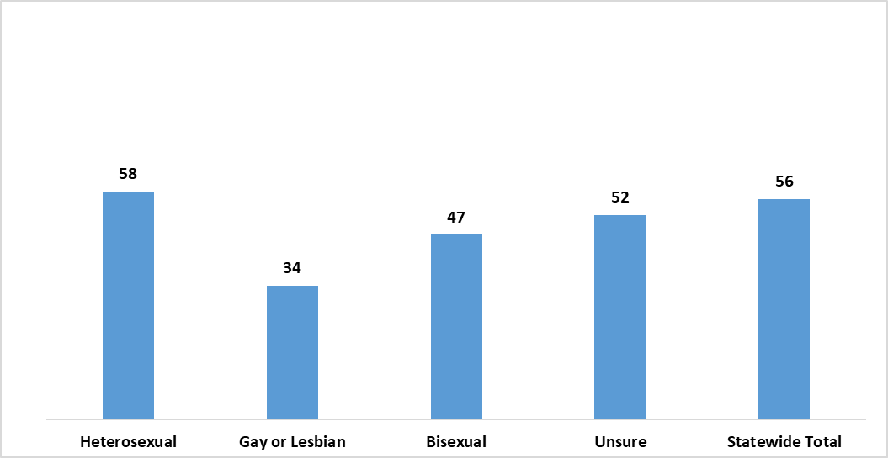
LGBQ Youth – Condom Use Percentage of high school students who reported using a condom the last time they had sexual intercourse (among sexually active students)
Source: “2017 Delaware Youth Risk Behavior Survey (YRBS).” Centers for Disease Control and Prevention (Administered by the Center for Drug and Health Studies, University of Delaware).
Notes:
Table copied as image (cannot be altered)

Slide 20
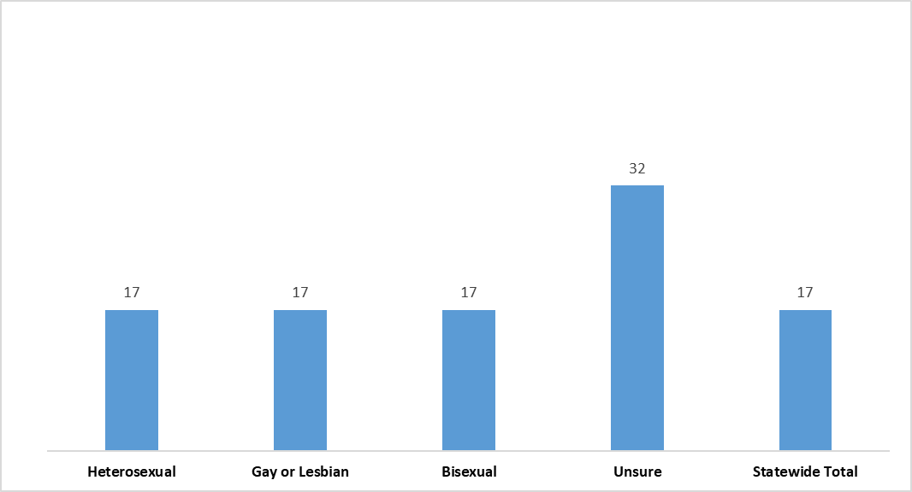
LGBQ Youth – Sexual Activity and Substance Use Percentage of high school students who reported drinking alcohol or using drugs before their last time having sexual intercourse (among sexually active students)
Source: “2017 Delaware Youth Risk Behavior Survey (YRBS).” Centers for Disease Control and Prevention (Administered by the Center for Drug and Health Studies, University of Delaware).
Notes:
Table copied as image (cannot be altered)

Slide 21
Safety and Mental Health

Slide 22
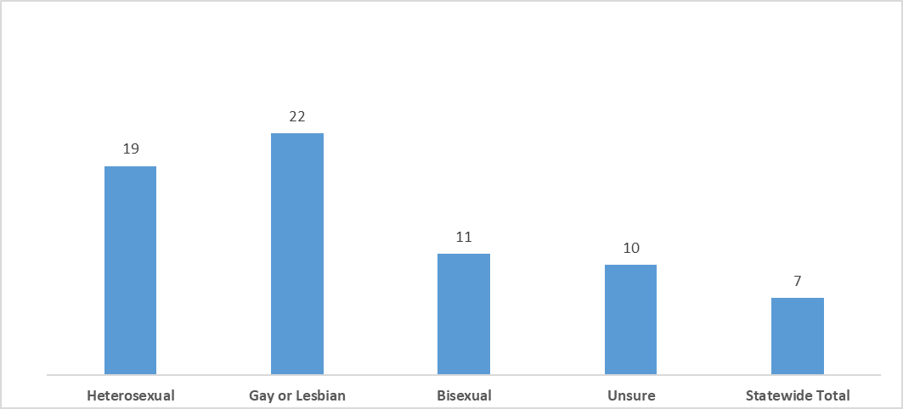
LGBQ Youth – Fighting Percentage of high school students who reported getting into a fight in the past year
Source: “2017 Delaware Youth Risk Behavior Survey (YRBS).” Centers for Disease Control and Prevention (Administered by the Center for Drug and Health Studies, University of Delaware).
Notes:
Table copied as image (cannot be altered)

Slide 23
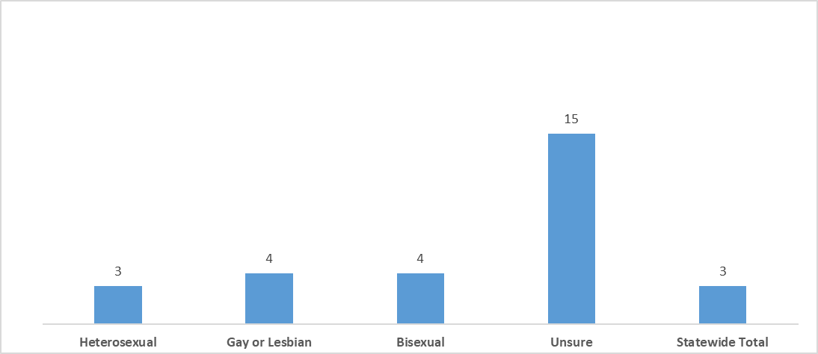
LGBQ Youth – Carrying a Weapon Percentage of high school students who reported carrying a weapon on school property in the past 30 days
Source: “2017 Delaware Youth Risk Behavior Survey (YRBS).” Centers for Disease Control and Prevention (Administered by the Center for Drug and Health Studies, University of Delaware).
Notes:
Table copied as image (cannot be altered)

Slide 24
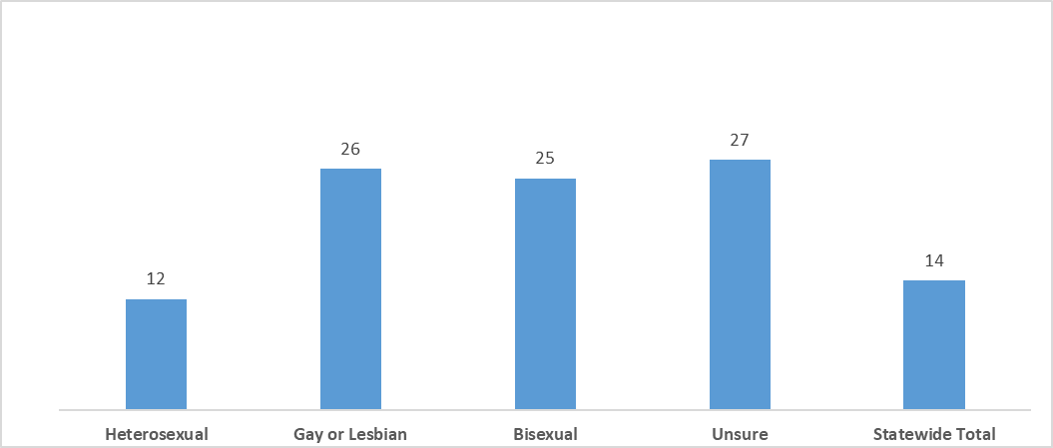
LGBQ Youth – Being Bullied Percentage of high school students who reported being bullied at school in the past year
Source: “2017 Delaware Youth Risk Behavior Survey (YRBS).” Centers for Disease Control and Prevention (Administered by the Center for Drug and Health Studies, University of Delaware).
Notes:
Table copied as image (cannot be altered)

Slide 25
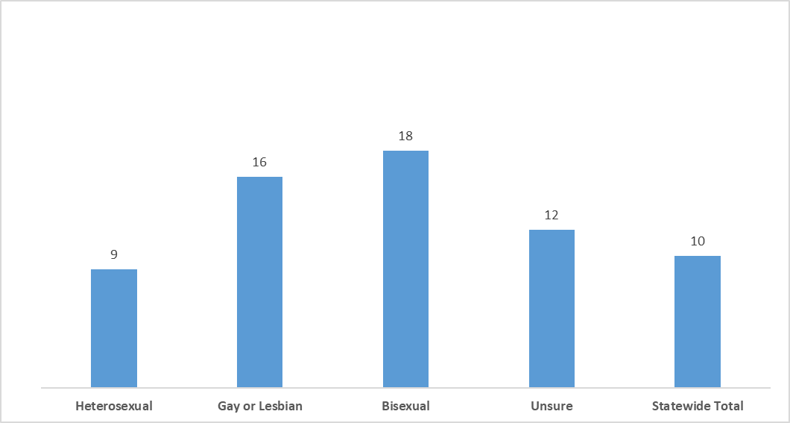
LGBQ Youth – Being Electronically Bullied Percentage of high school students who reported being electronically bullied in the past year
Source: “2017 Delaware Youth Risk Behavior Survey (YRBS).” Centers for Disease Control and Prevention (Administered by the Center for Drug and Health Studies, University of Delaware).
Notes:
Table copied as image (cannot be altered)

Slide 26
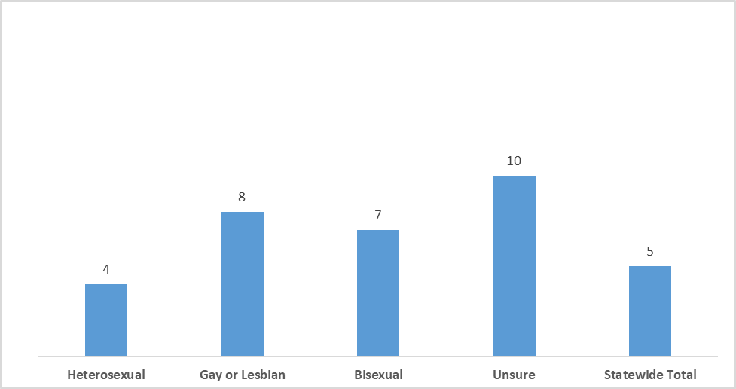
LGBQ Youth – School Attendance and Feeling Safe Percentage of high school students who reported not going to school for one or more days because they felt unsafe in the past 30 days
Source: “2017 Delaware Youth Risk Behavior Survey (YRBS).” Centers for Disease Control and Prevention (Administered by the Center for Drug and Health Studies, University of Delaware).
Notes:
Table copied as image (cannot be altered)

Slide 27
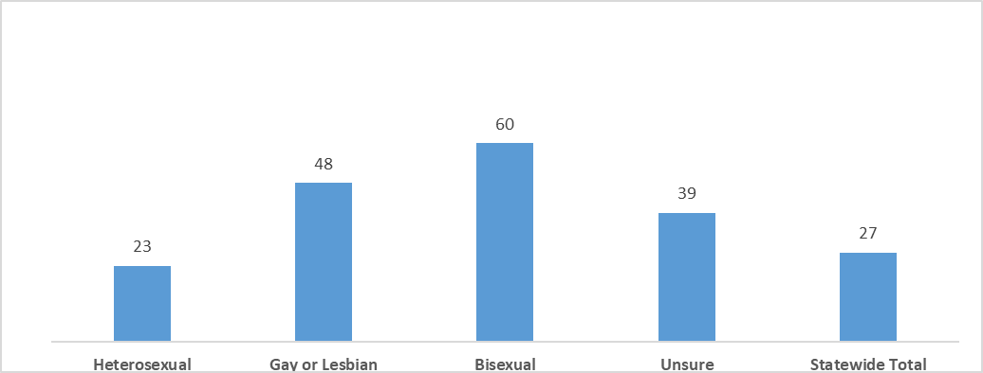
LGBQ Youth – Depressed or Hopeless Mood Percentage of high school students who reported feeling sad or hopeless for two or more weeks in the past year
Source: “2017 Delaware Youth Risk Behavior Survey (YRBS).” Centers for Disease Control and Prevention (Administered by the Center for Drug and Health Studies, University of Delaware).
Notes:
Table copied as image (cannot be altered)

Slide 28
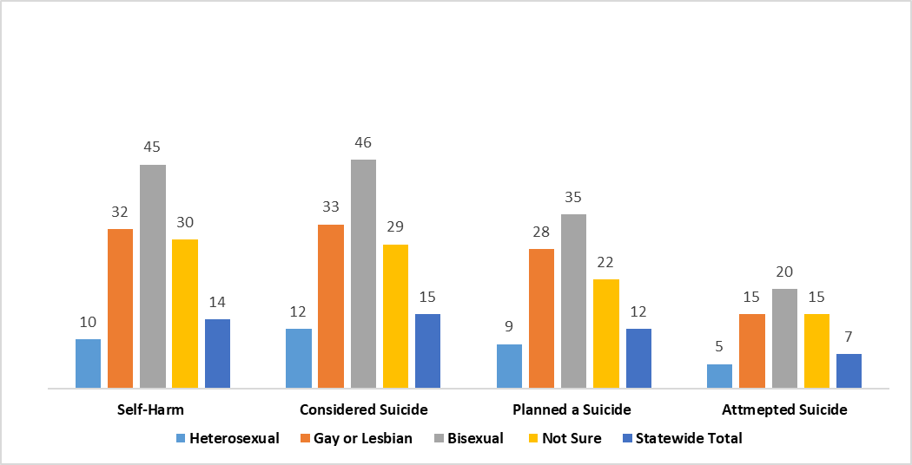
LGBQ Youth – Self-Harm and Suicide Percentage of high school students who reported self-harming, considering suicide, have a suicide plan, or attempting suicide in the past 12 months
Source: “2017 Delaware Youth Risk Behavior Survey (YRBS).” Centers for Disease Control and Prevention (Administered by the Center for Drug and Health Studies, University of Delaware).
Notes:
Table copied as image (cannot be altered)

Slide 29
Protective Factors

Slide 30
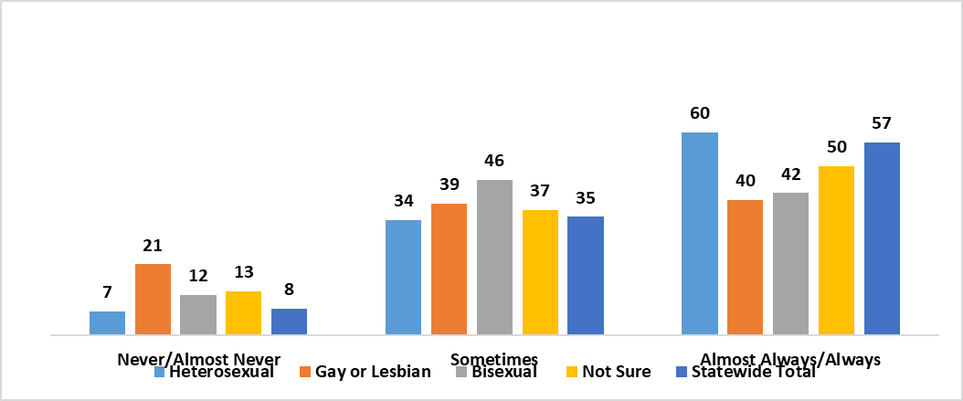
LGBQ Youth – Parental Pride Percentage of high school students who reported their parent(s) show them they are proud of them
Source: “2017 Delaware Youth Risk Behavior Survey (YRBS).” Centers for Disease Control and Prevention (Administered by the Center for Drug and Health Studies, University of Delaware).
Notes:
Table copied as image (cannot be altered)

Slide 31
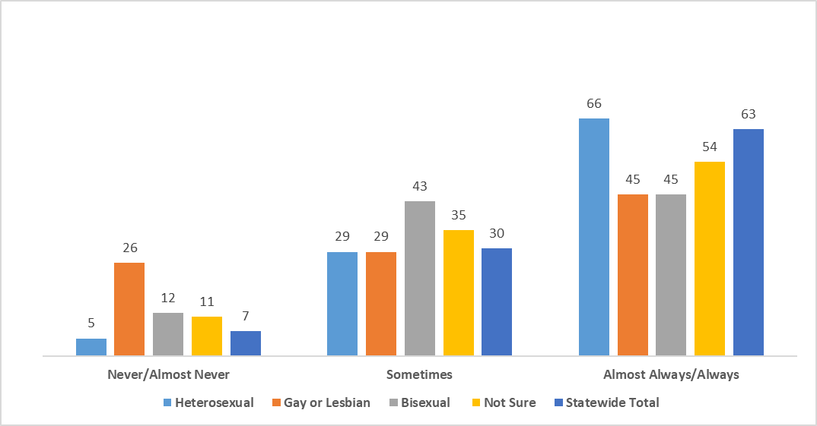
LGBQ Youth – Parent Engagement Percentage of high school students who reported their parent(s) take an interest in their activities
Source: “2017 Delaware Youth Risk Behavior Survey (YRBS).” Centers for Disease Control and Prevention (Administered by the Center for Drug and Health Studies, University of Delaware).
Notes:
Table copied as image (cannot be altered)

Slide 32
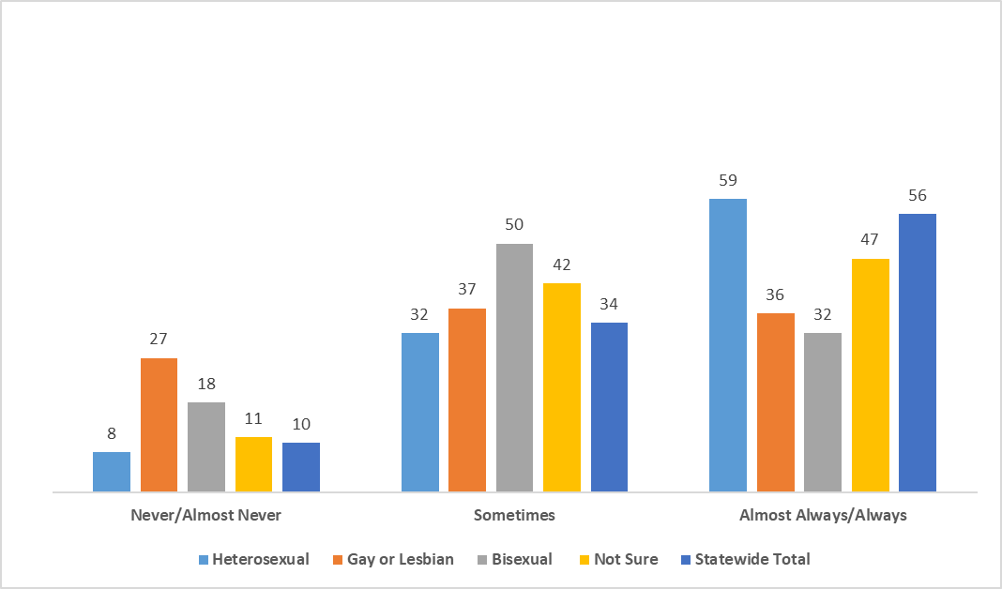
LGBQ Youth – Parent Engagement Percentage of high school students who reported that their parent(s) listen to them when they talk
Source: “2017 Delaware Youth Risk Behavior Survey (YRBS).” Centers for Disease Control and Prevention (Administered by the Center for Drug and Health Studies, University of Delaware).
Notes:
Table copied as image (cannot be altered)

Slide 33
Questions?

Slide 34
Thank You!

Slide 35
For More Information…
Sharon Merriman-Nai
smnai@udel.edu
302-831-6107
Center for Drug and Health Studies
at the University of Delaware
www.cdhs.udel.edu

