Slide 1
Overview of Delaware Violent Death Reporting System (DVDRS) and My Healthy Community Site
Amanda M. Bundek , BS, NREMT
Epidemiologist, II Delaware division of public health

Slide 2
Delaware Violent Death Reporting System(DVDRS)
State-based surveillance system which reports data in the Center for Disease Control and Prevention’s National Violent Death Reporting System (NVDRS)
Data is collected from death certificate, medical examiner, and law enforcement reports.
Violent deaths are entered into the system based on the location of the injury, not the individual's residence location or death location.
Demographic and Circumstance data is collected.
A narrative synopsis of medical examiner and law enforcement reports .

Slide 3
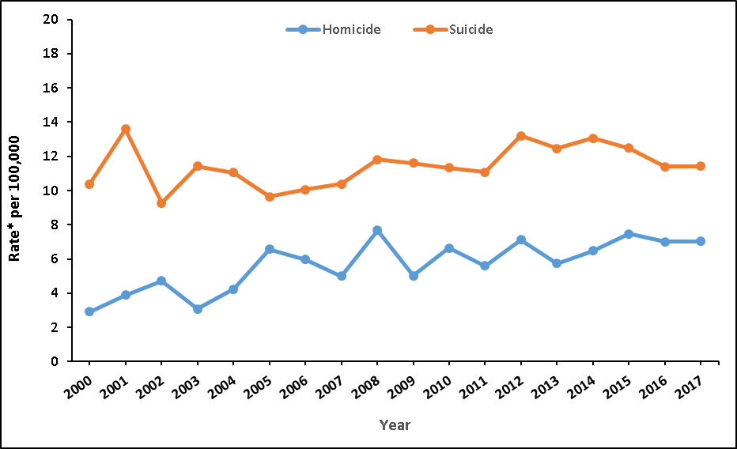
Violent Deaths by Intent, Delaware 2000-2017 Data Source: Delaware Health Statistics Center, Vital Records; *Rates are age-adjusted to the 2000 U.S. Standard Population.

Slide 4
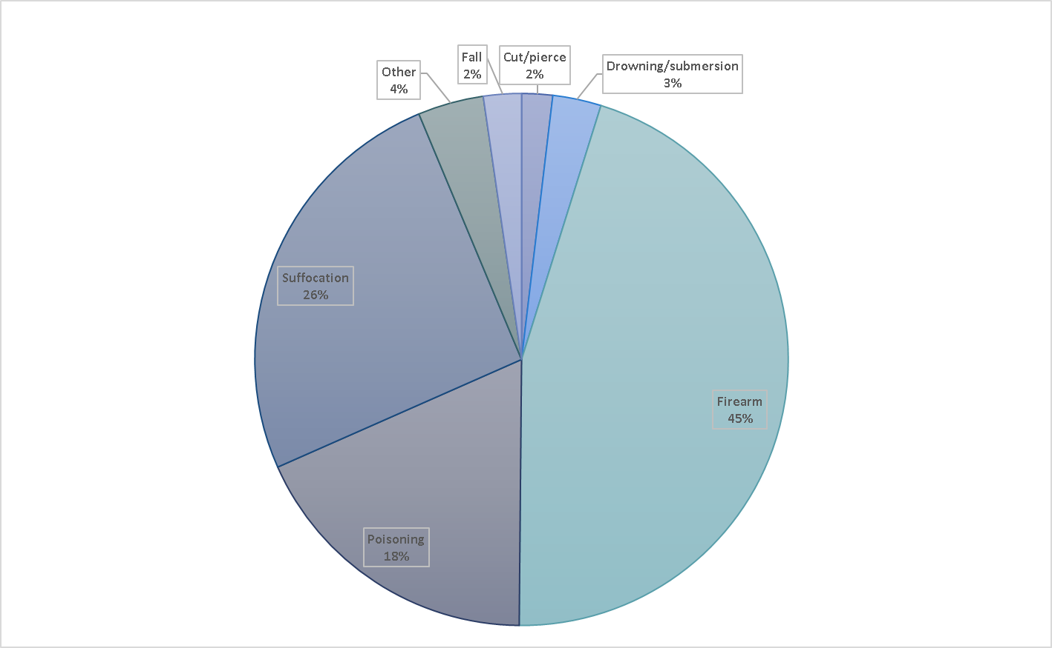
Distribution of Suicide Injury Mechanism-Delaware, 2000-2017 Data Source: Delaware Health Statistics Center, Vital Records

Slide 5
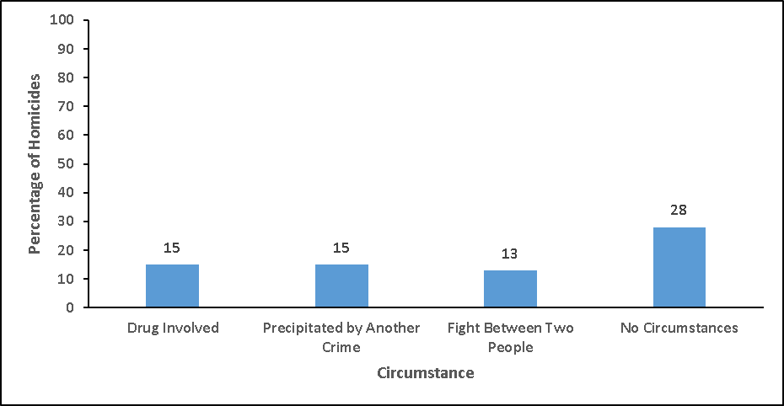
Homicide Circumstance Data- Delaware, 2017 Data Source: Delaware Violent Death Reporting System

Slide 6
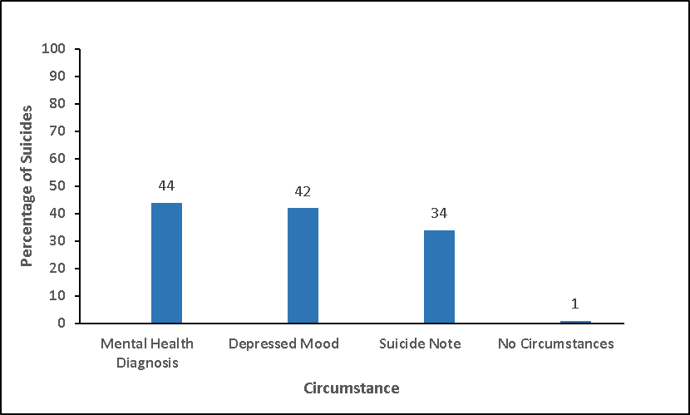
Suicide Circumstance Data- Delaware, 2017 Data Source: Delaware Violent Death Reporting System

Slide 7
My Healthy Community
Delaware’s Environmental Public Health Tracking Network

Slide 8
My Healthy Community https://myhealthycommunity.dhss.delaware.gov/
Data-sharing platform that delivers neighborhood-focused population health, environmental, and social determinants of health data to the public
Official launch: May 13th
Topics include:
Air Quality
Asthma
Drinking Water
Substance Use
Demo

Slide 9
Epidemiology Research Unit
Caroline Judd, MPH
Management Analyst, III
Delaware Division of Public Health
caroline.judd@delaware.gov
Amanda Bundek
Epidemiologist, II
Delaware Division of Public Health
amanda.bundek@delaware.gov

