Slide 1
The Delaware Rape Prevention and Education Program (RPE): Building Evaluation Capacity
University of Delaware Center for Drug and Health Studies
Presented to the Delaware SEOW July 29, 2021

Slide 2
The Delaware RPE Program
The RPE program is funded by the CDC and administered by the Delaware Office of Women’s Health under the direction of Karen McGloughlin in the Division of Public Health Bureau of Health Equity, Department of Health and Social Services.
The RPE Program coordinates with the Delaware DELTA Impact initiative to provide a cohesive approach to reduce sexual and intimate partner violence (SV/IPV). Both projects work in collaboration with one State Leadership Team.

Slide 3
The Delaware RPE Program
Statewide priorities for the RPE and DELTA projects are intended to create community and societal change. Priority areas include fostering safety and well-being for youth, improving economic opportunity, and expanding the IPV/SV prevention infrastructure.
The CDHS team’s main contribution is to create a process to track Delaware’s progress toward positive change over time.
The current RPE program is currently in year 4 of a 5-year funding cycle.
Notes:
- Not actually sure about which year of funding we’re in

Slide 4
PHASE I | Conduct Indicator Selection Readiness | Identify potential sexual violence outcomes indicators (SV) appropriate and feasible for evaluation
PHASE II | Complete Indicators Selection Criteria | Assess the appropriateness of select indicators to address State’s evaluation questions
PHASE III | Develop Recommendations to Increase State-Level Monitoring of SV Indicators | Recommendations to enhance data collection, systems, staffing, etc. Identify and incorporate new data sources, partnerships
PHASE IV | Update State Evaluation to include SV Outcomes Indicators | Identify indicators to measure change to show impact at community/societal level Align evaluation outcomes and RPE programs using indicators Develop enhanced evaluation plan if capacity allows

Slide 5
Phase 1: Indicator Selection
Frameworks
  Socioecological Framework; Life-course; Social Determinants of Health
Conducted 22 Key Informant Interviews
Performed an Extensive Literature Review
  Potential indicators and risk/protective factors of sexual violence
  Focus on women’s financial empowerment and children’s protective environments
Notes:
Socioecological framework: Individual level: Gender, age, health, individual-level risk and protective factors
Interpersonal level: Peers, family, romantic relationships, school or workplace
Community level: Neighborhood, education, violence in community, economic and employment options
Macro/Societal: Ideology, laws, policies, cultural norms
Literature: Life Course
Experiencing or witnessing childhood maltreatment increases the likelihood of future victimization or perpetration
ACEs increase the prevalence of risk factors of sexual violence
Social Determinants of Health
Biology, family life, socioeconomic status, neighborhood or community characteristics, larger societal structures, social stratification
Racism, sexism, ableism, ageism, and other -isms strongly influence health
Interviews: 5 - IPV or TDV
4 - Health in general or women’s
3 - SV specifically
4 - Violence prevention or response
6 - Substance use and mental health

Slide 6
Phase 2: Indicator Selection Refinement and Data Selection
Identify data and measures that are…
  Supported by literature
  Collected over time (yearly or biennially)
  Reliable and trustworthy
  Publically accessible
  Helpful in providing an overall picture of Delaware’s progress toward preventing sexual violence at the community and societal levels
Create a system to track data over time

Slide 7
Phase 3: Pilot and Continue Refinement
Piloted the data collection process
Developed a data collection guide
Refined selected indicators
  Swapped out indicators if sources or individual measures were no longer collected
  Encountered Covid-related data gaps
  Found ways to display and interact with the data

Slide 8
Phase 3: Pilot and Continue Refinement
TOTAL | Broad | Reduced | Refined | Pilot | Current
Sources* | 18 | 13 | 10 | 10 | 10
Indicators* | 35 | 27 | 23 | 14 | 11
Measures | 134 | 92 | 57 | 41 | 72
PREVALENCE
Sources | 5 | 4 | 3 | 3 | 6
Indicators | 5 | 8 | 6 | 4 | 5
Measures | 22 | 20 | 12 | 11 | 31
CHILD PROTECTIVE ENVIRONMENTS
Sources | 7 | 5 | 5 | 7 | 3
Indicators | 11 | 15 | 13 | 5 | 4
Measures | 62 | 42 | 29 | 17 | 14
WOMEN’S FINANCIAL EMPOWERMENT
Sources | 11 | 6 | 4 | 4 | 4
Indicators | 19 | 4 | 4 | 5 | 5
Measures | 50 | 30 | 16 | 13 | 27
* Total sources and indicators account for overlap across topics
Notes:
Data source ratings
Assign ratings based on ease of accessibility, whether they provide trend data, comprehensiveness/number of indicators included, and other factors
Allows us to narrow down and filter based on different criteria
Example: Identifying all data sources that include indicators at the outer two rings of the SEM and provide trend data

Slide 9
PHASE I | Conduct Indicator Selection Readiness | Identify potential sexual violence outcomes indicators (SV) appropriate and feasible for evaluation
PHASE II | Complete Indicators Selection Criteria | Assess the appropriateness of select indicators to address State’s evaluation questions
PHASE III | Develop Recommendations to Increase State-Level Monitoring of SV Indicators | Recommendations to enhance data collection, systems, staffing, etc. Identify and incorporate new data sources, partnerships
PHASE IV | Update State Evaluation to include SV Outcomes Indicators | Identify indicators to measure change to show impact at community/societal level Align evaluation outcomes and RPE programs using indicators Develop enhanced evaluation plan if capacity allows

Slide 10
Indicators
Prevalence
Policing
Resource Use
Victimization – Teens
Child Protective Environments
Access to Healthcare - Children
Adverse Childhood Experiences (ACEs) & Mental Health - Children
Poverty & Economic Factors
Safety
Violence
Women’s Financial Empowerment
Access to Childcare
Access to Healthcare - Women
ACEs & Mental Health - Adults
Poverty & Economic Factors - Adults
Substance Use
Notes:
Questions to SLT
What indicators and data sources do you believe would be most valuable to the project?
Do you see any gaps in the indicators or data sources?
Do you know of any data sources we’re missing that we would be able to access?

Slide 11
Policing
Prevalence
Measure | Time frame | Trend | Last year value | Most recent change
Reported Forcible Sex Offenses Crime in Delaware Report | 2017-19 |  | 715 | -34
Domestic Violence Police Contacts Crime in Delaware Report | 2017-20 |  | 22,587 | -823

Slide 12
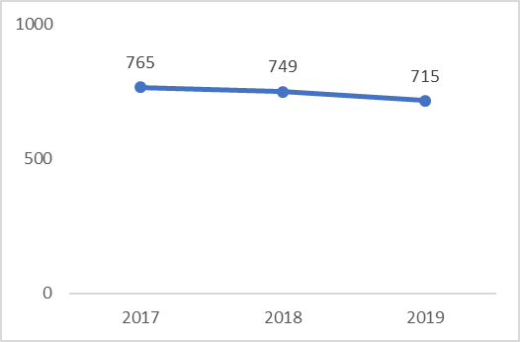
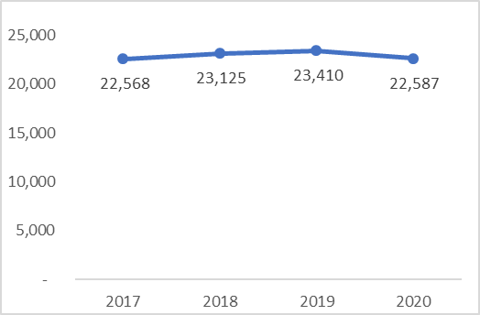
Domestic Violence Prevalence
Reported Forcible Sex Offenses
DV Police Contacts
Policing
Sources: Forcible Sex Offenses- Crime in Delaware Report
Police Contacts- DVCC Annual Report
Notes:
Data from different sources seem contradictory.
Increased DV shelter use & hotline use
Decrease DV police contacts
Amidst COVID quarantining

Slide 13
Resource Use
Measure | Time frame | Trend | Last year value | Most recent change
Domestic Violence Hotline Calls DVCC Annual Report | 2017-20 |  | 3249 | 579
Protection from Abuse Orders Filed DVCC Annual Report | 2017-20 |  | 2947 | -175
Protection from Abuse Orders Awarded DVCC Annual Report | 2017-20 |  | 1223 | -184
Individuals Housed in DV Shelters DVCC Annual Reports | 2017-20 |  | 760 | 265
Batterer Treatment Commitments Served DVCC Annual Report | 2017-20 |  | 777 | -104
Prevalence

Slide 14
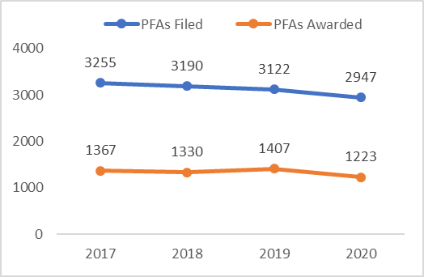
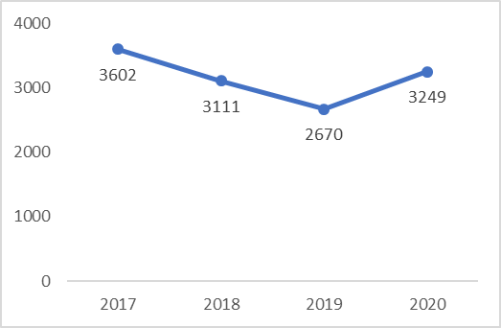
Interpersonal Violence
Batterer Treatment Commitments Served
Individuals Housed in DV Shelters
Resource Use
Protection From Abuse Orders
DV Hotline Calls
Sources: DVCC Annual Report
Notes:
Data from different sources seem contradictory.
Batterer treatment
PFAs Awarded
Shelter Placements

Slide 15
Teen Victimization
Measure | Time frame | Trend | Last year value | Most recent change
Lifetime Sexual Assault Youth Risk Behavior Survey | 2013-17 |  | 6% | -1%
Sexual Assault Last 12 Months Youth Risk Behavior Survey | 2017 | N/A | 8% | N/A
Sexual Assault by Partner Youth Risk Behavior Survey | 2013-17 |  | 5.2% | -2.7%
Physical Assault by Partner Youth Risk Behavior Survey | 2013-17 |  | 9.5% | 0.9%
Prevalence
Notes:
Help: We lack self-report data for sexual violence among adults.

Slide 16
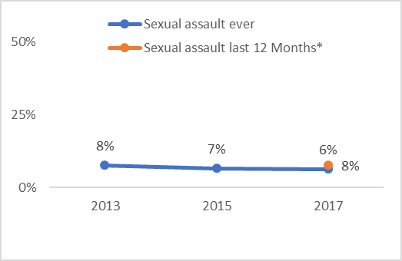
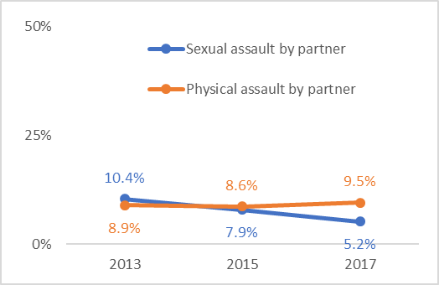
Teen Sexual Violence
Teen Victimization
Teen Sexual Violence
Teen Dating Violence Past 12 Months
Sources: Youth Risk Behavior Survey
Notes:
TDV is specifically in the context of a dating relationship

Slide 17
Access to Healthcare
Measure | Time frame | Trend | Last year value | Most recent change
Received Mental Healthcare NSCH | 2017-18 |  | 12% | -2%
Needed Mental Healthcare But Didn’t Receive It NSCH | 2017-18 |  | 3% | -1%
Received Preventative Healthcare NSCH | 2016-18 |  | 78.9% | -6.8%
Children w/o Health Insurance KIDS COUNT | 2016-18 |  | 4% | 1%
Children Protective Environments

Slide 18
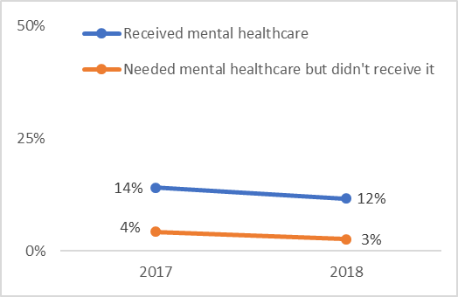
Mental Health
Mental Healthcare
Access to Health Care
Sources: Preventative Healthcare: National Survey of Children’s Health

Slide 19
Physical Health
Children Receiving Preventative Healthcare
Children Without Health Insurance
Access to Health Care
Sources: Preventative Healthcare: National Survey of Children’s Health
Health Insurance: KIDS COUNT
Notes:
The percentage of children receiving preventative healthcare is declining despite no decrease in the percentage of children without health insurance.

Slide 20
ACEs & Mental Health
Measure | Time frame | Trend | Last year value | Most recent change
Students Reporting 1 ACE SEOW Report | 2015-17 |  | 23% | -1%
Students Reporting 2+ ACEs SEOW Report | 2015-17 |  | 20% | -1%
Felt Sad or Helpless in the Last Two Weeks Youth Risk Behavior Survey | 2013-17 |  | 27.6% | 3.4%
Made a Plan to Commit Suicide Youth Risk Behavior Survey | 2013-17 |  | 12% | 1%
Children Protective Environments

Slide 21
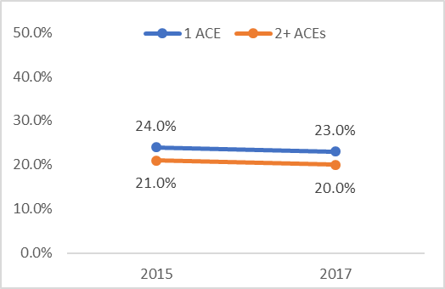
ACEs
Students Reporting ACEs
ACEs & Mental Health
Sources: SEOW Report

Slide 22
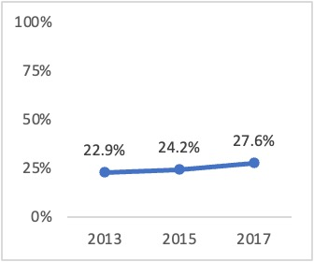
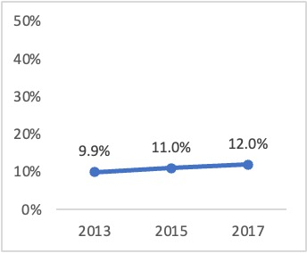
Depression in High School
Over past year, felt sad/hopeless almost every day for 2 weeks in a row that you stopped some usual activities.
Made a Plan to Commit Suicide
ACEs & Mental Health
Sources: Youth Risk Behavior Survey
Notes:
Teen mental health was worsening even before the pandemic

Slide 23
Poverty and Economic Factors
Children Protective Environments
Measure | Time frame | Trend | Last year value | Most recent change
Home Insecure in Last Month Delaware School Survey | 2017-19 |  | 2.2% | 0.2%
Total Teen Births KIDS COUNT | 2015-18 |  | 497 | -55
Children in Poverty KIDS COUNT | 2016-18 |  | 19% | 1%

Slide 24
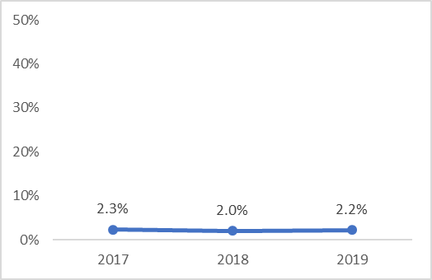
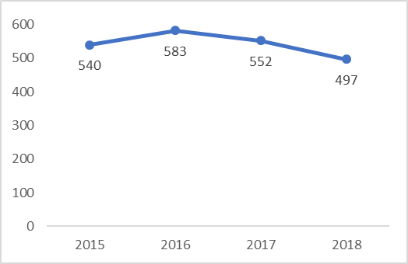
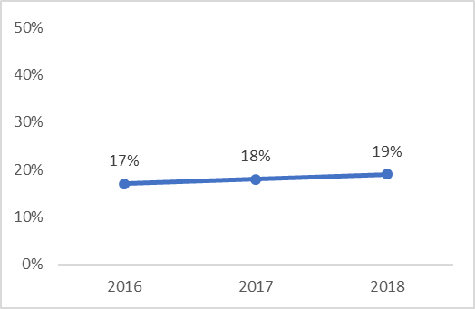
Poverty & Teen Births
Home Insecure in Last Month
Total Teen Births
Poverty & Economic Factors
Children in Poverty
Sources: Home insecurity: DSS
Teen Births/Children in Poverty- KIDS COUNT
Notes:
Data from different sources seem contradictory.
Batterer treatment
PFAs Awarded
Shelter Placements

Slide 25
Safety
Children Protective Environments
Measure | Time frame | Trend | Last year value | Most recent change
Protective Family Routines and Habits America’s Health Rankings | 2018-19 |  | 12.4% | 0%
Supportive Neighborhoods NSCH | 2016-18 |  | 51.9% | -0.3%

Slide 26
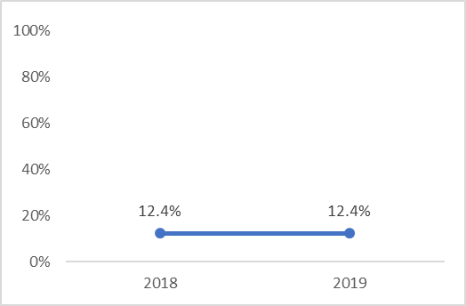
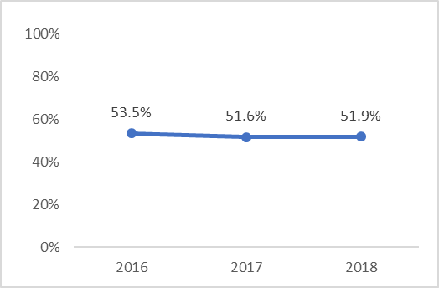
Protective Environment
Safety
Protective Family Routings and Habits
Supportive Neighborhoods
Sources: NSCH, American Health Rankings

Slide 27
Violence
Measure | Time frame | Trend | Last year value | Most recent change
Bullying Perpetration NSCH | 2018 | N/A | 11.5% | N/A
Bullying Victimization NSCH | 2018 | N/A | 3.7% | N/A
Bullying Incidents Reported by Schools Delaware Bullying Report | 2014-19 |  | 637 | -76
Substantiated Bullying Incidents Delaware Bullying Report | 2014-19 |  | 411 | -90
High schoolers bullied in school previous 12 months YRBS | 2013-17 |  | 14.1% | -2.3%
Middle schoolers bullied in school ever YRBS | 2013-19 |  | 35.7% | -2.9%
Children Protective Environments

Slide 28
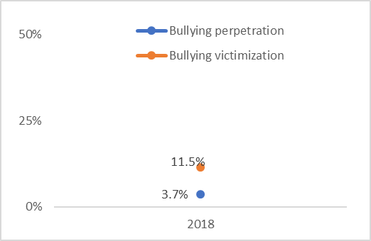
Bullying Perpetration & Victimization
Bullying Reported by Parents
Violence
Sources: NSCH
Notes:
This question changed in 2018, so we couldn’t include earlier years

Slide 29
Bullying
Bullying in School Previous 12 Months Reported by High Schoolers
Bullying Reported by Schools
Violence
Bullying in School Ever Reported by Middle Schoolers
Sources: Delaware Bullying Report, YRBS
Notes:
Why the drop off in school reported bullying from 2016/17 to 2017/18?
Bullying reported by students is declining, but does not show the huge drop off

Slide 30
Violence
Measure | Time frame | Trend | Last year value | Most recent change
11th graders saw violence b/w adults at home Delaware School Survey | 2017-19 |  | 9.6% | 0.2%
11th graders feel student violence is a problem Delaware School Survey | 2017-19 |  | 16.5% | -0.8%
11th graders see crime in their neighborhood Delaware School Survey | 2017-19 |  | 13.3% | -5.7%
8th graders saw violence b/w adults at home Delaware School Survey | 2017-20 |  | 8.7% | -0.2%
8th graders feel student violence is a problem Delaware School Survey | 2017-20 |  | 23.4% | 5.2%
8th graders see crime in their neighborhood Delaware School Survey | 2017-20 |  | 14.7% | -0.2%
Children Protective Environments

Slide 31
Family & Community Violence
Violence in 8th Graders’ Lives
Violence in 11th Graders’ Lives
Violence
Sources: Youth Risk Behavior Survey
Notes:
-no HS 2020 data due to COVID ☹

Slide 32
Access to Childcare
Measure | Time frame | Trend | Last year value | Most recent change
Married with Infant ChildCare Aware | 2017-19 |  | 11.2% | 0.3%
Married with Two Children ChildCare Aware | 2017-19 |  | 20.2% | 0.4%
Married with Two Children at the Poverty Line ChildCare Aware | 2017-19 |  | 81.4% | 2.4%
Single Parent with Infant ChildCare Aware | 2017-19 |  | 37.1% | 1.3%
Single Parent with Two Children ChildCare Aware | 2017-19 |  | 66.6% | 2.1%
Women’s Financial Empowerment

Slide 33
Percent of Income Spent on Childcare
Percent of Income Married Couples Spent on Center Child Care
Percent of Income Single Parents Spent on Center Child Care
Access to Child-Care
Sources: ChildCare Aware
Notes:
Families at the poverty line spend most of their income on child-care
Single parents spend 1/3 to 2/3 of their income on child-care

Slide 34
Access to Healthcare
Women’s Financial Empowerment
Measure | Time frame | Trend | Last year value | Most recent change
Did Not Receive Pap Test Behavioral Risk Factor Surveillance System | 2014-18 |  | 17.0% | -3.7%
Women Unable to See a Doctor Due to Cost Behavioral Risk Factor Surveillance System | 2014-18 |  | 10.6% | -1.4%
Babies Who Had Well-Baby Checks America’s Health Rankings | 2016-19 |  | 87.4% | -5.8%

Slide 35
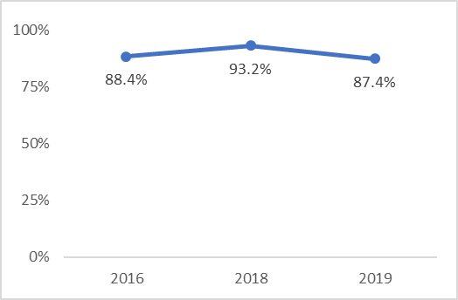
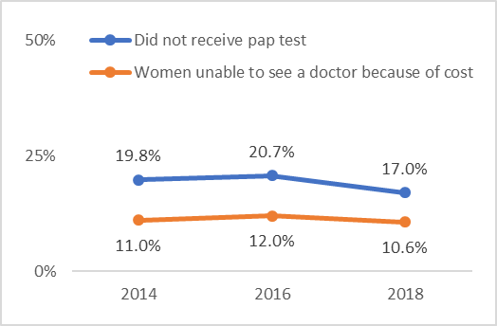
Women’s & Baby’s Healthcare
Access to Healthcare
Babies Who Had Well-Baby Checks
Access to Healthcare
Sources: Well-Baby Checks: America’s Health Rankings
Access to Healthcare: BRFSS

Slide 36
Poverty and Economic Factors
Measure | Time frame | Trend | Last year value | Most recent change
Unemployment KIDS COUNT | 2017-19 |  | 3.9% | 0.3%
Concentrated Disadvantage America’s health Rankings | 2017-20 |  | 23.4% | 2.4%
Female-Headed Families in Poverty KIDS COUNT | 2015-19 |  | 22.2% | -3.4%
Female High Schoolers Who Graduate Within Four Years KIDS COUNT | 2015-18 |  | 88.7% | 0.1%
Women’s Financial Empowerment

Slide 37
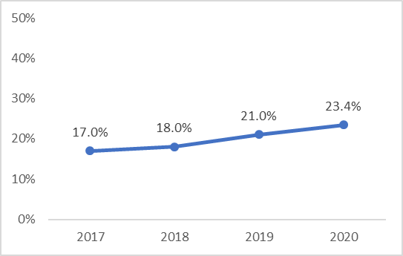
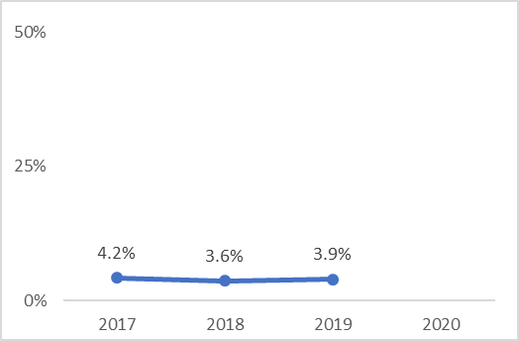
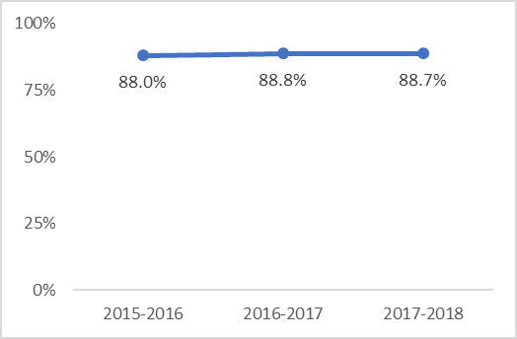
Poverty & Disadvantage
Concentrated Disadvantage
Unemployment
Poverty & Economic Factors
Female High Schoolers who Graduate Within Four Years
Female-Headed Homes in Poverty
Sources: KIDS COUNT
Concentrated Disadvantage- America’s Health Rankings
Notes:
Concentrated Disadvantage:
% households in census tracts with a high level of
Percentage below poverty line
Receiving public assistance
Female-headed households
Unemployed
Younger than 18.
Concentrated disadvantage is rising, while female-headed homes in poverty in declining

Slide 38
Births to Single Mothers
Measure | Time frame | Trend | Last year value | Most recent change
White mothers <20 yo Kids Count | 2011-17 |  | 91.7% | -.5%
Black mothers <20 yo Kids Count | 2011-17 |  | 98.7% | .5%
Hispanic mothers <20 yo Kids Count | 2011-17 |  | 93.2% | .7%
White mothers 20-24 yo Kids Count | 2011-17 |  | 67.6% | -1.5%
Black mothers 20-24 yo | 2011-17 |  | 90.4% | .2%
Hispanic mothers 20-24 yo Kids Count | 2011-17 |  | 74.5% | -.1%
All White mothers Kids Count | 2011-17 |  | 34.9% | 5.0%
All Black mothers Kids Count | 2011-17 |  | 70.5% | -.1%
All Hispanic mothers Kids Count | 2011-17 |  | 61.5% | -.2%
Women’s Financial Empowerment

Slide 39
Race, Ethnicity, & Age Differences
Births to Single Mothers < 20
Births to Single Mothers 20-24
Births to Single Mothers
Births to Single Mothers Total
Interpretation: Of all women who gave birth in this age group, what proportion were single?
Sources: KIDS COUNT
Notes:
Black women have the highest proportion of births to single women, followed by Hispanic women, then White women
Births to single women younger than 20 have been increasing
Relevance to childcare costs
Unclear definition of “single”

Slide 40
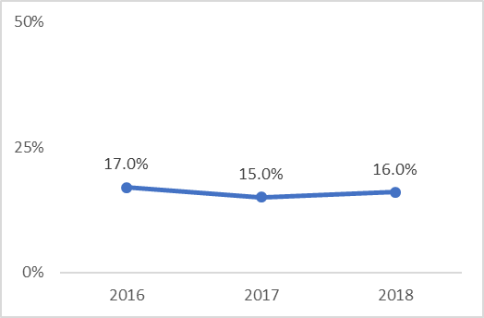
Substance Use
Women’s Financial Empowerment
Measure | Time frame | Trend | Last year value | Most recent change
Binge Drinking Behavioral Risk Factor Surveillance System | 2016-18 |  | 16% | 1%
Sources: BRFSS

Slide 41
Next Steps
Survey:
Which measures…
inform your organization’s work?
should change when your organization’s work is successful?
Model Development:
How are the measures directly or indirectly related to each other, particularly, measures of sexual violence?
Notes:
What we will be doing next.

Slide 42
Questions?
Comments?
Notes:
What we will be doing next.

Slide 43
Thank You
For questions regarding today’s presentation please contact the RPE Indicator Project team leader:
Cheryl M. Ackerman – cma@udel.edu
The RPE Indicator Project is also supported by CDHS team members:
Rachael Schilling – schillra@udel.edu
Sharon Merriman-Nai – smnai@udel.edu
Funded by the Centers for Disease Control and the Delaware Department of Public Health.
Notes:
What we will be doing next.
Include CDHS logo
Details about funding for the project

