Slide 1

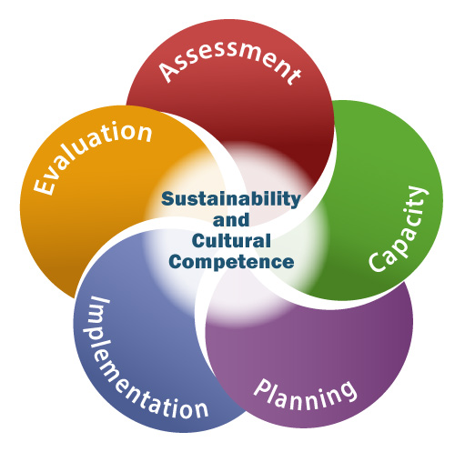

Welcome to the
Delaware SEOW Summer Meeting!
Please introduce yourself in the chat box and share your thoughts on the following:
What strategies are helping you to stay resilient and to continue your prevention efforts during the COVID-19 pandemic?
Reminder: The workgroup session is being recorded.
July 28, 2020

Slide 2
Agenda
Welcome and Introductions
4 Goals of the SEOW
The SEOW and COVID-19 – Updates on the Delaware Youth Surveys
(Rochelle Brittingham, CDHS)
Breakout: How have your data needs, data collection strategies changed due to COVID?
Delaware Youth: Well-Being Index (Laura Rapp, CDHS and Dana Carr, DSAMH)
Delaware Youth: Positive Childhood Experiences (MJ Scales, CDHS)
Delaware Youth: Positive Childhood Experiences and Protective Factors (Teri Lawler, DOE)
Action Steps: Member Discussion
Member Updates
SEOW Participant Survey

Slide 3
The 4 Goals of the SEOW

Slide 4
The SEOW and COVID-19
Update on the Delaware Youth Surveys

Slide 5
2019 -2020 Completed Surveys
DSS 8th Grade
DSS 5th Grade
Administered fall 2019 until March 2020
N = 3,799 students
County Breakdown:
  New Castle: 72%
  Kent County: 13%
  Sussex County: 16%
Racial Breakdown:
  Black: 23%
  Hispanic: 28%
  White: 42%
  Other/Mixed: 6%
School Participation Rate:
  56 Asked to participated
  27 Participated
N = 1050
DSS 11th Grade
N = 334
Notes:
The YRBS Middle school is a unique data set; not all states do a middle school YRBS. The 2019 was funded by the Kids Department block grant
The YRBS middle school was a sample of approximately half of DE middle schools. Schools selected for the YRBS also had the DSS administered in the fall.
A very successful administration in multiple ways:
Enough data was collected with the YRBS that it was able to be weighted
This ended up working in our favor because it meant that there were enough 8th grade DSS surveys completed

Slide 6
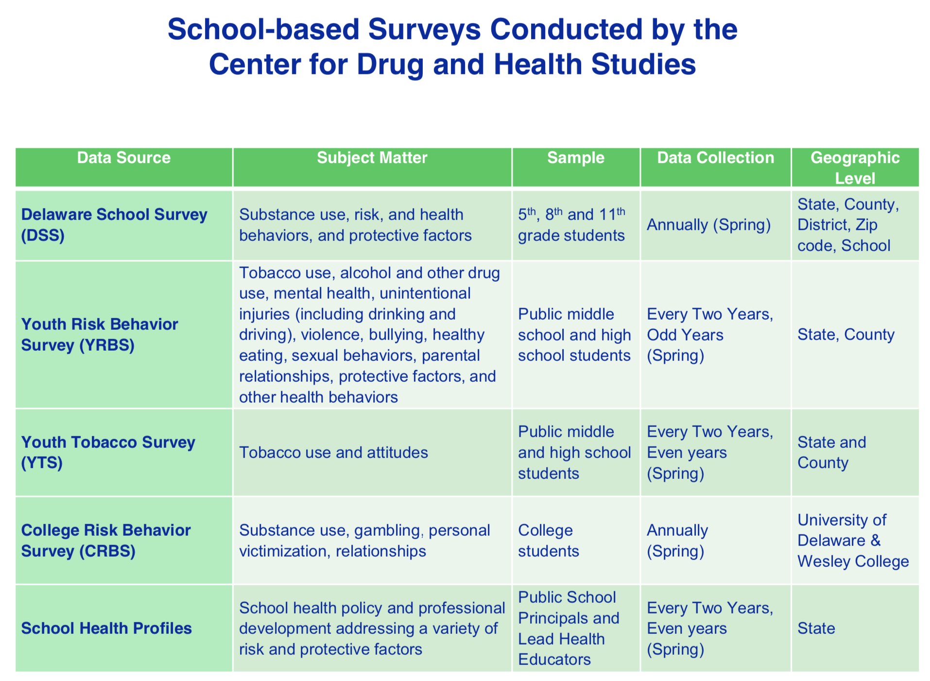

Slide 7
Administration Considerations
In-person
  Visitor policies
  Students in school
  Personal protective equipment
  All staff have a choice
Online
  Not been done before in DE
  Researching literature
  Discussions
  Sampling
Hybrid models
  Not been done before in DE
  Students in school on alternate days
  May still require an online component
Please keep in mind, this is not an exhaustive list of scenarios, variables, or options.
Notes:
Schools are discussing optional hybrid models

Slide 8
Breakout:
How have your data needs and collection strategies changed due to COVID-19?

Slide 9
Well-Being Index:
Delaware 8th Grade Students
Presented to Delaware’s state epidemiological outcomes workgroup (SEOW)
July 28, 2020

Slide 10
Delaware School Survey:
2020 Data Notes
Delaware School Survey (DSS)
Delaware public school 8th grade students
  Number of participants in the 8th grade: over 3,500 students
  Response rate for the Well-Being Index Questions: 90%
Survey domains of DSS Include: substance use, mental health, general health, social support, housing arrangement, and exposure to violence
Impact of COVID-19
  5th & 11th grade administration halted
  8th grade survey launched earlier in the school year and had robust participation

Slide 11
Delaware School Survey:
2020 Data Notes
Inclusion of Well-Being Index
For the first time, Well-Being Index questions were added to the 5th, 8th and 11th grade Delaware School Surveys
Tentative analysis included in this presentation
  All frequencies are rounded up to the nearest whole percent and may occasionally exceed or be less than 100% when added up
Cantril’s Self-Anchoring Scale questions were added to the surveys, in addition to the emotional well-being question.
  On which step of the ladder would you say you personally feel you stand at this time? (ladder-present)
  On which step do you think you will stand about five years from now? (ladder-future)

Slide 12
Well-Being Index
Measures people’s perception of their own well-being using Cantril’s ladder
Created from 2 simple questions
Administered 2.7 million times, highly validated
Delaware’s Division of Substance Abuse and Mental Health (DSAMH) is interested in using the Well-Being index on the Delaware School Survey to:
  Understand well-being and equity in population segments
  Monitor well-being of youth over time to understand whether well-being is improving

Slide 13
Well-being Index:
Thriving, Struggling, Suffering
Cantril’s Self-Anchoring Scale
Present and Future Scales vary slightly, as can be seen in this graphic. Present categorizes “Thriving” as 7 to 10 and “Struggling” as 5 and 6. These categories are slightly different from the Future scale, which has “Thriving” as 8 to 10 and “Struggling” as 5 to 7.
Present
Future (5 Years)
Thriving 8-10
Thriving 7-10
Struggling 5-7
Struggling 5-6
Suffering 0-4
Suffering 0-4

Slide 14
How many Delaware 8th grade students are Thriving? Struggling or Suffering?
67%
20%
Of Delaware 8th grade students
Of Delaware 8th grade students
n=2,281
n=669
n=475

Slide 15



In an average Delaware 8th grade classroom…
Thriving
(67%)
Struggling
(20%)
Suffering
(14%)

Slide 16
Delaware 8th Grade compared to Delaware Adults*
*Adult data source: Gallup National Health and Well-Being Index, 2017

Slide 17
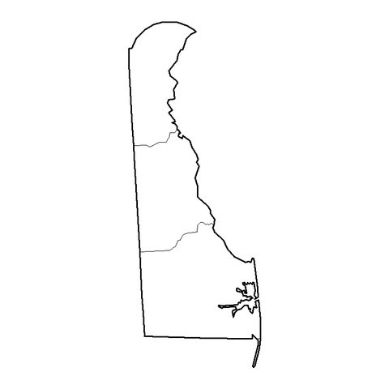
Geographic Differences in Mean Present Well-Being Index
Delaware 8th Grade Mean Present Score
Delaware Adult Mean Present Score*
Wilmington: 7.67
New Castle County: 7.07
New Castle County: 7.15
Kent County: 6.81
Kent County: 6.87
Sussex County: 7.24
Sussex County: 7.47
*Adult data source: Gallup National Health and Well-Being Index, 2017

Slide 18
Gender Differences in Mean Present & Future Well-Being Index
(N=3,379)
(n=1,640)
(n=1,739)
(N=3,358)
(n=1,632)
(n=1,726)

Slide 19
Race in Mean Present and Future Well-Being Index
(N=2,984)
(n=663)
(n=1,309)
(N=2,965)
(n=657)
(n=1,302)

Slide 20
Disability Status Differences, Present & Future
Medically diagnosed with a physical, emotional and/or learning disability?
(n=541)
(n=2,806)
(n=538)
(n=2,788)

Slide 21
Support and Encouragement, Present Well-Being Index
(n=154)
(n=2,911)
(n=1,479)
(n=2,327)
(n=813)

Slide 22
Risk Factor: Violence, Present Well-Being Index
(n=730)
(n=2,657)
(n=505)
(n=2,880)

Slide 23
Risk Factor: Alcohol Use, Present Well-Being Index
(n=232)
(n=3,104)

Slide 24
Risk Factor: Marijuana Use, Present Well-Being Index
(n=221)
(n=3,155)

Slide 25

Laura Rapp, PhD
lrapp@udel.edu
Scientist
Center for Drug & Health Studies
Dana Carr, MPH
Dana.carr@Delaware.gov
Senior Advisor for Prevention & Health
Division of Substance Abuse & Mental Health
Funding for this project has been provided by the Department for Health and Social Services, Division of Substance Abuse and Mental Health - State of Delaware through award SU-17-002 from the Substance Abuse and Mental Health Services Administration (SAMHSA).

Slide 26
Positive Childhood Experiences
state epidemiological outcomes workgroup
M. J. Scales, MPH, CPS
Aila Prieto, ba, bs
July 28, 2020

Slide 27

State Epidemiological Outcomes Workgroup
Funding for this project has been provided by the Department for Health and Social Services, Division of Substance Abuse and Mental Health - State of Delaware through award SU-17-002 from the Substance Abuse and Mental Health Services Administration (SAMHSA).

Slide 28
Positive Childhood Experiences (PCE)
Positive childhood experiences are opportunities and advantages in childhood that increase the likelihood of healthy development.
PCEs are NOT the absence of Adverse Childhood Experiences (ACEs) but may mitigate the deleterious effects of ACEs.
    Adolescent Connectedness and Adult Health Outcomes, 2019
    Positive Childhood Experiences and Adult Mental and Relational Health in a Statewide Sample Associations Across Adverse Childhood Experiences Levels, 2019
    Positive Childhood Experiences and Positive Adult Functioning: Prosocial Continuity and the Role of Adolescent Substance Use, 2011

Slide 29
PCE Score (Bethell et al., 2019)
  Felt able to talk to their family about their feelings
  Felt their family stood by them during difficult times
  Enjoyed participating in community traditions
  Felt a sense of belonging in high school
  Felt support by friends
  Had at least two non-parent adults who took genuine interest in them
  Felt safe and protected by an adult in their home

Slide 30
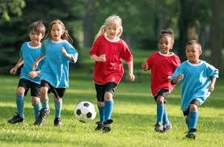
Protective Factors
Characteristics and resources that may mitigate the effects of adversity and promote resilience at various levels
Protective factors and PCEs work in tandem to provide a positive environment for youth to flourish and promote a stable foundation for adulthood

Slide 31
Delaware PCE Data: Youth

Slide 32
Communication
More than 63% of Delaware middle school students reported that they talk with their parents often or always about things that matter.
72% of Delaware middle school students reported that their parents often or always listen when they talk.
67% of Delaware middle school students reported that their parents often or always take interest in their activities.
2017 Youth Risk Behavior Survey administered by University of Delaware Center for Drug and Health Studies. https://www.cdhs.udel.edu/seow/school-surveys/youth-risk-behavior-survey-(yrbs)

Slide 33
Prevention Communication
94% of Delaware High School Students have talked with their parents, or other family adult, within the last 1-2 years about what they expect youth to do or not to do when it comes to sex.
2019 Delaware School Survey administered by University of Delaware Center for Drug and Health Studies. https://www.cdhs.udel.edu/seow/school-surveys/delaware-school-survey-(dss)
2017 Youth Risk Behavior Survey administered by University of Delaware Center for Drug and Health Studies. https://www.cdhs.udel.edu/seow/school-surveys/youth-risk-behavior-survey-(yrbs)

Slide 34
Feeling Safe
*5th Grade: Most of the Time (Yes/No)
*8th & 11th Grade: Often/Most of the Time (Scale)
2019 Delaware School Survey administered by University of Delaware Center for Drug and Health Studies. https://www.cdhs.udel.edu/seow/school-surveys/delaware-school-survey-(dss)

Slide 35
Conclusion
Positive Childhood Experiences are those that encourage a sense of support, safety, and encouragement within a child.
PCEs and Protective factors work to improve whole child wellness and promote later adult wellness.
There is more work to be done…
  Standardizing measurements
  Replicating studies in diverse populations

Slide 36
Questions?

Slide 37
References
2017 Youth Risk Behavior Survey administered by University of Delaware Center for Drug and Health Studies. https://www.cdhs.udel.edu/seow/school-surveys/youth-risk-behavior-survey-(yrbs)
2019 Delaware School Survey administered by University of Delaware Center for Drug and Health Studies. https://www.cdhs.udel.edu/seow/school-surveys/delaware-school-survey-(dss)
Bethell, C., Jones, J., Gombojav, N., Linkenbach, J., & Sege, R. (2019). Positive Childhood Experiences and Adult Mental and Relational Health in a Statewide Sample. JAMA Pediatrics, 173(11), e193007. https://doi.org/10.1001/jamapediatrics.2019.3007
Centers for Disease Control and Prevention (2019). Preventing Adverse Childhood Experiences: Leveraging the Best Available Evidence. Atlanta, GA: National Center for Injury Prevention and Control, Centers for Disease Control and Prevention.

Slide 38
References
Kosterman, R., Mason, W. A., Haggerty, K. P., Hawkins, J. D., Spoth, R., & Redmond, C. (2011). Positive Childhood Experiences and Positive Adult Functioning: Prosocial Continuity and the Role of Adolescent Substance Use. Journal of Adolescent Health, 49(2), 180–186. https://doi.org/10.1016/j.jadohealth.2010.11.244
Steiner, R. J., Sheremenko, G., Lesesne, C., Dittus, P. J., Sieving, R. E., & Ethier, K. A. (2019). Adolescent Connectedness and Adult Health Outcomes. Pediatrics, 144(1), e20183766. https://doi.org/10.1542/peds.2018-3766

Slide 39

Teri Brown Lawler, MA, LPCMH
Education Associate for Trauma-Informed Practices and Social and Emotional Learning (DDOE)
Delaware School Psychologist of the Year, 2010
Founding Member of
  Trauma Matters Delaware
  Delaware’s Compassionate Schools Learning Collaborative
  City of Wilmington’s Advisory Council for Youth Gun Violence Prevention

Slide 40
Action Steps:
What are the action steps you can take within your organizations to promote PCEs, protective factors, and resiliency?

Slide 41
Member Updates

Slide 42
Please remember to participate in the SEOW Satisfaction Survey!

Slide 43
Please visit the SEOW online at:
https://www.cdhs.udel.edu/seow/what-is-seow
Like us on Facebook
Follow us on Twitter
@CDHSDelaware

