Slide 1
Data Overview of Risks and Assets of Delaware Youth
Building a Continuum of Behavioral Health Support in Delaware High Schools
January 7, 2020

Slide 2
What school survey data do we have for Delaware students?
Delaware Secondary School Survey
Administered annually
5th, 8th, and 11th grade students
Youth Risk Behavior Survey
Administered biannually (odd-numbered years)
Middle and high school students
Major domains covered:

Slide 3
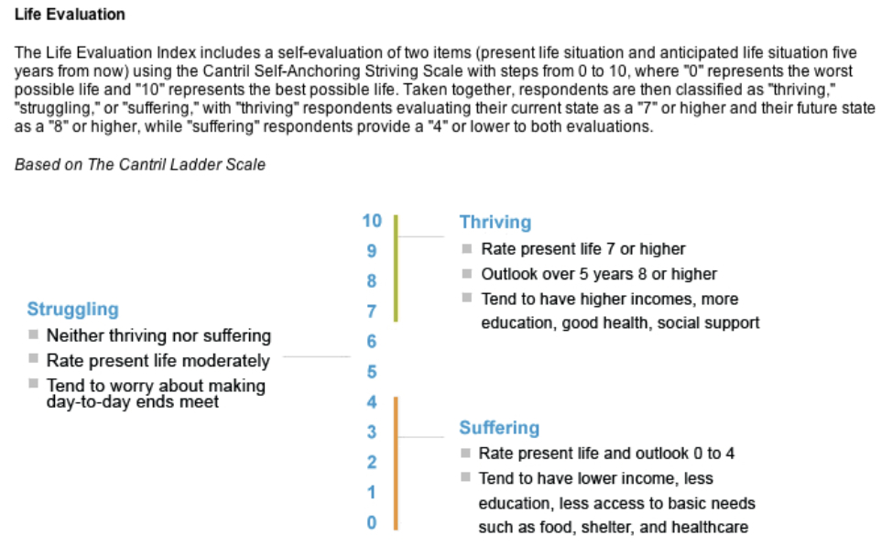
What is well-being? How do we measure it?

Slide 4
Are our youth suffering, struggling, or thriving?
Child well-being occurs in the context of families, schools, and communities.

Slide 5
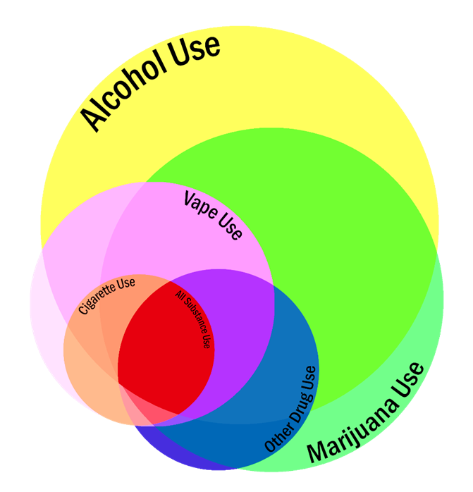
What do we know about overall youth substance use?
This Venn diagram represents the past year substance use patterns of 11th grade students in Delaware.
Substance | % reporting past year use
Alcohol | 45%
Marijuana | 34%
E-cigarette/Vape | 17%
Cigarettes | 7%
At least one other drug | 12%
All of the above categories | 2%
Source: 2018 Delaware Secondary School Survey

Slide 6
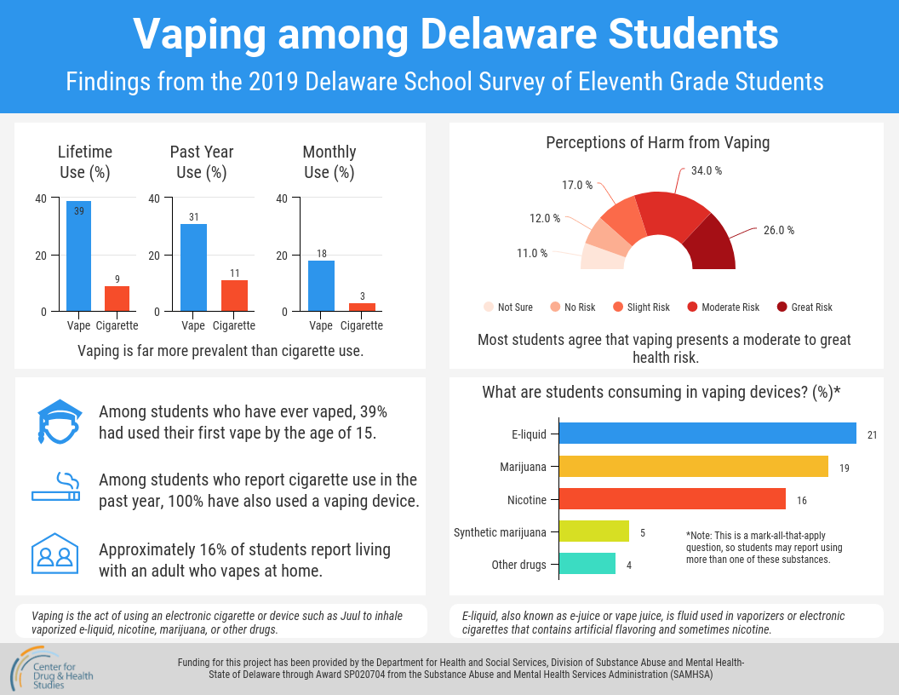

Slide 7
What do we know about overall mental health?
28% of high school students = about 11,700 students.
Source: 2017 Delaware High School Youth Risk Behavior Survey

Slide 8
What do we know about overall mental health?
Nearly 14% of high school students report purposely hurting or cutting themselves in the past year.
Trends in suicidal thoughts, plans, and attempts among Delaware students have remained relatively stable, neither decreasing or increasing substantially in the last decade.
Source: 2017 Delaware High School Youth Risk Behavior Survey

Slide 9
Asset and Risk Disparities: Substance Use
Population | Percent reporting past month alcohol use | Percent reporting past month prescription pain medicine misuse**
Total Population | 29% | 6%
Youth with two or more Adverse Childhood Experiences | 45% | 17%
Youth with Incarcerated Parents | 48% | 15%
LGBQ Youth | 31% | 11%
Youth with Disabilities* | 33% | 11%
Youth Diagnosed with ADD/ADHD, Anxiety or Depression | 36% | 9%
Bullying Victim | 40% | 11%
*Youth with disabilities includes both self-reported disabilities as well as those who indicate that they have been diagnosed with a disability.
**Prescription pain medicine use is use without a doctors prescription or differently then how a doctors told you to use it.
Source: 2017 Delaware High School Youth Risk Behavior Survey

Slide 10
Asset and Risk Disparities: Mental Health
Population | Percent reporting feeling sad or hopeless for past 14 days (2017 High School YRBS)
Total Population | 28%
Youth with two or more Adverse Childhood Experiences | 46%
Youth with Incarcerated Parents | 32%
LGBQ Youth | 53%
Youth with Disabilities* | 50%
Youth Diagnosed with ADD/ADHD, Anxiety or Depression | 49%
Bullying Victim | 50%
*Youth with disabilities includes both self-reported disabilities as well as those who indicate that they have been diagnosed with a disability.
**Prescription painkiller use is non-medical use of opioid painkiller medicines.
Source: 2017 Delaware High School Youth Risk Behavior Survey

Slide 11
Youth at Disproportionate Risk: Youth with a Disability
34% of high school students = a little over 14,000 students.
Source: 2017 Delaware High School Youth Risk Behavior Survey

Slide 12
Youth at Disproportionate Risk: Lesbian, Gay, Bisexual or Questioning Youth
Heterosexual | 86%
Gay or Lesbian | 3%
Bisexual | 8%
Unsure | 3%
Source: 2017 Delaware High School Youth Risk Behavior Survey

Slide 13
Youth at Disproportionate Risks: Adverse Childhood Experiences (ACES)
% of High School Students that Report ACEs
0 ACEs | 57%
1 ACE | 23%
2 or more | 20%
About 18,000 students report experiencing one or more ACE.
Notes: Students who confirmed experiencing any of the events above such as homelessness, incarcerated parent, fighting, being threatened, being bullied, or teen dating violence or sexual violence, were placed in either “1 ACE” or “2 or More ACEs” category depending on the number of different experiences they reported.
Source: 2017 Delaware High School Youth Risk Behavior Survey

Slide 14
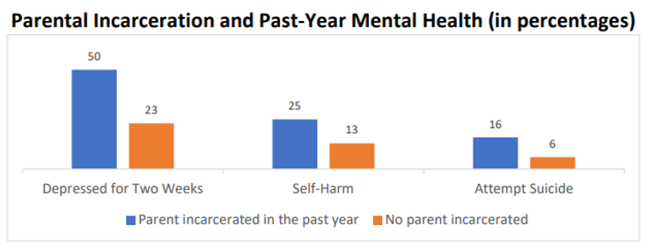
Risks and Assets:
Family
Students with incarcerated parents report feeling sad or hopeless, engaging in self-harm, and attempting suicide more than twice as frequently as students without incarcerated parents.
Source: 2017 Delaware High School Youth Risk Behavior Survey

Slide 15
Shared Risk:
Substance Use, Mental Health Concerns, and Sexual Risk Behaviors
64% of all students (approx. 26,000 students) reported at least one of these risky behaviors/concerns.
24% of all students reported both substance use and risky sexual behavior.
16% of all students reported both a mental health concern and risky sexual behavior.
12%
18% of all students reported both substance use and a mental health concern.
12% of all students reported substance use, a mental health concern, and risky sexual behavior.
Source: 2017 Delaware High School Youth Risk Behavior Survey

Slide 16
Risks and Assets:
Community
Frequency of Feeling Safe | Past month prescription drug misuse
Most of the time | 3%
Often | 3%
Some of the time | 5%
Not often | 7%
Never | 11%

Slide 17
Risks and Assets:
School
Approximately 86% of surveyed 11th graders report that they care about doing well in school.
Source: 2018 Delaware Secondary School Survey

Slide 18
Risks and Assets:
School
Source: 2017 Delaware High School Youth Risk Behavior Survey

Slide 19
Risks and Assets:
School Environment
Source: 2017 Delaware High School Youth Risk Behavior Survey

Slide 20
Risks and Assets:
Individual/Peer
Most Students…..
Think it is important to help friends (83%)
Think it is important to help people, including strangers (70%)
Try to plan ahead to make good decisions (69%)
Tell the truth, even when it isn’t easy (55%)
Feel that they have control over how their life is going often or most of the time (61%)
Source: 2019 Secondary Delaware School Survey

Slide 21
Risks and Assets:
Seeking Help
Source: 2019 Secondary Delaware School Survey, 11th grade students

Slide 22
Risks and Assets:
Sources of Support and Encouragement
Source: 2017 Delaware High School Youth Risk Behavior Survey

Slide 23
Risks and Assets: School Wellness Center Use - Delaware 11th Grade Students
According to the 2019 Delaware Secondary School Survey, 51% of 11th graders reported using school wellness centers.
Source: 2019 Secondary Delaware School Survey

Slide 24
Thank You!
This presentation was prepared for
Director Elizabeth Romero and the Delaware Division of Substance Abuse and Mental Health
by the State Epidemiological Outcomes Workgroup (SEOW) Facilitator Team
at the University of Delaware Center for Drug and Health Studies
with funding from the
Strategic Prevention Framework - Partnerships for Success Program.
For questions, please contact:
Laura Rapp, PhD
lrapp@udel.edu
Learn more about the SEOW at:
https://www.cdhs.udel.edu/seow/what-is-seow

