Slide 1
Youth Behavioral Health Data Overview
State Epidemiological Outcomes Workgroup
University of Delaware Center for Drug and Health Studies
November 20, 2020

Slide 2
State Epidemiological Outcomes Workgroup
Funding for this project has been provided by the Delaware Department for Health and Social Services, Division of Substance Abuse and Mental Health through the Substance Abuse and Mental Health Services Administration (SAMHSA).

Slide 3
State Epidemiological Outcomes Workgroup (SEOW)
Goals of the SEOW:
To build monitoring and surveillance systems to identify, analyze, and profile data from state and local sources;
To identify, share, and analyze data;
To create data-guided products that inform prevention planning and policies;
To train agencies and communities in understanding, using, and presenting data effectively.
https://www.cdhs.udel.edu/seow/what-is-seow

Slide 4
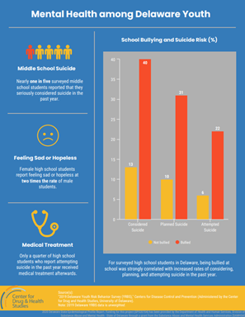
Some of the ways that the SEOW supports organizations and decisionmakers…
Technical Assistance
Data Presentations
Data Products
School Survey Data Dissemination & Analyses (CDHS)

Slide 5
Data: School Surveys
Instrument | Frequency of Data Collection | Grades | Geographic Level Availability | Topics
Delaware School Survey https://www.cdhs.udel.edu/seow/school-surveys/delaware-school-survey-(dss) | Annually | 5th, 8th, & 11th | State, County, Zip Code, District* | Mental Health, Risk & Protective Factors, etc.
Youth Risk Behavior Survey https://www.cdhs.udel.edu/seow/school-surveys/youth-risk-behavior-survey-(yrbs) | Every Two Years | Middle & High School | State, County | Risk Behaviors, Reproductive Health, Nutrition & Physical Activity, etc.
*Requires additional permission.

Slide 7
Feeling Sad/Hopeless: High School Students
Sources: CDHS. (2017). YRBS: High School. University of Delaware.; Centers for Disease Control and Prevention. [2017] Youth Risk Behavior Survey Data. Available at: www.cdc.gov/yrbs

Slide 8
Past Year Self Harm: High School Students (%)
Source: CDHS. (2017). YRBS: High School. University of Delaware

Slide 9
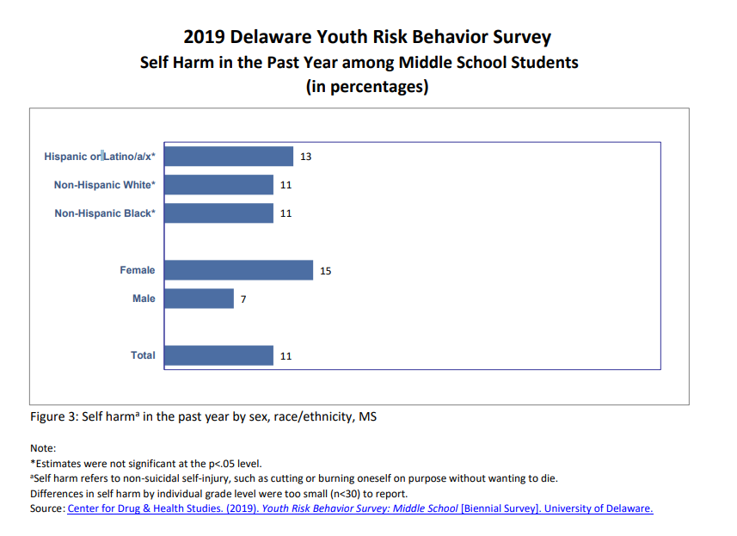
Self Harm: Delaware Middle School Students (%)
Source: CDHS. (2019). YRBS: High School. University of Delaware

Slide 10
Past Year Suicidal Ideation: High School Students (%)
Source: CDHS. (2017). YRBS: High School. University of Delaware

Slide 11
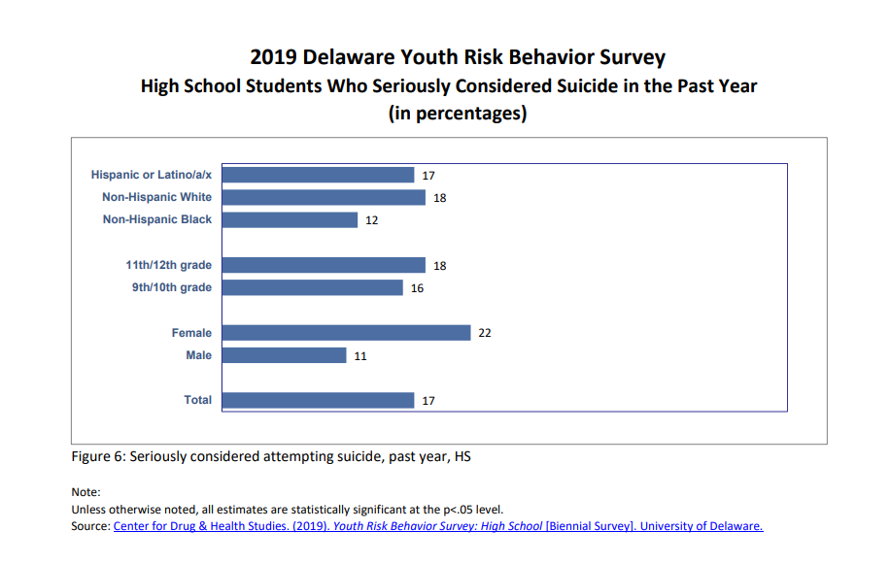
Self Harm: Delaware Middle School Students (%)
Source: CDHS. (2019). YRBS: High School. University of Delaware

Slide 12
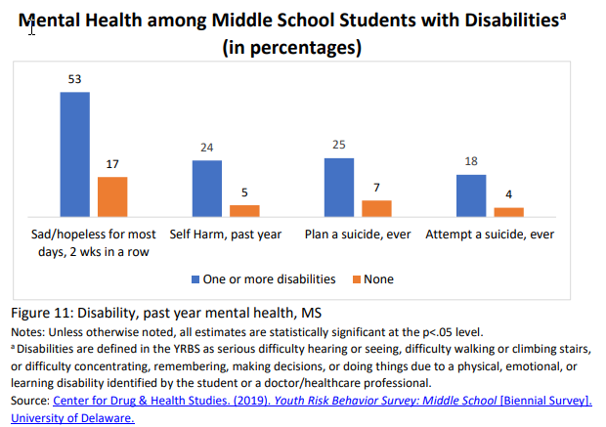

Slide 13
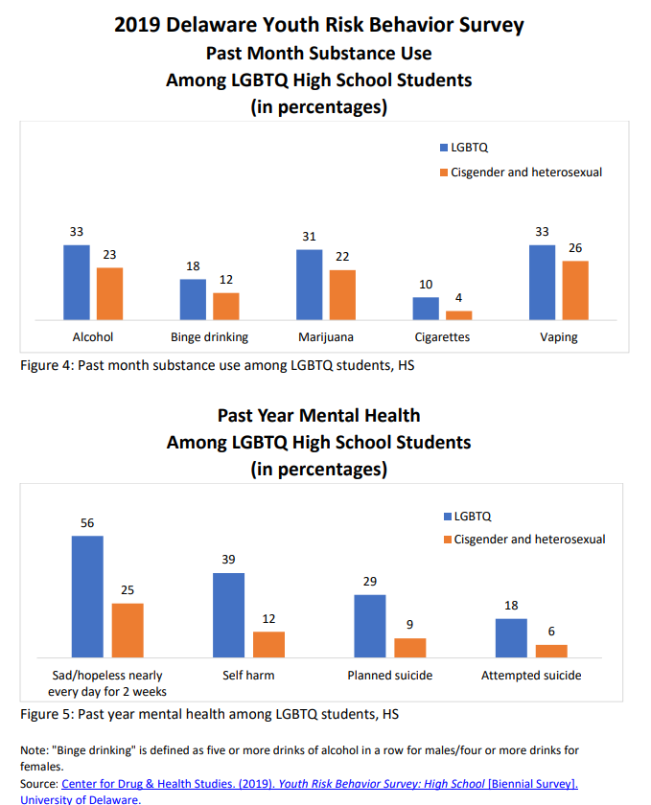

Slide 14
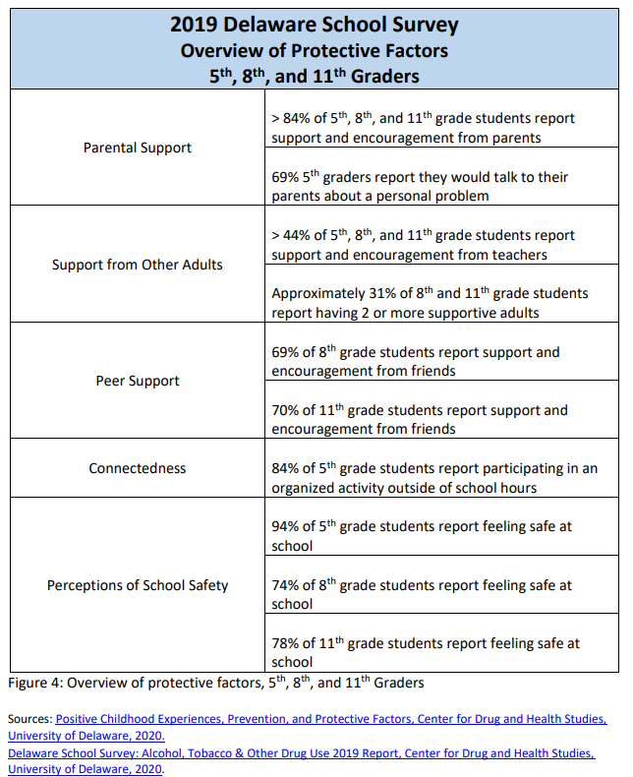

Slide 15
For questions about this presentation or the seow: M. J. Scales, MPH, CPS mjscales@udel.edu
Thank you!

