Slide 1
Youth Health Data Overview
State Epidemiological Outcomes Workgroup
University of Delaware Center for Drug and Health Studies
November 18, 2020

Slide 2
State Epidemiological Outcomes Workgroup
Funding for this project has been provided by the Delaware Department for Health and Social Services, Division of Substance Abuse and Mental Health through the Substance Abuse and Mental Health Services Administration (SAMHSA).

Slide 3
State Epidemiological Outcomes Workgroup (SEOW)
Goals of the SEOW:
To build monitoring and surveillance systems to identify, analyze, and profile data from state and local sources;
To identify, share, and analyze data;
To create data-guided products that inform prevention planning and policies;
To train agencies and communities in understanding, using, and presenting data effectively.
https://www.cdhs.udel.edu/seow/what-is-seow

Slide 4
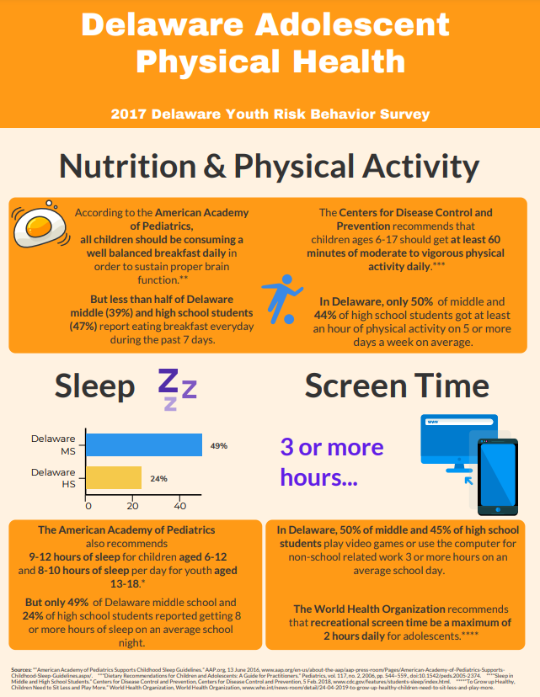
Some of the ways that the SEOW supports organizations and decisionmakers…
Technical Assistance
Data Presentations
Data Products
School Survey Data Dissemination & Analyses (CDHS)

Slide 5
Data: School Surveys
Instrument | Frequency of Data Collection | Grades | Geographic Level Availability | Topics
Delaware School Survey https://www.cdhs.udel.edu/seow/school-surveys/delaware-school-survey-(dss) | Annually | 5th, 8th, & 11th | State, County, Zip Code, District* | Mental Health, Risk & Protective Factors, etc.
Youth Risk Behavior Survey https://www.cdhs.udel.edu/seow/school-surveys/youth-risk-behavior-survey-(yrbs) | Every Two Years | Middle & High School | State, County | Risk Behaviors, Reproductive Health, Nutrition & Physical Activity, etc.
*Requires additional permission.

Slide 6
Nutrition: Sussex County High School Students
In the past 7 days… | None (0) | 1-3 times | 4-6 times | 1/day | 2/day | 3/day | 4 or more /day
Fruit Consumption | 6.7% | 23.9% | 25.1% | 12.7% | 19.2% | 6.7% | 5.7%
Vegetable/Salad Consumption | 10.6% | 28.5% | 24.5% | 14.0% | 12.4% | 3.7% | 6.3%
CDHS. (2017). YRBS: High School. University of Delaware.

Slide 7
Nutrition: Sussex County High School Students
CDHS. (2017). YRBS: High School. University of Delaware.

Slide 8
Physical Activity & Sleep: Sussex County High School Students
CDHS. (2017). YRBS: High School. University of Delaware.

Slide 9
In the Car: Sussex County High School Students
How often do you wear a seat belt when riding in a car driven by someone else?
Always: 62.9%
Most of the Time: 25.3%
Sometimes: 6.5%
Rarely: 3%
Never: 2.3%
During the past 30 days, on how many days did you text or e-mail while driving a car or other vehicle?
 | 16-17 y. o. | 18 or older
Do not drive | 24.6% | 20.4%
0 days | 44.5% | 16.3%
1-19 days | 19% | 49.8%
20-30 days | 11.8% | 13.7%
CDHS. (2017). YRBS: High School. University of Delaware.

Slide 10
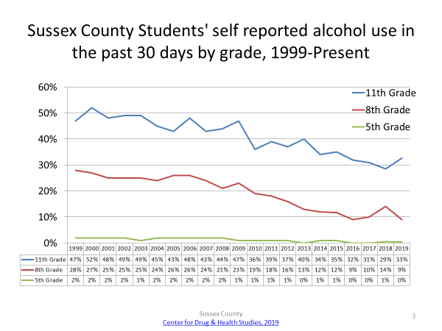
CDHS. (2020). DSS: Secondary. University of Delaware. CDHS. (2020). DSS: 5th Grade. University of Delaware.

Slide 11
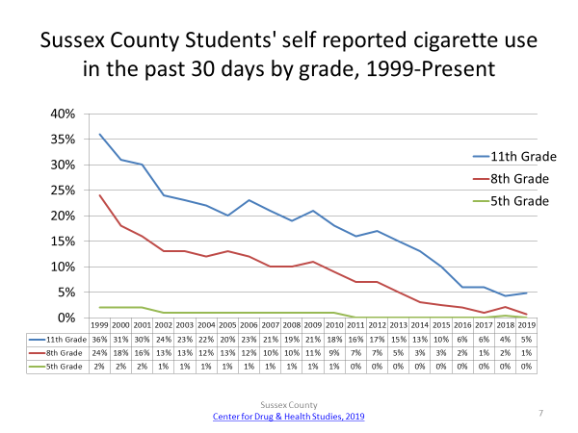
CDHS. (2020). DSS: Secondary. University of Delaware. CDHS. (2020). DSS: 5th Grade. University of Delaware.

Slide 12
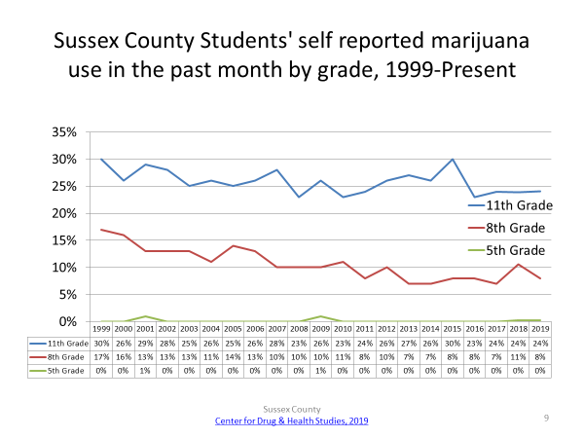
CDHS. (2020). DSS: Secondary. University of Delaware. CDHS. (2020). DSS: 5th Grade. University of Delaware.

Slide 13
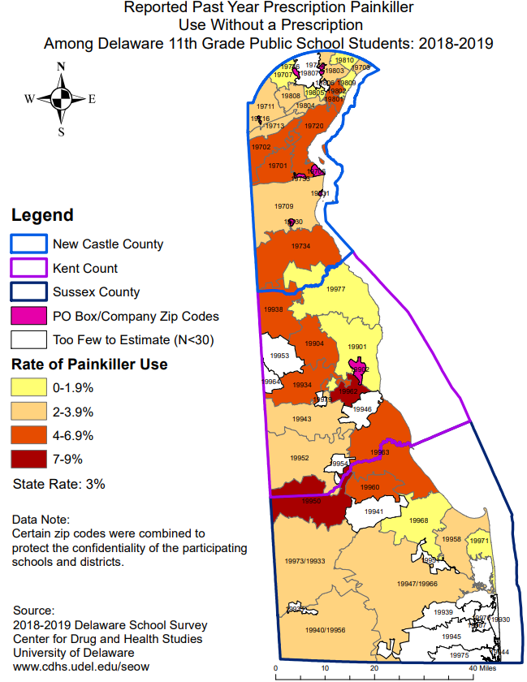

Slide 14
Emotional Health: Sussex County High School Students
CDHS. (2017). YRBS: High School. University of Delaware.

Slide 15
For questions about this presentation or the seow: M. J. Scales, MPH, CPS mjscales@udel.edu
Thank you!

