Slide 1
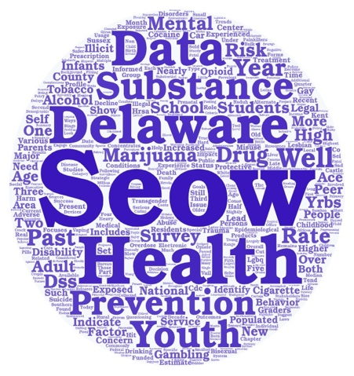
Welcome!
We will get started in just a few moments.
Please introduce yourself in the chat.
All attendees are muted upon entry.
This meeting is being recorded.

Slide 2
State Epidemiological Outcomes Workgroup Winter Session
University of Delaware
Center for Drug and Health Studies
January 28, 2021

Slide 3
State Epidemiological Outcomes Workgroup
Funding for this project has been provided by the Delaware Department for Health and Social Services, Division of Substance Abuse and Mental Health through the Substance Abuse and Mental Health Services Administration (SAMHSA).

Slide 4
Agenda
Welcome, Opening Announcements, & Introductions
Four Goals of the SEOW
Data Champions
National Behavioral Health Landscape and
Breakout Discussion and Debrief
Adverse Childhood Experiences
Positive Childhood Experiences Report
Mapping Naloxone Distribution in Delaware
SEOW Stakeholder Satisfaction Survey
Network Members Share Out

Slide 5
Who We Are

Slide 6
The Four Goals of the SEOW

Slide 7
Data Champions!

Slide 8
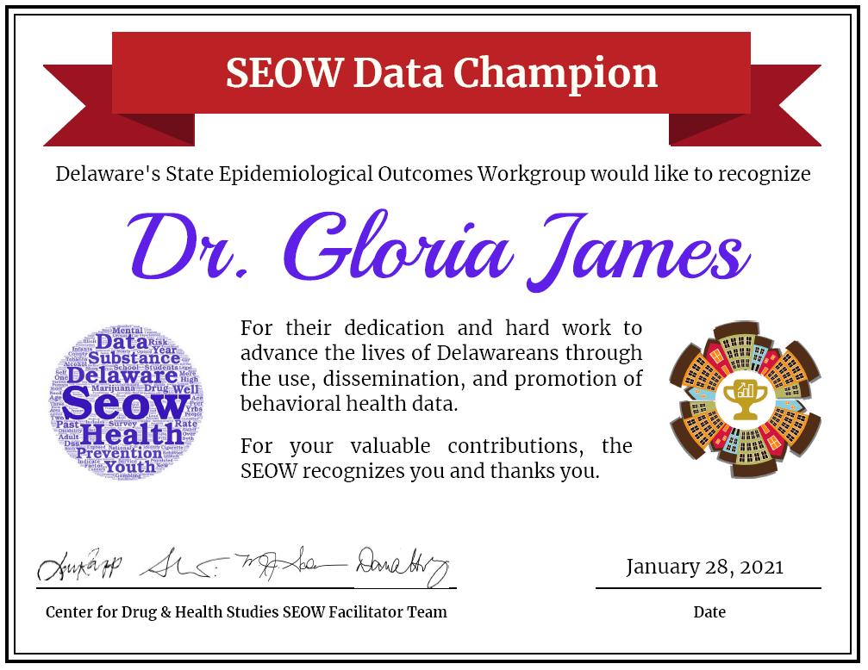

Slide 9
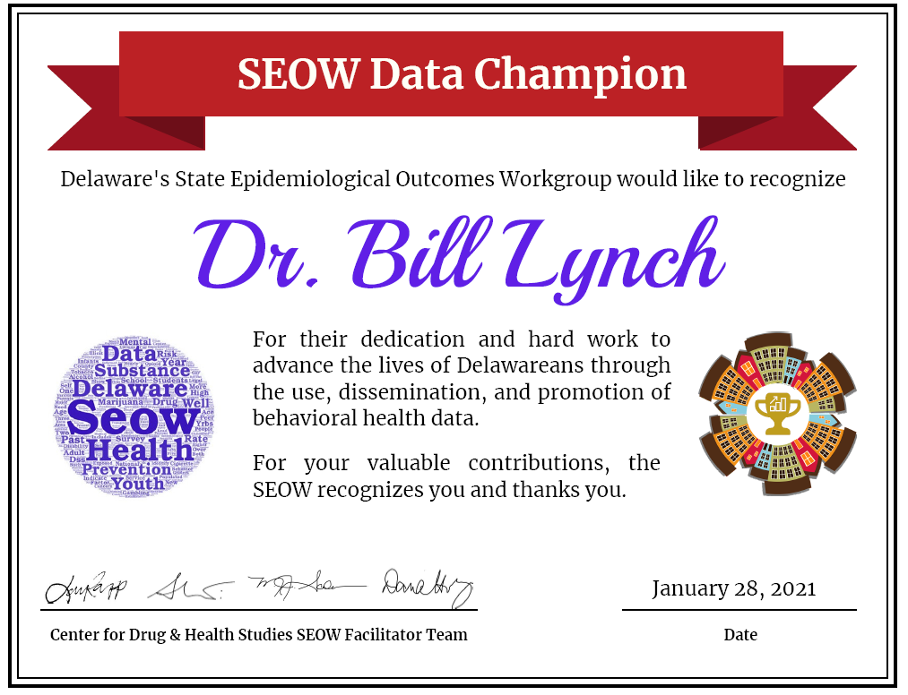

Slide 10
National Behavioral Health Landscape
Latest Trends and Impact of the COVID-19 Pandemic
Dana Holz, PhD
Rachel Ryding, MA
Center for Drug and Health Studies

Slide 11
Prior to COVID-19 Pandemic
An Overview of National Behavioral Health Data
Notes:
We know that the pandemic has negatively impacted behavioral health for a lot of people, and we know that the pandemic has also complicated research and data collection on these issues. First going to discuss where we know we stand with some of the data that was collected in the year prior to the pandemic that is now available, and then Dana is going to talk a bit about what we do know about how the pandemic has impacted some of these issues.

Slide 12
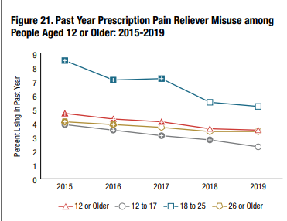
Prescription Opioid Misuse and Overdose Fatality
National Survey on Drug Use and Health, 2019
Past year painkiller misuse continues to decline, but overdose deaths have increased nationwide, with Delaware maintaining one of the highest overdose fatality rates per capita in the U.S.
SAMHSA 2020; CDC 2020
Notes:
Starting with data from National Survey on Drug Use and Health from 2019, this report was released in late 2020.

Slide 14
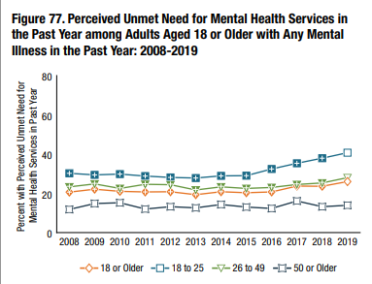
Rising Unmet Need for Mental Health Services
National Survey on Drug Use and Health, 2019
There has been an increasing rate of unmet need for mental health services, particularly among younger adults
SAMHSA 2020

Slide 15
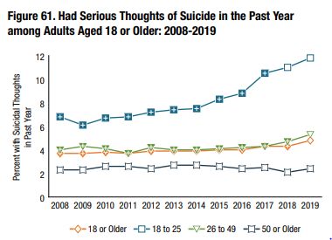
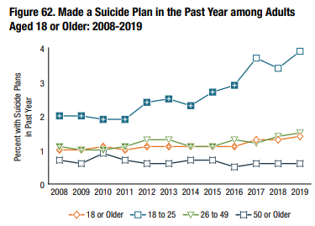
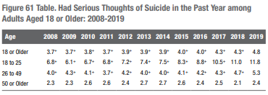
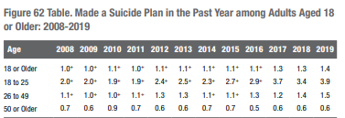
Thoughts and Plans for Suicide, Recent Increases
National Survey on Drug Use and Health, 2019
SAMHSA 2020

Slide 16
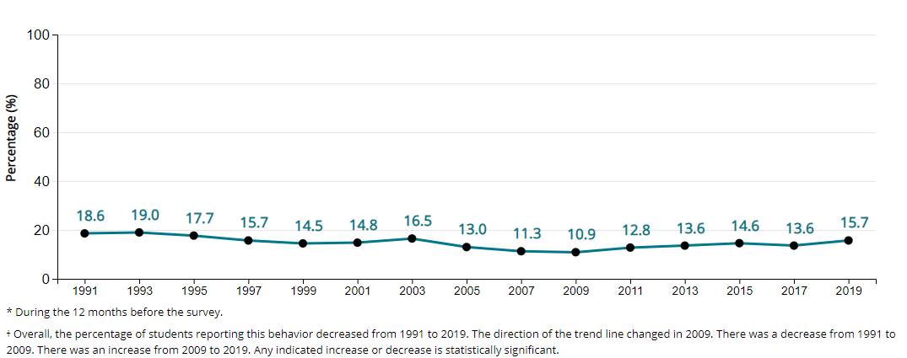
High School Students with Suicide Plans in Past Year
National Youth Risk Behavior Survey, 2019
Centers for Disease Control and Prevention (CDC). 1991-2019 High School Youth Risk Behavior Survey Data. Available at http://yrbs-explorer.services.cdc.gov/. Accessed on January 20, 2021.

Slide 17
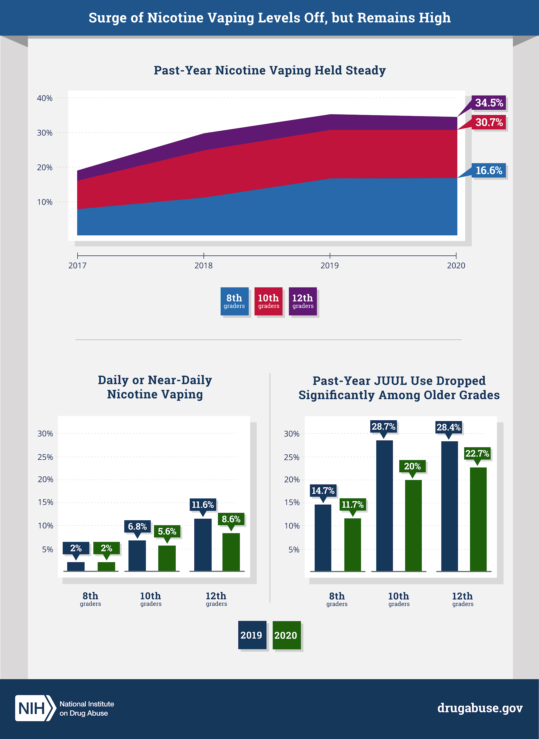
Teen Vaping Patterns
Monitoring the Future, 2020*
The rapid increases in teen vaping of nicotine seem to have levelled off, and Juul use specifically has decreased.
*Monitoring the Future 2020 survey collection was halted by the onset of the pandemic, the survey sample size was 25% of its usual size.
Notes:
*Data collection stopped prematurely due to the COVID-19 pandemic. Completed surveys represent about 25% of the size of a typical year’s data collection. However, results were gathered from a broad geographic range and were statistically weighted to be nationally representative.

Slide 20
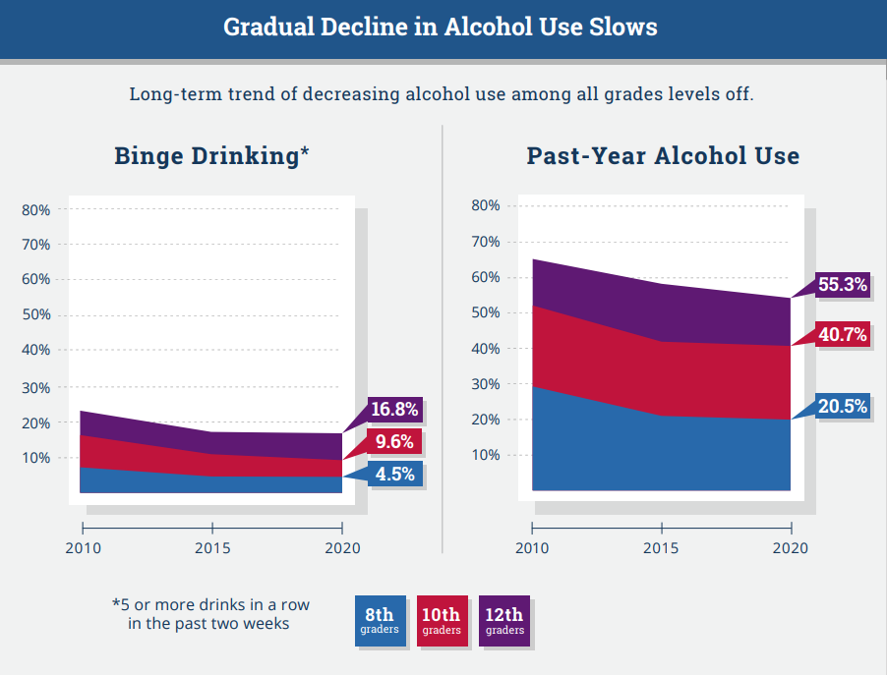

Slide 21
The Impact of COVID-19
What We Know from Preliminary Available Data

Slide 22
Children and Families
Rapid Assessment of Pandemic Impact on Development – Early Childhood
Ongoing, nationally representative survey of households with children 0-5
Single parents, lower income families, and parents of children with special needs are experiencing very high rates of stress (RAPID-EC, 2020, Nov. 11 and Dec. 17)
Overall, for all families, there has been a decline in preventive care and vaccines (RAPID-EC, 2020, Oct. 13).
Caregivers experiencing more financial and material hardship also have more emotional distress and they report that their children have more emotional distress (RAPID-EC, 2020, Jul. 20).

Slide 23
Mental Health
American Psychological Association adapted their annual Stress in America poll for a monthly analysis. Results from online survey April 23- May 4 (APA, 2020).
Overall stress higher than found in the 2019 survey.
Parents reported more stress than non-parents.
Hispanics reported more stress than other racial and ethnic groups
CDC report on pediatric mental health-related ED visits (Leeb et al., 2020)
Based on surveillance data from 47 states during March – October 2020 and in comparison with data from the same time period in 2019
Overall ED visits were less than in 2019, including the total number of mental health related visits
The proportion of mental health related ED visits increased by 24% among children age 5-11 and 31% among youth age 12-17 than that of the same time period in 2019
This may be in part due to an overall decrease in all types of ED visits.

Slide 24
In one national survey in June 2020, respondents reported increased substance use, suicidal ideation, and symptoms of anxiety disorder or depressive disorders compared to responses from the 2019 National Health Interview Survey.
More than twice the number of all respondents reported suicidal ideation than those that responded to the NSDUH in 2018 (10.7% versus 4.3%)
Adverse mental health outcomes were reported more frequently for certain populations:
Young adults
Black and Hispanic adults
Unpaid caregivers for adults
Essential workers
(Czeisler et al., 2020)
4 out of 10
surveyed Americans report symptoms of anxiety or depressive disorders
Household Pulse Survey (U.S. Census Bureau and the National Center for Health Statistics; data from Dec. 9-21, 2020)
In comparison, survey respondents to the National Health Interview Survey reported these same symptoms at 11% in 2019

Slide 25
EMS Mental Health Related Activation data
EMS data from 47 states
While suicide-related activations have not increased during the pandemic, the rate of mental/behavioral activations has increased.

Slide 26
Alcohol
Researchers have found that Americans are reporting increased alcohol use since the pandemic (Barbosa, Cowell, & Dowd, 2020; Capasso, et al., 2021)
One survey in March and April of 2020 of 10,780 English speaking social media users found an overall 29% reported increase in drinking, with some populations reporting more use than others: women, adults under the age of 40, and those with symptoms of anxiety or depressive disorders (Capasso, et al., 2021)

Slide 27
Opioids and Drug Overdose Events
Nationally, 18.2% increase in fatal drug overdoses, in the 12 month period ending in May 2020. with the largest increase occurring during March – May (CDC Health Alert Network, 2020).
Synthetic opioids involved in most cases
Increases in overdose deaths due to cocaine (25.6% increase) and psychostimulants (34.8% increase) from previous 12 month period

Slide 28
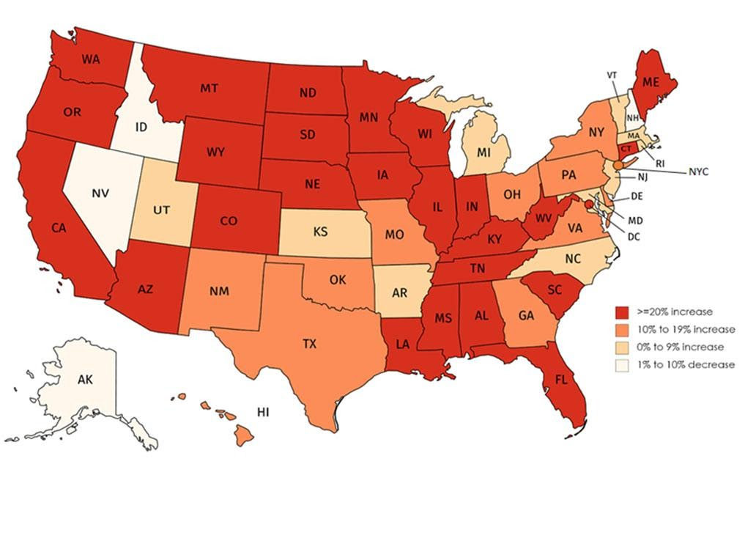
Percentage change in 12-months ending provisional data on all fatal drug overdoses, 50 states, the District of Columbia, and New York City: Overdose deaths from 12-months ending in June 2019 to 12-months ending in May 2020
HAN Archive - 00438 | Health Alert Network (HAN) (cdc.gov)

Slide 29
EMS Opioid Related Activation data
Increased rates of opioid-related and naloxone activations particularly in the early part of the pandemic, and more recent increases going into 2021

Slide 30
Treatment and Recovery
A NIDA supported survey of 1079 respondents with a substance use disorder, conducted between 4/27 – 5/8 through Addiction Policy forums found:
1 in 3 reported changes or disruptions in accessing treatment of recovery support services.
14% reported being unable to receive services
4% reported an overdose since the pandemic began
Analyses of U.S. electronic health records showed that those who were diagnosed with a substance use disorder (SUD) had an increased risk for COVID-19, and significantly worse outcomes from the disease (Wang, Kaelber, Xu, & Volkow, 2020).

Slide 31
References
Addiction Policy Forum. (2020, Sep. 10). COVID-19 pandemic impact on patients, families & individuals in recovery from a SUD. Retrieved from https://www.addictionpolicy.org/post/covid-19-pandemic-impact-on-patients-families-individuals-in-recovery-fromsubstance-use-disorder
American Psychological Association. (2020). Stress in the time of COVID-19 [Volume One]. Retrieved from https://www.apa.org/news/press/releases/stress/2020/stress-in-america-covid.pdf
Barbosa, C., Cowell, A. J., & Dowd, W. N. (2020). Alcohol consumption in response to the COVID-19 pandemic in the United States. Journal of Addiction Medicine. doi: 10.1097/ADM.0000000000000767
Capasso, A., Jones, A. M., Ali, S. H., Foreman, J., Tozan, Y., & DiClemente, R. J. (2021 [pre-release]). Increased alcohol use during the COVID-19 pandemic: The effect of mental health and age in a cross-sectional sample of social media users in the U.S. Preventive Medicine, 145, 106422. https://doi.org/10.1016/j.ypmed.2021.106422
Centers for Disease Control and Prevention. (2020, Dec. 17). Increase in fatal drug overdoses across the United States driven by synthetic opioids before and during the COVID-19 pandemic. Health Alert Network – CDCHAN-00438. Retrieved from https://emergency.cdc.gov/han/2020/han00438.asp
Czeisler, M., Lane, R.I., Petrosky, E., Wiley, J.F., Christensen, A., Njai, R., Weaver, M.D., Robbins, R., Facer-Childs, E.R., Barger, L.K., Czeisler, C.A., Howard, M.E., Rajaratnam, S. M. W. (2020) Mental health, substance use, and suicidal ideation during the COVID-19 pandemic – United States, June 24-30, 2020. MMWR Morbidity and Mortality Weekly Report, 69(32), 1049-1057. Retrieved from https://www.cdc.gov/mmwr/volumes/69/wr/mm6932a1.htm.

Slide 32
Hedegaard H, Miniño AM, Warner M. (2020). Drug overdose deaths in the United States, 1999–2018. NCHS Data Brief, 356. Hyattsville, MD: National Center for Health Statistics. 2020. Retrieved from https://www.cdc.gov/nchs/data/databriefs/db356-h.pdf
Leeb, R. T., Bitsko, R. H., Radhakrishnan, L., Martinez, P., Njai, R., & Holland, K. M. (2020). Mental health-related emergency department visits among children aged <18 years during the COVID-19 pandemic – United States, January 1 – October 17, 2020. MMWR Morbidity and Mortality Weekly Report, 69(45), 1675-1680. Retrieved from https://www.cdc.gov/mmwr/volumes/69/wr/pdfs/mm6945a3-H.pdf
National Center for Health Statistics. (n.d.). Mental health care in the last 4 weeks [Table]. Retrieved from https://www.cdc.gov/nchs/covid19/pulse/mental-health-care.htm
National Institute on Drug Abuse. (2020, Dec.15.) Study: Surge of teen vaping levels off, but remains high as of early 2020. Retrieved from https://www.drugabuse.gov/news-events/news-releases/2020/12/study-surge-of-teen-vaping-levels-off-but-remains-high-as-of-early-2020 on 2021, January 20
Mann, C. (2021). EMS by the Numbers: Impact of COVID-19, January 21st, 2021 [PowerPoint Slides]. National Emergency Medical Services Information System (NEMSIS). Retrieved from https://nemsis.org/wp-content/uploads/2021/01/NEMSIS-TAC-Update-to-COVID_19-Trends-1_21_2021-Pre-Findings-V1.pdf

Slide 33
Rapid Assessment of Pandemic Impact on Development – Early Childhood. (2020, Dec. 17). Overloaded: Families with children who have special needs are bearing an especially heavy weight, and support is needed. University of Oregon, Center for Translational Neuroscience. Retrieved from https://medium.com/rapid-ec-project/overloaded-families-with-children-who-have-special-needs-are-bearing-an-especially-heavy-weight-4e613a7681bd
Rapid Assessment of Pandemic Impact on Development – Early Childhood. (2020, Nov. 11). Home alone: The pandemic is overloading single-parent families. University of Oregon, Center for Translational Neuroscience. Retrieved from https://medium.com/rapid-ec-project/home-alone-the-pandemic-is-overloading-single-parent-families-c13d48d86f9e
Rapid Assessment of Pandemic Impact on Development – Early Childhood. (2020, Jul. 20). A hardship chain reaction: Financial difficulties are stressing families’ and young children’s wellbeing during the pandemic, and it could get a lot worse. University of Oregon, Center for Translational Neuroscience. Retrieved from https://medium.com/rapid-ec-project/a-hardship-chain-reaction-3c3f3577b30
Rapid Assessment of Pandemic Impact on Development – Early Childhood. (2020, Oct. 13). Health (still) interrupted: Pandemic continues to disrupt young children’s healthcare visits. University of Oregon, Center for Translational Neuroscience. Retrieved from https://medium.com/rapid-ec-project/health-still-interrupted-pandemic-continues-to-disrupt-young-childrens-healthcare-visits-e252126b76b8

Slide 34
Substance Abuse and Mental Health Services Administration. (2020). Key substance use and mental health indicators in the United States: Results from the 2019 National Survey on Drug Use and Health (HHS Publication No. PEP20-07-01-001, NSDUH Series H-55). Rockville, MD: Center for Behavioral Health Statistics and Quality, Substance Abuse and Mental Health Services Administration. Retrieved from https://www.samhsa.gov/data/
Wang, Q. Q., Kaelber, D. C., Xu, R., & Volkow, N. D. (2020). COVID-19 risk and outcomes in patients with substance use disorders: analyses from electronic health records in the United States. Molecular Psychiatry, 14, pp. 1-10. doi: 10.1038/s41380-020-00880-7

Slide 35
Break Out Rooms
Q: Does the national picture reflect what you and/or your organization are seeing locally?

Slide 36
Break Out Rooms Debrief
Facilitators: What are the key takeaways from your group?

Slide 37
National Survey of Children’s Health and Delaware ACEs Data
Khaleel Hussaini, PhD
Maternal Child and Health Epidemiologist
Delaware Division of Public Health

Slide 38
Protective Factors,
Positive Childhood Experiences, & Resilience
M. J. Scales, MPH, CPS
Center for Drug and Health Studies

Slide 39
Take a moment…

Slide 40
What’s the difference?
Protective Factors – “are characteristics associated with a lower likelihood of negative outcomes or that reduce a risk factor’s impact” (SAMHSA, 2019)
Positive Childhood Experiences – healthy and supportive events, activities, and experiences that occur during childhood
Resilience – “understood as referring to positive adaptation…despite experiencing adversity” (Herrman et al., 2011)

Slide 41
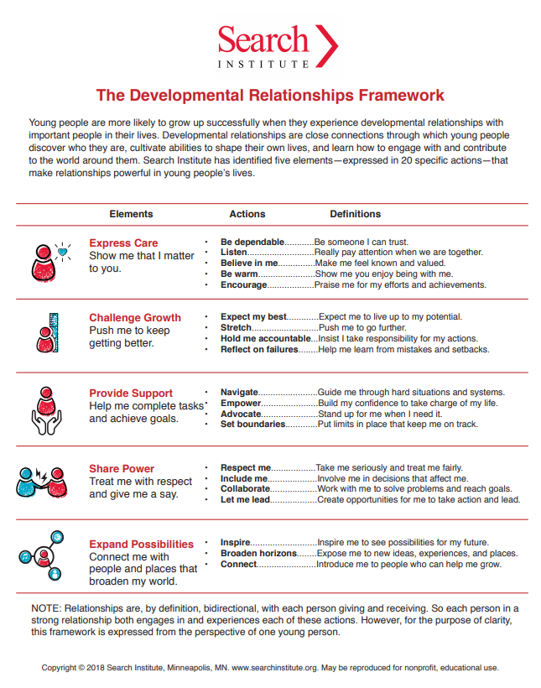

Slide 42
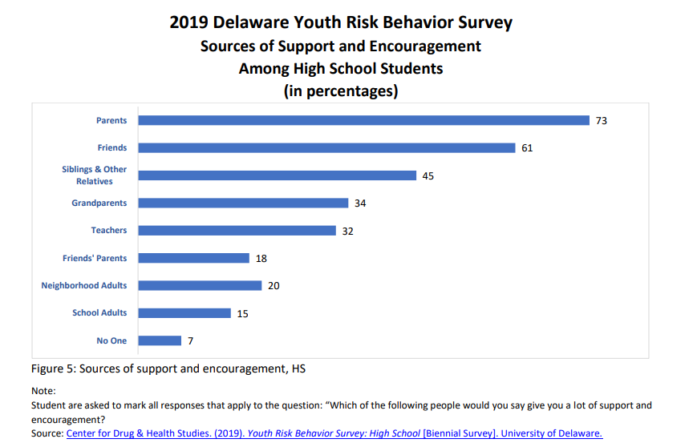

Slide 43
Parents
Approximately 60% of Delaware 11th graders reported ever feeling sad, empty, hopeless, angry or anxious.
Students with 2 or more of the parental protective factors were less likely to report feeling this way.
Similarly, students who reported experiencing more of these protective factors were more likely to report getting the help they need when they feel this way.
Support & Encouragement
2. Strictly Enforced Rules (Most of the Time/Often)
3. Getting Along with Parents, Talking to Parents about School, Parental Pride, Can Count on Parents (At least one Most of the Time/Often)
Source: CDHS. (2019). DSS: Secondary. University of Delaware.

Slide 44
Parents
Support & Encouragement
2. Strictly Enforced Rules (Most of the Time/Often)
3. Getting Along with Parents, Talking to Parents about School, Parental Pride, Can Count on Parents (At least one Most of the Time/Often)
Source: CDHS. (2019). DSS: Secondary. University of Delaware.

Slide 45
During the past 12 months, was there someone that you could turn to for day-to-day emotional support with parenting or raising children?
How well do you think you are handling the day-to-day demands of raising children?
Approximately 76% of national respondents reported yes.
Note: This rate varies when looked at by nativity of parent, race of child, primary household language, etc.
Sixty-three percent of national respondents reported that they handled these demands “very well”.
Source: 2018-2019 National Survey of Children’s Health, Health Resources and Services Administration, Maternal and Child Health Bureau.

Slide 47
We all have more work to do…
Data Collection and Analysis
Ex. CDC pilot of additional YRBS PCE questions
Long term outcomes of PCEs
Expansion to include role of Community Resilience
Operationalizing Definitions
Shift in Focus
Assets
Culturally Responsive Analysis and Interventions

Slide 48
References
Center for Drug & Health Studies. (2019). Delaware School Survey: Secondary [Annual Survey]. University of Delaware. https://www.cdhs.udel.edu/seow/school-surveys/delaware-school-survey-%28dss%29
Center for Drug & Health Studies. (2020). Youth Risk Behavior Survey: High School [Biennial Survey]. University of Delaware. https://www.cdhs.udel.edu/seow/school-surveys/youth-risk-behavior-survey-%28yrbs%29
Child and Adolescent Health Measurement Initiative. 2018-2019 National Survey of Children’s Health (NSCH) data query. Data Resource Center for Child and Adolescent Health supported by the U.S. Department of Health and Human Services, Health Resources and Services Administration (HRSA), Maternal and Child Health Bureau (MCHB)
Herrman, H., Stewart, D. E., Diaz-Granados, N., Berger, E. L., Jackson, B., & Yuen, T. (2011). What is Resilience? The Canadian Journal of Psychiatry, 56(5), 258-265. doi:10.1177/070674371105600504
Substance Abuse and Mental Health Services Administration. (2019, July 18). Risk and Protective Factors. Retrieved from https://www.samhsa.gov/sites/default/files/20190718-samhsa-risk-protective-factors.pdf

Slide 49
Mapping Naloxone Distribution in Delaware
Nuno Martins, BHA I, Research and Evaluation
Kris Fraser, BHA II, Research and Evaluation
Michael C. Williams, MA III, Research and Evaluation
John Gudzelak, MA III, Research and Evaluation
Delaware Division of Substance Abuse and Mental Health

Slide 50
SEOW Stakeholder Satisfaction Survey
Sharon Merriman-Nai, MC
Center for Drug and Health Studies

Slide 51
Key Findings – Data Needs
29 network members responded from across sectors, and 28 had accessed the SEOW online
Top needs for data:
Increase knowledge or raise awareness
Program planning, implementation, evaluation
Analyze, develop, or advocate for policy
Apply for funding
Research, training, community engagement

Slide 52
Key Findings – Data Products
Broad use of various types of SEOW products, including:
Youth Survey Data (YRBS, DSS, YTS, CRBS)
SEOW Heat Maps of substance use
SEOW Infographics
SEOW Delaware Annual Epidemiological Profile
SEOW Power Point Slides and Reports

Slide 53
Key Findings – Data Dissemination
3 out of 4 respondents had shared the data through publications, reports, and other means. Most commonly, people shared data with the general public.
More than half shared data with government agencies
Half shared data with legislators

Slide 54
SEOW Engagement
Technical assistance - > 1 in 5 respondents had asked for assistance within the past 2 years and found the assistance helpful
85% had participated in at least 1 SEOW meeting within the past 2 years.

Slide 55
Recommendations
Although feedback was very positive, several suggestions were offered:
continued and strengthened focus on shared risk and protective factors at community, environmental, and societal levels
co-host a research forum with allied partners for a broader audience of researchers, administrators, and policymakers
sustained and more frequent dissemination of data “bites” (email and social media)

Slide 56
SEOW Resources and Activities
Please visit the SEOW online for new products such as the Epi Profile, infographics, and upcoming publications: www.cdhs.udel.edu/seow
Next SEOW meeting will be held in Summer 2021
Stay tuned for announcements about 3D: Delaware Data Discourse events
Continue to reach out with your data needs and recommendations

Slide 57
Member Network share out

Slide 58
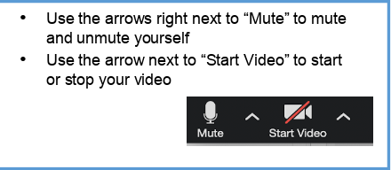
We would like to invite any new members, if comfortable, to unmute their microphones to introduce themselves.
Everyone is welcome to share the latest on your group’s news, upcoming events, and activities.
Please also feel free to post links and information into the chat box.

Slide 59
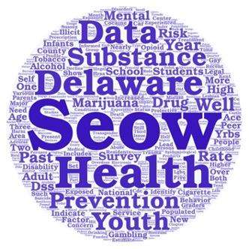
Thank you! We hope to see you at the SEOW Summer Meeting!
For More Information
visit the SEOW at:
www.cdhs.udel.edu/seow

