Slide 1
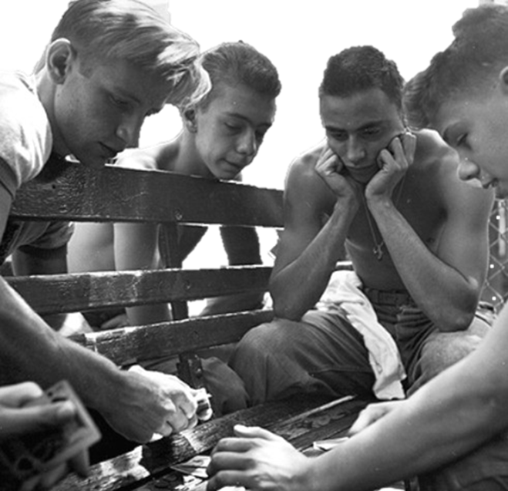
The Danger of Youth Gambling

Slide 2
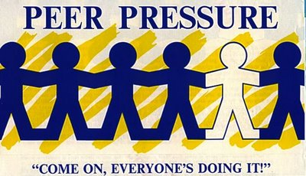
We all know that teens are under stress

Slide 3
And we know that youth use potentially addictive substances and behaviors as an unhealthy way to deal with their stress

Slide 4
And that the use of substances (ATOD) and certain behaviors at an early age increases the likelihood of addiction

Slide 5
But what about gambling? Have you ever seriously thought about how underage gambling effects youth?

Slide 6
Unlike ATOD, most adults consider youth gambling to be harmless so they encourage it or, at the very most, turn a blind eye to it

Slide 7
In fact, youth problem gambling rates are three times higher than adults.

Slide 8
So why is current society so blasé about underage gambling?
While it is true that addictive substances often lower inhibitions leading to poor choices, research has shown that gambling addiction can exist without the influence of any substance, and the problems can be devastating for persons of any age.

Slide 9
Let’s Talk About Youth Gambling in Delaware

Slide 10
Note: Beginning in 2008, Gambling data are collected every other year

Slide 11
Frequency of Different Types of Gambling
Among 2016 Delaware 8th Graders

Slide 12
Frequency of Different Types of Gambling
Among 2016 Delaware 11th Graders

Slide 13
In the 8th grade, 29% of the kids that gambled in the past year drank alcohol, versus 12% of the kids who did not gamble in the past year.

Slide 14
In the 11th grade, 65% of the kids that gambled in the past year drank alcohol, versus 45% of the kids who did not gamble in the past year.

Slide 15
You Wouldn’t Do This (psa)

Slide 16
Let’s think ATOD-G and work together
Risky behaviors go together. ATOD and Gambling clearly have correlations that exist and need to be further explored.
In your prevention efforts with kids, please remember to invite DCGP to make presentations as part of your orientation, summer and afterschool programs, as well as major youth events.

Slide 17
Gambling Addiction is a treatable disorder
DELAWARE COUNCIL ON GAMBLING PROBLEMS
provides a toll-free, 24/7 HELPLINE
that is answered by a LIVE person, 365 days a year.
Please call us.
We can help problem gamblers and their families
get the help they need.
1-888-850-8888

