Slide 1
Welcome!
We will get started in just a few moments.
Please introduce yourself in the chat.
All attendees are muted upon entry.
This presentation will be recorded.

Slide 2
State Epidemiological Outcomes Workgroup
Summer Meeting
Center for Drug and Health Studies at the University of Delaware
July 29th, 2021

Slide 3
Funding for the State Epidemiological Outcomes Workgroup (SEOW) has been provided by the
Delaware Department for Health and Social Services,
Division of Substance Abuse and Mental Health (DSAMH)
through the Substance Abuse and Mental Health Services Administration (SAMHSA).
This webinar is being recorded and will be available for future viewing. Please contact the webinar facilitator if you have any concerns or questions.
The SEOW is facilitated by the
Center for Drug and Health Studies at the University of Delaware.
Visit:
https://www.cdhs.udel.edu/seow/what-is-seow

Slide 4
Agenda
Welcome & Introductions
Mission & Accomplishments
New Data Products
Data Champion
Adverse Childhood Experiences
Breakout
Rape Prevention Education
Breakout
Network Share Out

Slide 5
Continuing Education Hours
The Delaware Certification Board has approved continuing education hours for the following presentations of this meeting:
Adverse Childhood Experiences in Delaware (.75 hours)
The Delaware Rape Prevention and Education Program (RPE): Building Evaluation Capacity ( .5 hours)

Slide 6
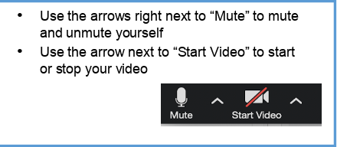
Introductions
We would like to invite any new members, if comfortable, to unmute their microphones to introduce themselves.
Facilitator Team
Center for Drug and Health Studies Team

Slide 7
The Four Goals of the SEOW

Slide 8
New Data Products and Publications
NEW! Infographic-LGBTQ+ Affirming Spaces NEW! Infographic-Driving and Substance Use: A Look at National and Delaware Data
NEW! Infographic-Behavioral Health: Black/African American Youth in Delaware
Delaware Journal of Public Health July 2021:
The Value (and Nuances) of Mapping as a Public Health Tool
What is the Delaware SEOW?

Slide 9
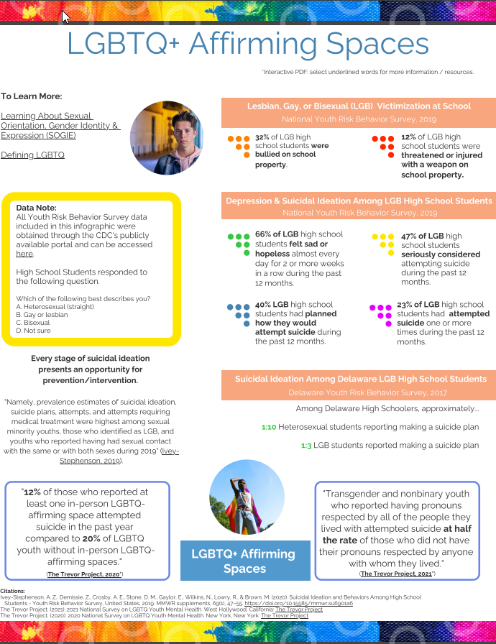
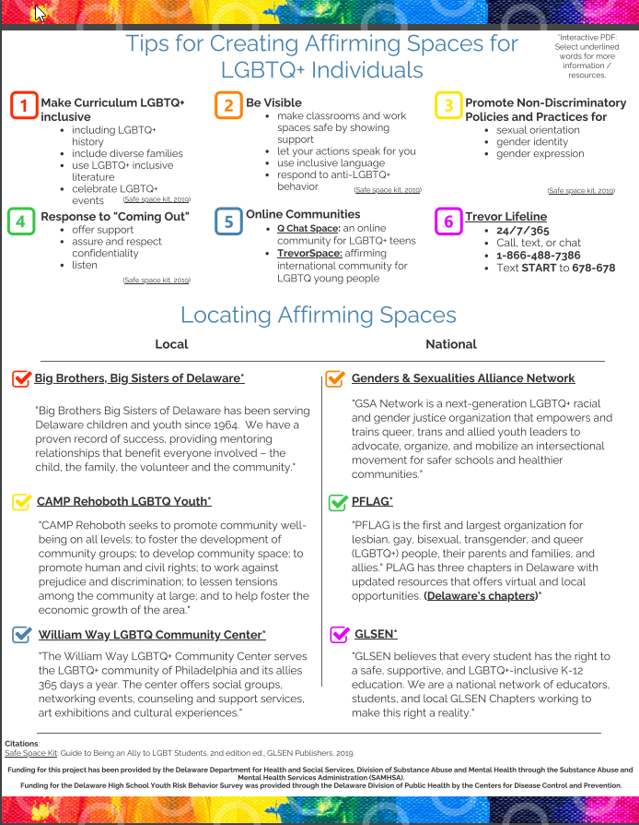

Slide 10
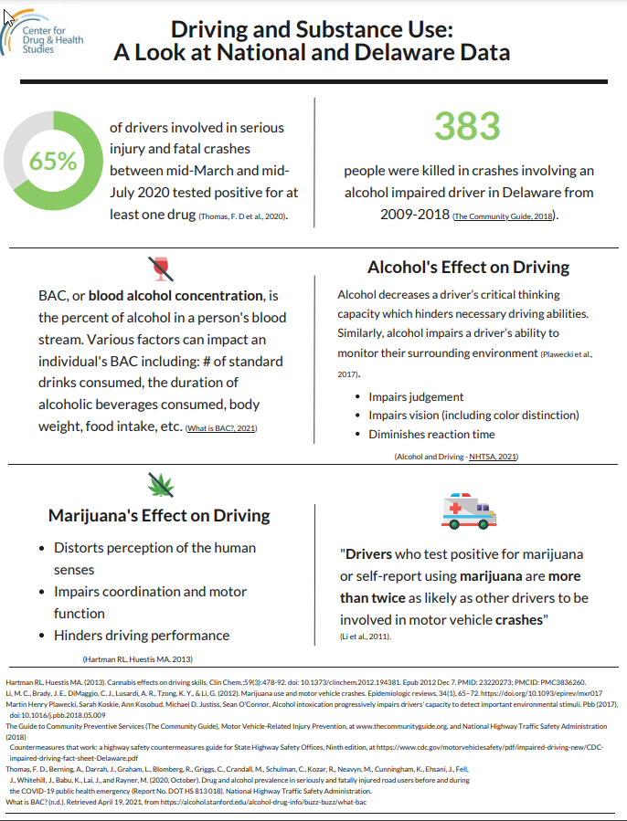
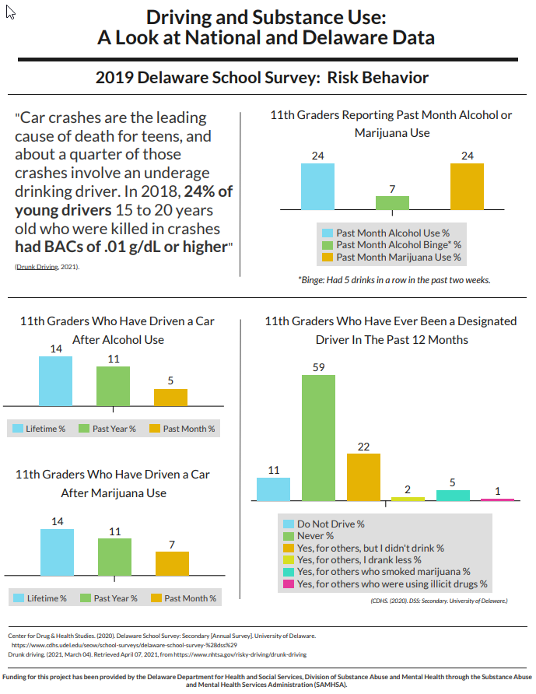

Slide 11
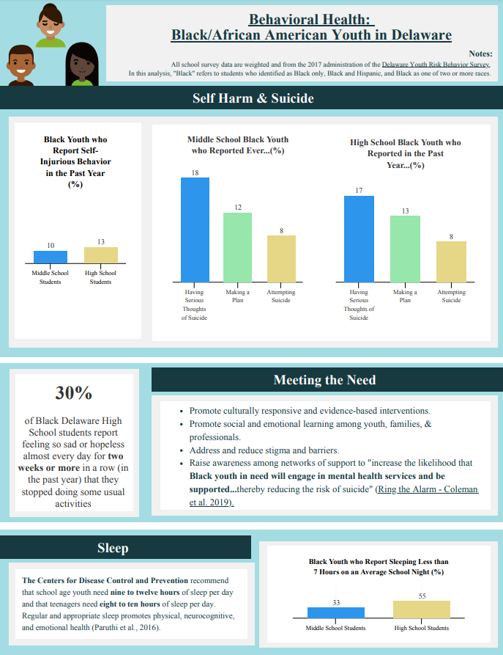
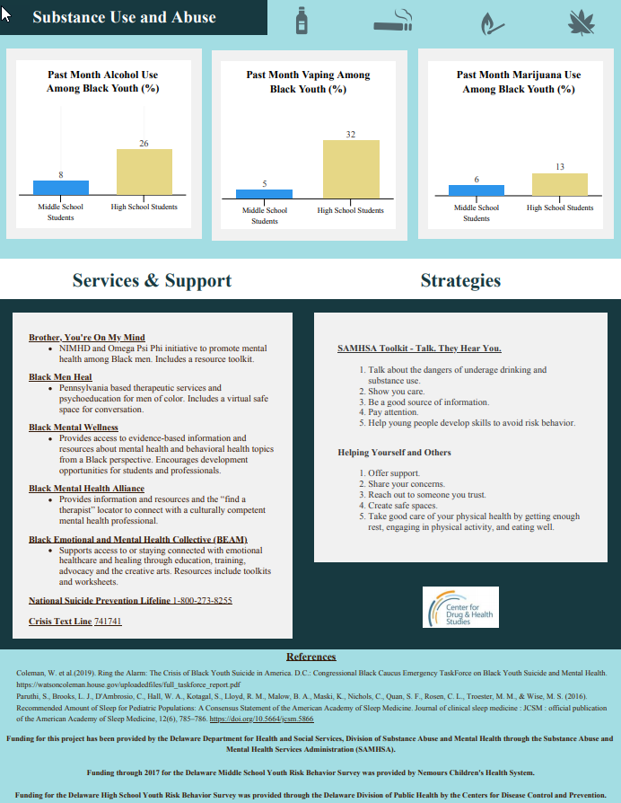

Slide 12
Data Champion

Slide 14
Featured Presentation:
Adverse Childhood Experiences in Delaware, 2019
Khaleel Hussaini, PhD., Senior Scientist
Centers for Disease Control and Prevention and
Assignee to the Delaware Division of Public Health

Slide 15
Break Out Rooms
Q: How does the prevalence of ACEs impact your prevention and mental health promotion work?

Slide 16
Break Out Reporting
Facilitators: What are the key takeaways from your group?

Slide 17
Featured Presentation:
The Delaware Rape Prevention and Education
Program (RPE): Building Evaluation Capacity
Cheryl Ackerman, PhD., Scientist
Center for Drug and Health Studies at the University of Delaware

Slide 18
Break Out Rooms
Q: Have you ever created an evaluation framework for your program?
If so or if not, what are some benefits and challenges to creating an evaluation framework for your program?

Slide 19
Break Out Reporting
Facilitators: What are the key takeaways from your group?

Slide 20
SEOW Member
Network Share Out

Slide 21
Thank You!
We look forward to seeing you next January at our Winter Meeting, and we hope to see you at our
3D webinar this the Fall!
Notes:
Also enter into the chat: https://delaware.ca1.qualtrics.com/jfe/form/SV_2nHrqtuX8wZVPnw

Slide 22
For More Information…
Visit the SEOW:
Center for Drug and Health Studies
at the University of Delaware
https://www.cdhs.udel.edu
and view recordings of earlier events at
https://www.youtube.com/channel/UCju6_hmcBAAd2LLn0Oxpw3Q
Laura Rapp lrapp@udel.edu
MJ Scales mjscales@udel.edu
Sharon Merriman-Nai smnai@udel.edu
Dana Holz danaholz@udel.edu
Rachel Ryding rryding@udel.edu

