Slide 1
Substance Abuse Prevention in Delaware: Past and Present
June 2015
SPF-SIG
Delaware Drug and Alcohol Tracking Alliance (DDATA) Meeting

Slide 2
The role of the SPF-SIG Evaluation is to answer the questions:
Has there been sustainable infrastructure created through use of the SPF model?
Have there been reductions in substance abuse?
(Inputs)
(Outcomes)

Slide 3
Logic Model
Context
(Outcomes)
Contributing Factors
Risk Behaviors
(Inputs)
Consequences

Slide 4
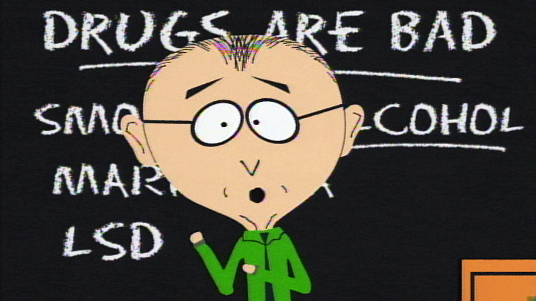
Context:
Delaware laws
Law enforcement
Media messages/information dissemination
Amount/accessibility of prevention education programs and alternative activities
Community coalitions
Workforce

Slide 5
Delaware Alcohol Consumption Laws 2010 and 2015
2010 | 2015
No keg registration laws | No keg registration laws
No dram shop laws | No dram shop laws
No social host laws | No social host laws
No open container laws | No open container laws
Furnishing is prohibited WITH THE FOLLOWING EXCEPTION(S): private residence AND EITHER parent/guardian OR spouse | Furnishing is prohibited WITH THE FOLLOWING EXCEPTION(S): private residence AND EITHER parent/guardian OR spouse (small increase in fines)
Illegal for "[w]hoever, being under the age of 21 years, has alcoholic liquor in his or her possession at any time, or consumes or is found to have consumed alcoholic liquor. | Illegal for "[w]hoever, being under the age of 21 years, has alcoholic liquor in his or her possession at any time, or consumes or is found to have consumed alcoholic liquor.

Slide 6
Law Enforcement 2010 and 2014
 |  | 2010 | 2014
DATE Compliance checks | Data requested | Supported by EUDL funds | Supported by SPF-SIG
Arrests (DELJIS) | Youth Consumers - Possession/consumption | 915 | 587
 | Youth consumers - DUI | 24 | 152
 | Adult | 3540 | 3166

Slide 7
Media Messages—2010
Office of Highway Safety and the Governor’s Office “Think. Don’t drink!” media campaign
DSCYF Parents Step Up campaign

Slide 8
Media Messages—2014
DATE “Buyers Beware” campaign of 10 billboards
“Underage? Understand. Don’t Drink!” Campaign of 109 billboards plus other materials
DHSS “Thinking Hurts Drinking” campaign (2015)
Information dissemination to over 237,000
Stall Stories Posters campaign—over 5990 posted
PSA’s shown at Penn Center—38,290 times
Information disseminated to over 176,000

Slide 9
DATE “Buyers Beware” campaign of 10 billboards

Slide 10
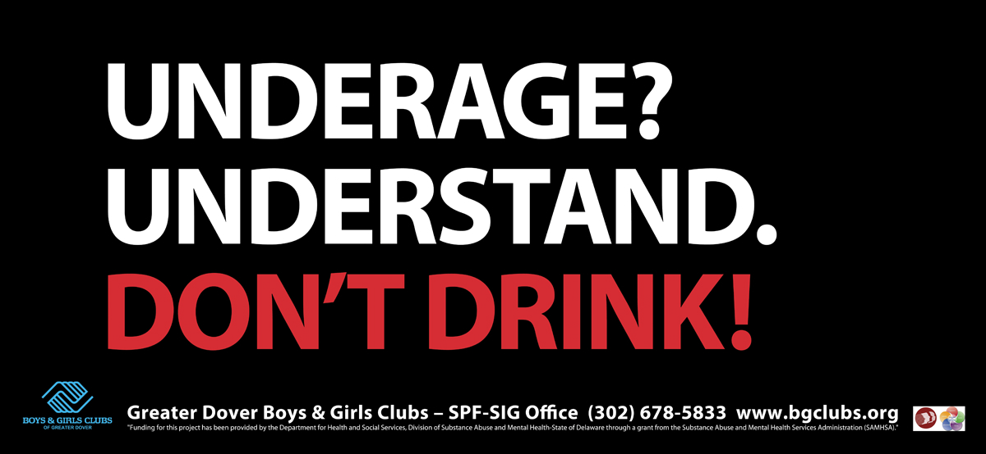
“Underage? Understand. Don’t Drink!” Campaign of 109 billboards plus other materials—almost 7 million impacts

Slide 11
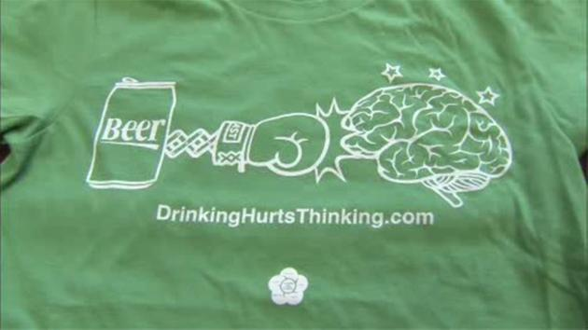
DHSS “Drinking Hurts Thinking” online campaign

Slide 12
Stall Stories

Slide 13
PSA’s

Slide 14
Prevention Education/Alternative Activities—2010
Safe and Drug Free Schools
Enforcing Underage Drinking Laws
SAPT-BG funded activities

Slide 15
Prevention Education/Alternative Activities—2014
SPF funded educational activities impacting over 36,000
Over 21,400 youth in SPF-funded alternative activities in past year
SAPT-BG funded activities

Slide 16
Increases in Number of Activities/Education Sessions attributable to SPF-SIG

Slide 17
Community Coalitions

Slide 18
Number Attending CADCA

Slide 19
Workforce Development—Number of Persons Achieving Prevention Certification

Slide 20
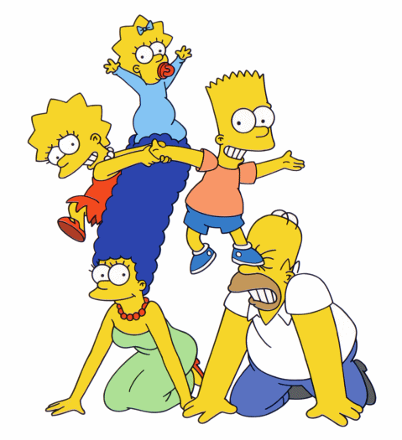
Contributing Factors:
Perceived harmfulness
Student’s disapproval
Family norms
Community/social norms (parties with alcohol and no parents present/parties where parents bought alcohol for kids)

Slide 21
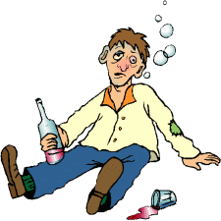
Perceived Risk of Binge Drinking

Slide 22
Student’s Disapproval of Daily Drinking

Slide 23
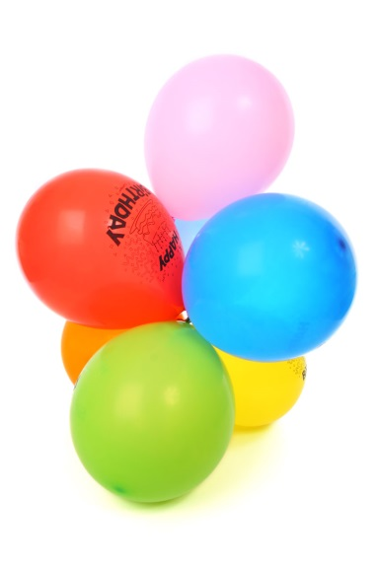
Family-based Norms: Parents asked Parents Hosting a Party if They Would Be Present at the Party

Slide 24
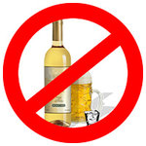
Family-based Norms: Parents asked Parents Hosting Party if Alcohol Would Be Served

Slide 25
Family-based Norms: Parents Told Child Not to Drink Alcohol

Slide 26
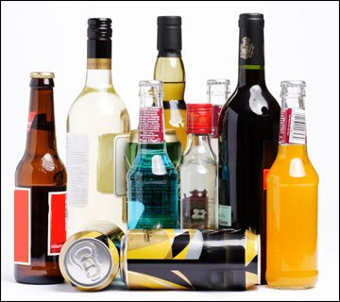
Family-based Norms: Took Alcohol from House with Permission

Slide 27
Community-based Norms: Attended Party Where Parents Bought Alcohol for Teens

Slide 28
Community-based Norms: Attended Party with Alcohol and No Parents

Slide 29
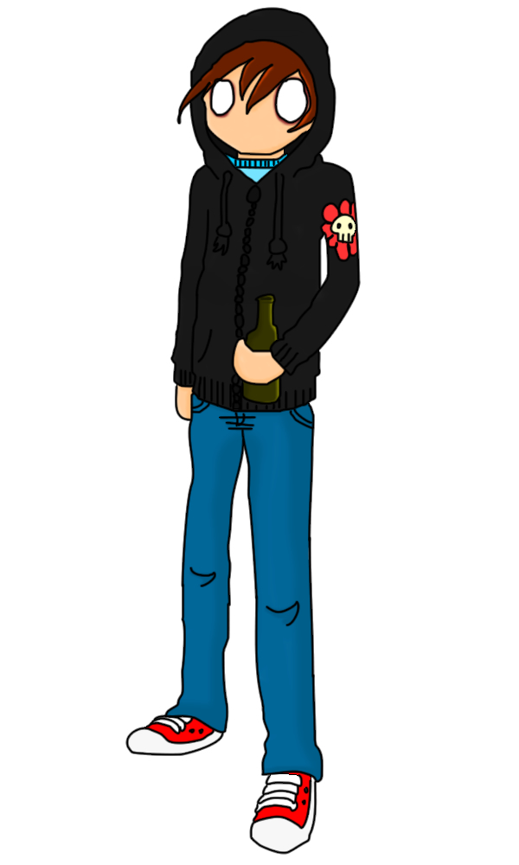
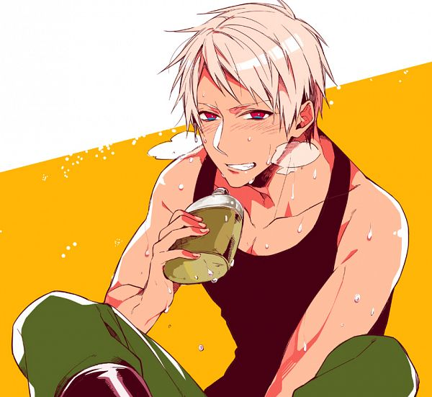
Risk Behaviors
School-aged underage drinking
School-aged binge drinking
College underage drinking
College binge drinking

Slide 30
Past 30 Day Alcohol Use by School-aged Youth

Slide 31
Binge Drinking by School-aged Youth

Slide 32
Changes at UD: -- Coalition -- Ongoing commitment of the provost -- UD APPLE Team created to do prevention with athletes -- Permanent staff member for alcohol prevention outreach​ --additional $50K in funding for alcohol prevention initiatives in permanent budget. -- UDPD and NPD formed the joint agency policing initiative -- Late night alternative activities on key holidays now expected --- Pro-active communication with incoming students and families now a norm. -- Dean of Students sends annual email letter to all students

Slide 33
Alcohol/Binge Use by College Youth—UD

Slide 34
Alcohol/Binge Use by College Youth—Wesley

Slide 35
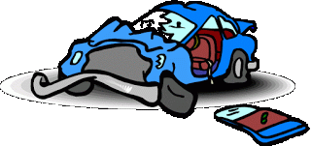
Consequences:
Alcohol-related vehicular fatalities/crashes
DUI rates (alcohol and alcohol/drug combined)
Underage possession arrests
School suspension/expulsion rates

Slide 36
DUI Arrests

Slide 37
Underage Possession/Consumption Arrests

Slide 38
Percent of Total Traffic Fatalities and Injuries That Were Alcohol-related

Slide 39
Delaware Public School Dropout Rates
Race to the Top

Slide 40
Alcohol and Drug-related School Offenses Reported

Slide 41
Summary
In some areas there has been steady progress, but challenges remain:
No substantive changes in consumption laws
Fewer arrests for youth consumption but an increase in youth DUI
Increase in media messaging, prevention education and alternative activities, coalition, workforce capacity
Declines in some family-based norms (asking about parents and alcohol at parties) but improvements in other (parents supplying alcohol, students taking alcohol from home, attending parties without parental presence)
Decrease in rates of youth past 30-day alcohol use and binge-drinking
Increase in percentage of traffic fatalities related to alcohol-related accidents

