Slide 1
Youth substance use in Delaware
Data from the State epidemiological outcomes workgroup
and the
Center for drug and health studies at the university of Delaware
January 21, 2021
Dana Holz, danaholz@udel.edu
Rachel Ryding, rryding@udel.edu
Notes:
Different subtitle?

Slide 2
What is the state epidemiological outcomes workgroup (SEOW)?
Four goals:
To build monitoring and surveillance systems to identify, analyze, and profile data from state and local sources;
To identify, share, and analyze data;
To create data-guided products that inform prevention planning and policies;
To train agencies and communities in understanding, using, and presenting data effectively.
https://www.cdhs.udel.edu/seow/what-is-seow
Notes:
Two meetings a year, production of annual state epidemiological report as well as related infographics and data products. Data in this presentation is from our most recent epi report, which was officially published online at the end of October.

Slide 3
Support the SEOW can provide:
Data presentations
Data points for media or public awareness campaigns
Technical assistance on finding and utilizing data for prevention planning and evaluation
Analyses using Center for Drug and Health Studies data, as requested. Or connect with data project lead.

Slide 4
SEOW data products
Annual Delaware State Epidemiological Report
Infographics
Gap reports on special topics
Hot spot maps

Slide 5
Delaware Opioid Metric Intelligence Project (DOMIP)
State Epidemiological Outcomes Workgroup (SEOW) Annual Report
SEOW heat maps
School Surveys
https://www.cdhs.udel.edu/
Notes:
Dana can do a live demo here of where to find things on the website and the kind of resources the SEOW has?

Slide 6
Nationally, evidence is emerging to suggest that rates of mental health issues and substance use are on the rise as people face uncertainty over health and financial security and experience isolation due to social distancing measures (Czeisler et al., 2020).
National Household Pulse Survey (U.S. Census Bureau and National Center for Health Statistics) latest survey (Dec. 9-21, 2020) suggests that 4 out of 10 of those surveyed reported symptoms of anxiety or depressive disorders. In comparison, in a 2019 survey with similar questions, 11% of respondents reported these symptoms.
During March – October 2020, the proportion of mental health related ED visits increased by 24% among children aged 5-11 and 31% among youth age 12-17 than that of the same time period in 2019 based on surveillance data from 47 states – this may be in part due to an overall decrease in all types ED visits (Leeb et al., 2020).
Nationally, 18.2% increase in fatal drug overdoses, in the 12 month period ending in May 2020. with the largest increase occurring during March – May (CDC Health Alert Network, 2020).
A note about the covid-19 pandemic and behavioral health

Slide 7
Overview of youth substance use

Slide 8
School Surveys
Data Source | Description | Sample | Data Collection | Geographic Level
Delaware School Survey (DSS) | Substance use, risk and health behaviors | 5th, 8th, and 11th grade public school students | Annually | State, County, District, Zip code, School
Youth Risk Behavior Survey (YRBS) | Substance use, risk and health behaviors and other health topics | Public middle school and high school | Every Two Years, Odd Years | State, County

Slide 9
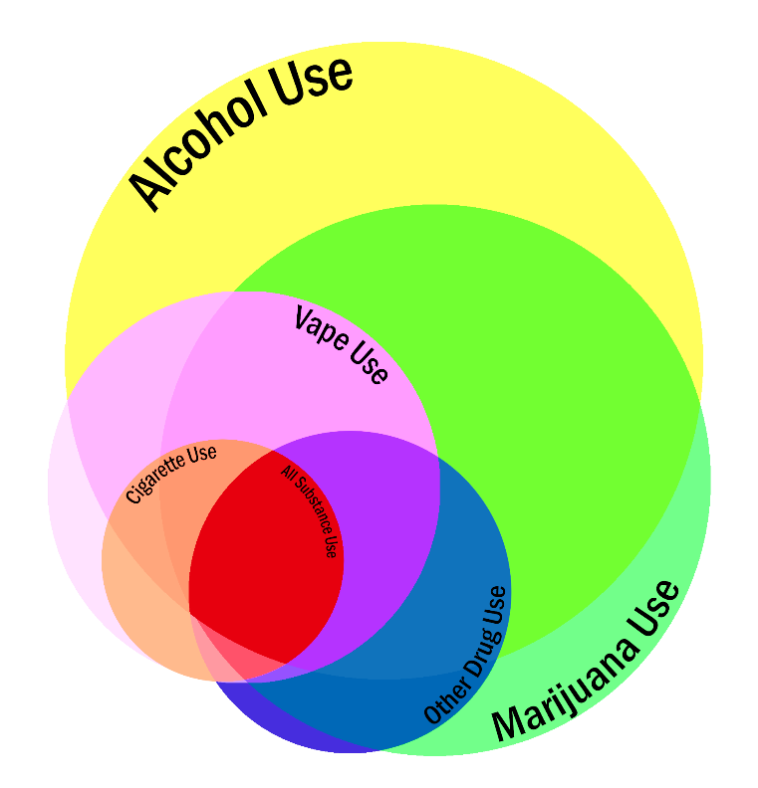
Polysubstance use among 11th graders
Substance | % Reporting Past-Year Use
Alcohol | 45%
Marijuana | 34%
E-cigarette/Vape | 17%
Cigarettes | 7%
At least one other drug | 12%
All of the above categories | 2%
Center for Drug & Health Studies. (2018). Delaware School Survey: Secondary [Annual Survey]. University of Delaware.

Slide 10
Cigarettes and vaping

Slide 11
Notes:
Heat maps combine two years of data, white spaces are where there were too few students surveyed to provide an estimate, and in some cases we combined responses from two zip codes in order to be reportable. But from these maps we see that there seems to be a higher prevalence of cigarette use and vaping among students in the southern part of the state.

Slide 12
trends in vaping among 11th grade students (in percentages)
We’ve seen a rapid increase in vaping among Delaware students; in the past 5 years, the percent of 11th grade students that report vaping in the past month has more than quadrupled.
Center for Drug & Health Studies. (2019). Delaware School Survey: Secondary [Annual Survey]. University of Delaware.
Notes:
Maybe hide this and just include stats on what students are vaping.

Slide 13
41% of white students
16% of Black students
28% of Latinx students
Center for Drug & Health Studies. (2019). Delaware School Survey: Secondary [Annual Survey]. University of Delaware.
Notes:
When looking at the race and ethnicity of students who vape, we see that white students are overrepresented compared to Black and Hispanic or Latino students. So while about 50% of the students we surveyed in 2019 were white, 65% of the students who vaped were white. By comparison, while 22% of the surveyed students were Black, only 11% of the vaping students were Black.
When you run the percentages the other way and look at vaping by race, we still see that white students are reporting vaping at a higher rate than Black and Latino students.

Slide 14
Alcohol

Slide 15
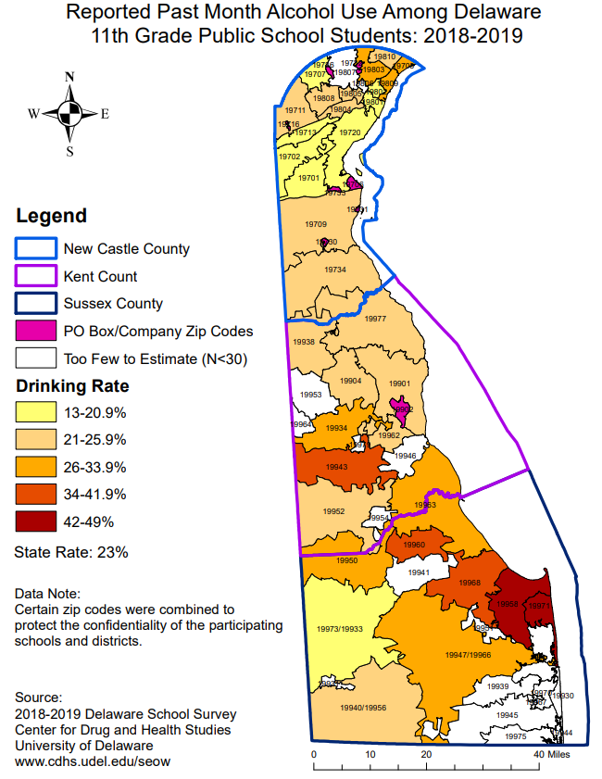
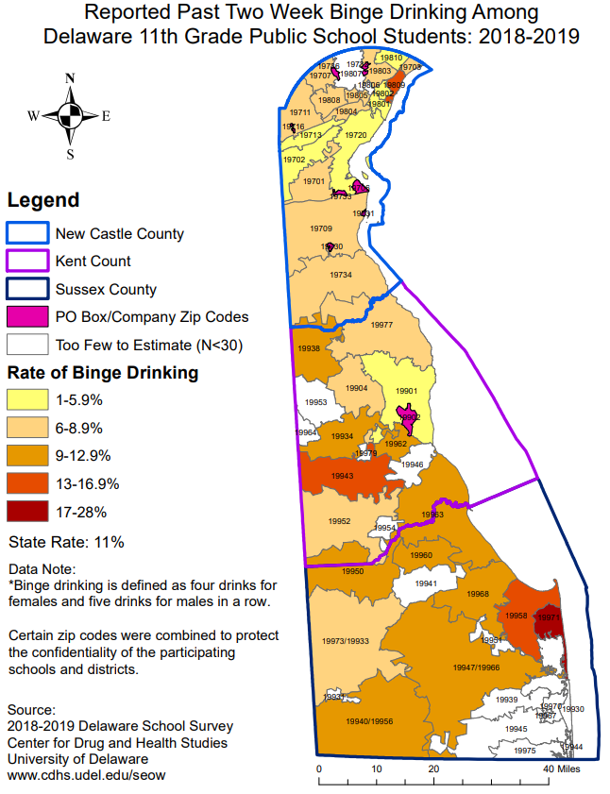
Notes:
Binge drinking

Slide 16
30% of white students
16% of Black students
22% of Latinx students
Center for Drug & Health Studies. (2019). Delaware School Survey: Secondary [Annual Survey]. University of Delaware.
Notes:
When looking at the race and ethnicity of students who vape, we see that white students are overrepresented compared to Black and Hispanic or Latino students. So while about 50% of the students we surveyed in 2019 were white, 65% of the students who vaped were white. By comparison, while 22% of the surveyed students were Black, only 11% of the vaping students were Black.
When you run the percentages the other way and look at vaping by race, we still see that white students are reporting vaping at a higher rate than Black and Latino students.

Slide 17
Declines in high school binge drinking at state and national level
(in percentages)
Year | National | Delaware
1999 | 32 | 27
2001 | 30 | 27
2003 | 28 | 27
2005 | 26 | 24
2007 | 26 | 25
2009 | 24 | 24
2011 | 22 | 23
2013 | 21 | 20
2015 | 18 | 16
2017 | 14 | 10
2019* | 14 | 14
Centers for Disease Control and Prevention. (2019). National Youth Risk Behavior Survey: High School.
Center for Drug & Health Studies. (2019). Youth Risk Behavior Survey: High School [Biennial Survey]. University of Delaware.

Slide 18
marijuana

Slide 19
Perceptions of risk associated with regular marijuana use (in percentages)
Center for Drug & Health Studies. (2019). Delaware School Survey: Secondary [Annual Survey]. University of Delaware.
Notes:
With most drugs, the perception of risk has increased over time. Marijuana is the exception, in the last 20 years the percentage of students who believe that using marijuana regularly poses a moderate or great risk to their health has declined substantially (by a third among 8th graders and by more than half among 11th graders). Marijuana is also a drug where there aren’t clear and significant racial patterns to use, about a quarter of high school students report using marijuana in the past month.

Slide 20
Opioids and prescription misuse

Slide 21
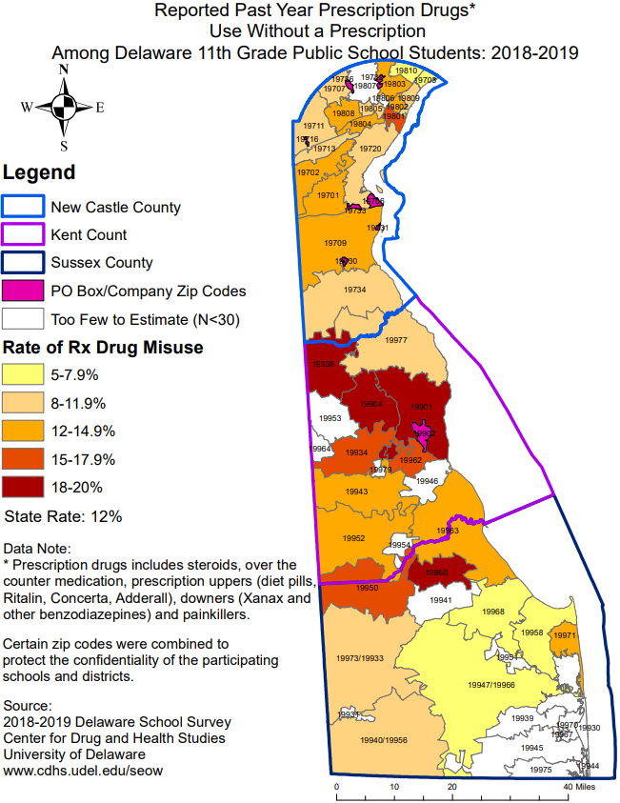
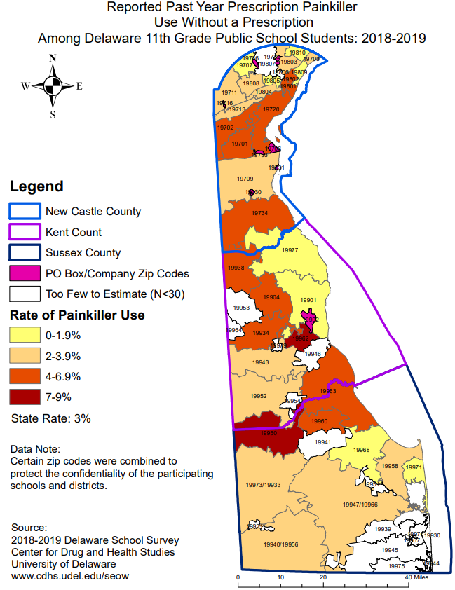
Notes:
https://www.cdhs.udel.edu/projects/domip

Slide 22
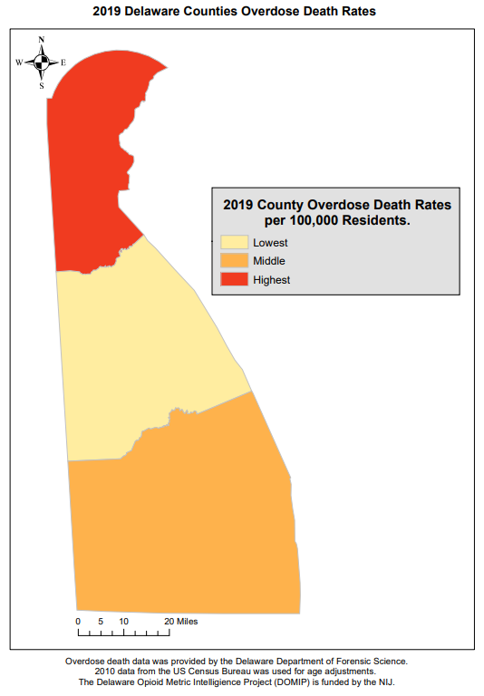
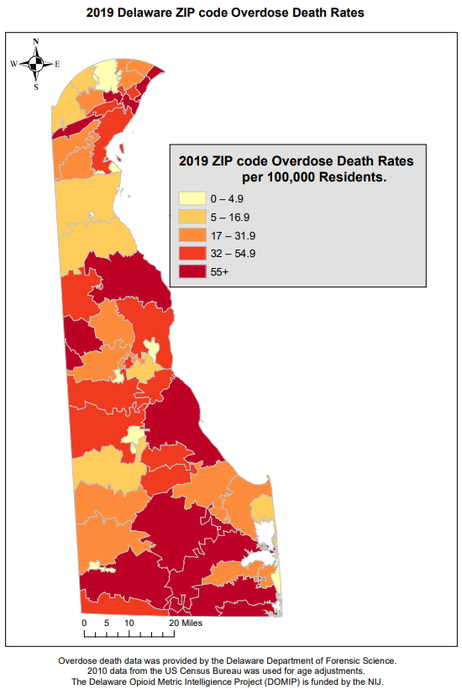
Notes:
https://www.cdhs.udel.edu/projects/domip

Slide 23
Relatively High perceptions of great risk from rx misuse among 11th grade students (in percentages)
Center for Drug & Health Studies. (2019). Delaware School Survey: Secondary [Annual Survey]. University of Delaware.
Notes:
Among surveyed 11th graders, 65% reported a perception of ‘great risk’ from using prescription medications without a prescription. That perception of risk was even higher among female students; 72% of female students report a perceived great risk from prescription misuse, compared to roughly 58% of male students. The only drug with a higher perception of risk was cigarette smoking.

Slide 24
risk and protective factors

Slide 25
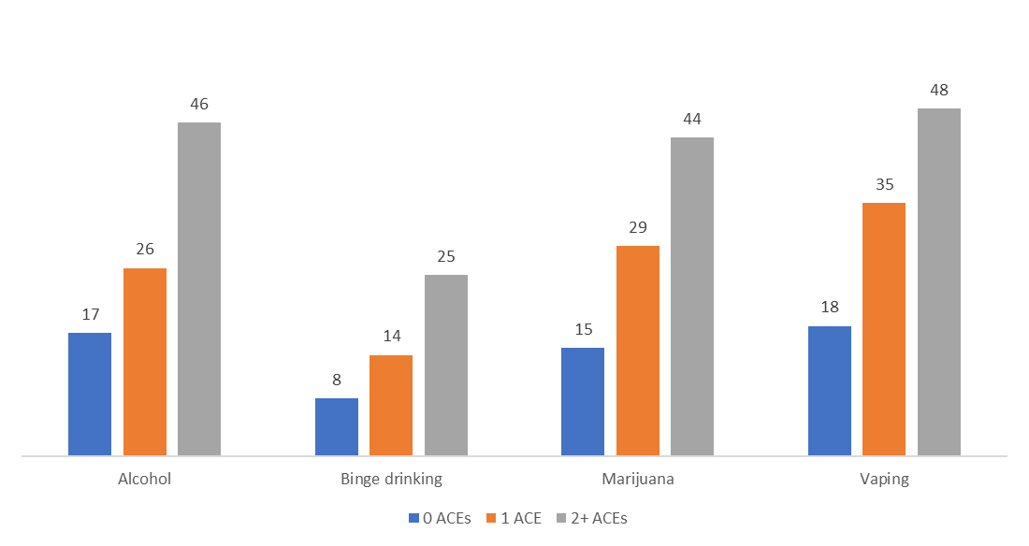
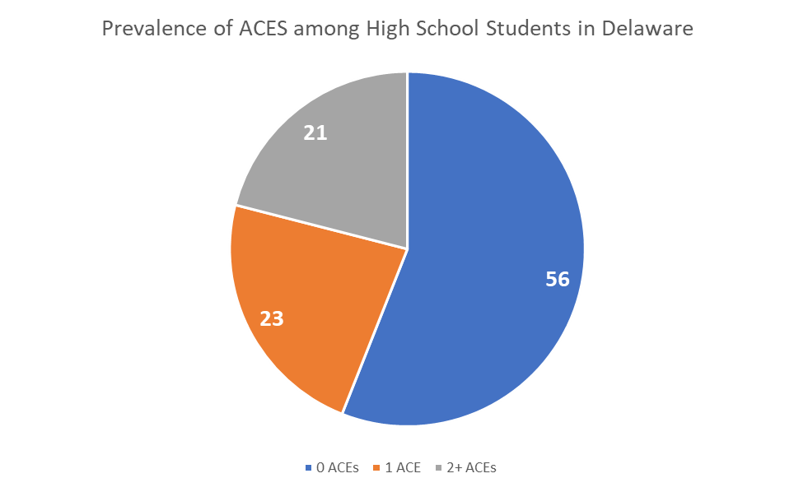
Adverse Childhood Experiences and Substance Use
Center for Drug & Health Studies. (2019). Youth Risk Behavior Survey: High School [Biennial Survey]. University of Delaware
Notes:
What do we know is protective against substance use risk? Plug upcoming gap report on positive childhood experiences.

Slide 26
Having strong rules and consequences at home and mental health indicators (in percentages)
Center for Drug & Health Studies. (2019). Youth Risk Behavior Survey: High School [Biennial Survey]. University of Delaware

Slide 27
Sources of Support and Encouragement Among High School Students (in percentages)
Center for Drug & Health Studies. (2019). Youth Risk Behavior Survey: High School [Biennial Survey]. University of Delaware

Slide 28
Upcoming reports and events:
Winter SEOW meeting (January 28)
Special gap report on Positive Childhood Experiences and Protective Factors (estimated release at end of the month)

Slide 29
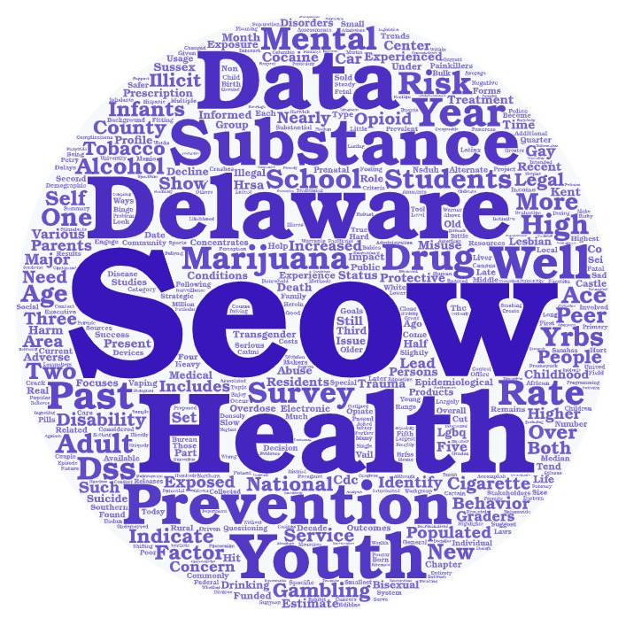
For more information about the Seow or to be added to the listserv, please contact:
Meisje Scales, mjscales@udel.edu or Sharon Merriman-Nai, smnai@udel.edu
cdhs.udel.edu/seow

Slide 30
References
Centers for Disease Control and Prevention. (2020, Dec. 17). Health Alert Network – CDCHAN-00438. Retrieved January 17, 2021 from HAN Archive - 00438 | Health Alert Network (HAN) (cdc.gov)
Czeisler, M., Lane, R.I., Petrosky, E., Wiley, J.F., Christensen, A., Njai, R., Weaver, M.D., Robbins, R., Facer-Childs, E.R., Barger, L.K., Czeisler, C.A., Howard, M.E., Rajaratnam, S. M. W. (2020, Aug. 14) Mental health, substance use, and suicidal ideation during the COVID-19 pandemic – United States, June 24-30, 2020. MMWR Morbidity and Mortality Weekly Report, 69(32), 1049-1057. Retrieved January 17, 2021 from https://www.cdc.gov/mmwr/volumes/69/wr/pdfs/mm6945a3-H.pdf.
Leeb, R. T., Bitsko, R. H., Radhakrishnan, L., Martinez, P., Njai, R., & Holland, K. M. (2020, Nov. 13). Mental health-related emergency department visits among children aged <18 years during the COVID-19 pandemic – United States, January 1 – October 17, 2020. MMWR Morbidity and Mortality Weekly Report, 69(45), 1675-1680. Retrieved January 17, 2021 from https://www.cdc.gov/mmwr/volumes/69/wr/mm6932a1.htm.
National Center for Health Statistics. (n.d.). Mental health care in the last 4 weeks [Table]. Retrieved January 17, 2021 from https://www.cdc.gov/nchs/covid19/pulse/mental-health-care.htm

