Slide 1
UMatter2DE:
Data Presentation
State Epidemiological Outcomes Workgroup
University of Delaware Center for Drug and Health Studies

Slide 2
State Epidemiological Outcomes Workgroup
Funding for this project has been provided by the Delaware Department for Health and Social Services, Division of Substance Abuse and Mental Health through the Substance Abuse and Mental Health Services Administration (SAMHSA).
https://www.cdhs.udel.edu/seow/what-is-seow

Slide 3
The 4 Goals of the SEOW
Identify, Analyze, and Share Data
Create Data Products
Train Communities in Understanding and Using Data
Build State and Local Level Monitoring Systems

Slide 4
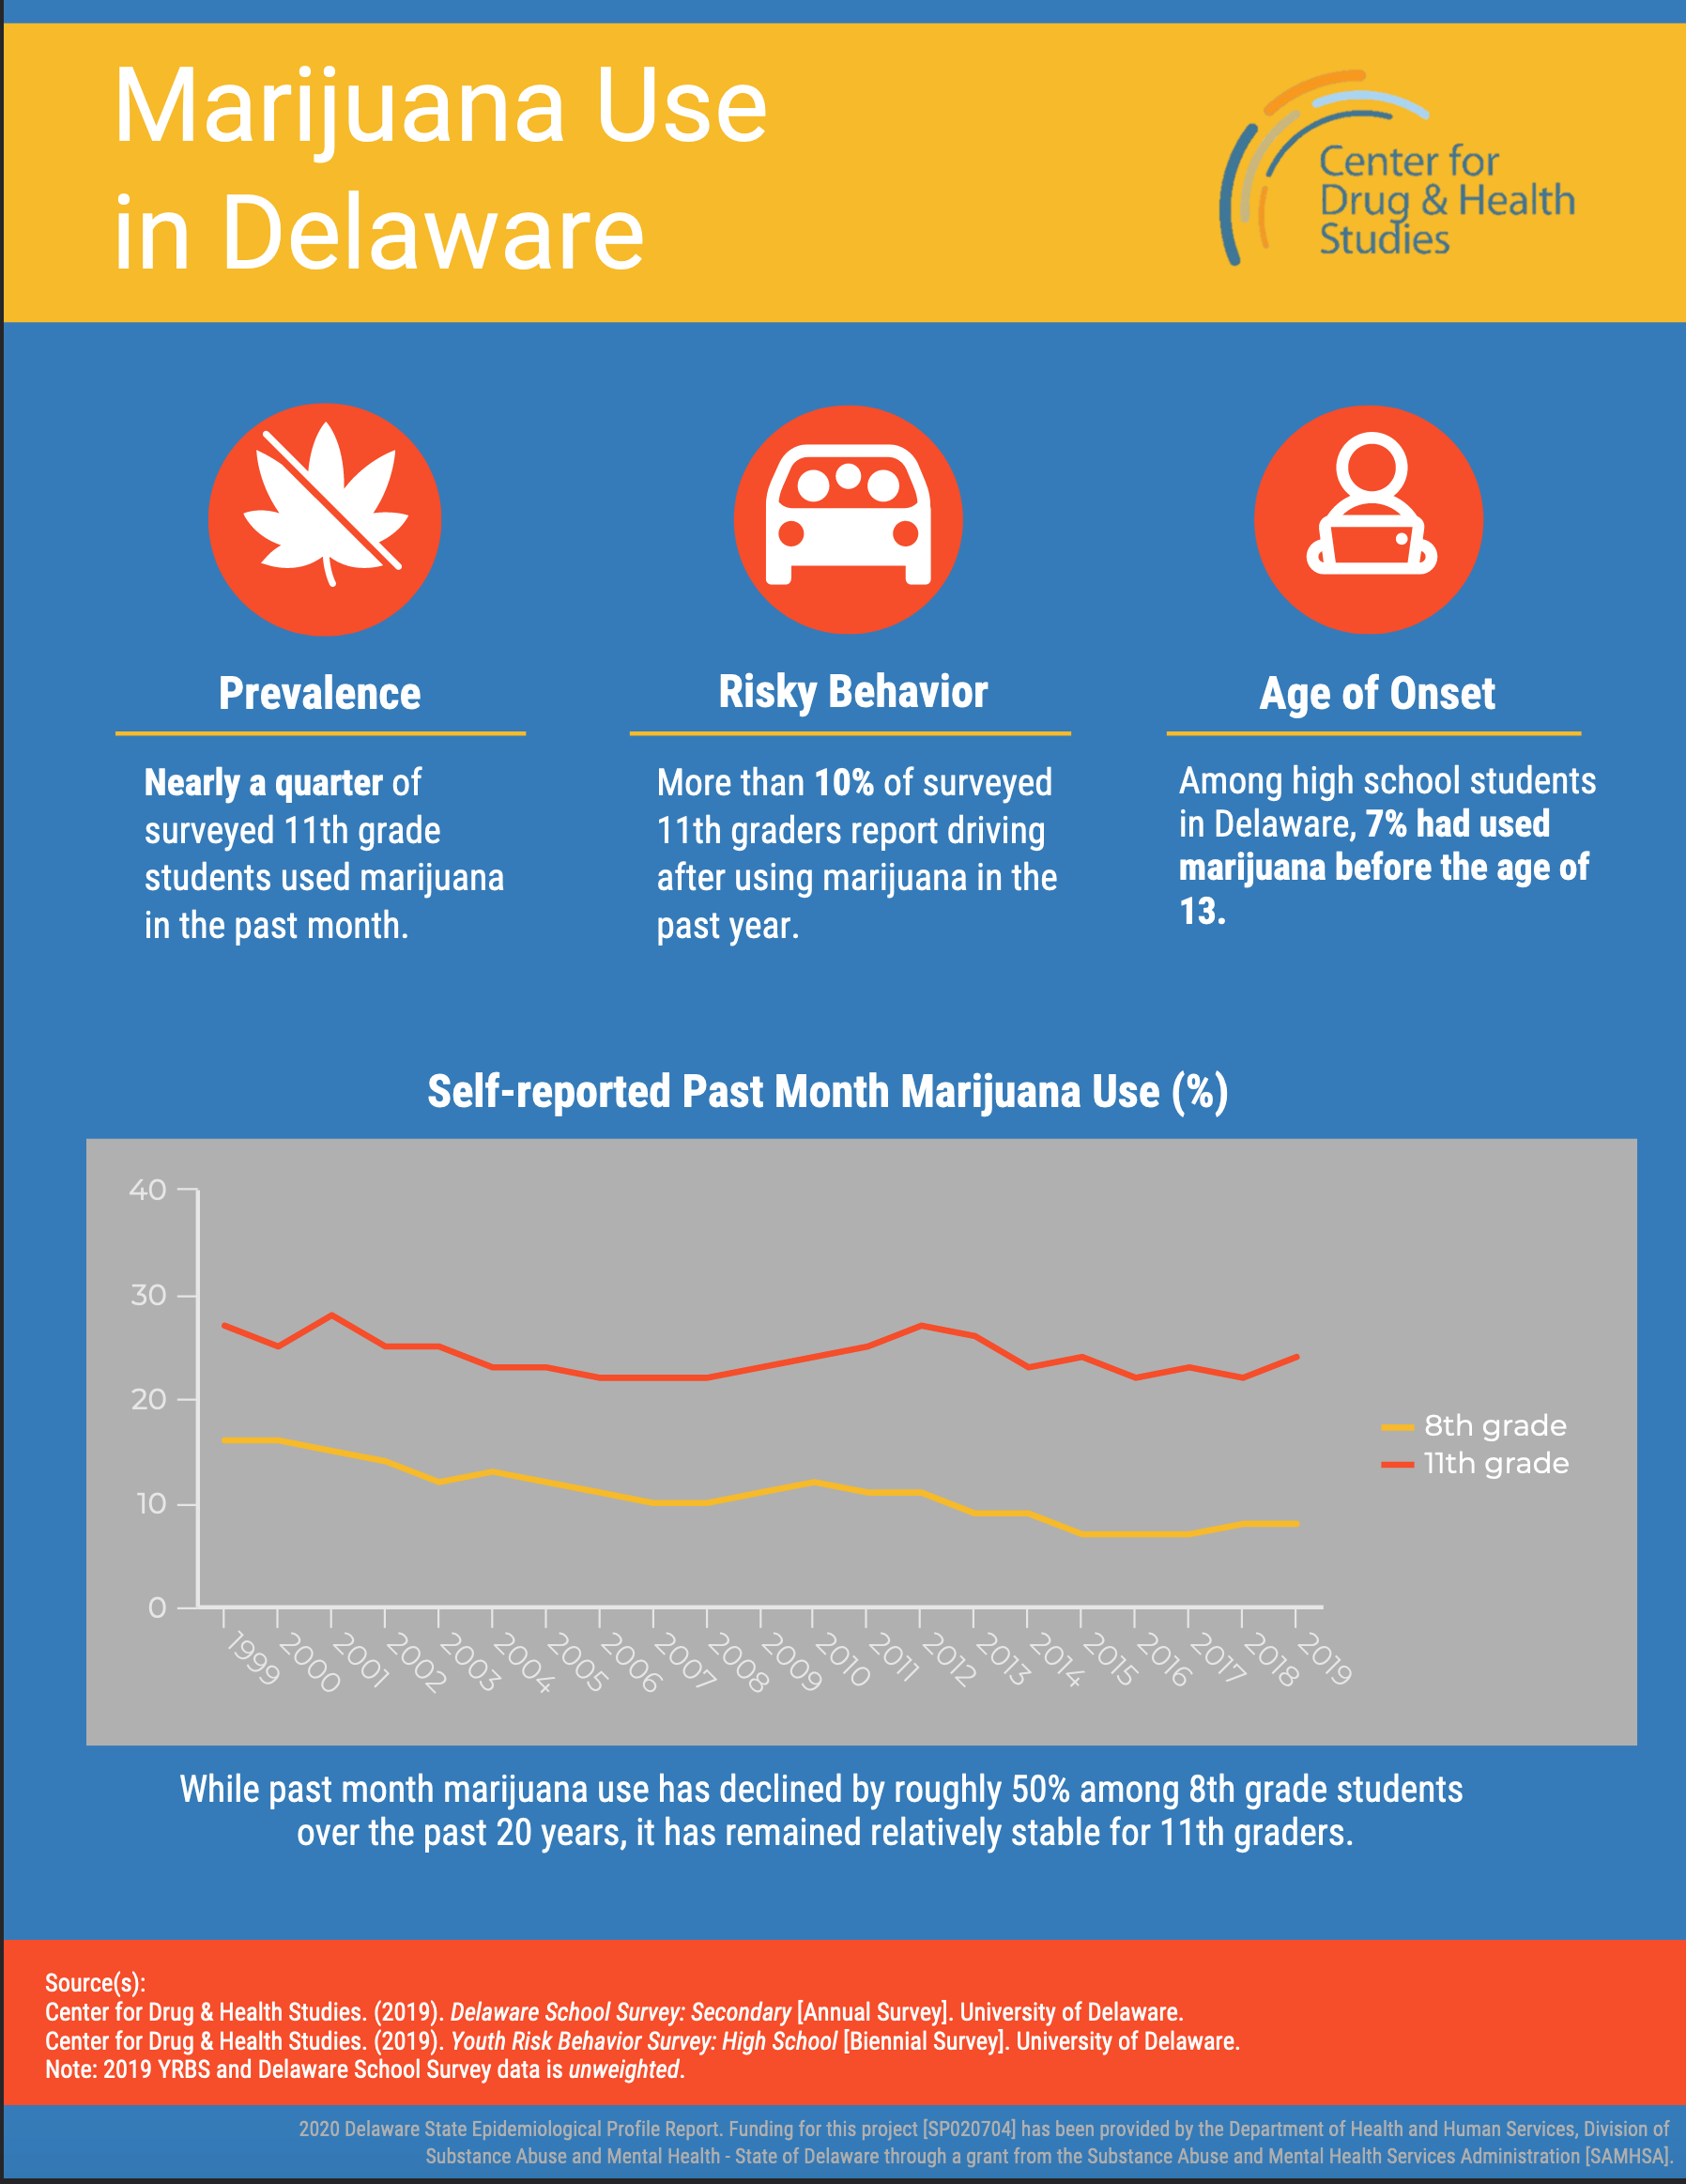
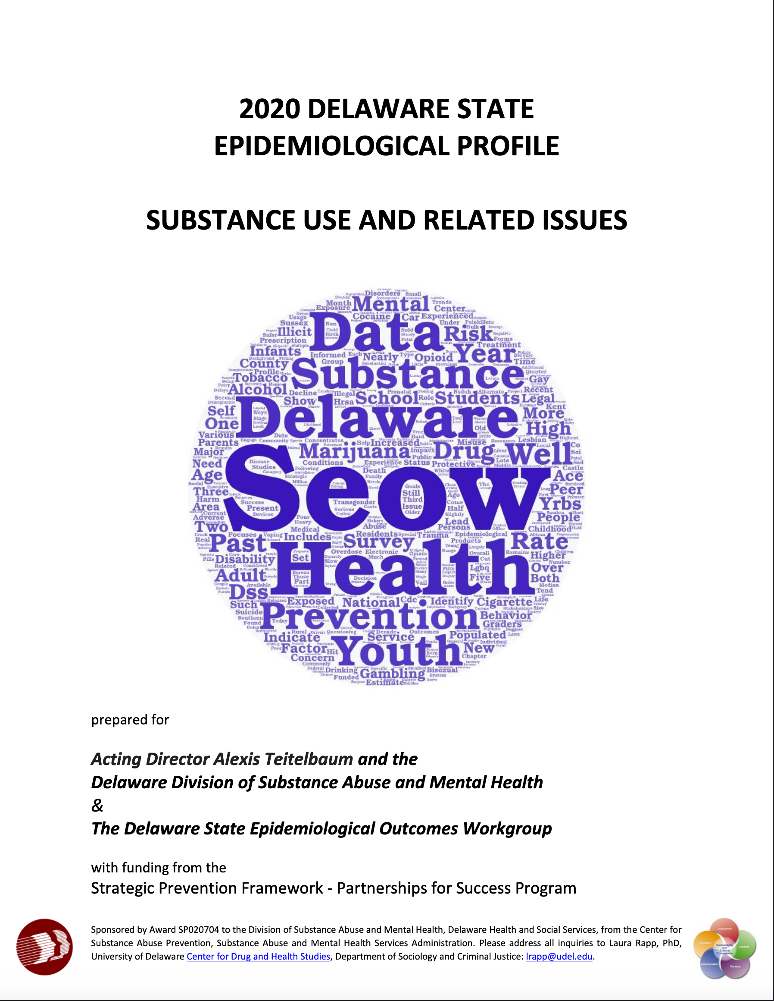
SEOW Data Products
Annual Delaware epidemiological profile – 2021 Coming Soon!
Gap reports
Infographics
NEW! Infographic-Violence: Delaware Youth Data
NEW! Infographic-LGBTQ+ Affirming Spaces
Presentations and recordings

Slide 5
Pause

Slide 6
Disparity
Acknowledgement:
Reporting totals does not reflect the diverse experience of mental health and mental health service engagement varies across geography, cultures, income levels, etc.
People may….
-need to navigate cultural and social norms, especially when it comes to seeking help
-face stigma and discrimination
-experience challenges accessing and staying engaged in services
-fear how engaging with services can impact the status of their employment, parental custody, immigration, etc.

Slide 7
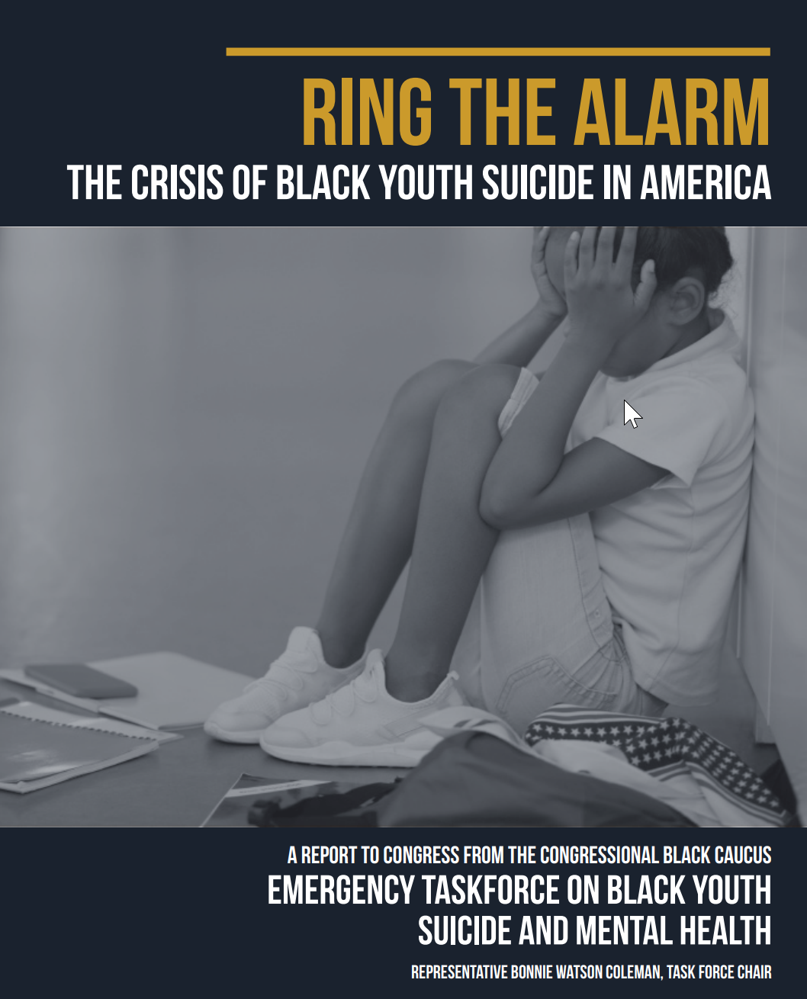
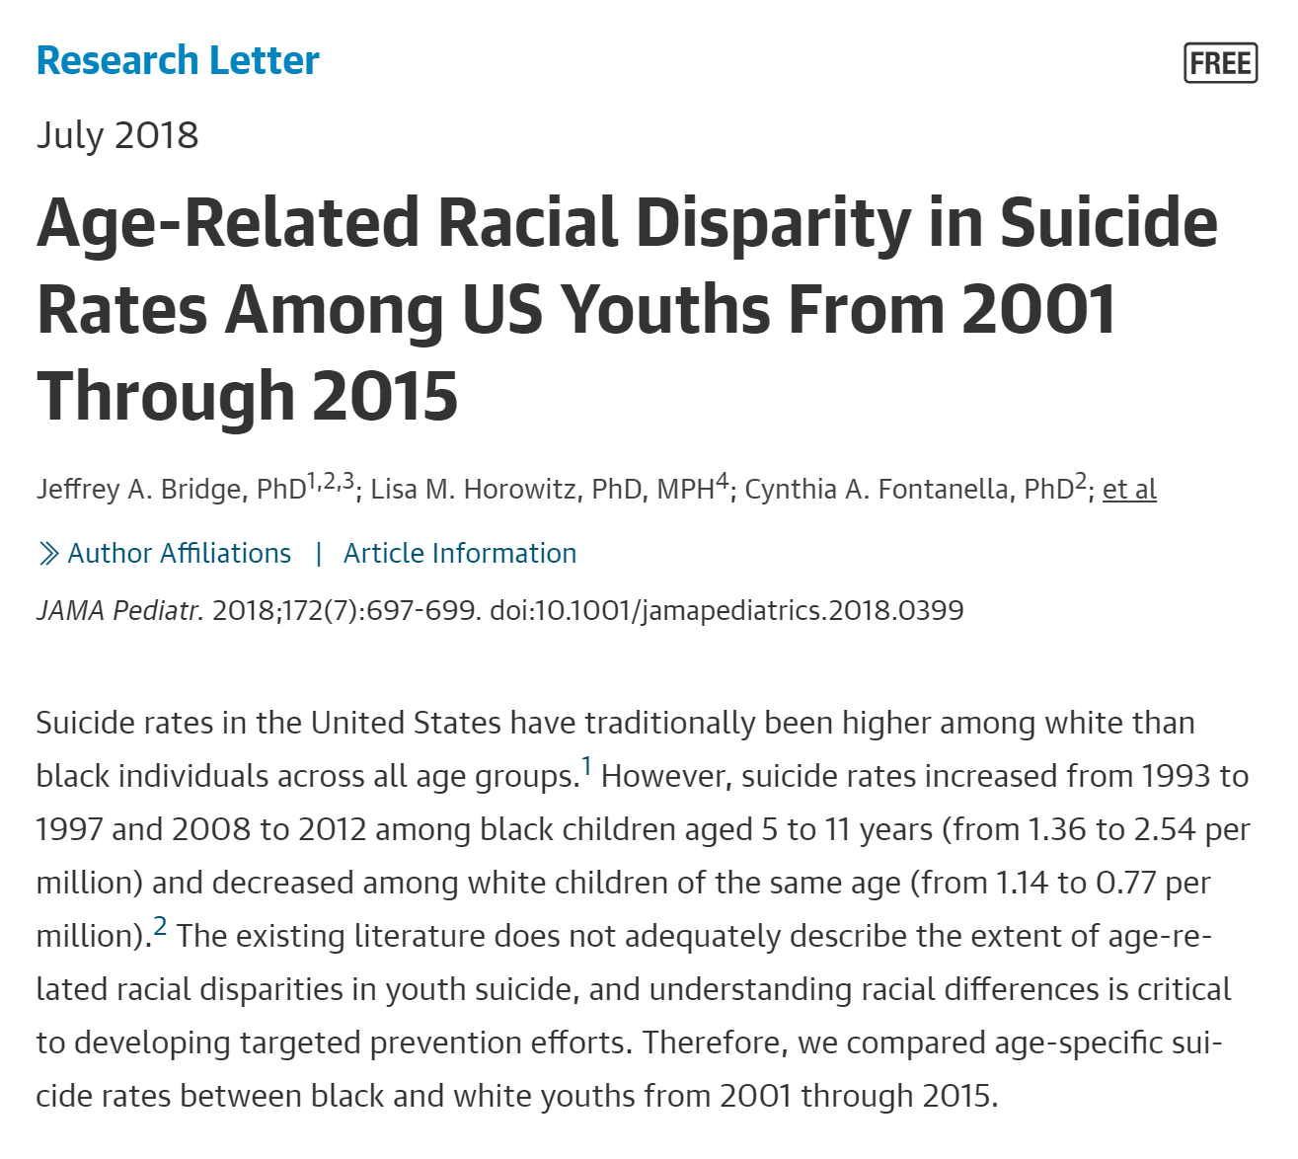
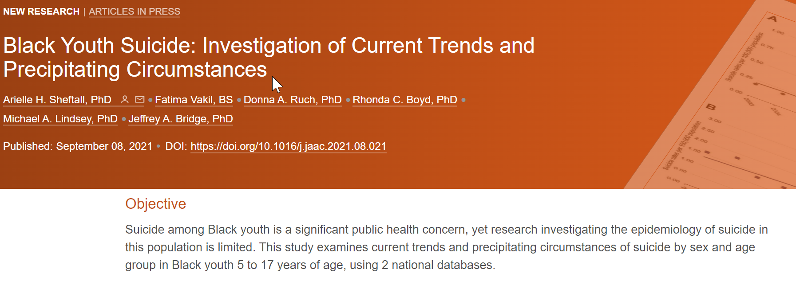
Race: Black Youth
Upward trend in suicide among Black youth
Trajectory varies
(Romanelli et al., 2021)
Age differences
(Bridge et al., 2018; Sheftall et al., 2021)
Risk:
Ex. Discrimination

Slide 8
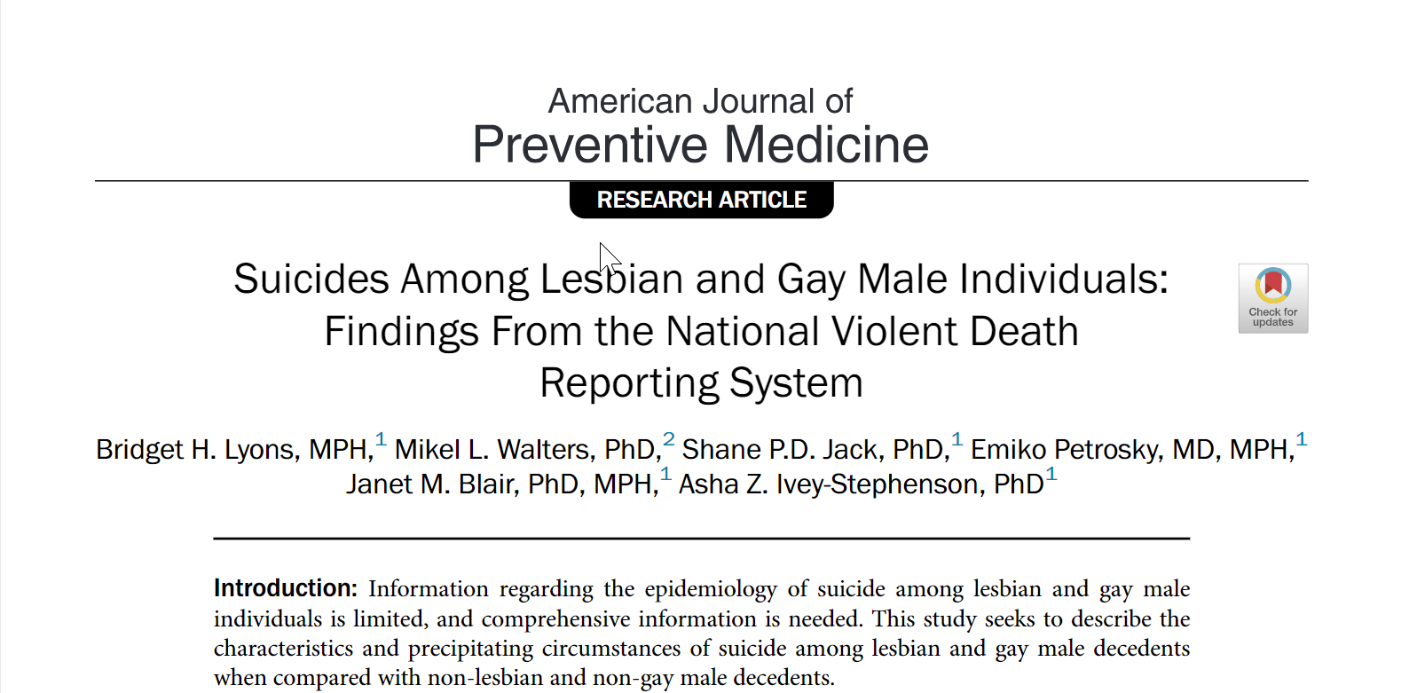
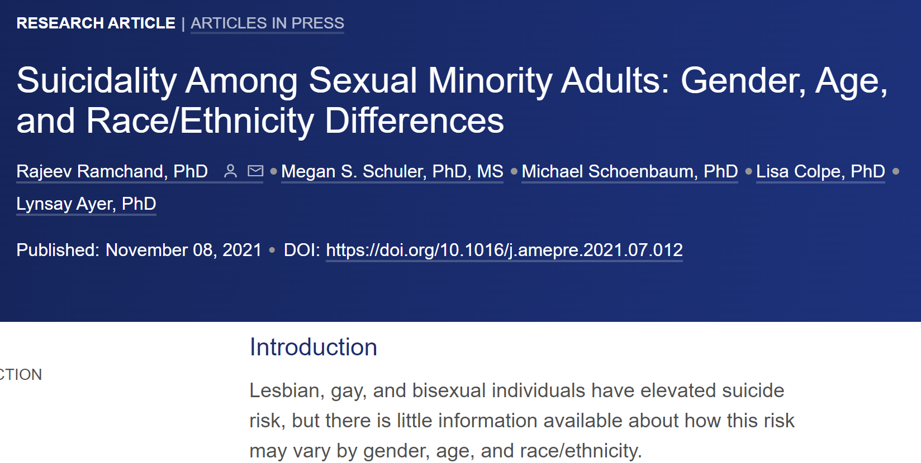
Sexual Orientation: LGB
LGB adults are more likely to report suicidal ideation
(Ramchand et al., 2021)
Prevalence within the group varies
(Lyons et al., 2019)
Risk
Ex. Harrassment

Slide 9
Emergency Department Visits for Suspected Suicide Attempts Among Persons Aged 12–25 Years Before and During the COVID-19 Pandemic
Visits for suspected suicide attempts include visits for suicide attempts, as well as nonsuicidal self-harm. Data included from 71% of the nation’s EDs in 49 states and the District of Columbia.
In May 2020, during the COVID-19 pandemic, ED visits for suspected suicide attempts began to increase among adolescents aged 12–17 years
In particular, ED visits for suspected suicide attempts increased among adolescent girls aged 12–17 years during summer 2020 and remained elevated throughout the remaining study period; the mean weekly number of these visits was 26.2% higher during summer 2020 and 50.6% higher during winter 2021 compared with the corresponding periods in 2019.
Yard E, Radhakrishnan L, Ballesteros MF, et al. Emergency Department Visits for Suspected Suicide Attempts Among Persons Aged 12–25 Years Before and During the COVID-19 Pandemic — United States, January 2019–May 2021. MMWR Morb Mortal Wkly Rep 2021;70:888–894. ://dx.doi.org/10.15585/mmwr.mm7024e1
external icon
Notes:
Yard E, Radhakrishnan L, Ballesteros MF, et al. Emergency Department Visits for Suspected Suicide Attempts Among Persons Aged 12–25 Years Before and During the COVID-19 Pandemic — United States, January 2019–May 2021. MMWR Morb Mortal Wkly Rep 2021;70:888–894. DOI: http://dx.doi.org/10.15585/mmwr.mm7024e1
external icon
Examine emergency department data from 49 states and the District of Columbia. Found that while ED visits for suspected suicide attempts decreased in 2020 compared to 2019 in the spring during the initial “lockdown” period (March/April), in the summer and beyond ED visits for suicide began to increase, particularly for young women. These figures remained higher through winter 2021. There are some difference by age group, breakdown by 13-17 and 18-25 years old.

Slide 10
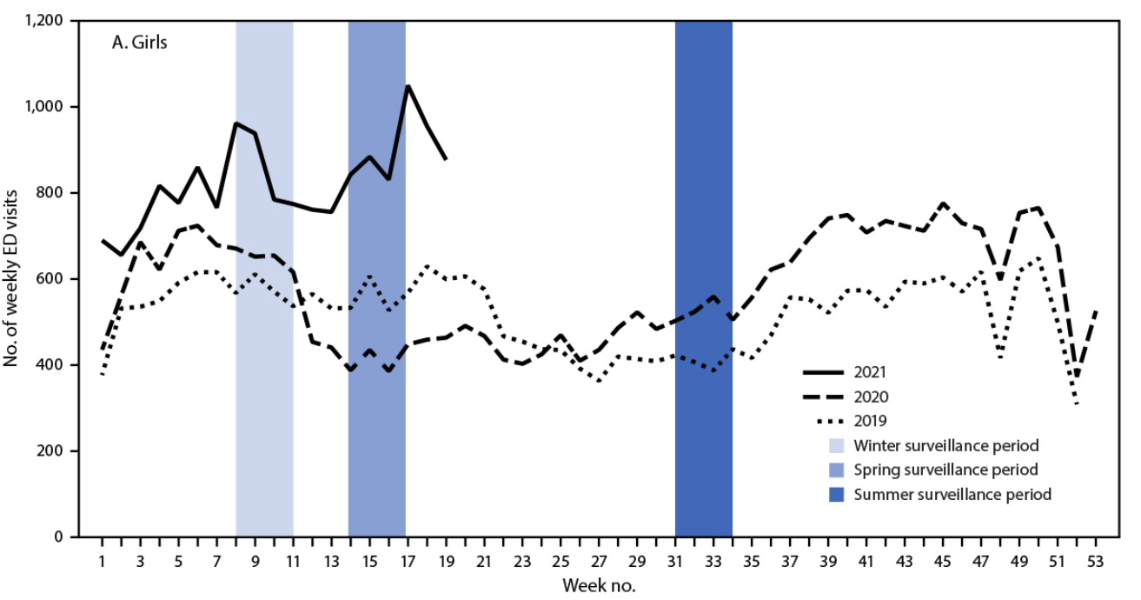
FIGURE 1. Numbers of weekly emergency department visits* for suspected suicide attempts† among adolescents aged 12–17 years, by sex — National Syndromic Surveillance Program, United States, January 1, 2019–May 15, 2021
Notes:
* ED visits for suspected suicide attempts were identified by querying an NSSP syndrome definition developed by CDC in partnership with state and local health departments (https://stacks.cdc.gov/view/cdc/106694). NSSP ED visit data include approximately 71% of the nation’s EDs in 49 states (all except Hawaii) and the District of Columbia.

Slide 11
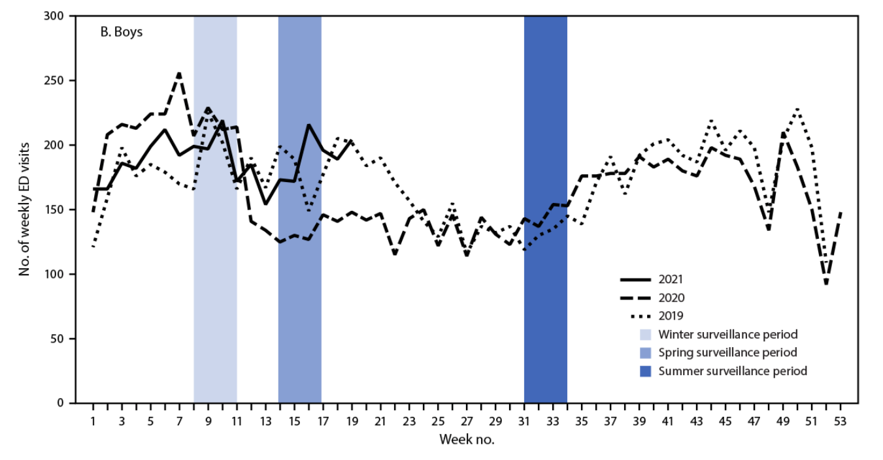
FIGURE 1. Numbers of weekly emergency department visits* for suspected suicide attempts† among adolescents aged 12–17 years, by sex — National Syndromic Surveillance Program, United States, January 1, 2019–May 15, 2021
Notes:
Girls were more impacted than boys in this age group. Can see with boys that 2019, 2020, and 2021 data all overlap.
The number of ED visits for suspected suicide attempts remained stable among adolescent boys aged 12–17 years and among all adults aged 18–25 years compared with the corresponding periods in 2019, although rates of ED visits for suspected suicide attempts increased.”

Slide 12
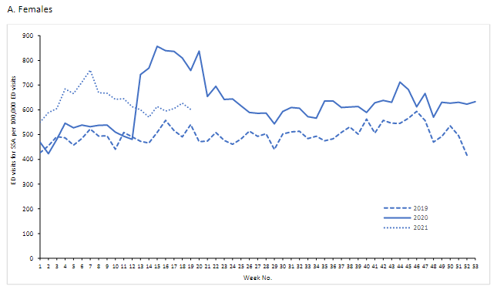
Notes:
Yard E, Radhakrishnan L, Ballesteros MF, et al. Emergency Department Visits for Suspected Suicide Attempts Among Persons Aged 12–25 Years Before and During the COVID-19 Pandemic — United States, January 2019–May 2021. MMWR Morb Mortal Wkly Rep 2021;70:888–894. DOI: http://dx.doi.org/10.15585/mmwr.mm7024e1
external icon

Slide 13
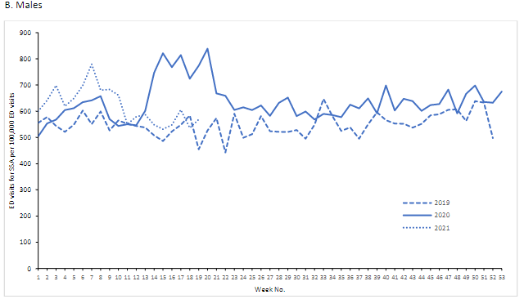
Notes:
Yard E, Radhakrishnan L, Ballesteros MF, et al. Emergency Department Visits for Suspected Suicide Attempts Among Persons Aged 12–25 Years Before and During the COVID-19 Pandemic — United States, January 2019–May 2021. MMWR Morb Mortal Wkly Rep 2021;70:888–894. DOI: http://dx.doi.org/10.15585/mmwr.mm7024e1
external icon

Slide 14
The COVID-19 Pandemic and Youth and Young Adult Behavioral Health
Why has the pandemic been particularly hard on mental health?
In many ways we are experiencing not just a pandemic but a syndemic.
The pandemic has triggered a host of social problems that contribute to public health, from social isolation due to lockdowns and shifts virtual learning/working from home, increases in stress, and financial insecurity due to economic impacts.
Notes:
Rachel

Slide 15
Notes:
This is from the Aspen Institute https://www.aspeninstitute.org/blog-posts/the-covid-19-eviction-crisis-an-estimated-30-40-million-people-in-america-are-at-risk/
These things all have mental health impacts. We know that there is a relationship between homeless and housing insecurity and mental health outcomes, so when the pandemic impacts a family’s financial security via the parents’ employment, and they potentially face eviction as a result, that impacts the children detrimentally as well. This about these kinds of interactions when thinking about the pandemic as “syndemic” and the overlapping health crises that we are seeing.
Note: The first article I discussed has both college-aged and pre-college aged data, and while this is particular conference is focused on creating a suicide safer higher education environment, it’s also really important to address and understand pre-college experiences. Prevention doesn’t begin in college when the behaviors are manifesting, it needs to begin before that point. MJ will discuss a bit more in the following slides about primary prevention and pre-college health interventions, in addition to providing a better understanding of disparities and health equity as it pertains to suicide and behavioral health, and then I’ll talk some more about some of the data that we do have about mental and behavioral health during this time.

Slide 16
Universal Strategies
Mental Health Promotion (psychoeducation) - early and consistently
Affordable and Accessible Mental Health Services
Reduce Stigma and Encourage Open Dialogue
Substance Use Prevention
Reduce and Mitigate Adverse Childhood Experiences
Build Community and Networks of Support
Reduce Access to Means

Slide 17
“Pre-College” Health
When asked, “How would you rate your emotional health”...
approximately 36% of DE 8th graders responded fair/poor
approximately 40% of DE 11th graders responded fair/poor
Source: 2021 Delaware School Survey
When asked, “When you feel sad, empty, hopeless, angry, or anxious, how often do you get the kind of help you need”...
approximately 57% of DE 8th graders who reported feeling that way responded never/rarely
approximately 54% of DE 11th graders who reported feeling that way responded never/rarely
Source: 2021 Delaware School Survey
Notes:
76% of 11th reported feeling this way; 72% reported feeling this way [3:4 students reported]

Slide 18
Considering other data sources, what do we know about the state of mental health in the U.S. before and during the pandemic?
Notes:
Other suicide data
Overdose and substance use

Slide 19
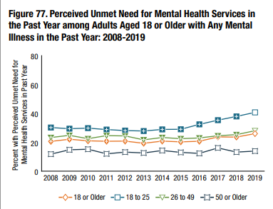
Rising Unmet Need for Mental Health Services
National Survey on Drug Use and Health, 2019
There has been an increasing rate of unmet need for mental health services, particularly among younger adults
SAMHSA 2020
Notes:
Pre-COVID, conditions were already trending in a concerning direction. The stressors of the pandemic exacerbated a lot of underlying social problems and brought pre-existing disparities to the surface, resources were strained prior to the pandemic.
Data from 2019 suggested rising unmet need for mental health services that was sharpest for the youngest age group of adults.
Relate to eviction “epidemic” referenced earlier in this presentation, housing insecurity and evictions are a problem at the current scale because of how many households prior to the pandemic that had no savings or safety net and were one missed paycheck or one medical bill away from missing a rent payment.

Slide 20
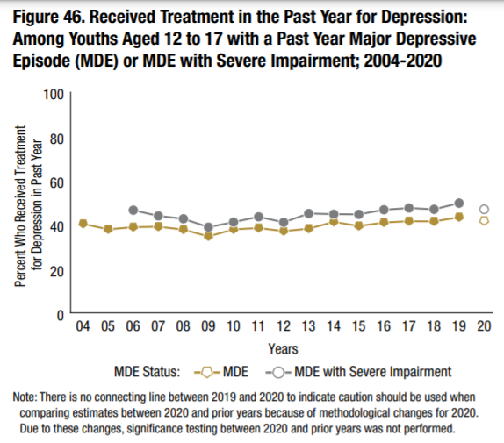
Notes:
2020 NSDUH data suggests a decrease in access to mental health treatment among adolescents, though these findings should be interpreted with caution.

Slide 21
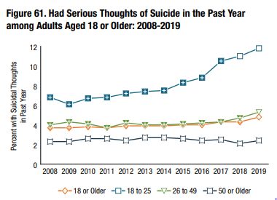
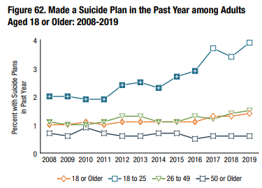
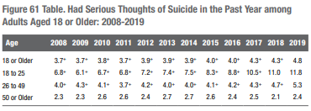
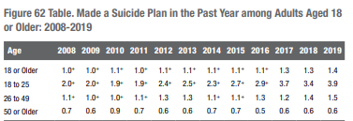
Thoughts and Plans for Suicide, Recent Increases
National Survey on Drug Use and Health, 2019
SAMHSA 2020
Notes:
We see similar trends in 2019 with thoughts and plans for suicide among young adults. Pre-pandemic, the 18-25 year old age group had some of highest increases in thoughts and plans for suicide.

Slide 22
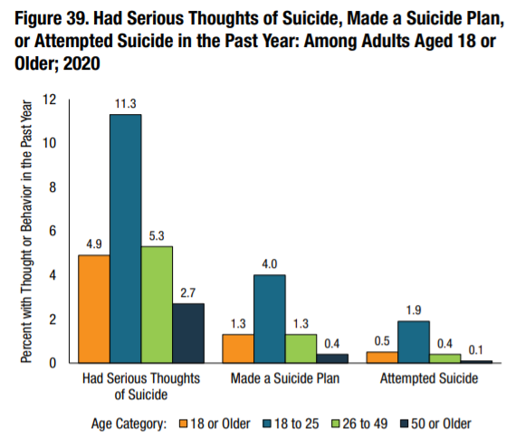
2020 NSDUH Data on Suicidal Thoughts Related to the Pandemic
Among adults aged 18 or older in 2020 who had serious thoughts of suicide in the past year, 21.1 percent (or 2.5 million people) had serious thoughts of suicide because of the COVID-19 pandemic. Among adults who made a suicide plan in the past year, 8.5 percent (or 266,000 people) made a suicide plan because of the COVID-19 pandemic
Notes:
2020 NSDUH data just became available, and to adjust for the pandemic, respondents who answered that they had serious thoughts of suicide were subequently asked if this was because of the COVID pandemic, and roughly one-fifth of these adults said their thoughts of suicide were due to the pandemic.
AMong adults who had made a suicide plan, roughly 8% said that this was because of the pandemic.
Again it is the 18-25 year old age group (traditional college aged) that is most impacted.

Slide 23
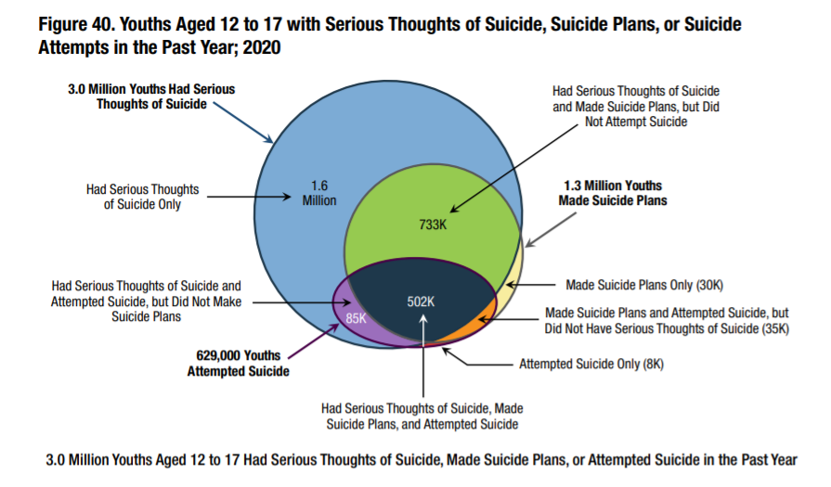
Notes:
Page 37 of 2021 nsduh report
https://www.samhsa.gov/data/sites/default/files/reports/rpt35325/NSDUHFFRPDFWHTMLFiles2020/2020NSDUHFFR1PDFW102121.pdf

Slide 24
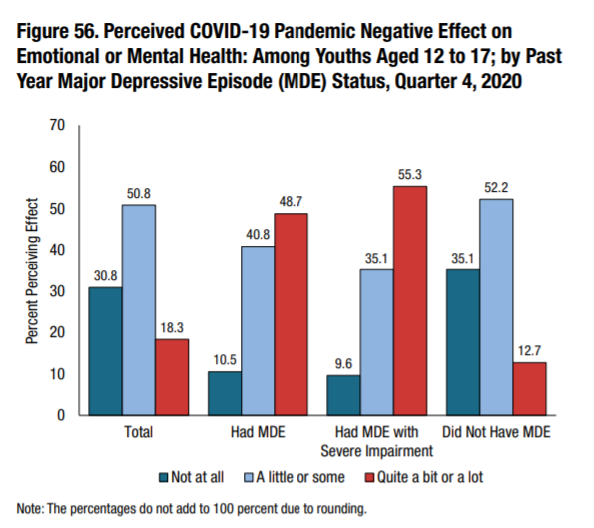
Notes:
2020 NSDUH

Slide 25
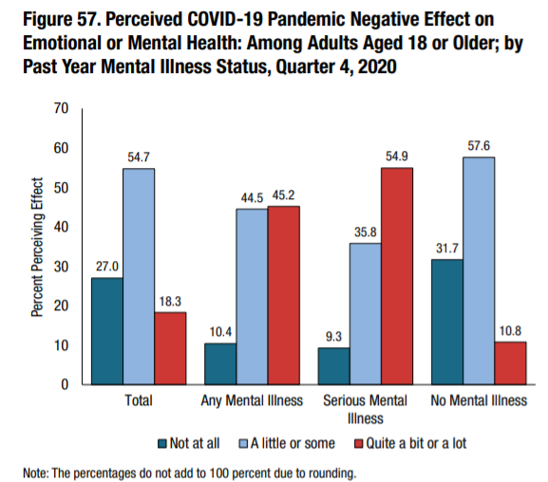
Notes:
Perceived COVID 19 negative impact on emotional or mental health of adults was slightly greater than adolescents, but not by much.

Slide 26
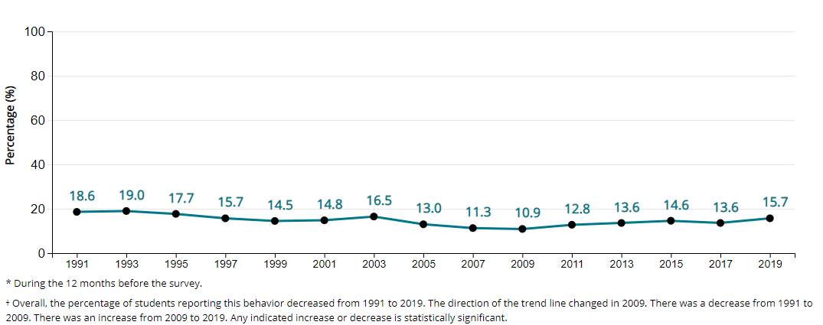
High School Students with Suicide Plans in Past Year
National Youth Risk Behavior Survey, 2019
Notes:
We don’t have 2021 YRBS data yet but this shows trends leading up to the pandemic. Hopefully will have data to follow this up in the upcoming year.

Slide 27
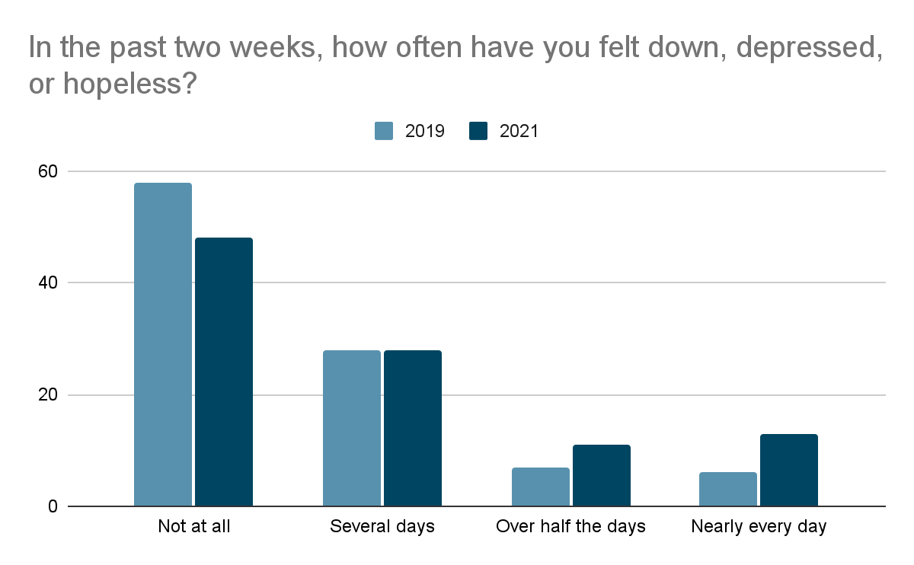
DELAWARE SCHOOL SURVEY, 11th Grade
Notes:
From 2019 to 2021, our own Delaware school survey shows increased in feelings of depression and anxiety among 11th grade students.

Slide 28
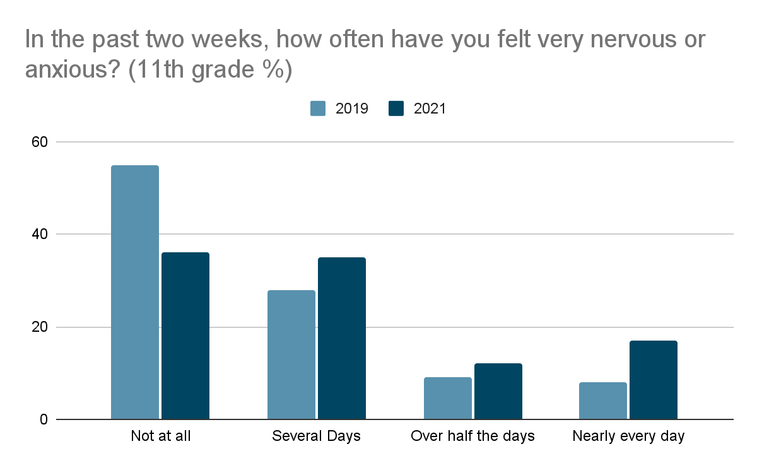
DELAWARE SCHOOL SURVEY, 11th Grade

Slide 29
In one national survey in June 2020, respondents reported increased substance use, suicidal ideation, and symptoms of anxiety disorder or depressive disorders compared to responses from the 2019 National Health Interview Survey.
More than twice the number of all respondents reported suicidal ideation than those that responded to the NSDUH in 2018 (10.7% versus 4.3%)
Adverse mental health outcomes were reported more frequently for certain populations:
Young adults
Black and Hispanic adults
Unpaid caregivers for adults
Essential workers
(Czeisler et al., 2020)
4 out of 10
surveyed Americans report symptoms of anxiety or depressive disorders
Household Pulse Survey (U.S. Census Bureau and the National Center for Health Statistics; data from Dec. 9-21, 2020)
In comparison, survey respondents to the National Health Interview Survey reported these same symptoms at 11% in 2019.

Slide 30
Opioids and Drug Overdose Events
Nationally, 18.2% increase in fatal drug overdoses, in the 12 month period ending in May 2020. with the largest increase occurring during March – May (CDC Health Alert Network, 2020).
Synthetic opioids involved in most cases
Increases in overdose deaths due to cocaine (25.6% increase) and psychostimulants (34.8% increase) from previous 12 month period

Slide 31
EMS Opioid Related Activation data
Increased rates of opioid-related and naloxone activations particularly in the early part of the pandemic, and more recent increases going into 2021

Slide 32
Limitations of Data in Field
General limitations of self-report mental health data in surveys.
With ED and health data, differences in reporting and categorization of data.
Missing or incomplete information within death record
Challenges in capturing accurate demographic information during data collection
Cannot necessarily infer causality in all cases.
Notes:
“The findings in this report are subject to at least nine limitations. First, these data are not nationally representative. Second, facility participation varies within and across states; however, data were only analyzed from facilities that reported consistently over the study period, thus minimizing the impact of reporting fluctuations on resultant trends. Third, differences in availability, coding practices, and reporting of chief complaints and discharge diagnoses from facilities might influence results returned by the syndrome definition. Fourth, distinguishing initial visits from follow-up visits for the same event was not possible, so the number of ED visits for suspected suicide attempts might be lower than presented. Fifth, NSSP race and ethnicity data were not available at the national level for this analysis at the time it was conducted, so analyses of differences among racial/ethnic groups was not possible. Sixth, these data likely underrepresent the true prevalence of suspected suicide attempts because persons with less severe injuries might be less likely to seek emergency care during the pandemic when many persons avoided medical settings to reduce the risk for contracting COVID-19. Seventh, the suspected suicide attempt syndrome definition excludes some, but not all, visits for nonsuicidal self-harm. Eighth, the sharp decline in all ED visits during the pandemic likely affected the number and proportion of visits for suspected suicide attempts (6). Finally, this analysis was not designed to determine whether a causal link existed between these trends and the COVID-19 pandemic.”

Slide 33
Limitations: COVID-19
COVID-19 caused delays in data collection and forced adjustments to methodology, difficulties in physically collecting data.
Much of this data is not nationally generalizable (in part because of these COVID-influenced limitations).
Notes:
“The findings in this report are subject to at least nine limitations. First, these data are not nationally representative. Second, facility participation varies within and across states; however, data were only analyzed from facilities that reported consistently over the study period, thus minimizing the impact of reporting fluctuations on resultant trends. Third, differences in availability, coding practices, and reporting of chief complaints and discharge diagnoses from facilities might influence results returned by the syndrome definition. Fourth, distinguishing initial visits from follow-up visits for the same event was not possible, so the number of ED visits for suspected suicide attempts might be lower than presented. Fifth, NSSP race and ethnicity data were not available at the national level for this analysis at the time it was conducted, so analyses of differences among racial/ethnic groups was not possible. Sixth, these data likely underrepresent the true prevalence of suspected suicide attempts because persons with less severe injuries might be less likely to seek emergency care during the pandemic when many persons avoided medical settings to reduce the risk for contracting COVID-19. Seventh, the suspected suicide attempt syndrome definition excludes some, but not all, visits for nonsuicidal self-harm. Eighth, the sharp decline in all ED visits during the pandemic likely affected the number and proportion of visits for suspected suicide attempts (6). Finally, this analysis was not designed to determine whether a causal link existed between these trends and the COVID-19 pandemic.”

Slide 34
Thank You

Slide 35
Contact Information
M. J. Scales, MPH, CPS
mjscales@udel.edu
Rachel Ryding, PhD
rryding@udel.edu

Slide 36
Sources
Benfer, E., Bloom Robinson, D., Butler, S., Edmonds, L., Gilman, S., Lucas McKay, K., Owens, L., Steinkamp, N., Yentel, D., & Neumann, Z. (2020, August 7). The COVID-19 Eviction Crisis: an Estimated 30-40 Million People in America Are at Risk. Retrieved from https://www.aspeninstitute.org/blog-posts/the-covid-19-eviction-crisis-an-estimated-30-40-million-people-in-america-are-at-risk/.
Bridge JA, Horowitz LM, Fontanella CA, et al. Age-Related Racial Disparity in Suicide Rates Among US Youths From 2001 Through 2015. JAMA Pediatr. 2018;172(7):697–699. doi:10.1001/jamapediatrics.2018.0399
Centers for Disease Control and Prevention (CDC). 1991-2019 High School Youth Risk Behavior Survey Data. Available at http://yrbs-explorer.services.cdc.gov/. Accessed on January 20, 2021.
Centers for Disease Control and Prevention. (2020, Dec. 17). Increase in fatal drug overdoses across the United States driven by synthetic opioids before and during the COVID-19 pandemic. Health Alert Network – CDCHAN-00438. Retrieved from https://emergency.cdc.gov/han/2020/han00438.asp
Center for Drug & Health Studies. (2021). Delaware School Survey: Secondary [Annual Survey]. University of Delaware. https://www.cdhs.udel.edu/seow/school-surveys/delaware-school-survey/%28dss%29

Slide 37
Sources
Congressional Black Caucus (CBC) Emergency Taskforce on Black Youth Suicide and Mental Health. (2020). (rep.). Ring the Alarm: the Crisis of Black Youth Suicide in America. https://watsoncoleman.house.gov/uploadedfiles/full_taskforce_report.pdf
Czeisler, M., Lane, R.I., Petrosky, E., Wiley, J.F., Christensen, A., Njai, R., Weaver, M.D., Robbins, R., Facer-Childs, E.R., Barger, L.K., Czeisler, C.A., Howard, M.E., Rajaratnam, S. M. W. (2020) Mental health, substance use, and suicidal ideation during the COVID-19 pandemic – United States, June 24-30, 2020. MMWR Morbidity and Mortality Weekly Report, 69(32), 1049-1057. Retrieved from https://www.cdc.gov/mmwr/volumes/69/wr/mm6932a1.htm.
Hedegaard H, Miniño AM, Warner M. (2020). Drug overdose deaths in the United States, 1999–2018. NCHS Data Brief, 356. Hyattsville, MD: National Center for Health Statistics. 2020. Retrieved from https://www.cdc.gov/nchs/data/databriefs/db356-h.pdf
Lyons, B. H., Walters, M. L., Jack, S. P. D., Petrosky, E., Blair, J. M., & Ivey-Stephenson, A. Z. (2019). Suicides among lesbian and gay male individuals: Findings from the National Violent Death Reporting System. American Journal of Preventive Medicine, 56(4), 512–521. https://doi.org/10.1016/j.amepre.2018.11.012
Mann, C. (2021). EMS by the Numbers: Impact of COVID-19, January 21st, 2021 [PowerPoint Slides]. National Emergency Medical Services Information System (NEMSIS). Retrieved from https://nemsis.org/wp-content/uploads/2021/01/NEMSIS-TAC-Update-to-COVID_19-Trends-1_21_2021-Pre-Findings-V1.pdf

Slide 38
Sources
Ramchand, R., Schuler, M. S., Schoenbaum, M., Colpe, L., & Ayer, L. (2021). Suicidality among sexual minority adults: Gender, age, and Race/ethnicity differences. American Journal of Preventive Medicine. https://doi.org/10.1016/j.amepre.2021.07.012
Romanelli, M., Sheftall, A. H., Irsheid, S. B., Lindsey, M. A., & Grogan, T. M. (2021). Factors associated with distinct patterns of suicidal thoughts, suicide plans, and suicide attempts among us adolescents. Prevention Science. https://doi.org/10.1007/s11121-021-01295-8
Sheftall, A. H., Vakil, F., Ruch, D. A., Boyd, R. C., Lindsey, M. A., & Bridge, J. A. (2021). Black Youth Suicide: Investigation of current trends and precipitating circumstances. Journal of the American Academy of Child & Adolescent Psychiatry. https://doi.org/10.1016/j.jaac.2021.08.021
Substance Abuse and Mental Health Services Administration. (2020). Key substance use and mental health indicators in the United States: Results from the 2019 National Survey on Drug Use and Health (HHS Publication No. PEP20-07-01-001, NSDUH Series H-55). Rockville, MD: Center for Behavioral Health Statistics and Quality, Substance Abuse and Mental Health Services Administration. Retrieved from https://www.samhsa.gov/data/
Substance Abuse and Mental Health Services Administration. (2021). Key substance use and mental health indicators in the United States: Results from the 2020 National Survey on Drug Use and Health (HHS Publication No. PEP21-07-01-003, NSDUH Series H-56). Rockville, MD: Center for Behavioral Health Statistics and Quality, Substance Abuse and Mental Health Services Administration. Retrieved from https://www.samhsa.gov/data/

