Slide 1
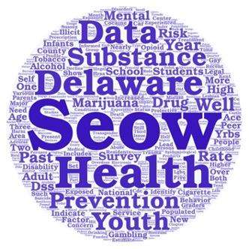
Behavioral Health Data Highlights from the 2022 Delaware Epidemiological Profile
3D: Delaware Data Discourse
Hosted by the State Epidemiological Outcomes Workgroup (SEOW)
Center for Drug and Health Studies of the University of Delaware
December 14th, 2022

Slide 2
The State Epidemiological Outcomes Workgroup (SEOW)
Funding for the State Epidemiological Outcomes Workgroup has been provided by the
Delaware Department for Health and Social Services, Division of Substance Abuse and Mental Health (DSAMH) through the Substance Abuse and Mental Health Services Administration (SAMHSA).
The SEOW is facilitated by the Center for Drug and Health Studies at the University of Delaware. Visit the SEOW online at:
https://www.cdhs.udel.edu/seow/what-is-seow

Slide 3
The 4 Goals of the SEOW
Identify, Analyze, and Share Data
Create Data Products
Train Communities in Understanding and Using Data
Build State and Local Level Monitoring Systems

Slide 4
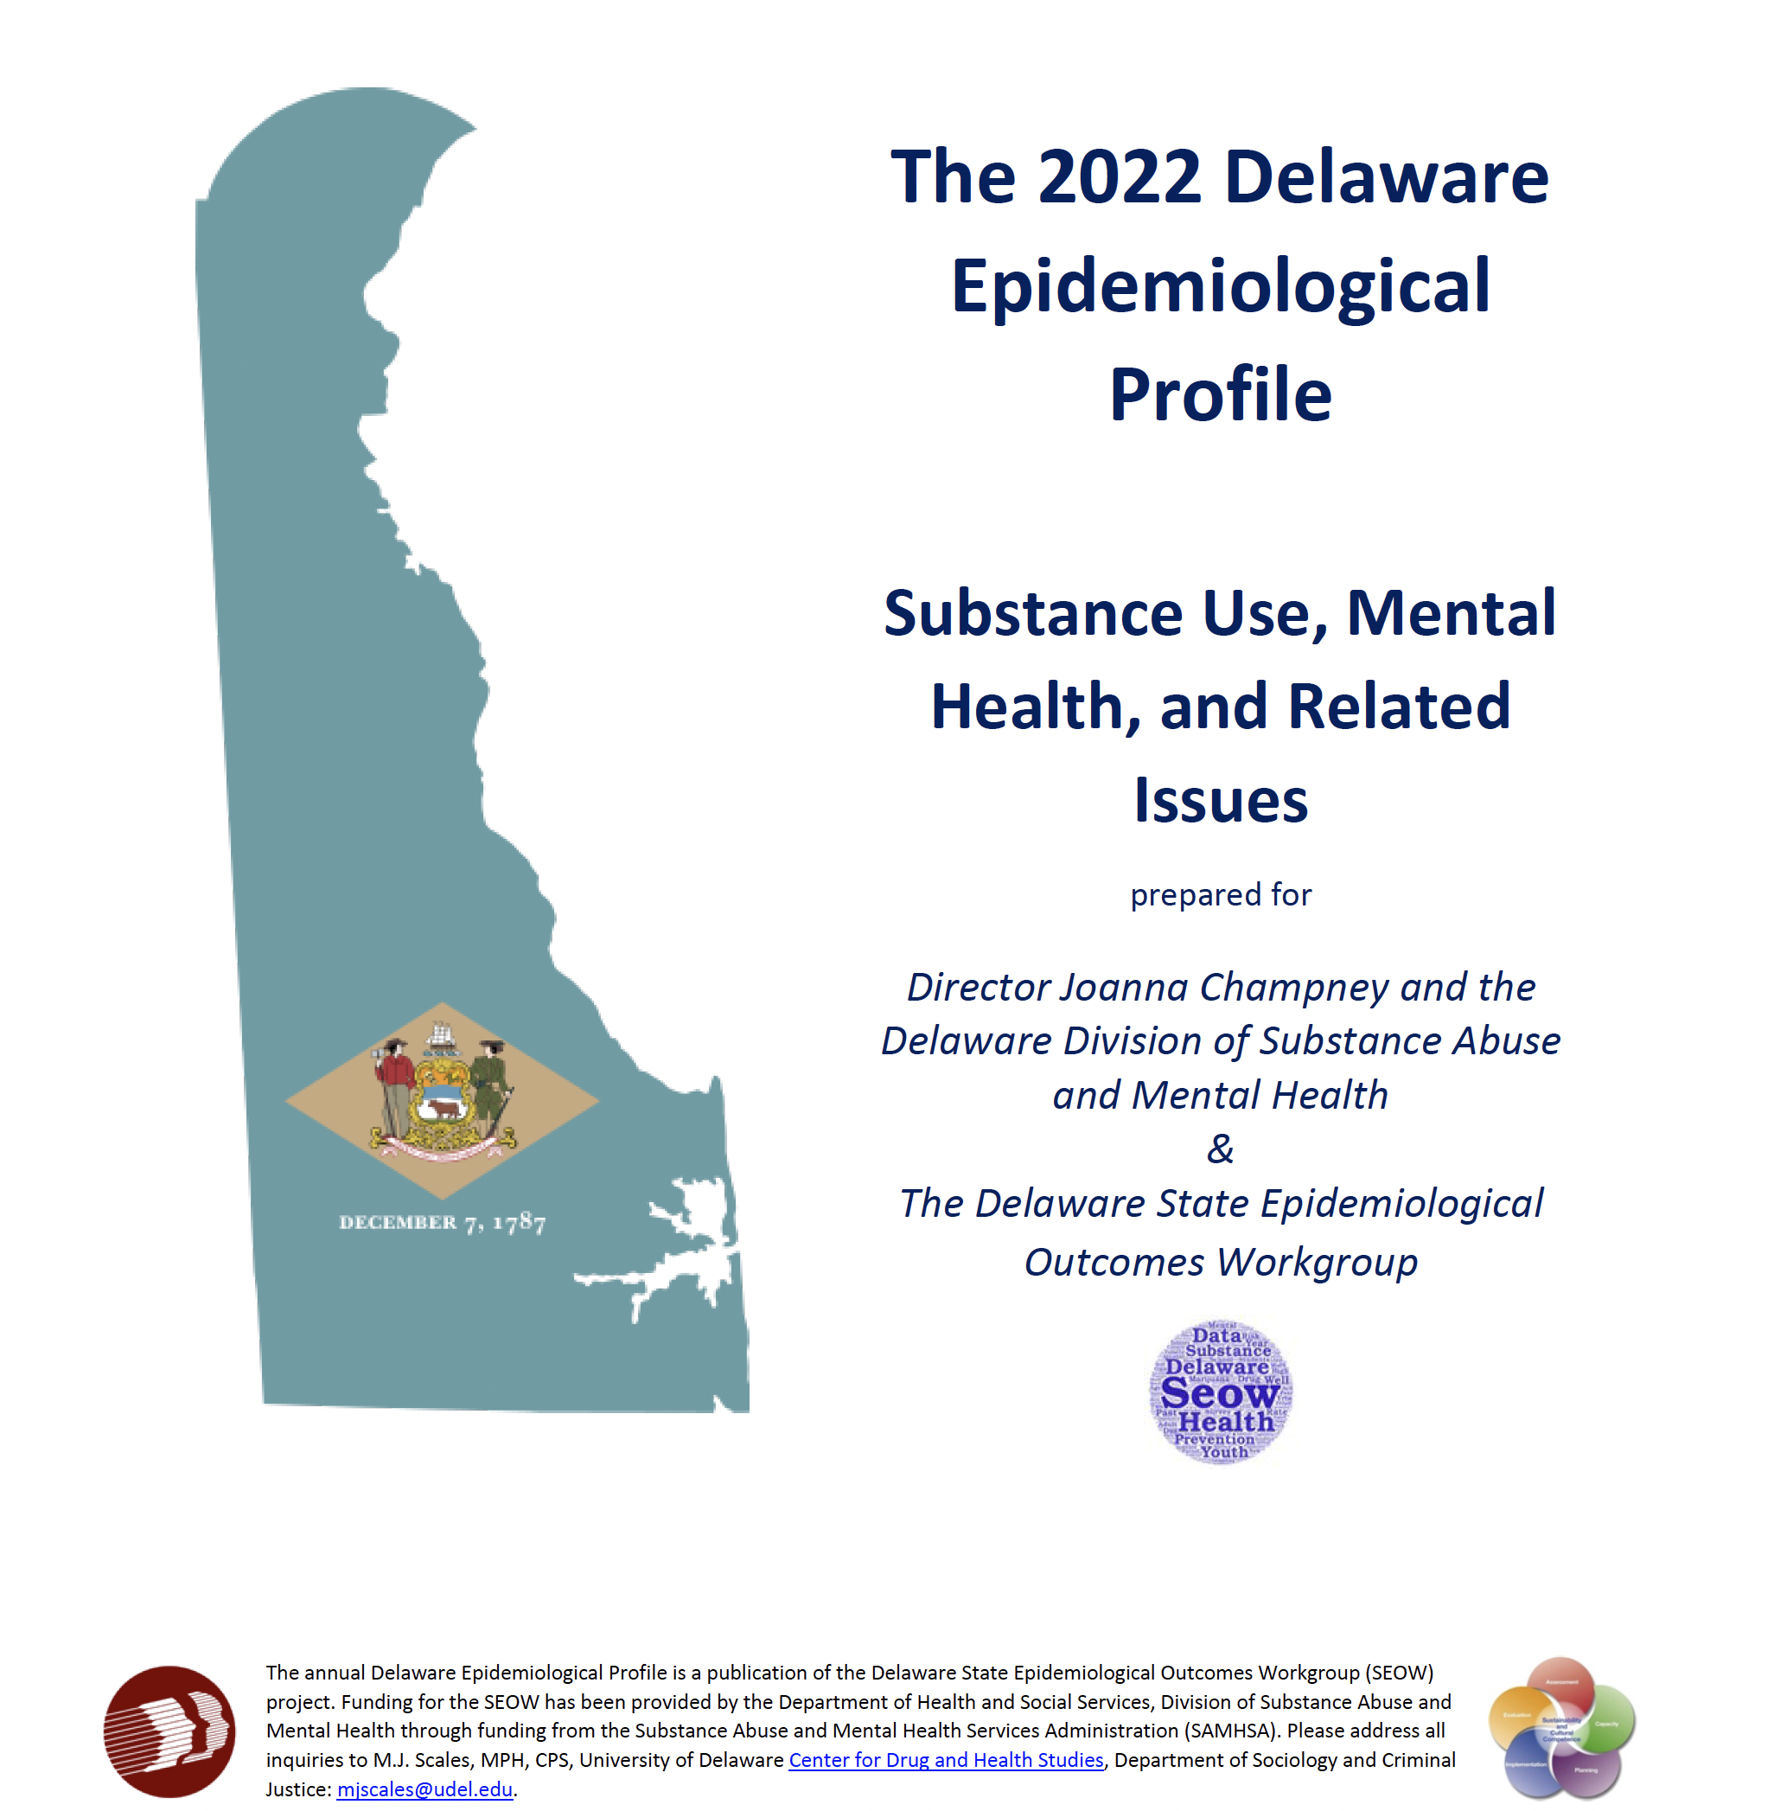
“The Epi”
The Delaware Epidemiological Profile is an annual report of data highlighting the trends and patterns in substance use, mental health indicators, risk and protective factors, and special topics.
The report is a resource for:
Needs assessment
Grant applications
Evaluation planning
Presentations, public awareness, and media outreach

Slide 5
Data Sources
Additional Data References
America’s Health Rankings
American Psychological Association
Bureau of Labor Statistics
Center for Drug and Health Studies, University of Delaware
Crisis Text Line
Delaware Department of Education
Delaware Department of Health and Social Services, Division of Public Health, My Healthy Community
Delaware Drug Monitoring Initiative
Delaware Department of Safety and Homeland Security, Division of Forensic Science
Delaware Household Health Survey
Drug Enforcement Administration
Gallup
KIDS COUNT in Delaware
KFF
National Academies of Sciences, Engineering, and Medicine
National Center for Health Statistics
National Conference of State Legislatures
National Institute on Alcohol Abuse and Alcoholism
National Institute on Drug Abuse
National Institutes of Health
National Institute on Mental Health
Rapid Assessment of Pandemic Impact on Development – Early Childhood
State of Delaware Economic Development Office
The Trevor Project
The Williams Institute
U.S. Census Bureau
U.S. Centers for Disease Control and Prevention
U.S. Health Resources and Services Administration
Data Instrument | Most Recent Data | Trend Range
Delaware Annual Traffic Statistical Report | 2021 | -
Delaware Behavioral Risk Factor Surveillance System (BRFSS) | 2020 | -
Delaware Division of Forensic Science Annual Report | 2021 | 2019-2021
Delaware Infants with Prenatal Substance Exposure Program | 2020 | 2015-2020
Delaware Online/NewsJournal Gun Violence Database | 2022 | 2017-2022
Delaware Prescription Monitoring Program (PMP) | 2020 | 2012- 2020
Delaware School Survey (DSS) – 5th, 8th, and 11th grades | 2021 | 1999 - 2021
Delaware Youth Risk Behavior Survey (YRBS) –High School | 2017 | 1999 - 2017
Delaware Youth Risk Behavior Survey (YRBS) – Middle School | 2019 | 1999 - 2019
Delaware Youth Tobacco Survey – 6th – 12th grades | 2020 | -
DOMIP (Delaware Opioid Metric Intelligence Program) | 2020 | -
Household Pulse Survey | 2022 | 2021 - 2022
Monitoring the Future – 8th, 10th, and 12th grades | 2021 | 1999 - 2021
National High School Youth Risk Behavior Survey | 2019 | 1999 - 2019
National Survey on Children’s Health (NSCH) | 2019 | 2016 - 2019
National Survey on Drug Use and Health (NSDUH) | 2018-2019 | 2002 - 2019
Treatment Admissions Data | 2019 | -

Slide 6
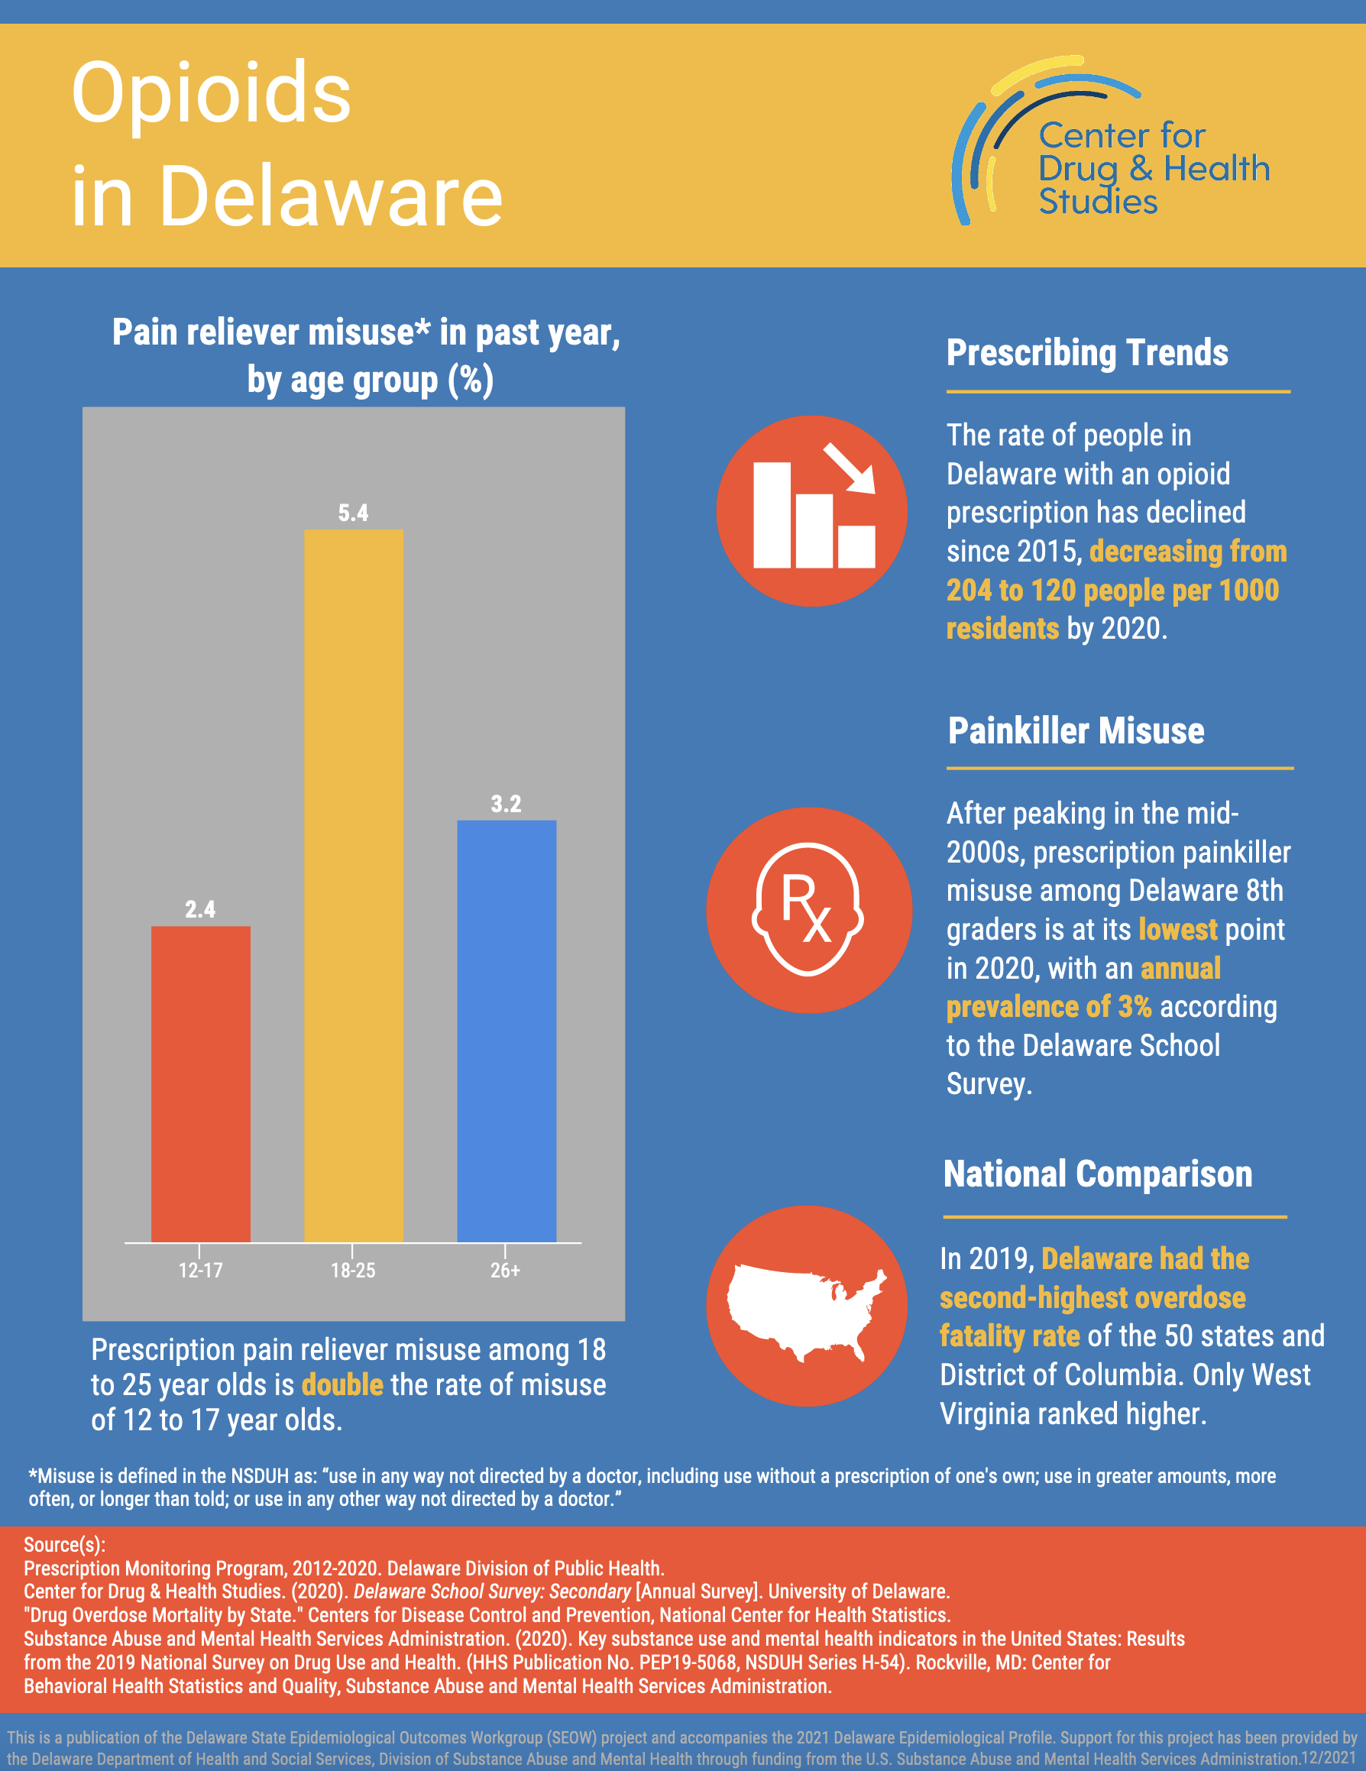
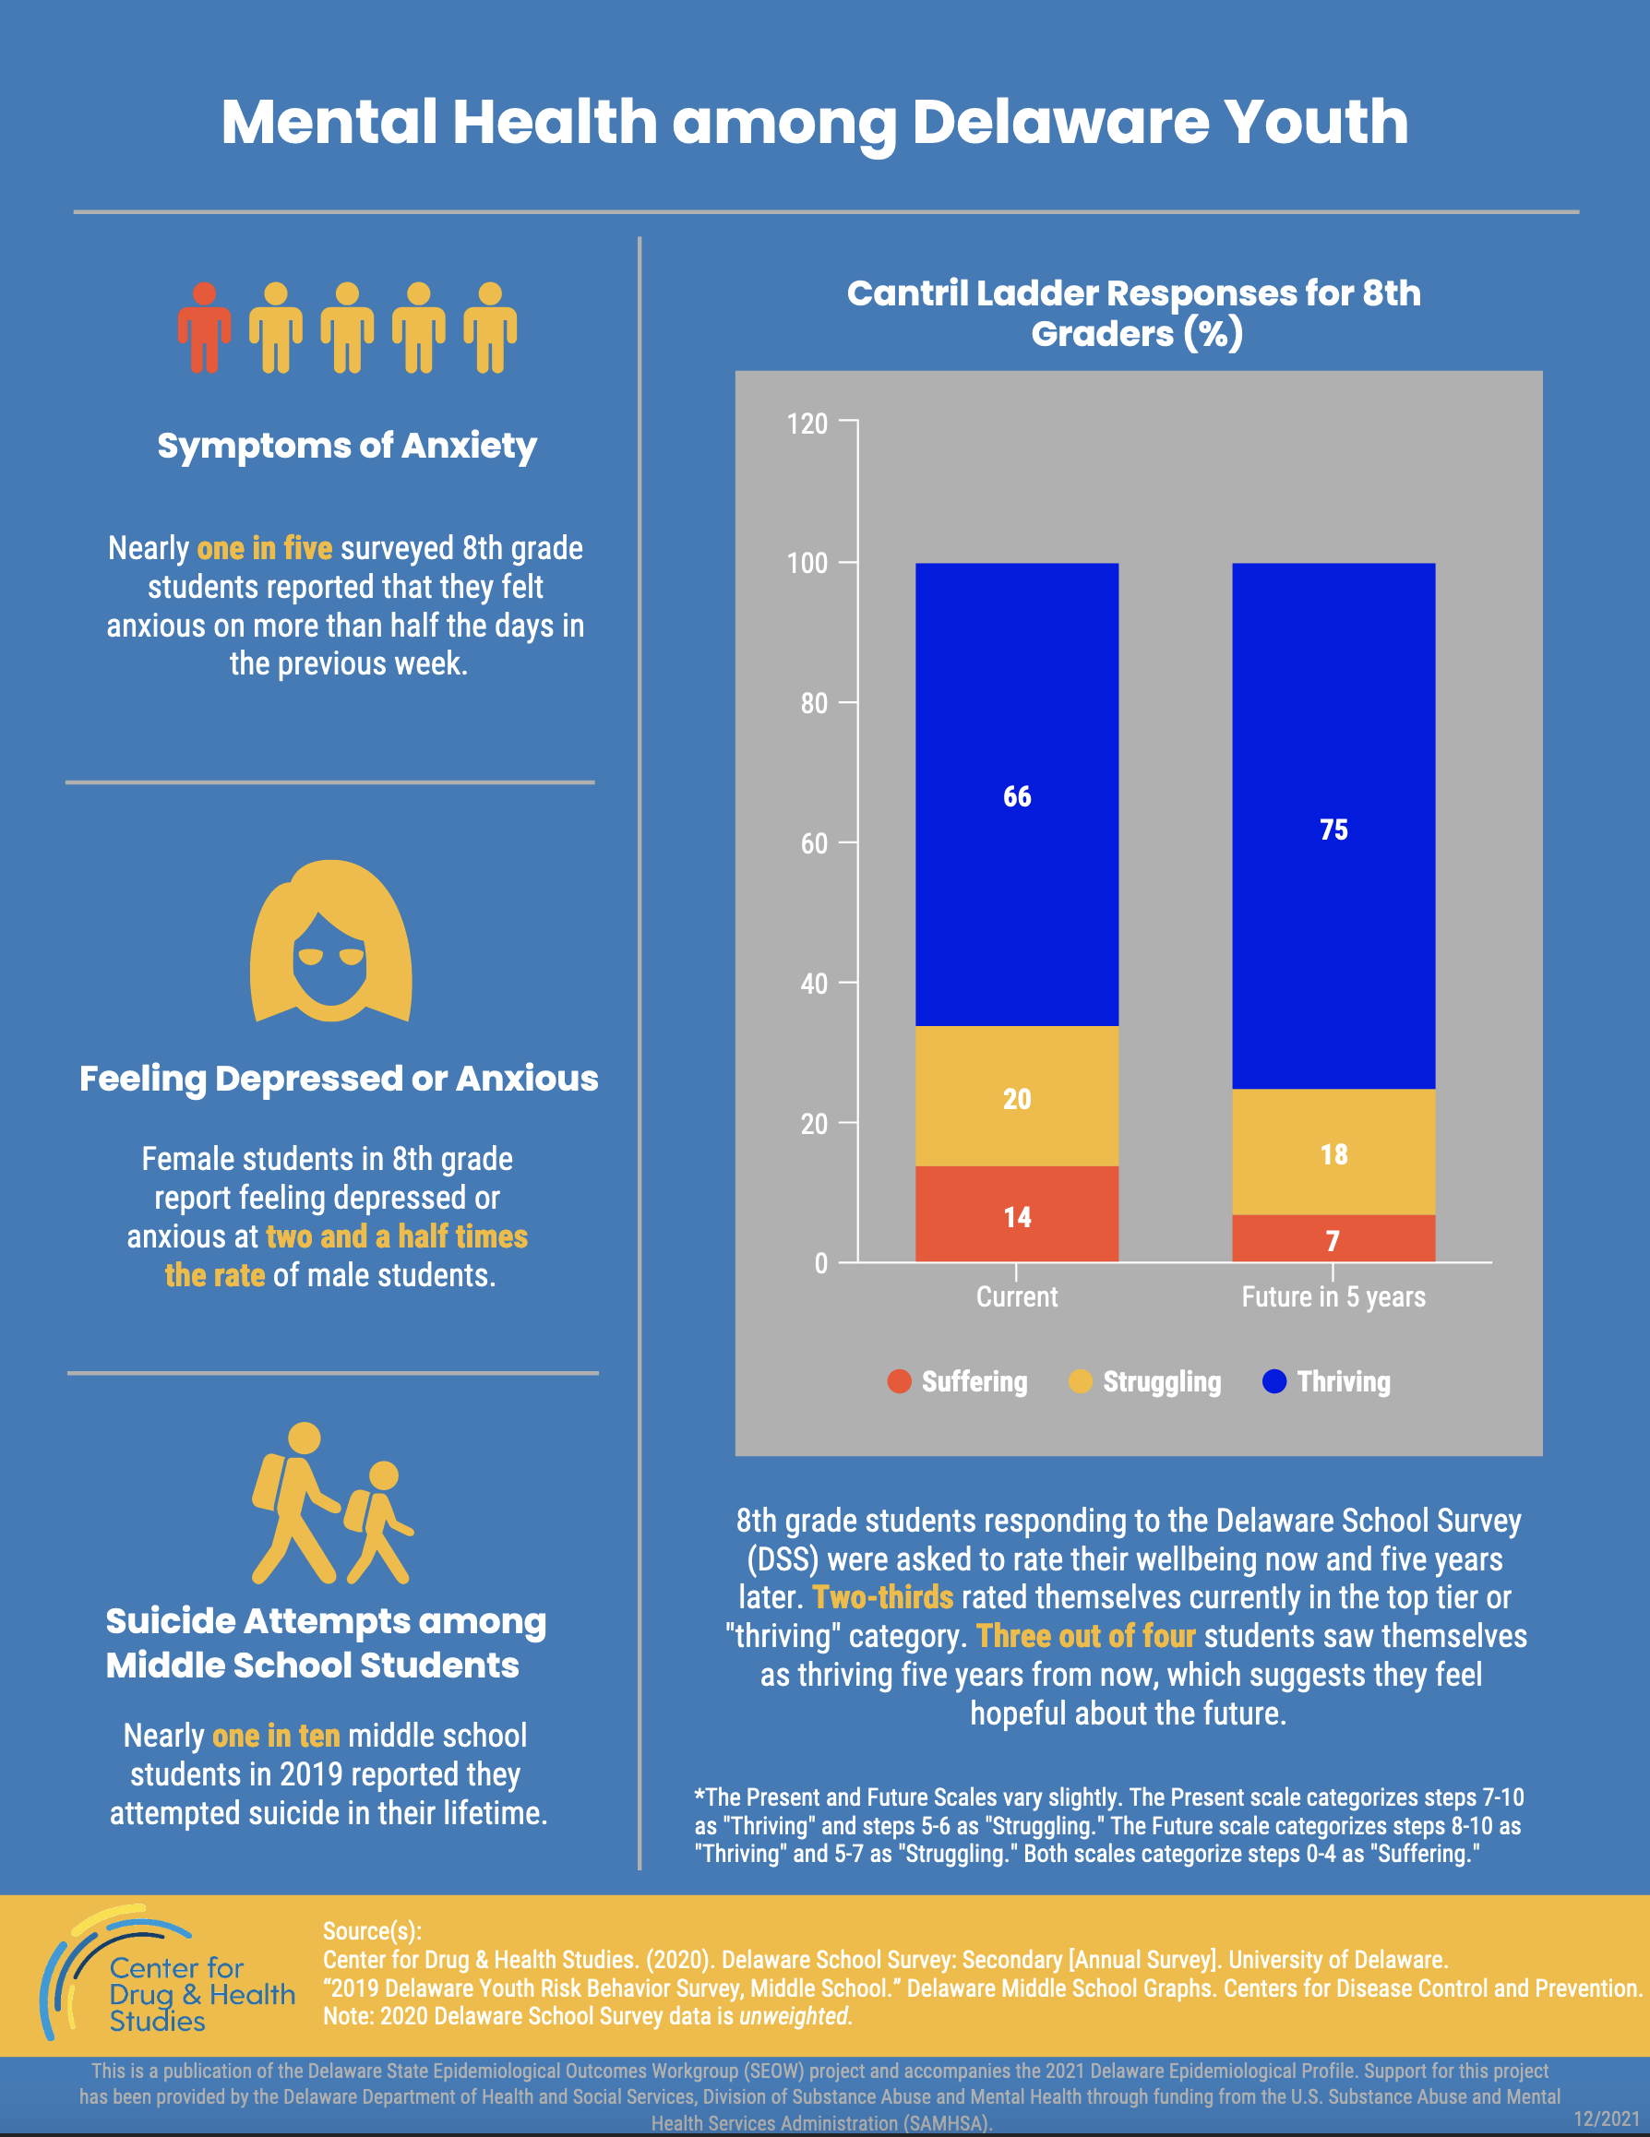
2022 Epi Infographic Series

Slide 7
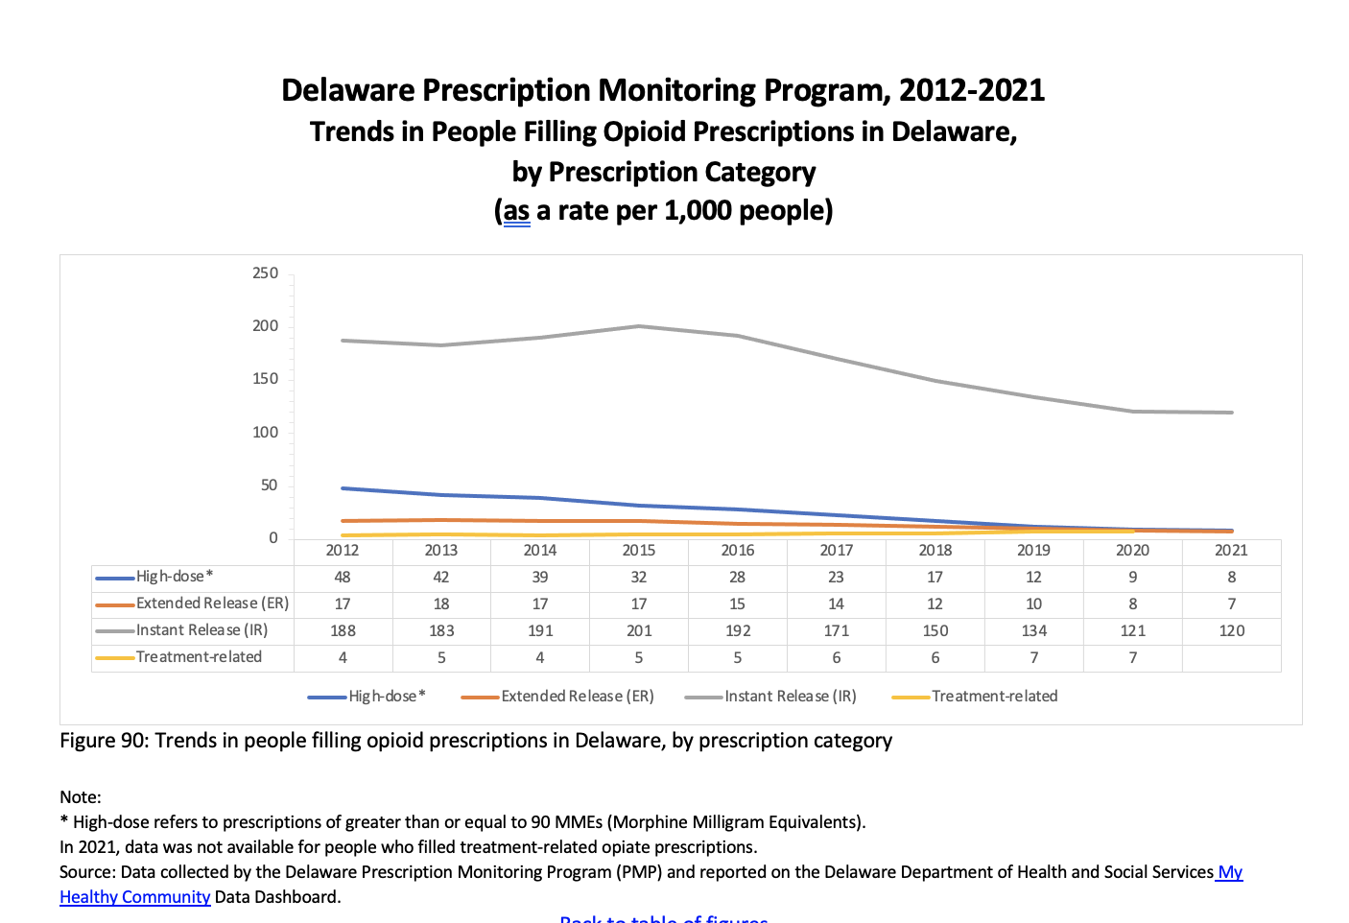
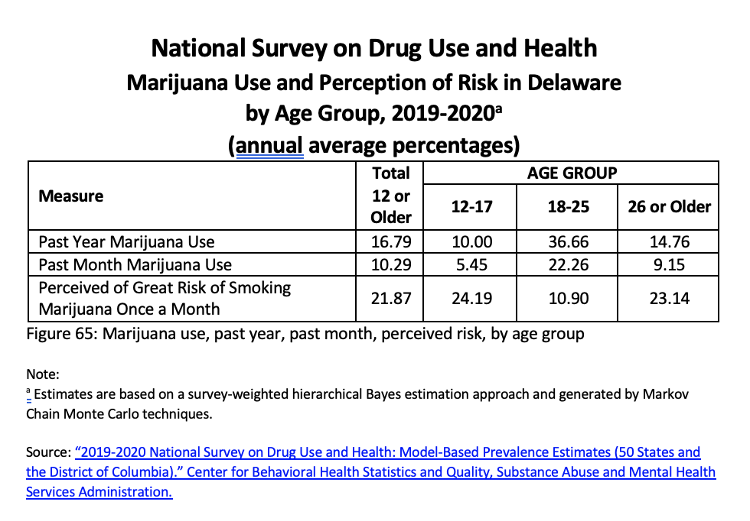
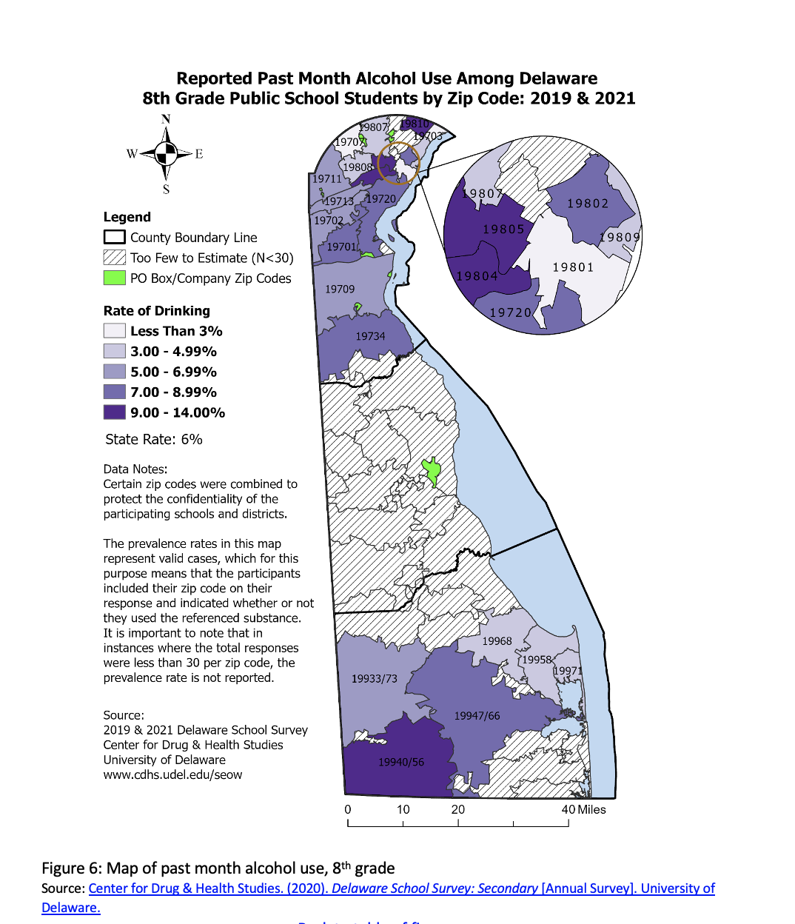
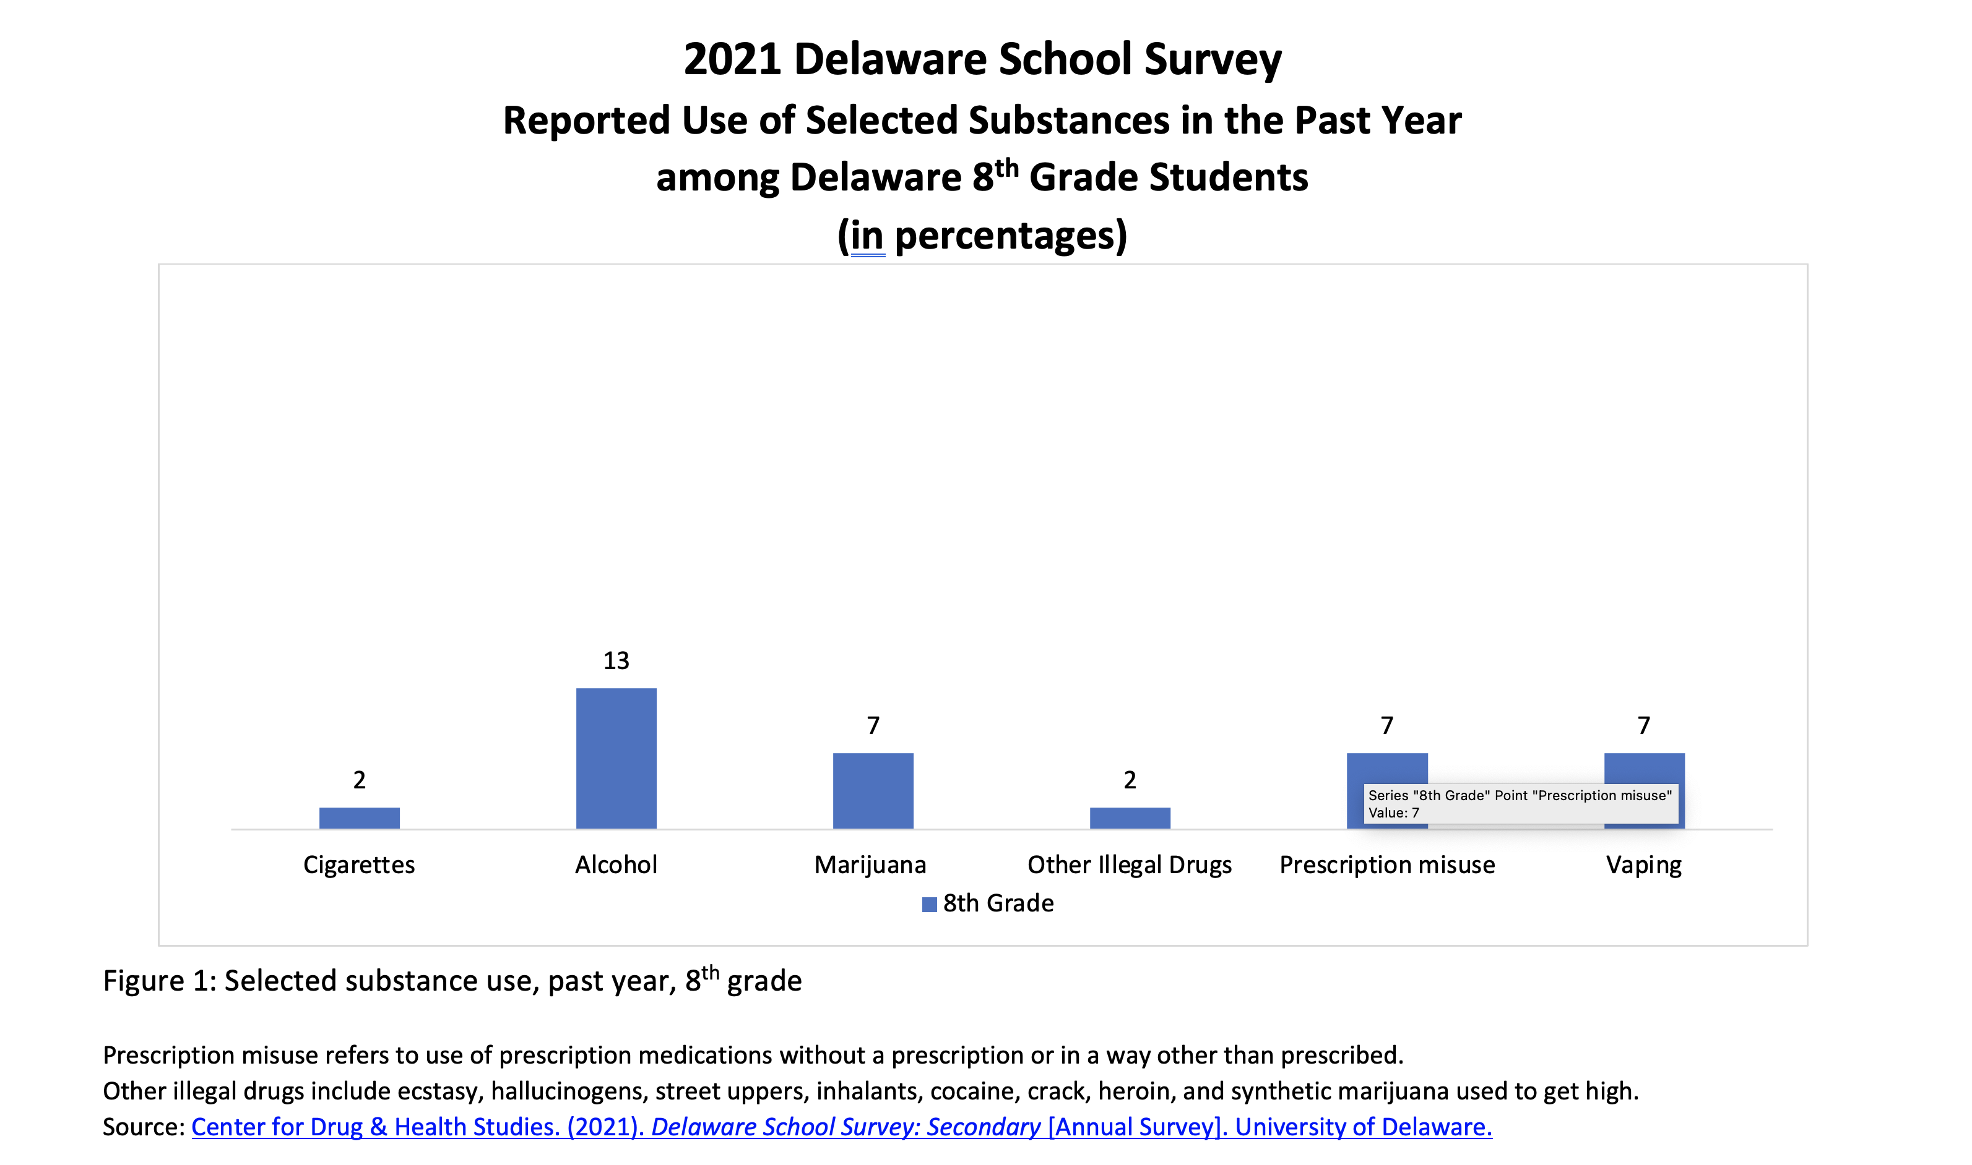
2022 Epi Slides

Slide 8
What’s New in the 2022 Profile?
Adult mental health data from the Household Pulse Survey
Policy updates on state and local legislation regarding behavioral health
An expanded chapter on trauma and ACEs

Slide 9
2022 Delaware State Epidemiological Report
Data Reporting and Interpretation

Slide 10
Notes on Data Reporting and Interpretation
In order to protect the anonymity of respondents and to ensure that the data reported meet certain statistical standards, the Center for Drug and Health Studies (CDHS) at the University of Delaware recently updated its guidelines for reporting and interpreting data from surveys that it administers to students across the state of Delaware. As a result, in the 2021 Delaware State Epidemiological Profile, data in some tables and figures have been aggregated or otherwise reported differently than in years prior.
The following notes summarize the guidelines for
interpreting data presented in this report:
Reporting Small Numbers
Rounding
Missing Observations
Statistical Significance
Discrepancies in Reporting
Weighted Data

Slide 11
Reporting Small Numbers and Rounding
Reporting small numbers: For any estimate where the raw number of responses is less than 30, no statistical estimates are reported. Statistics computed from such a small proportion of the total number of students may be unreliable, inflating the significance of existing relationships in the data, and among some special populations, may put individuals at risk of being identified. In some data products such as our heat maps, multiple years of data have been combined in order to increase the sample sizes to a reportable figure.
Rounding: All figures from Delaware school survey data (DSS) are rounded to the nearest whole percent. As such, in some cases the cells in a table may add up to slightly more or less than 100%.

Slide 12
Missing Observations
In the analysis of Delaware school survey data, any missing observations (responses) are not calculated into the total percentages. Because different questions have varying numbers of missing responses, the total sample size and percent missing may fluctuate slightly from question to question. This is due to a few factors:
Students may not answer all questions on a survey, particularly those towards the end if they run out of time or they get tired of answering questions.
Students may also skip or decide not to respond to certain questions for various reasons (e.g., if they fear their responses will not be kept confidential; if they consider the question too personal or sensitive; if they do not understand the question; etc.)

Slide 13
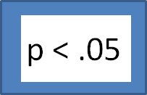
Statistical Significance
Unless otherwise indicated, all reported correlations between variables are statistically significant at the p<.05 level. Null hypothesis testing, used to estimate statistical significance, provides an estimate of the likelihood that the relationship between two indicators is not due to random chance. If the p-value for a given crosstab is less than .05, this suggests that in 95% of cases, the correlation between the relevant variables is because there is a relationship between them.

Slide 14
Discrepancies in Reporting
In some instances, there may be slight differences in estimates reported by the Center for Drug and Health Studies compared to those reported by other state or federal entities for the same data source. In most cases this is due to differing practices in rounding or handling missing observations in the data and does not substantially impact the overall prevalence estimates, trends, and relationships among these data points.
This report draws upon data from multiple but highly regarded sources to provide a comprehensive profile of behavioral health. At times, rates of behavior reported may vary substantially across these data sources. The nature and timing of the survey administration, sampling methods, wording and order of questions, definitions of key terms, and other factors may account for differences in these rates.
This Photo by Unknown Author is licensed under CC BY-SA
This Photo by Unknown Author is licensed under CC BY-SA

Slide 15
Weighted Data
Weighting data is a correction technique that compensates for nonresponses, helps correct for unequal probabilities of being selected within the sample, and helps ensure that the sample drawn is representative of the Delaware student population. If data is weighted, there will be a notation indicating the data is weighted for the specific fact, figure, or table.

Slide 16
Pandemic Impacts on Data Collection
Since 2020, the COVID-19 pandemic has greatly affected data collection of all kinds. Given that the timing and methods of various data survey administrations may have changed within the past several years, it will be important to consider this when interpreting trends.
Before the pandemic, the Delaware School Survey (DSS) was administered at participating schools in person and using paper and pencil copies. In 2021, to accommodate the new pandemic-related protocols put in place when in-person learning resumed, the survey was administered to students online. Data from this survey should be interpreted with this in mind, especially when comparing trends against previous years, as survey format changes may impact student participation in unknown ways.

Slide 17
School Surveys
The Delaware School Survey is administered annually to students in 5th, 8th, and 11th grades in Delaware public schools. The sample sizes for the 2021 survey are:
5th grade: 2,601
8th grade: 2,896
11th grade: 1,597
The CDC’s Youth Risk Behavior Survey (YRBS) is administered to students in a sample of classes in Delaware middle and high school every other year. Due to low school participation rates, Delaware did not receive weighted YRBS data for high school students in 2019. Therefore, the most recent Delaware YRBS data reported in this report are 2019 middle school findings. Whenever available, trend data from the CDC Youth Online Data Portal is included. Additional high school YRBS data from previous years may be requested by following the Delaware Division of Public Data Information & Request Process.

Slide 18
2022 Delaware State Epidemiological Report
An Overview of Key Findings

Slide 19
2022 Delaware State Epidemiological Report Chapter Outline
Specific Focus by Type of Substance Use
Specific Focus by Special Topics and Subgroups
State Demographic Background
Tobacco and Electronic Cigarettes
Alcohol
Marijuana
Opioid Use
Other Illegal Drugs
Infants with Prenatal Substance Exposure
Gambling
Mental Health and Wellness
Persons with Disabilities
Adverse Childhood Experiences (ACEs) and Other Trauma
Gender and Sexuality
Protective Factors
Notes:
We do not have updated data for chapters 7 and 8 this year, IPSE and gambling.

Slide 20
Reported Use of Selected Substances in the Past Year among Delaware Students (%) 2021 Delaware School Survey, 8th Grade
State Overview: A Snapshot of Substance Use (8th Grade)
Prescription misuse includes any prescription medications used without a prescription or in a way other than prescribed, such as prescription uppers (diet pills, Ritalin, Concerta, Adderall), downers (Xanax and other benzodiazepines), and painkillers.
Other illegal drugs include ecstasy, hallucinogens, street uppers, inhalants, cocaine, crack, heroin, and synthetic marijuana used to get high.
Center for Drug & Health Studies. (2021). Delaware School Survey: Secondary [Annual Survey]. University of Delaware.
Notes:
Among 8th grade students, alcohol use if most common, and marijuana, prescriptions, and vaping are all tied for the second most common at 7% in the past year.

Slide 21
Reported Use of Selected Substances in the Past Year among Delaware Students (%) 2021 Delaware School Survey, 11th Grade
State Overview: A Snapshot of Substance Use (11th Grade)
Prescription misuse includes any prescription medications used without a prescription or in a way other than prescribed, such as prescription uppers (diet pills, Ritalin, Concerta, Adderall), downers (Xanax and other benzodiazepines), and painkillers.
Other illegal drugs include ecstasy, hallucinogens, street uppers, inhalants, cocaine, crack, heroin, and synthetic marijuana used to get high.
*The unweighted sample size of 11th grade students who used cigarettes in the past year was below the minimum threshold for reporting (n<30).
Center for Drug & Health Studies. (2021). Delaware School Survey: Secondary [Annual Survey]. University of Delaware.
Notes:
Three most common substances used by 11th grade students in the past year remain alcohol, marijuana, and vaping/e-cigarettes.

Slide 22
Declining Perception of “Great Risk” of Cigarettes (%) 2021 Delaware School Survey, 8th and 11th Grade
Tobacco and Electronic Cigarettes (Vaping)
Center for Drug & Health Studies. (2021). Delaware School Survey: Secondary [Annual Survey]. University of Delaware.
Notes:
While perception of risk associated with cigarette use has remained relatively high, in the last couple data cycles this perception of risk decreased. It is too soon to tell if this is a trend that will continue to decrease/stay lower or if this is an anomaly of pandemic years.

Slide 23
Trends in Past Month Use of Cigarettes (%) 2021 Delaware School Survey, 8th and 11th Grade
Tobacco and Electronic Cigarettes (Vaping)
In 2019, the number of 8th grade students reporting past month cigarette use was too small to report.
In 2020, 11th grade data was not available for the Delaware School Survey.
In 2021, the number of 8th grade and 11th grade students reporting past month cigarette use were too small (n<30) to report.
Center for Drug & Health Studies. (2021). Delaware School Survey: Secondary [Annual Survey]. University of Delaware.
Notes:
Despite inconsistencies in perception of great risk associated with cigarettes, cigarette smoking has continued to decline among 8th and 11th grade students and has reached historic lows.

Slide 24
Trends in Self-Reported Vaping (%) 2021 Delaware School Survey, 11th Grade
Tobacco and Electronic Cigarettes (Vaping)
Center for Drug & Health Studies. (2021). Delaware School Survey: Secondary [Annual Survey]. University of Delaware.
Notes:
Vaping peaked in 2019, after a data gap in 2020 the reported 2021 rates of vaping are much lower again. This is something to watch in the next few cycles of data collection to see if this is a sustained downward trend or a fluke.

Slide 25
Trends in Delaware Students’ Self-Reported Binge Drinking (%) Delaware School Survey, 1999-2021
Alcohol
*In 2020, 11th grade data was not available for the Delaware School Survey.
**In 2021, prevalence estimates for self-reported binge drinking by 8th graders were too small (n<30) to report.
ª Binge drinking defined as 4 or more drinks of alcohol in a row for female students and 5 or more drinks of alcohol in a row for male students in the past two weeks (Previously binge use was reported as 3 or more drinks).
Center for Drug & Health Studies. (2021). Delaware School Survey: Secondary [Annual Survey]. University of Delaware.
Notes:
Past month alcohol use among high school students has generally declined, though it remains the most commonly used drug among youth in Delaware.

Slide 26
Adult Alcohol Use by Age Group (%) Behavior Risk Factor Surveillance Survey (BRFSS)
Alcohol
Age Group | Current Drinking | Binge Drinking | Heavy Drinking
Overall | 51.1% | 14.3% | 5.9%
18 - 24 | 50.2% | 24.8% | 10.4%
25 - 34 | 54.1% | 18.5% | 6.0%
35 - 44 | 57.4% | 21.7% | 6.7%
45 - 54 | 53.5% | 13.0% | 5.6%
55 - 64 | 52.5% | 12.4% | 5.7%
65 and Older | 43.9% | 5.0% | 3.9%
Current drinking is defined by the BRFSS as at least one drink of alcohol within the past 30 days.
Binge drinking is defined in the BRFSS as 4 or more drinks for a woman or 5 or more drinks for a man on an occasion during the past 30 days.
Heavy drinking is defined by the BRFSS as more than 7 drinks per week for women or more than 14 drinks per week for men.
“2020 Delaware Behavior Risk Factor Surveillance System.” BRFSS Prevalence & Trends Data, Centers for Disease Control and Prevention.
Notes:
Among adults in Delaware, while 18-24 year olds have the highest reported rates of binge drinking and heavy drinking, the 35-44 year old age group has the highest rate of current drinking.

Slide 27
Trends in Delaware Students’ Past Month Marijuana Use by Grade (%) Delaware School Survey, 1999-2021
Marijuana
Center for Drug & Health Studies. (2021). Delaware School Survey: Secondary [Annual Survey]. University of Delaware.
Notes:
While we’ve seen overall declines in alcohol use, marijuana use has remained relatively stable among 11th grade students, fluctuating by about 5% points from 1999-2019 and then dropping in 2021 (though a few more years of data need to be collected before we can definitively say whether this is a new downward trend or a data anomaly). Among 8th grade students since 1999, past month marijuana use has slowly but steadily declined over the past 2 decades.

Slide 28
Opioids and Prescription Misuse
Trends in People Filling Opioid Prescription in Delaware,
By Prescription Category (rate per 1,000 people)
In 2021, fentanyl was identified in 425 of 515 overdose deaths and 68 involved heroin (Delaware Division of Forensic Science [DFS], 2022).
^In 2021, data was not available for people who filled treatment-related opiate prescriptions.
Data collected by the Delaware Prescription Monitoring Program (PMP) and reported on the Delaware Department of Health and Social Services My Healthy Community Data Dashboard.
Delaware Division of Forensic Science. (2022). Division of Forensic Science 2021 Annual Report.
Notes:
Can also reference our short report on Drug Overdoses in Delaware for more information on overdoses.
https://www.cdhs.udel.edu/content-sub-site/Documents/Overdose%20Short%20Report%20Final%20_July%2020_22.pdf

Slide 29
Household Pulse Survey National and Delaware, July 2021 – July 2022 Symptoms of Anxiety Disorder (in percentages)
Mental Health and Wellness
Centers for Disease Control and Prevention. (2022). Household Pulse Survey.
Notes:
Respondents were asked two questions: “Over the last 7 days*, how often have you been bothered by feeling nervous, anxious, or on edge?”; and “Over the last 7 days, how often have you been bothered by not being able to stop or control worrying?” For each scale, the answers are assigned a numerical value: not at all = 0, several days = 1, more than half the days = 2, and nearly every day = 3. The two responses for each scale are added together. A sum equal to three or greater on the PHQ-2 has been shown to be associated with diagnoses of anxiety disorder.
* Beginning in Phase 3.2 (July 21, 2021) of data collection and reporting, the question reference period changed from the ‘last 7 days’ to the ‘last two weeks’.

Slide 30
Household Pulse Survey National and Delaware, July 2021 – July 2022 Symptoms of Depressive Disorder (in percentages)
Mental Health and Wellness
Centers for Disease Control and Prevention. (2022). Household Pulse Survey.
Notes:
Respondents were asked two questions: “Over the last 7 days*, how often have you been bothered by having little interest or pleasure in doing things?”; and
“Over the last 7 days, how often have you been bothered by feeling down, depressed, or hopeless?” For each scale, the answers are assigned a numerical
value: not at all = 0, several days = 1, more than half the days = 2, and nearly every day = 3. The two responses for each scale are added together. A sum equal
to three or greater on the PHQ-2 has been shown to be associated with diagnoses of major depressive disorder.
* Beginning in Phase 3.2 (July 21, 2021) of data collection and reporting, the question reference period changed from the ‘last 7 days’ to the ‘last two weeks’.

Slide 31
Mental Health among Students with Self-Reported Disabilities* (%) Delaware School Survey, 11th Grade, 2021
Persons with Disabilities
Various data sources estimate that approximately 13% to 24% of Delaware residents have a disability.
*Disabilities are defined in the DSS as serious difficulty hearing or seeing, difficulty walking or climbing stairs, or difficulty concentrating, remembering, making decisions, or doing things due to a physical, emotional, or learning disability identified by the student or a doctor/healthcare professional.
**Anxious is defined as students who respond that they have felt very nervous or anxious on more than half of the days in the past two weeks
***Depressed is defined as students who respond that they have been bothered by feeling down, depressed or hopeless on more than half of the days in the past two weeks.
Center for Drug & Health Studies. (2021). Delaware School Survey: Secondary [Annual Survey]. University of Delaware.
Notes:
**Add note about disability indicators.

Slide 32
Prevalence of ACEs, aggregated and individual (%) 2021 Delaware School Survey, 11th Grade
Adverse Childhood Experiences and Other Trauma
ªStudents who confirmed experiencing any of the following events: homelessness (past 30 days), incarcerated parent (past year), ever seeing/hearing violence between adults at home, ever being hit by an adult who intends to hurt you, being ever hit by another teen who intends to hurt you; ever being bullied at school or in their neighborhood; ever been a victim or known someone who was a victim of gun violence, or have ever lived with a household member who was depressed, mentally ill, or attempted suicide, or lived with someone who had a problem with drinking or drugs, were placed in either the “1 ACE” or “2 ACES” or “3 or More ACEs” category depending on the number of different experiences they reported.
Center for Drug & Health Studies. (2021). Delaware School Survey: Secondary [Annual Survey]. University of Delaware.
Notes:
General statement of how our aces indicator is an accumulation of various traumatic experiences, but will not be a 1:1 comparison to other aces indicators from different surveys. Our understanding of aces and childhood trauma is fluid and expanding from the initial study 25 years ago. New this year, we added an indicator to our ACEs calculation for whether students have been a victim of gun violence or known someone who was a victim of gun violence in their lifetime. Among 11th grade students, more than 1 in 5 students responded yes to this.
By our indicator, more than two-thirds of 11th grade students report at least one adverse experience.

Slide 33
What would make your school feel safer? (%) 2021 Delaware School Survey, 11th Grade
Adverse Childhood Experiences and Other Trauma
Center for Drug & Health Studies. (2021). Delaware School Survey: Secondary [Annual Survey]. University of Delaware.
Notes:
In addition to adding the experiences of gun violence question to our ACEs indicator, we also included more data on perceptions of school safety to this chapter. The majority of students responded that they would feel safer if their school provided more mental health counselors or school psychologists.

Slide 34
Gender and Sexuality
Self-Reported Sexual Orientation among 11th Grade Students (%)
Delaware School Survey, 2021
Center for Drug & Health Studies. (2021). Delaware School Survey: Secondary [Annual Survey]. University of Delaware.
Notes:
Last year we did not have new data in time to update the report, but this year we do! A substantial proportion of 11th grade students identify their sexuality as gay, lesbian, bisexual, or other.
Would also like to continue to link folks back to our infographic on wellbeing among LGBQ youth in Delaware. https://www.cdhs.udel.edu/content-sub-site/Documents/FINAL%20LGBQ%20Youth%20Wellbeing%20Infographic.pdf

Slide 35
Gender and Sexuality
Self-Reported Emotional Health among LGBQ Students (%)
Delaware School Survey, 2021, 11th Grade
Center for Drug & Health Studies. (2021). Delaware School Survey: Secondary [Annual Survey]. University of Delaware.
Notes:
There is a clear disparity in self-reported emotional health among LGBQ students compared to their heterosexual peers.

Slide 36
Sources of Support and Encouragement among Students (%) 2021 Delaware School Survey, 5th Grade
Protective Factors
Center for Drug & Health Studies. (2021). Delaware School Survey: Secondary [Annual Survey]. University of Delaware.
Notes:
We continue to ask students who are their sources of support and encouragement, here is a snapshot of 5th grade responses to those questions.

Slide 37
Feeling Safe in Neighborhood and Mental Health(%) 2021 Delaware School Survey, 8th Grade
Protective Factors
Center for Drug & Health Studies. (2021). Delaware School Survey: Secondary [Annual Survey]. University of Delaware.
Notes:
Students who feel safe in their neighborhood tend to report l
ª Students were asked how often they feel safe in their neighborhood.
* Anxious here is reported as students who respond that they have felt very nervous or anxious on more than half of the days in the past two weeks.
** Depressed here is reported as students who respond that they have been bothered by feeling down, depressed or hopeless on more than half of the days in the past two weeks.
ower rates of feelings of depression and anxiety

Slide 38
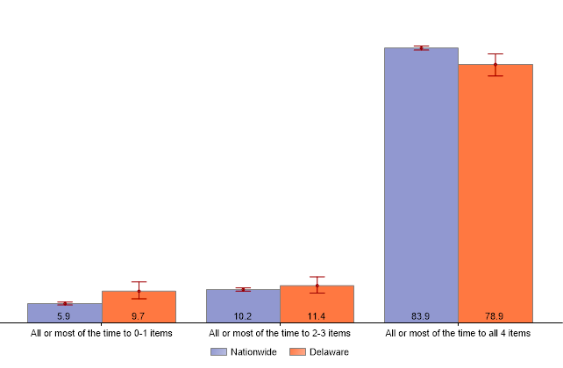
Protective Factors
2019-2020 National Survey of Children’s Health
Family Resilience Composite Measure (%)
Indicator 6.12 Family Resilience: “Does this child live in a home where the family demonstrates qualities of resilience during difficult times.” The composite measure includes four items: “Talk together about what to do; Work together to solve the problem; Know we have strengths to draw upon; Stay hopeful even in difficult times.”
National Survey of Children’s Health, Health Resources and Services Administration, Maternal and Child Health Bureau. https://mchb.hrsa.gov/data/national-surveys.
Notes:
This is updated from last year’s 2018-2019 measure of family resilience from the NSCH.

Slide 39
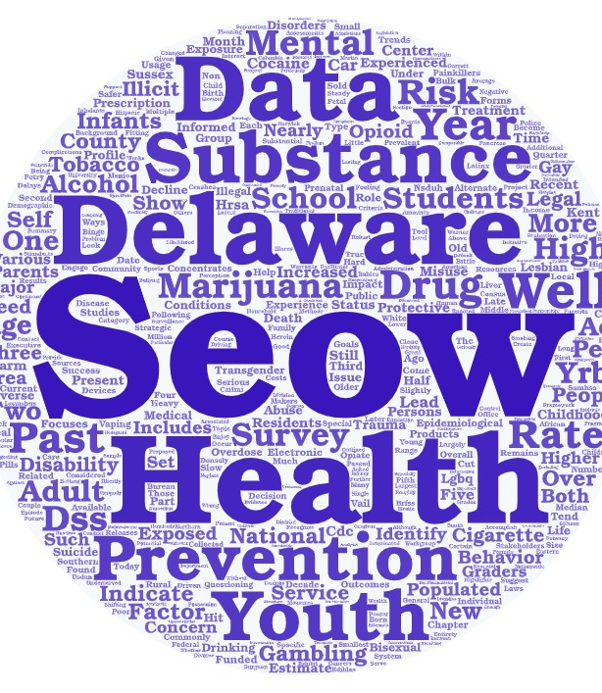
Questions?

Slide 40
For More Information…
Sharon Merriman-Nai smnai@udel.edu
Rachel Ryding rryding@udel.edu
Center for Drug and Health Studies
at the University of Delaware
www.cdhs.udel.edu
Suggested citation for the report:
Center for Drug and Health Studies, University of Delaware. (2022). The 2022 Delaware Epidemiological Profile: Substance Use, Mental Health, and Related Issues. Prepared for the Delaware Division of Substance Abuse and Mental Health and the Delaware State Epidemiological Outcomes Workgroup.

Slide 41
Thank You!

