Slide 1
Welcome!
We will get started in just a few moments.
Please introduce yourself in the chat.
All attendees are muted upon entry.

Slide 2
State Epidemiological Outcomes Workgroup Winter Session
University of Delaware
Center for Drug and Health Studies
January 31, 2023

Slide 3
State Epidemiological Outcomes Workgroup
Funding for this project has been provided by the Delaware Department for Health and Social Services, Division of Substance Abuse and Mental Health through the Substance Abuse and Mental Health Services Administration (SAMHSA).

Slide 4
Agenda
Welcome & Introductions
SEOW Goals
SEOW Announcements
Data Champion
Highlights from the Field
Main Speaker
Breakout
Network Share Out

Slide 5
Introductions:
We would like to invite anyone joining for the first time, if they are comfortable, to unmute their microphones and introduce themselves.
SEOW Facilitator Team
Center for Drug and Health Studies Team

Slide 6
The goals of the State Epidemiological Outcomes Workgroup (SEOW) are…
To build monitoring and surveillance systems to identify, analyze, and profile data from state and local sources;
To identify, share, and analyze data;
To create data-guided products that inform prevention planning and policies;
To train agencies and communities in understanding, using, and presenting data effectively.

Slide 7
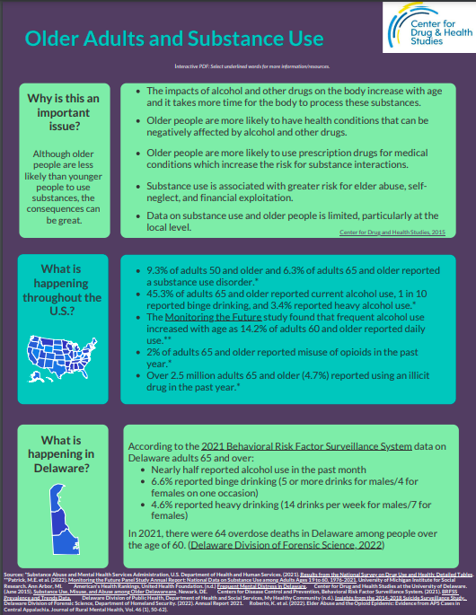
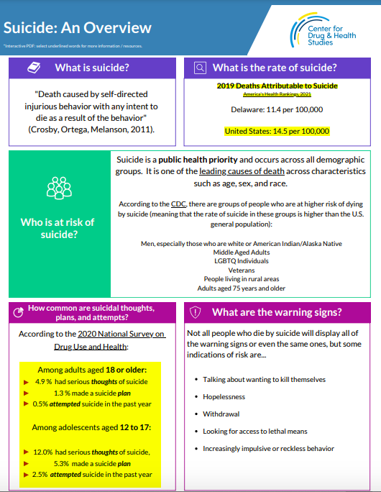
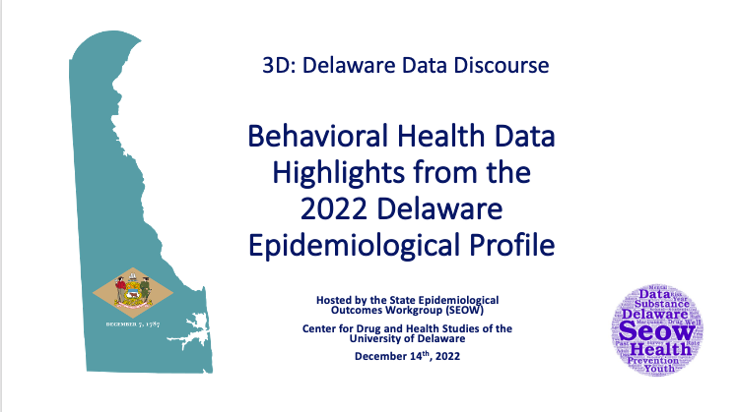
Since we last saw you in July…
NEW!
Infographic-Suicide: An Overview
Infographic-Older Adults and Substance Use
3D: Delaware Data Discourse. Behavioral Health Data Highlights from the 2022 Delaware Epidemiological Profile
All of the above, and more, coming to the SEOW site soon!

Slide 8
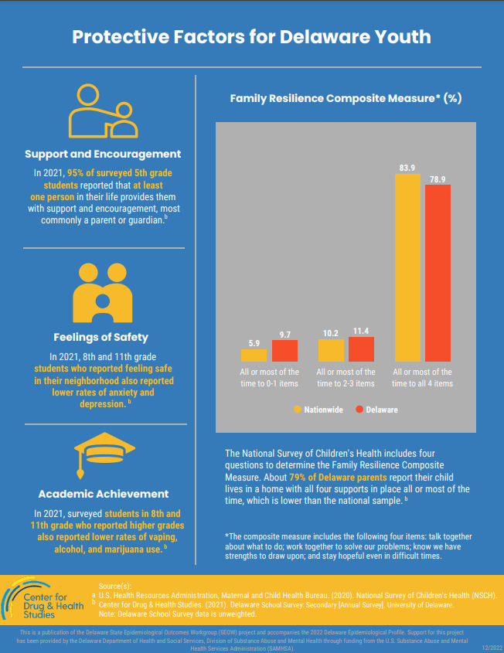
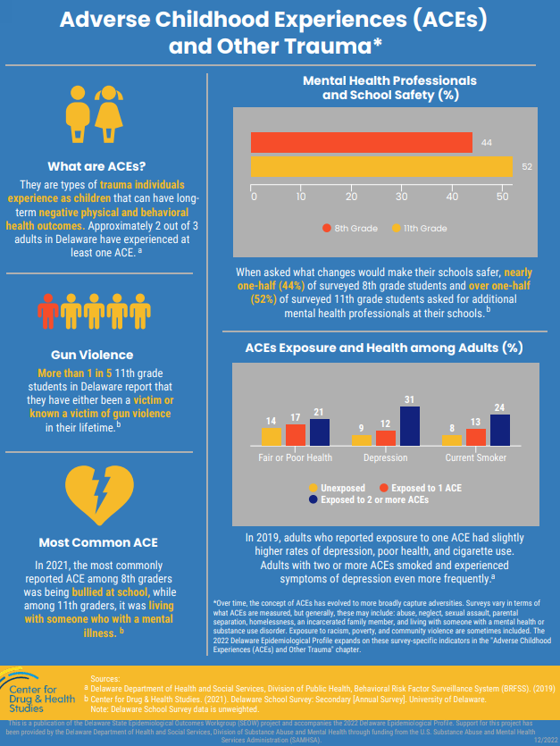
Notes:
Delete or update with new infographic?

Slide 9
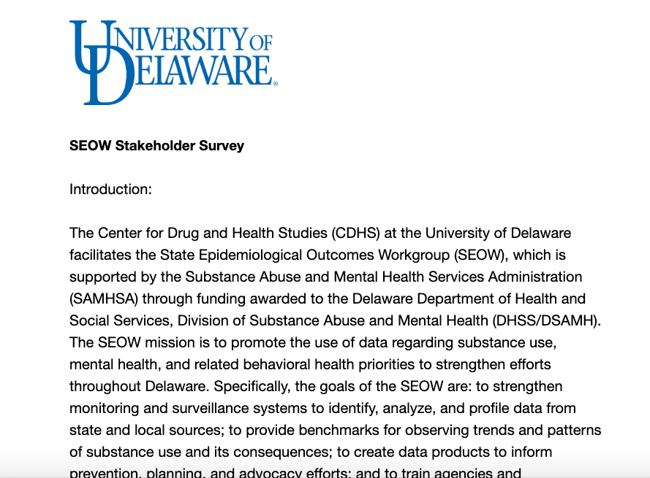
SEOW
Stakeholder
Feedback

Slide 10
Data Champion

Slide 12
Highlights from the Field
Recent reports and data releases of interest, including:
2021 NSDUH Annual National Report
CADCA Practical Theorist special issue on Fentanyl
Mental Health America dashboard on mental health screenings by state and county, 2020-2022
The Trevor Project 2022 National Survey on LGBTQ Youth Mental Health by State

Slide 13
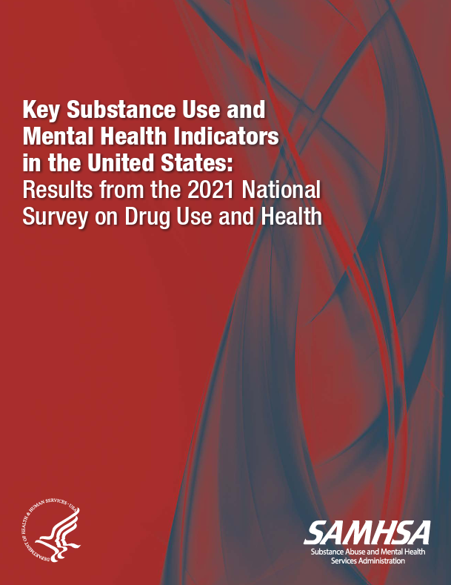
National Survey on Drug Use and Health 2021 Key Substance Use and Mental Health Indicators
Substance use (tobacco, alcohol, vaping, marijuana and other illicit drug use, as well as the use and misuse of prescription drugs)
Initiation of substance use by type
Substance use disorders (SUDs)
Major depressive episode (MDE), any mental illness, and serious mental illness
Mental illness and MDE co-occurring with substance use & SUDs
Suicidal thoughts, plans, and non-fatal attempts
Substance use treatment and mental health service use
Perceived impact of the COVID-19 pandemic on substance use, mental health issues, and treatment
Notes:
https://www.samhsa.gov/data/release/2021-national-survey-drug-use-and-health-nsduh-releases
This page has a link to the key findings report as well as a short report that highlights key findings by race and ethnicity.
This link also includes some FAQs and methodology notes to accompany the 2021 survey data, most importantly is that due to changes in the way the data was collected during the pandemic, SAMHSA is emphasizing that 2021 estimates cannot be reliably compared to previous years of data. This is guidance that many large annual surveys are issuing now that we are getting more data that was collected in a hybrid or virtual form during the pandemic.

Slide 14
Notes:
Key findings from this report are also available as a powerpoint that can be downloaded, I’m going to show just a handful of their slides with some of their key findings at the national level.
https://www.samhsa.gov/data/sites/default/files/reports/rpt39443/2021_NNR_figure_slides.pdf

Slide 20
CADCA Practical Theorist Fentanyl: Why Fentanyl/Why Now
“This practical theorist is part of a series of publications designed to summarize field research on key drug use issues and to present it in a concise, practical format, with strategies for using the data to mobilize communities and support your coalition’s mission.”
Notes:
https://www.cadca.org/news/new-practical-theorist-fentanyl-available
Link in the chat that takes you to their page where they have this report posted and there is also a youtube link to their web presentation.

Slide 21
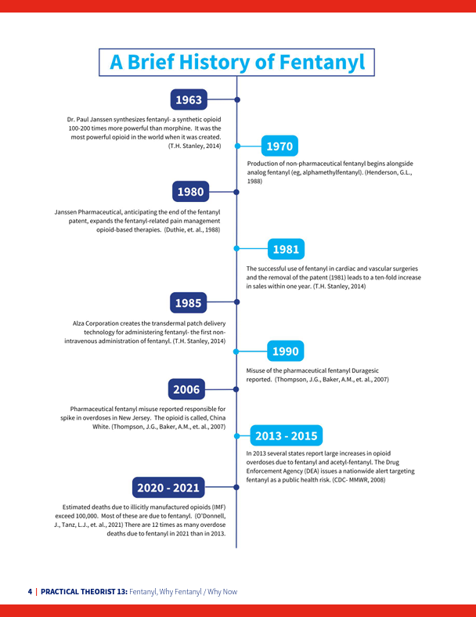
Includes information on:
The beginnings of pharmaceutical fentanyl-intense treatment
The emergence of illicitly manufactured fentanyl (IMF)
IMFs and Polysubstance Use
The impact of fentanyl on overdose deaths and who is at greatest risk
Geographical distribution of overdose deaths
The economic burden of the overdose epidemic
The impact of the COVID-19 Pandemic
Highlights the importance of:
Collecting and disseminating local data
Increasing awareness
Promoting protective factors
Engaging with new partners
The Role of Primary Prevention

Slide 22
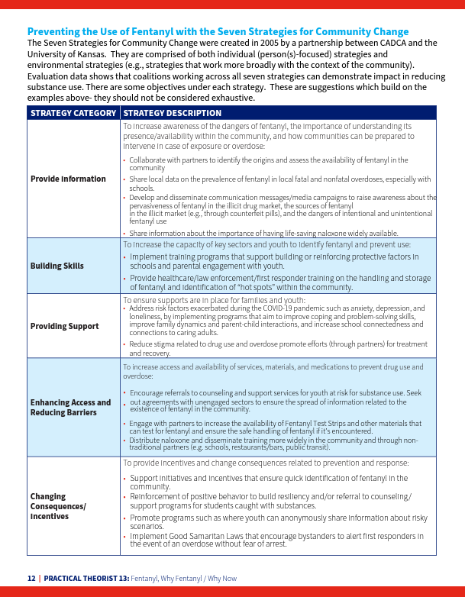
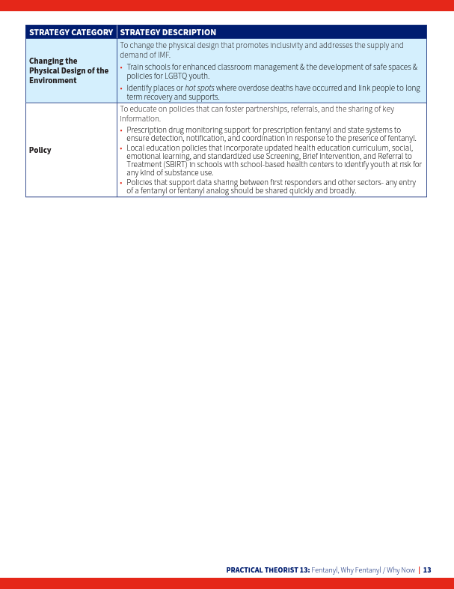
Notes:
The final portion of the report lists their Seven Strategies for Community Change, pictured here, and also provides a list of partner resources on fentanyl, including data resources, communication materials, and a variety of toolkits and guides specifically dealing with fentanyl.

Slide 23
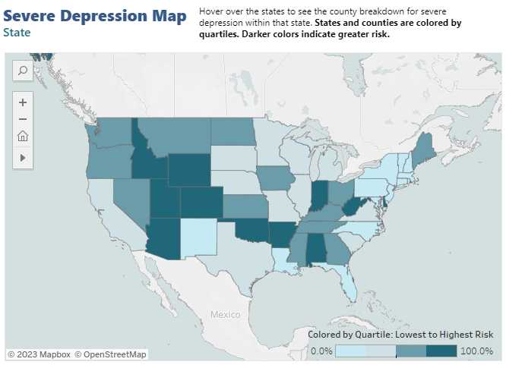
Mental Health America Mapping the Health of Our Communities
Dashboard contains data collected from MHA’s online screening from January 2020-December 2022
Can sort data by year, age, state, and county
Has screening data for the following: depression, suicide, PTSD, trauma survivors, and psychosis.
Notes:
Mapping the Mental Health of Our Communities: MHA’s Unique County and State Data webinar recording on youtube: https://www.youtube.com/watch?v=X-WdrulcSw8
I would suggest taking a look at their methodology reports if you plan on trying to use this data for anything as it is a self-selected group rather than a survey of a representative sample of residents., https://mhanational.org/mhamapping/mha-data-methodology

Slide 24
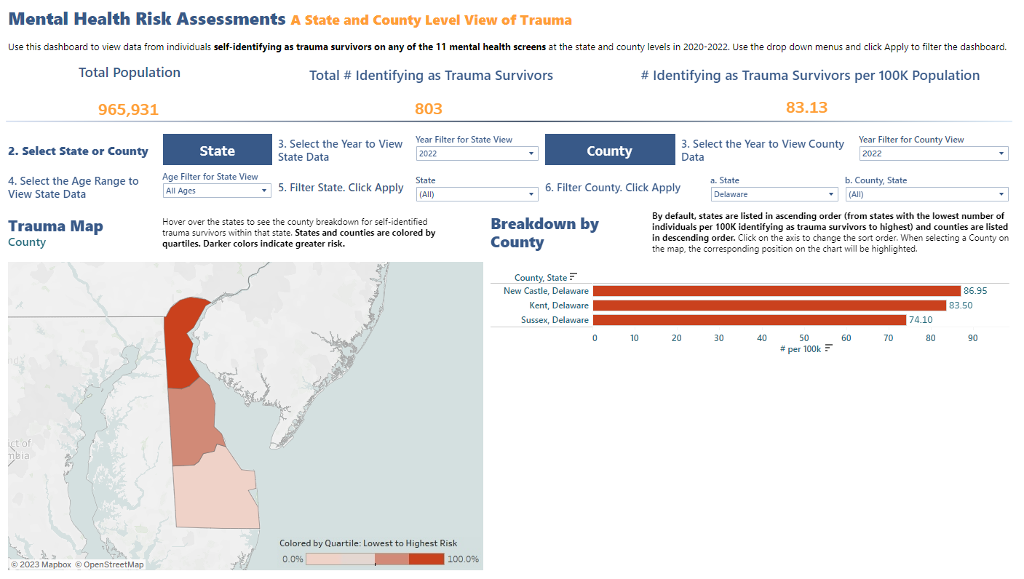
Notes:
Example of county-level view of trauma in Delaware.

Slide 25
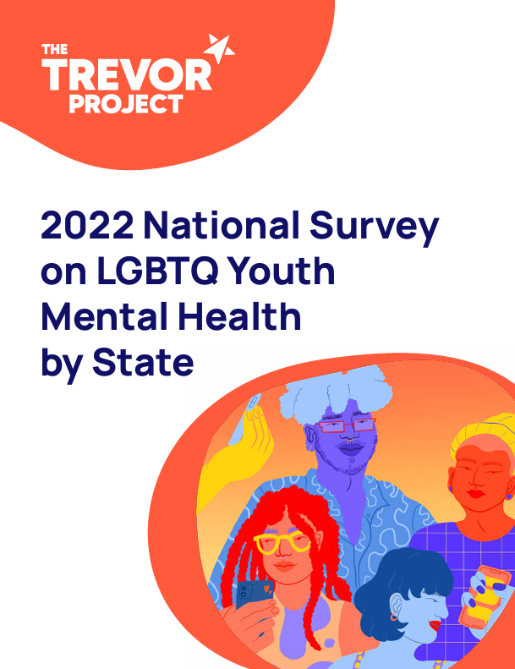
The Trevor Project 2022 National Survey on Youth Mental Health by State
This includes data points related to:
Mental health and suicide risk
Access to mental health care
Challenges face by LGBTQ youth
Ways to support LGBTQ youth
Demographics of LGBTQ youth
Notes:
The Trevor Project is a nonprofit that conducts a national survey of LGBTQ youth and young adults, and for the first time they published their survey data by state.
This is data collected in the last few months of 2021, they surveyed people ages 13-24 via targeted ads on social media. 34000 responses nationwide.
Respondents were identified as LGBTQ if they identified a sexual orientation other than straight/heterosexual, a gender other than cisgender, or both.
Model their survey questions on
Full report with links to the individual state reports: https://www.thetrevorproject.org/research-briefs/2022-u-s-national-survey-on-lgbtq-youth-mental-health-by-state-dec-2022/

Slide 26
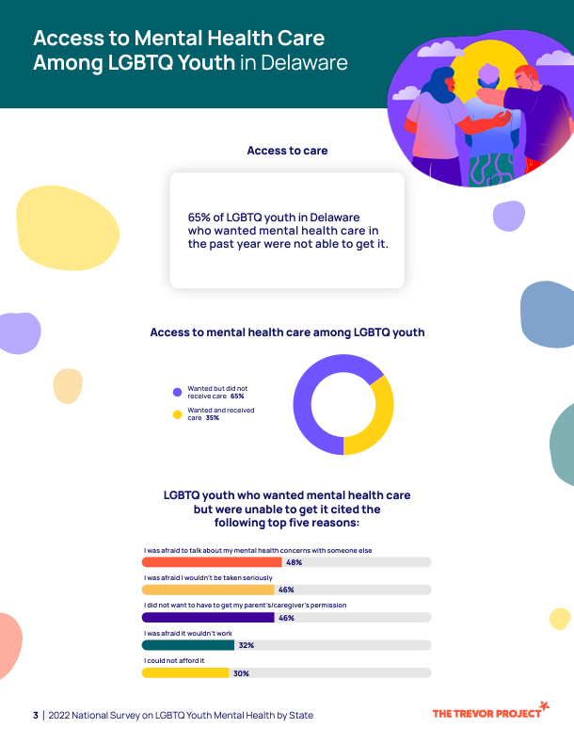
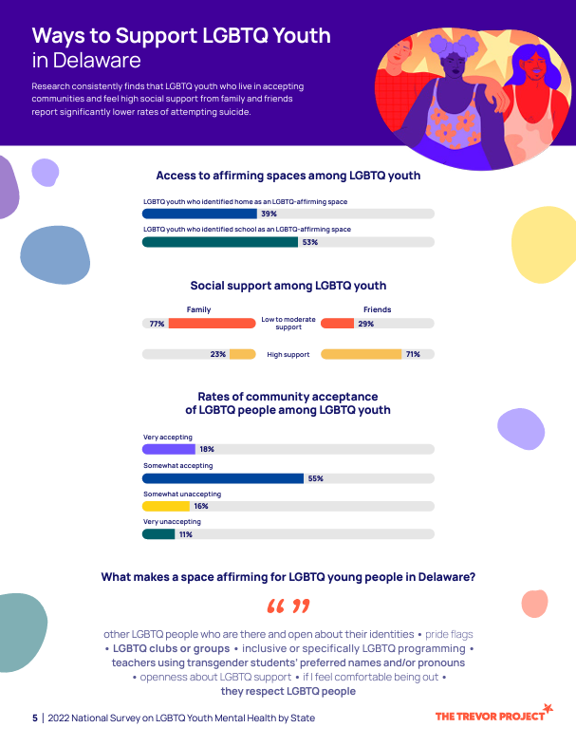

Slide 27
Featured Presentation:
The Poison Control Center at CHOP
Slides are accessible from the SEOW Presentations Page at: https://www.cdhs.udel.edu/seow/reports-and-products/publications

Slide 28
Q & A

Slide 29
MEMBER NETWORK SHARE OUT

Slide 30
THANK YOU! WE WILL SEE YOU IN JULY 2023.

