Slide 1
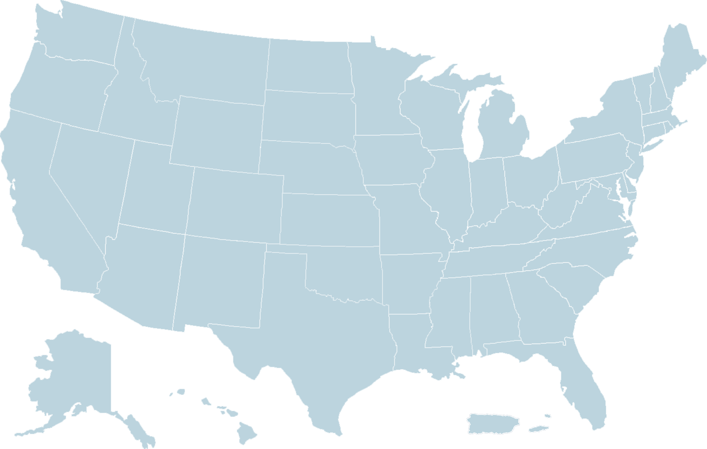
Delaware Drug Monitoring Initiative (DMI)
SEOW Meeting- 07/27/22

Slide 2
Introduction
Overdose Response Strategy (ORS)
The mission of the ORS is to help communities reduce fatal and non-fatal drug overdoses by connecting public health and public safety agencies, sharing information and supporting evidence-based interventions.

Slide 3
Introduction
ORS is an unprecedented and unique collaboration between public health and public safety, created to help local communities reduce drug overdoses and save lives by sharing timely data, pertinent intelligence and innovative strategies.

Slide 4
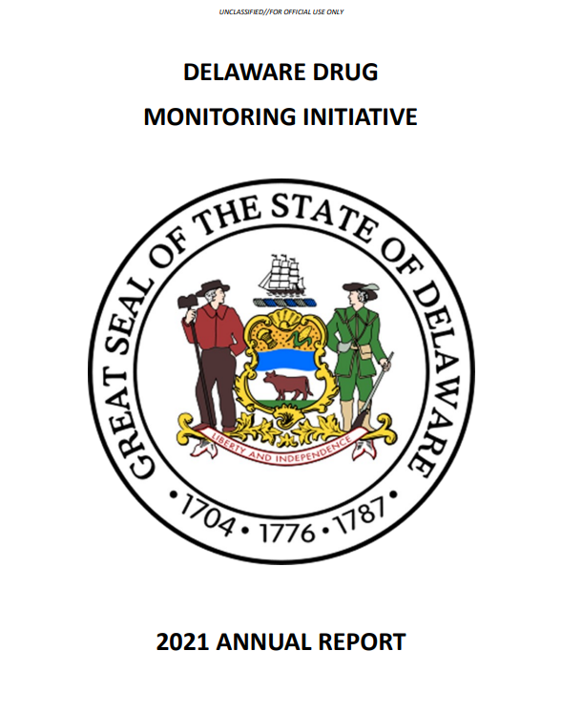
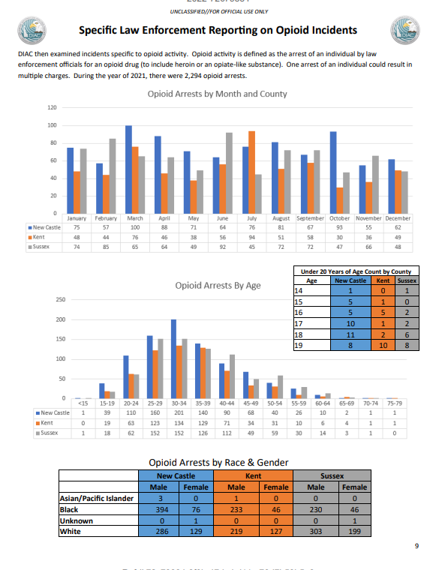
DMI Overview
History and evolution
Current contributors
Component parts
Source: Delaware Information & Analysis Center
Source: Delaware Information & Analysis Center

Slide 5
Creation of DMI August 2016 at National Governors’ Association Learning Lab
Department of Health and Social Services (Secretary Rita Landgraf)
Division of Public Health, Office of EMS (Director Diane Hainsworth)
Division of Substance Abuse and Mental Health (Director Michael Barbiari)
Department of Safety and Homeland Security (Secretary Robert Coupe)
Division of Forensic Science (COO Rebecca Walker)
Delaware State Police, DIAC (Lt. Tim Hulings, Analyst Nicole Sapp)

Slide 6
Addition of Infectious Disease Data in 2018 National Governors’ Association Learning Lab
Department of Health and Social Services (Secretary Kara Odom-Walker)
Division of Public Health, Communicable Disease Bureau (Dr. Martin Luta)
Division of Medicaid & Medical Assistance (Dr. Elizabeth Brown)
Division of Substance Abuse and Mental Health (Dr. Sherry Nykiel)
Brandywine Counseling (Dr. Lynn Morrison)
Department of Safety and Homeland Security (Secretary Robert Coupe)
Delaware State Police, DIAC (Lt. Tim Hulings)

Slide 7
Current DMI Partners
Department of Health and Social Services (Secretary Molly Magarik)
Division of Public Health, Office of EMS (Director Diane Hainsworth)
Division of Substance Abuse and Mental Health (Director Joanna Champney, Kris Fraser)
Division of Public Health, Communicable Disease Bureau (James Dowling)
Department of Safety and Homeland Security (Secretary Nathaniel McQueen, Jr.)
Division of Forensic Science (Director John R. Evans)
Delaware State Police, DIAC (Captain Joshua Bushweller, Lt. David Hake, Sgt. Christopher Sutton, Analyst Andrew Valladares)

Slide 8
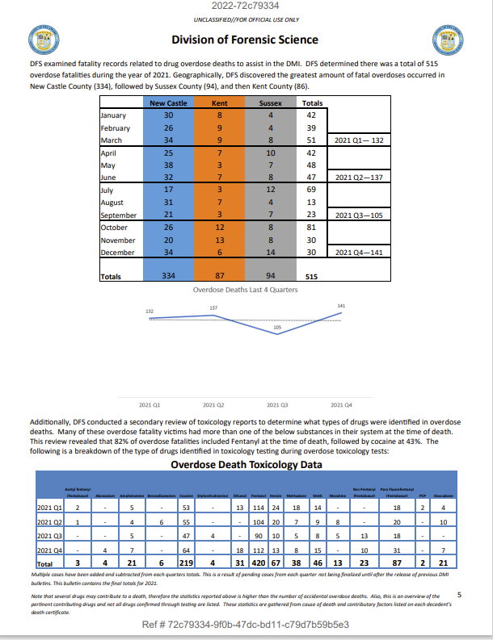
DMI Data Contribution: Division of Forensic Science
Overdose death numbers
Toxicology information
Death by age, sex, race
Death by county
Source: Delaware Information & Analysis Center

Slide 9
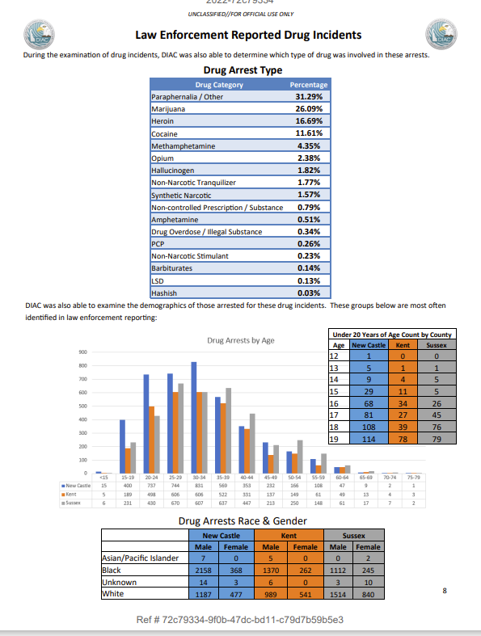
DMI Data Contribution: Delaware Information and Analysis Center
Drug arrest numbers by city
Drug arrest by types of drug (%)
Drug arrest by race, sex, age
Drug arrest by county
Opioid arrest numbers
Opioid arrest by race, sex, age
Opioid arrest by county
Source: Delaware Information & Analysis Center

Slide 10
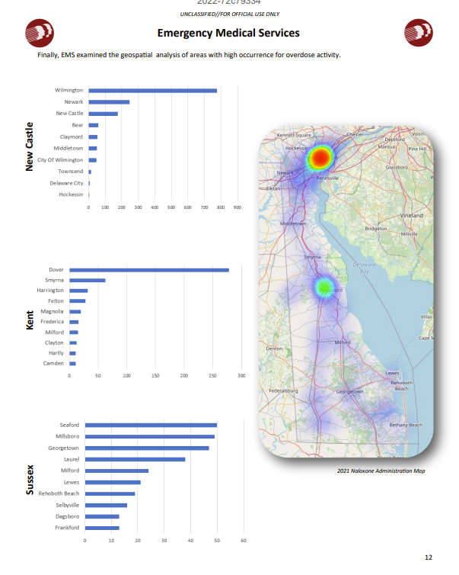
DMI Data Contribution: Office of Emergency Medical Services
Number of naloxone patients
Number of naloxone administrations
Top 5 incident type locations by county (home/residence/street/business)
Top 5 “primary impressions” of patients
Naloxone patients by age, sex, race
Number of naloxone patients by county
Number of public safety naloxone patients by county
Overdose activity by city (with heat map)
Source: Delaware Information & Analysis Center

Slide 11
DMI Data Contribution: Division of Substance Abuse and Mental Health
Treatment admission numbers
Treatment admission by “primary
drug at admission” by county
Top 10 treatment facilities
Treatment admissions by age, sex,
race, and county
Source: Delaware Information & Analysis Center

Slide 12
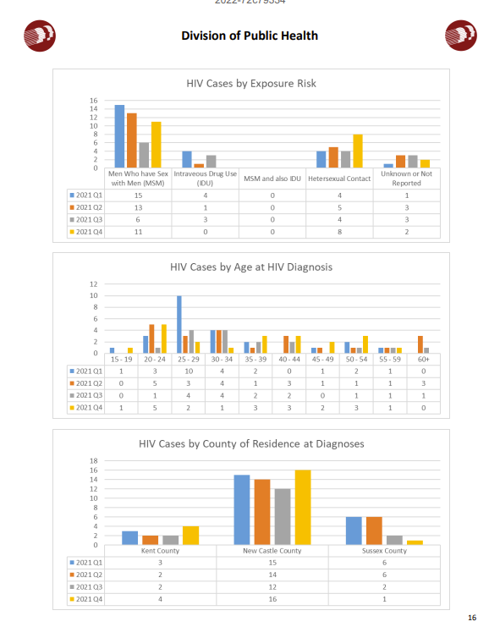
DMI Data Contribution: Communicable Disease Bureau
New HIV diagnosis numbers
HIV cases by sex at birth
HIV cases by race
HIV cases by exposure risk
HIV cases by age
HIV cases by county
Source: Delaware Information & Analysis Center

Slide 13
Questions/Comments
Sgt. Christopher Sutton
Delaware State Police
Delaware Information & Analysis Center (DIAC)
christopher.sutton@delaware.gov
Tim Hulings
Public Health Analyst
CDC Foundation‒Overdose Response Strategy (ORS)
tim.hulings@delaware.gov

