Slide 1
How to Think Things Through: Testing Cognitive Behavioral Therapy in an Incarcerated Setting
Dr. Daniel O’Connell
Emalie Rell, MA
Dr. Christy Visher
Center for Drug and Health Studies
This Research is funded by the National Institute of Justice, Award: 2018-75-CX- 0020
Project Title: Cognitive Behavioral Interventions and Misconduct Behind
Bars: A Randomized Control Trial of CBI-CC

Slide 2
Why Evaluate CBT in Prison Settings?
Important to change behavior in prison. (why wait for reentry?)
CBT Effective at reducing anxiety, anger, and aggression
BUT: Limited evaluation in correctional facilities
Mixed support for efficacy at reducing criminal behavior
Most frequently looks at substance use
Delaware CBI-CC Study
Cognitive Behavioral Intervention: Comprehensive Curriculum
Developed @ University of Cincinnati
Targets High-Risk Incarcerated Persons
High Dosage: 55 sessions – 90 minutes each over 6 months
Large-Scale Randomized Control Trial in a Prison

Slide 3
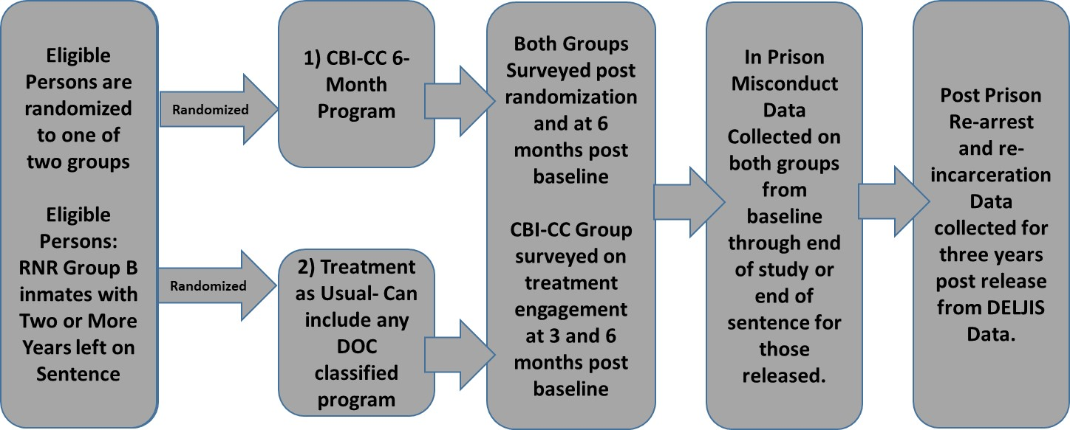
Research Design: Plan A

Slide 4
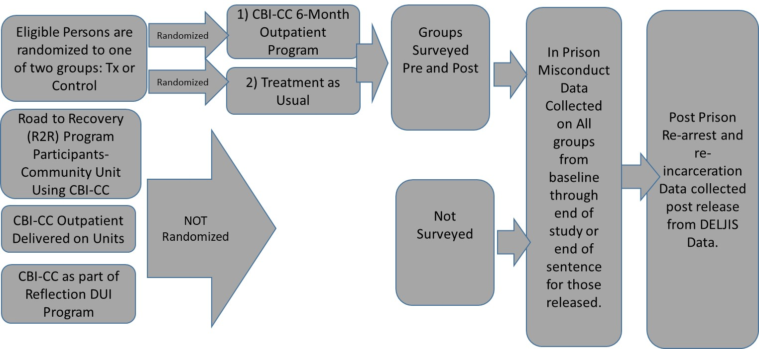
UD-Delaware DOC CBI-CC Effectiveness Study Post COVID Research Re-Design
Misconduct and Recidivism Data not available until June, 2023

Slide 5
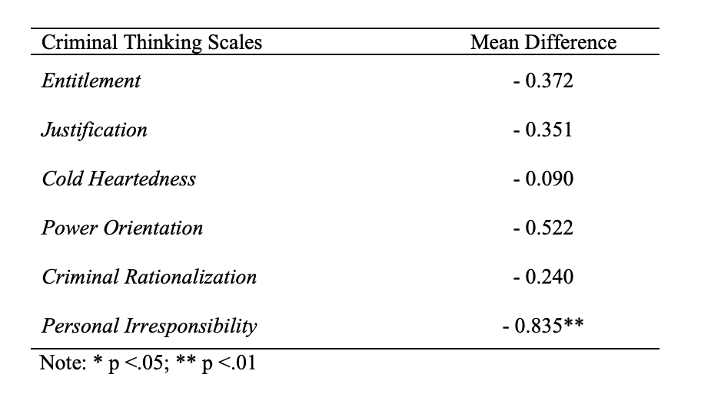
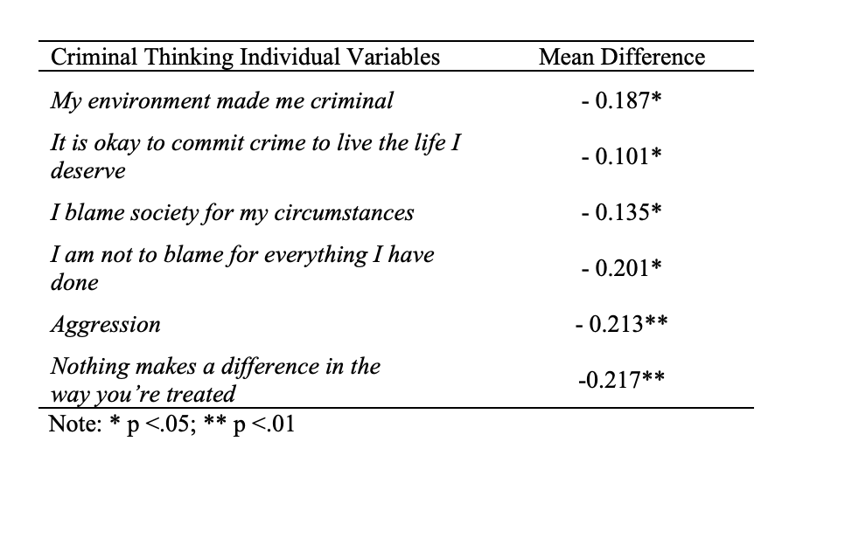
Survey Data: What is the impact of the CBI-CC intervention on criminal thinking of program participants?

Slide 6
Conclusions - 1
COVID wreaked havoc on the overall project.
Working closely with partners enabled us to salvage a study
Be flexible.
Changes in law related to expungement of records provided additional hurdles
Be flexible.
Still: Data illustrated limited support for change in criminal thinking after completing CBI-CC
Takeaway 1: In spite of myriad hurdles, Intensive in prison CBT can impact criminal thinking (stay tuned for distal outcomes)
Takeaway 2: Need to consider starting treatment earlier to change behavior in prison

Slide 7
Conclusions - 2
Dosage: CBI-CC is an intensive cohort program.
Difficult in prison setting
Drop outs, lost sessions due to misconducts and movement
Social learning
90 minutes twice a week vs the culture of the prison
Culture- cell block culture equates to street culture
Programs change the language, focus, interactions (culture)
Program communities – TCs, Cognitive Communities, Treatment blocks, etc. Begin to change the culture.
Start Early: move CBT-types programs earlier in sentence and reinforce on lived units to change the culture of the prison.

